Slide 1
Research Applications of Optimization:
Data-Driven Spectroscopy
Megan Bedell, CCA
with thanks to collaborators: Lily Zhao (Yale/CCA),
Dan Foreman-Mackey (CCA), Rodrigo Luger (CCA),
David W Hogg (NYU/CCA)

Slide 2
My objective: find Earth-like planets around other stars.

Slide 3
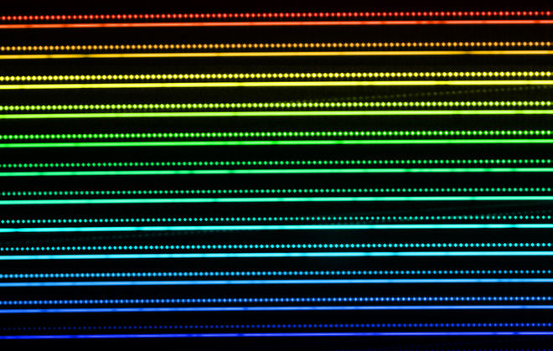
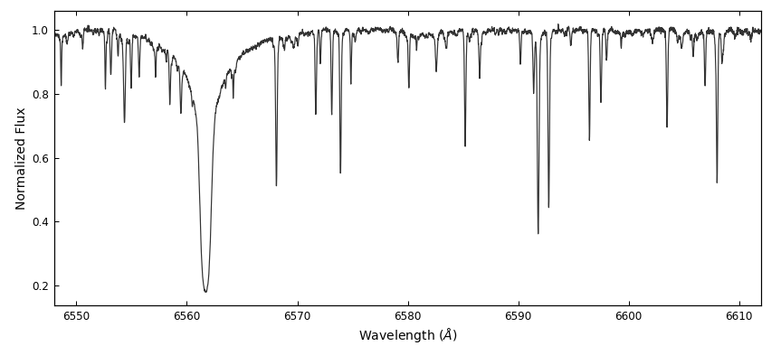
My data: high-signal-to-noise, high-resolution stellar spectra.

Slide 4
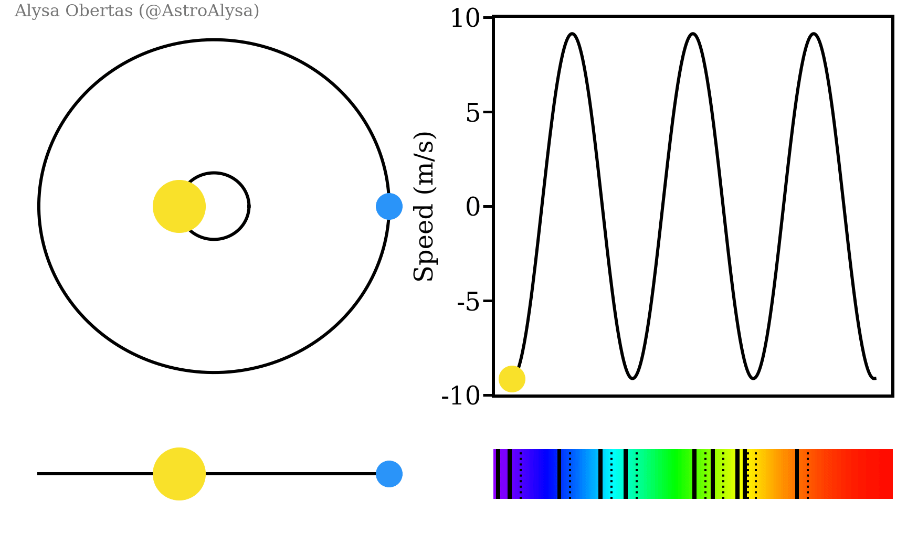
Planets cause stars to move, and I want to measure that motion in the stellar radial velocity.

Slide 5
How do you measure a radial velocity?

Slide 6
How do you measure a radial velocity?
Solve for a well-known spectral feature
(simple but imprecise)

Slide 7
How do you measure a radial velocity?
Cross-correlate with many known features
(limited by knowledge of the star)

Slide 8
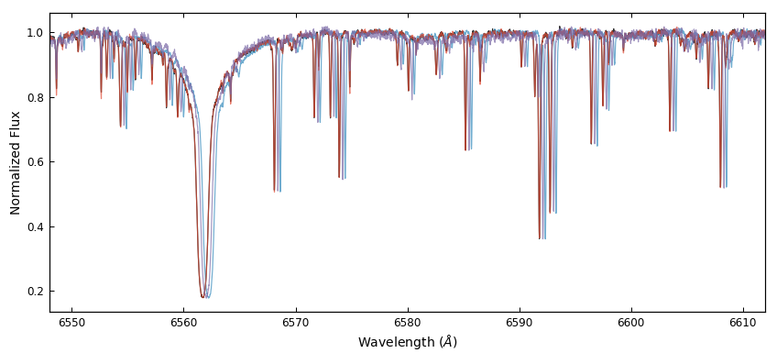
How do you measure a radial velocity?
Use a “template observation” of the star itself

Slide 9
How do you measure a radial velocity?
If you’re going to use all the data, you need to have a model that fits it all!

Slide 10
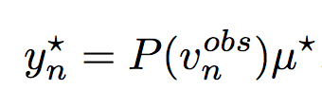
A simple, flexible, data-driven model:
Free parameters: observed stellar RVs; stellar spectral template (M-length vector of normalized fluxes); telluric spectral template (M-length vector)
github.com/megbedell/wobble

Slide 11
A simple, data-driven model:
For a typical data set: 2 x 250,000 + 100 free parameters
Free parameters: observed stellar RVs; stellar spectral template (M-length vector of normalized fluxes); telluric spectral template (M-length vector)
github.com/megbedell/wobble

Slide 12
I need gradients!

Slide 13
I need gradients!

Slide 14
Automatic differentiation with TensorFlow
Pros
quick & easy optimization
nice implementations of gradient-based optimizers like Adam, Adagrad
you can change your model on the fly
Cons
it’s only easy if TF has built-in ops for the functions you’ll use
built-in TF optimizers may not be best for your problem
all the documentation assumes you’re doing deep learning

Slide 15
Toy version, 164 free parameters,
scipy.optimize.minimize:
Same data, TensorFlow:

Slide 16
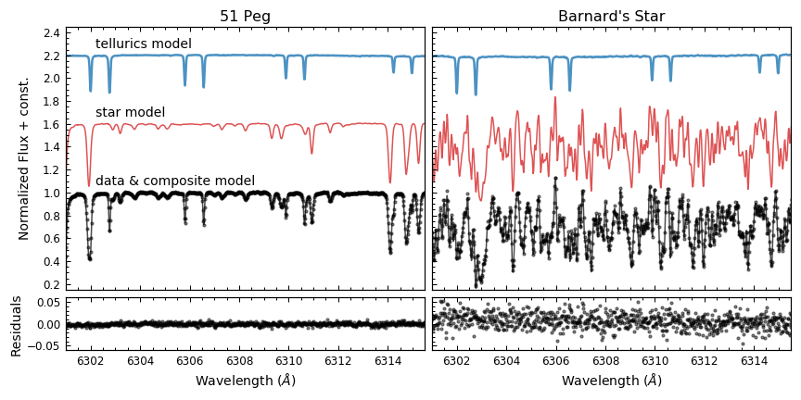

Slide 17
Other practical optimization lessons learned:
Don’t optimize every free parameter at once straight out of the gate
convex-ish
convex
Optimize RVs
(with spectra fixed)
Optimize spectra
(with RVs fixed)
non-convex
Optimize everything

Slide 18
Other practical optimization lessons learned:
Don’t optimize every free parameter at once straight out of the gate
Check on optimizer progress with every step & tune settings accordingly

Slide 19
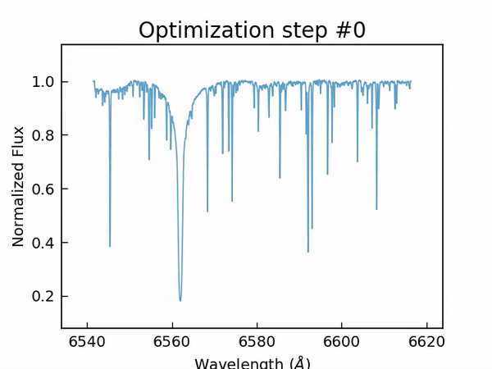
Other practical optimization lessons learned:
Don’t optimize every free parameter at once straight out of the gate
Check on optimizer progress with every step & tune settings accordingly
Generally: make lots of plots

Slide 20
Other practical optimization lessons learned:
Don’t optimize every free parameter at once straight out of the gate
Check on optimizer progress with every step & tune settings accordingly
Generally: make lots of plots
Don’t be afraid to re-parameterize

Slide 21
Other practical optimization lessons learned:
Don’t optimize every free parameter at once straight out of the gate
Check on optimizer progress with every step & tune settings accordingly
Generally: make lots of plots
Don’t be afraid to re-parameterize
Consider use of priors/regularization (even the best optimizer is only as good as your objective function!)

Slide 22
Thanks & happy optimizing!

