Slide 1
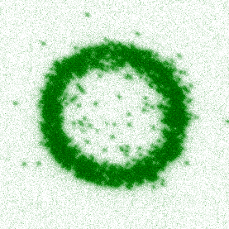

Studying charge and heat transport in Fermi-Hubbard systems using a quantum gas microscope
Waseem Bakr
Aspen 2020

Slide 2
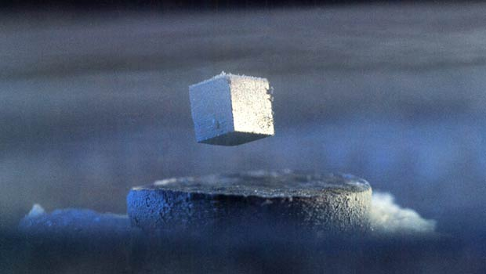
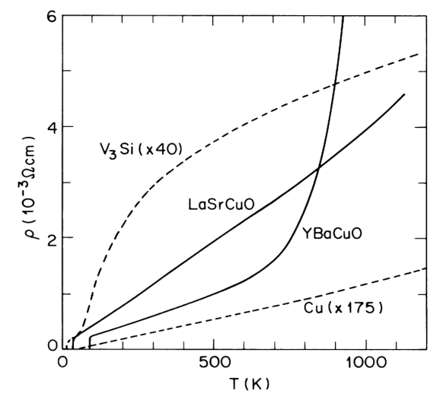
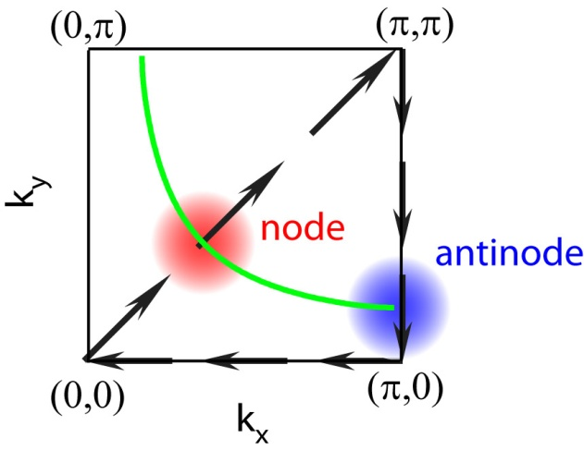


The cuprate superconductors
High-T_{c} superconductivity a challenge for over 30 years.
Condensed matter community has brought many tools to bear on the problem: transport, ARPES, optics, specific heat, NMR, etc.
ARPES
d-wave symmetry of gap, pseudogap, Fermi arcs
Transport:
Superconductivity, strange metal
$$θ$$
$$cos2θ$$
node
H. Ding et al, PRB 54, R9678 (1996)
M. Gurvitch et al, PRL 59, 1337 (1987)

Slide 3

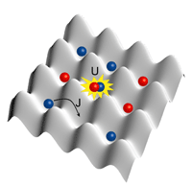
The Fermi-Hubbard model
Paradigm for studying strong-coupling physics in a lattice.
With repulsive interactions, a possible minimal model for cuprate high-T_{c} superconductivity (P. Anderson)
Realized naturally with cold atoms in optical lattices with fully tunable parameters (U/t, T/t, doping)

Slide 4
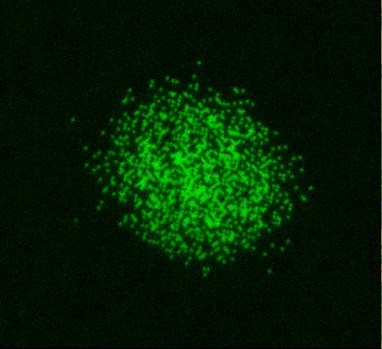
⁶Li Fermi Gas Microscope
Fermionic quantum gas microscopes:
Parsons … Greiner, PRL 114, 213002 (2015)
Cheuk … Zwierlein, PRL 114, 193001 (2015)
Omran … Bloch, Gross, PRL 115, 263001 (2015)
Edge … Thywissen, PRA 92, 063406 (2015)
Haller … Kuhr, Nature Phys 11, 738 (2015)

Slide 5
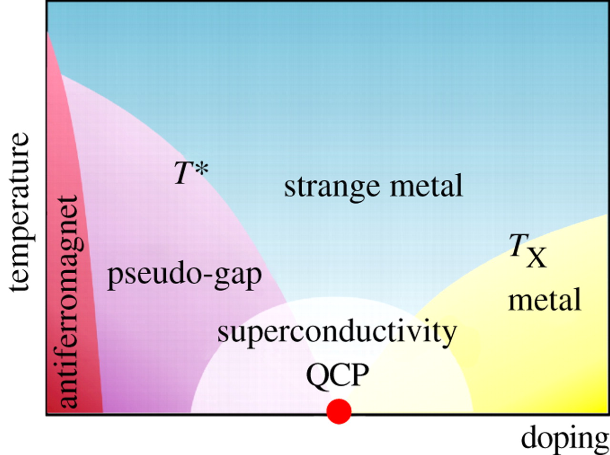
Cuprate phase diagram
temperature
doping
Notes:
What is the phenomonology to reproduce?
Look in temperature and doping axis.
Would like to study SC, but don’t reach cold enough temperatures.
Instead, focus on also very interesting higher temperature phases.
Most previous work focused on antiferromagnet: static quantity. Many results from fermionic QGM microscopes soon after they came online. Also previous work in non-microscope systems. Excellent demonstration of power of the microscopes.
To explore rest of phase diagram, need to look at dynamical quantities
Strange metal phase: anomalous scaling of transport quantities (resistivity, thermopower, etc.)
Pseudogap: anomalous spectral properties. Primarily, remnant of the sc gap above Tc. Finite, but decreased, spectral weight where the gap was.
Characterized by dynamical quantities.
If controlled by same physics as SC, will give us information about that state.
Can we study these states in our QGM?

Slide 6
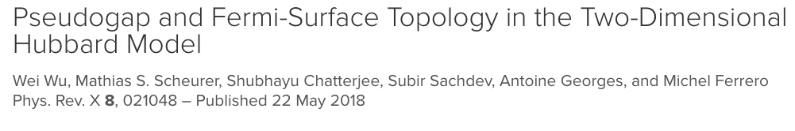
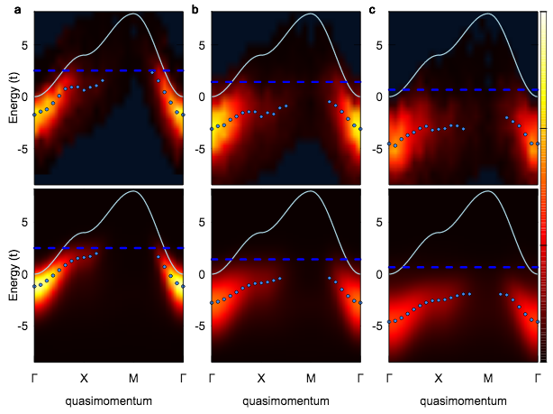
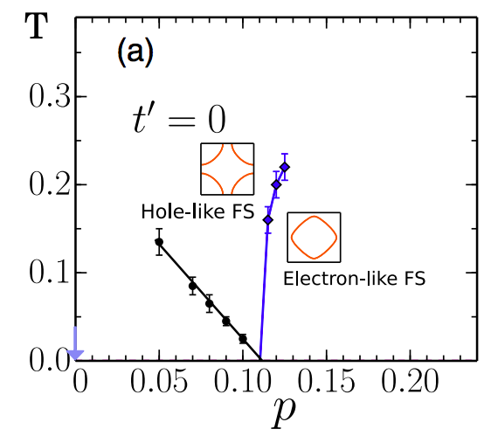
ARPES in Hubbard systems
ARPES in attractive Hubbard systems
U/t = -3.7
U/t = -6.0
U/t = -7.5
Experiment
ARPES in unitary Fermi gases:
Stewart … Jin, Nature 454, 744 (2008)
Gaebler … Jin, Nature Phys. 6, 569 (2010)
Feld … Kohl, Nature 480, 75-78 (2011)
QMC
Brown et. al., Nature Physics 16, 26-31 (2020)
Notes:
What is the phenomonology to reproduce?
Look in temperature and doping axis.
Would like to study SC, but don’t reach cold enough temperatures.
Instead, focus on also very interesting higher temperature phases.
Most previous work focused on antiferromagnet: static quantity. Many results from fermionic QGM microscopes soon after they came online. Also previous work in non-microscope systems. Excellent demonstration of power of the microscopes.
To explore rest of phase diagram, need to look at dynamical quantities
Strange metal phase: anomalous scaling of transport quantities (resistivity, thermopower, etc.)
Pseudogap: anomalous spectral properties. Primarily, remnant of the sc gap above Tc. Finite, but decreased, spectral weight where the gap was.
Characterized by dynamical quantities.
If controlled by same physics as SC, will give us information about that state.
Can we study these states in our QGM?

Slide 7
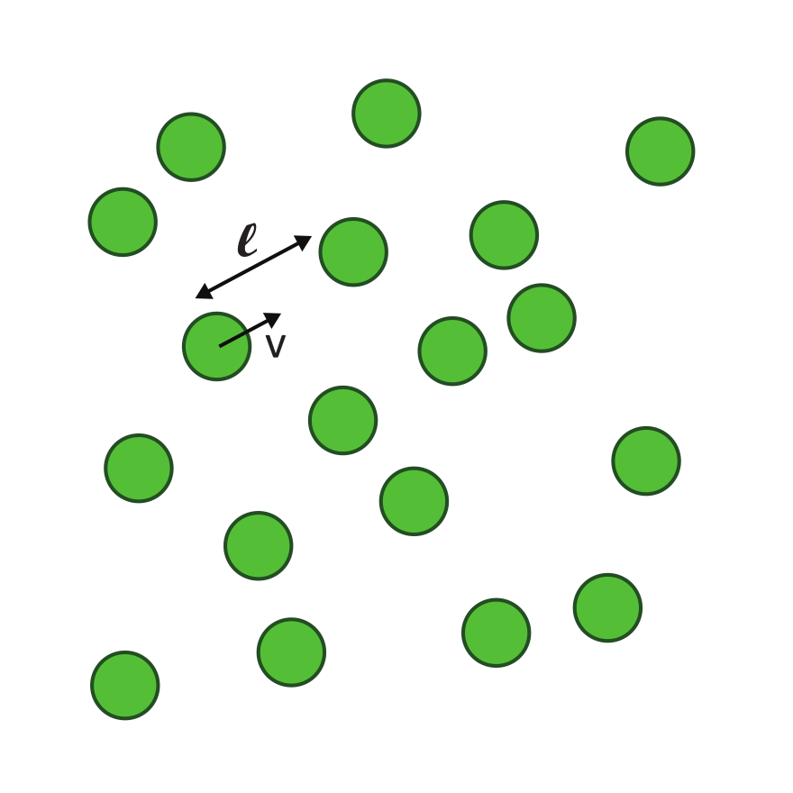
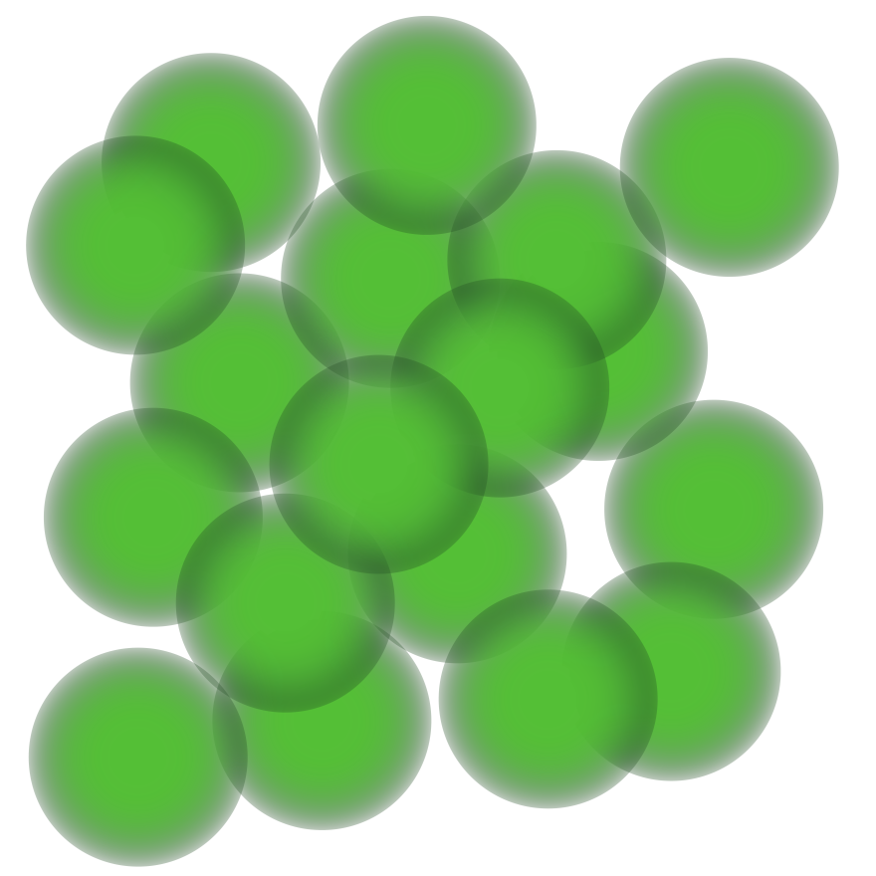
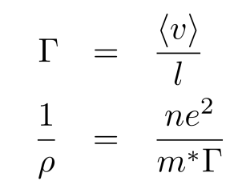
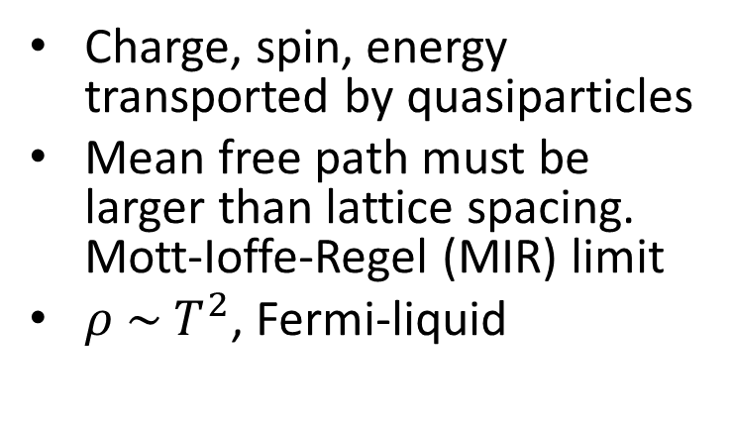
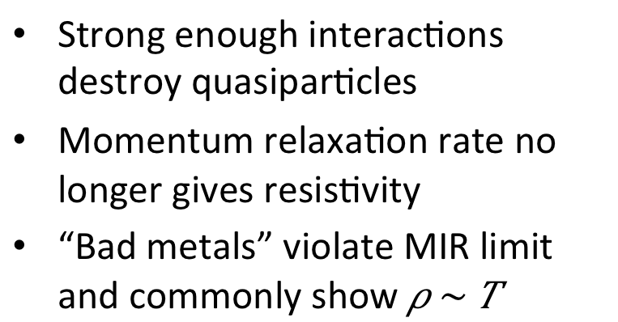
Conventional (weakly interacting)
Unconventional (strongly correlated)
Notes:
Before I tell you how we measure the resistivity, let me step back and contrast transport in weakly and strongly interacting systems.
Transport is well understood phenomenon in weakly interacting systems. Here we think of charge, spin, other conserved quantities as being transported by quasiparticles. Boltzmann theory (semiclassical) describes transport. For the case of charge transport, get the drude theory. Scattering time determines the resistivity. We imagine a particle with mean velocity that travels on average distance l, the mean free path, between collisions. We can alternatively think of the scattering rate, Gamma, which is in some sense interchangeable with the mean free path.
Setting implies limits on transport: minimum mean free path is interparticle spacing. Translation to lattice system: lattice constant. This implies upper bound on resistivity through Drude formula. So called MIR limit. Can also show that resistivity scales quadratically for FL.
If the lifetime of the quasiparticle is much shorter than other characteristic time scales of your system, it is not sensible to describe transport this way. We cannot think of a “scattering rate” anymore, but instead a “current relaxation rate”. How fast is a current damped. Cannot think of mean free path – closely related concept is the mass diffusion constant. Not exactly 1-1. A lot of work, towards developing theories.
No drude formula, so can violate MIR. -> bad metal
Also violate resistivity scaling. E.g. linear scaling. Call these strange metals by analogy with cuprates.

Slide 8
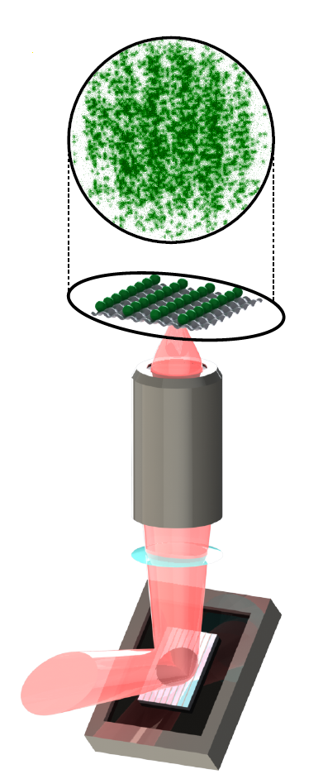
Previous Work
Mass transport experiments with Fermions
Mesoscopic systems:
Brantut et al. Science 337, 1069 (2012) (ETH Zurich)
…
Lebrat et al. PRX 8, 011053 (2018) (ETH Zurich)
Valtolina et al. Science 350, 1505 (2015) (Florence)
Bulk systems:
Ott et al. PRL 92, 160601 (2004) (Florence)
Strohmaier et al. PRL 99, 220601 (2007) (ETH Zurich)
Schnedier et al. Nat. Phys 8, 213 (2012) (Munich)
Xu et al. arXiv:1606.06669 (2016) (UIUC)
Anderson et al, PRL 122, 153602 (2019) (Toronto)
Notes:
Previous work on mass transport with fermions, mostly using mesoscopic systems such as channels, or bulk systems, including lattice experiments. In this experiment, we study a Fermions in a “bulk” 2D lattice, which is described by the Fermi Hubbard Hamiltonian. This Fermi Hubbard system is a model for strong correlation physics. We use a quantum gas microscope to observe the atomic density on a single site level.
We want to study unconventional transport in a strongly interacting system: a 2D fermi hubbard model using a quantum gas microscope. As opposed to a two terminal setup, where we apply a voltage and measure a current we study microscopic charge transport. We impose a density modulation on our gas and observe its decay. The macroscopic and microscopic pictures are connected through the Nernst-Einstein relation, which gives the resistivity in terms of the mass diffusion constant and the compressibility, which is a static quantity.
We load atoms into an optical lattice and project a sinusoidally modulated potential using a spatial light modulator. Here is a schematic of this projection through our objective. This produces a density modulation. Here is a schematic view, with an exaggerated density modulation. Here is a fluorescence image of the actual modulation.
After applying the potential modulation, we snap it off and observe the decay of the density modulation pattern. Here is a 1D cut through the potential created by the spatial light modulator. The 2D density of the cloud looks like this. We focus on the central region where the density is flat and average orthogonal to the modulation to produce a 1D image. We rapidly turn of the modulation potential. The modulation pattern decays until at long times the denity is flat.
Also: work on spin transport Nichols … Zwierlein Science 363, 383 (2019)
𝑡⁄ℎ=925(10)𝐻𝑧
𝑎_13=1070(10) 𝑎_𝑜 @ 𝐵=616 𝐺

Slide 9
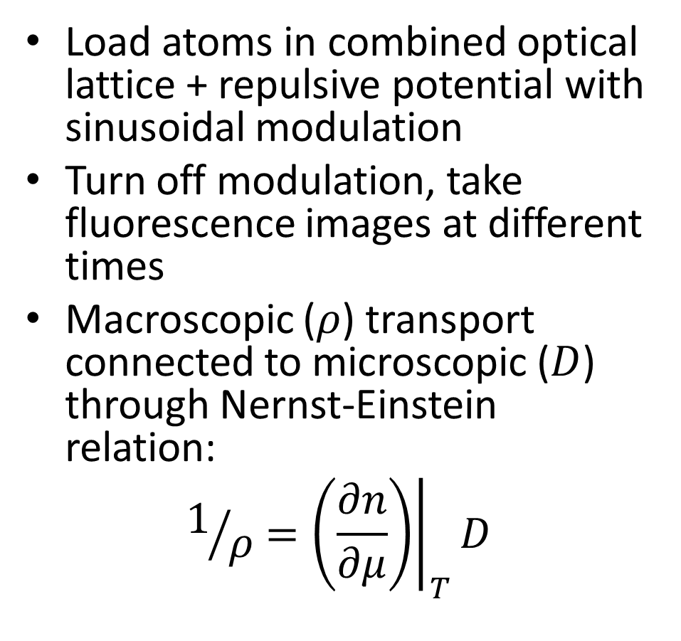
Measurement Protocol
Brown et. al., Science 363, 379 (2019)
Spin transport: Nichols … Zwierlein, Science 363, 383 (2019)
Notes:
Previous work on mass transport with fermions, mostly using mesoscopic systems such as channels, or bulk systems, including lattice experiments. In this experiment, we study a Fermions in a “bulk” 2D lattice, which is described by the Fermi Hubbard Hamiltonian. This Fermi Hubbard system is a model for strong correlation physics. We use a quantum gas microscope to observe the atomic density on a single site level.
We want to study unconventional transport in a strongly interacting system: a 2D fermi hubbard model using a quantum gas microscope. As opposed to a two terminal setup, where we apply a voltage and measure a current we study microscopic charge transport. We impose a density modulation on our gas and observe its decay. The macroscopic and microscopic pictures are connected through the Nernst-Einstein relation, which gives the resistivity in terms of the mass diffusion constant and the compressibility, which is a static quantity.
We load atoms into an optical lattice and project a sinusoidally modulated potential using a spatial light modulator. Here is a schematic of this projection through our objective. This produces a density modulation. Here is a schematic view, with an exaggerated density modulation. Here is a fluorescence image of the actual modulation.
After applying the potential modulation, we snap it off and observe the decay of the density modulation pattern. Here is a 1D cut through the potential created by the spatial light modulator. The 2D density of the cloud looks like this. We focus on the central region where the density is flat and average orthogonal to the modulation to produce a 1D image. We rapidly turn of the modulation potential. The modulation pattern decays until at long times the denity is flat.
Also: work on spin transport Nichols … Zwierlein Science 363, 383 (2019)
𝑡⁄ℎ=925(10)𝐻𝑧
𝑎_13=1070(10) 𝑎_𝑜 @ 𝐵=616 𝐺

Slide 10
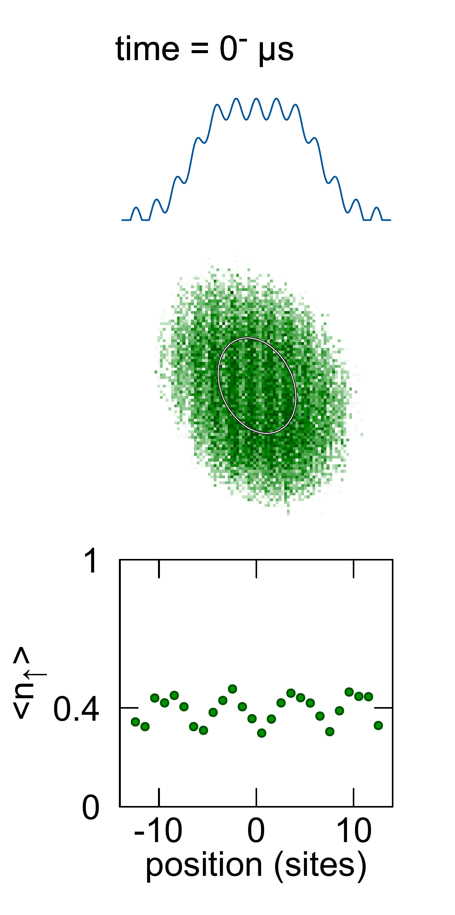
Measurement Protocol
Brown et. al., Science 363, 379 (2019)
Notes:
Previous work on mass transport with fermions, mostly using mesoscopic systems such as channels, or bulk systems, including lattice experiments. In this experiment, we study a Fermions in a “bulk” 2D lattice, which is described by the Fermi Hubbard Hamiltonian. This Fermi Hubbard system is a model for strong correlation physics. We use a quantum gas microscope to observe the atomic density on a single site level.
We want to study unconventional transport in a strongly interacting system: a 2D fermi hubbard model using a quantum gas microscope. As opposed to a two terminal setup, where we apply a voltage and measure a current we study microscopic charge transport. We impose a density modulation on our gas and observe its decay. The macroscopic and microscopic pictures are connected through the Nernst-Einstein relation, which gives the resistivity in terms of the mass diffusion constant and the compressibility, which is a static quantity.
We load atoms into an optical lattice and project a sinusoidally modulated potential using a spatial light modulator. Here is a schematic of this projection through our objective. This produces a density modulation. Here is a schematic view, with an exaggerated density modulation. Here is a fluorescence image of the actual modulation.
After applying the potential modulation, we snap it off and observe the decay of the density modulation pattern. Here is a 1D cut through the potential created by the spatial light modulator. The 2D density of the cloud looks like this. We focus on the central region where the density is flat and average orthogonal to the modulation to produce a 1D image. We rapidly turn of the modulation potential. The modulation pattern decays until at long times the denity is flat.
Also: work on spin transport Nichols … Zwierlein Science 363, 383 (2019)
𝑡⁄ℎ=925(10)𝐻𝑧
𝑎_13=1070(10) 𝑎_𝑜 @ 𝐵=616 𝐺

Slide 11

Measurement Protocol
Brown et. al., Science 363, 379 (2019)
Notes:
Previous work on mass transport with fermions, mostly using mesoscopic systems such as channels, or bulk systems, including lattice experiments. In this experiment, we study a Fermions in a “bulk” 2D lattice, which is described by the Fermi Hubbard Hamiltonian. This Fermi Hubbard system is a model for strong correlation physics. We use a quantum gas microscope to observe the atomic density on a single site level.
We want to study unconventional transport in a strongly interacting system: a 2D fermi hubbard model using a quantum gas microscope. As opposed to a two terminal setup, where we apply a voltage and measure a current we study microscopic charge transport. We impose a density modulation on our gas and observe its decay. The macroscopic and microscopic pictures are connected through the Nernst-Einstein relation, which gives the resistivity in terms of the mass diffusion constant and the compressibility, which is a static quantity.
We load atoms into an optical lattice and project a sinusoidally modulated potential using a spatial light modulator. Here is a schematic of this projection through our objective. This produces a density modulation. Here is a schematic view, with an exaggerated density modulation. Here is a fluorescence image of the actual modulation.
After applying the potential modulation, we snap it off and observe the decay of the density modulation pattern. Here is a 1D cut through the potential created by the spatial light modulator. The 2D density of the cloud looks like this. We focus on the central region where the density is flat and average orthogonal to the modulation to produce a 1D image. We rapidly turn of the modulation potential. The modulation pattern decays until at long times the denity is flat.
Also: work on spin transport Nichols … Zwierlein Science 363, 383 (2019)
𝑡⁄ℎ=925(10)𝐻𝑧
𝑎_13=1070(10) 𝑎_𝑜 @ 𝐵=616 𝐺

Slide 12
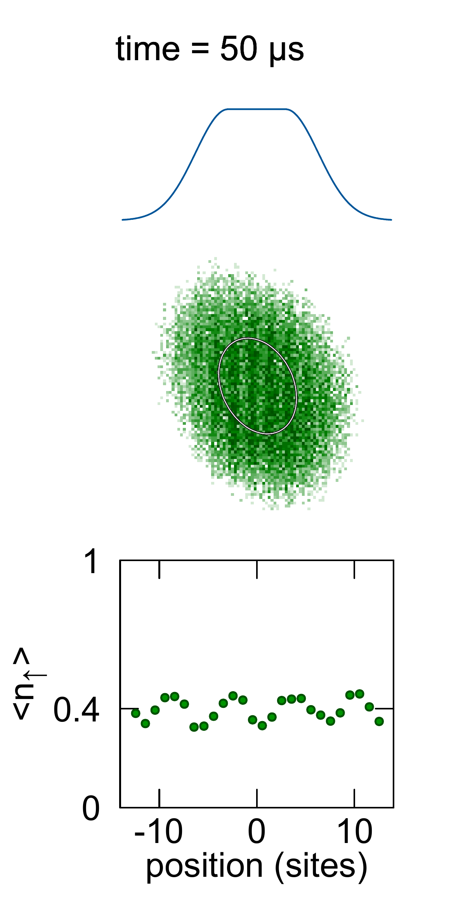
Measurement Protocol
Brown et. al., Science 363, 379 (2019)
Notes:
Previous work on mass transport with fermions, mostly using mesoscopic systems such as channels, or bulk systems, including lattice experiments. In this experiment, we study a Fermions in a “bulk” 2D lattice, which is described by the Fermi Hubbard Hamiltonian. This Fermi Hubbard system is a model for strong correlation physics. We use a quantum gas microscope to observe the atomic density on a single site level.
We want to study unconventional transport in a strongly interacting system: a 2D fermi hubbard model using a quantum gas microscope. As opposed to a two terminal setup, where we apply a voltage and measure a current we study microscopic charge transport. We impose a density modulation on our gas and observe its decay. The macroscopic and microscopic pictures are connected through the Nernst-Einstein relation, which gives the resistivity in terms of the mass diffusion constant and the compressibility, which is a static quantity.
We load atoms into an optical lattice and project a sinusoidally modulated potential using a spatial light modulator. Here is a schematic of this projection through our objective. This produces a density modulation. Here is a schematic view, with an exaggerated density modulation. Here is a fluorescence image of the actual modulation.
After applying the potential modulation, we snap it off and observe the decay of the density modulation pattern. Here is a 1D cut through the potential created by the spatial light modulator. The 2D density of the cloud looks like this. We focus on the central region where the density is flat and average orthogonal to the modulation to produce a 1D image. We rapidly turn of the modulation potential. The modulation pattern decays until at long times the denity is flat.
Also: work on spin transport Nichols … Zwierlein Science 363, 383 (2019)
𝑡⁄ℎ=925(10)𝐻𝑧
𝑎_13=1070(10) 𝑎_𝑜 @ 𝐵=616 𝐺

Slide 13

Measurement Protocol
Brown et. al., Science 363, 379 (2019)
Notes:
Previous work on mass transport with fermions, mostly using mesoscopic systems such as channels, or bulk systems, including lattice experiments. In this experiment, we study a Fermions in a “bulk” 2D lattice, which is described by the Fermi Hubbard Hamiltonian. This Fermi Hubbard system is a model for strong correlation physics. We use a quantum gas microscope to observe the atomic density on a single site level.
We want to study unconventional transport in a strongly interacting system: a 2D fermi hubbard model using a quantum gas microscope. As opposed to a two terminal setup, where we apply a voltage and measure a current we study microscopic charge transport. We impose a density modulation on our gas and observe its decay. The macroscopic and microscopic pictures are connected through the Nernst-Einstein relation, which gives the resistivity in terms of the mass diffusion constant and the compressibility, which is a static quantity.
We load atoms into an optical lattice and project a sinusoidally modulated potential using a spatial light modulator. Here is a schematic of this projection through our objective. This produces a density modulation. Here is a schematic view, with an exaggerated density modulation. Here is a fluorescence image of the actual modulation.
After applying the potential modulation, we snap it off and observe the decay of the density modulation pattern. Here is a 1D cut through the potential created by the spatial light modulator. The 2D density of the cloud looks like this. We focus on the central region where the density is flat and average orthogonal to the modulation to produce a 1D image. We rapidly turn of the modulation potential. The modulation pattern decays until at long times the denity is flat.
Also: work on spin transport Nichols … Zwierlein Science 363, 383 (2019)
𝑡⁄ℎ=925(10)𝐻𝑧
𝑎_13=1070(10) 𝑎_𝑜 @ 𝐵=616 𝐺

Slide 14
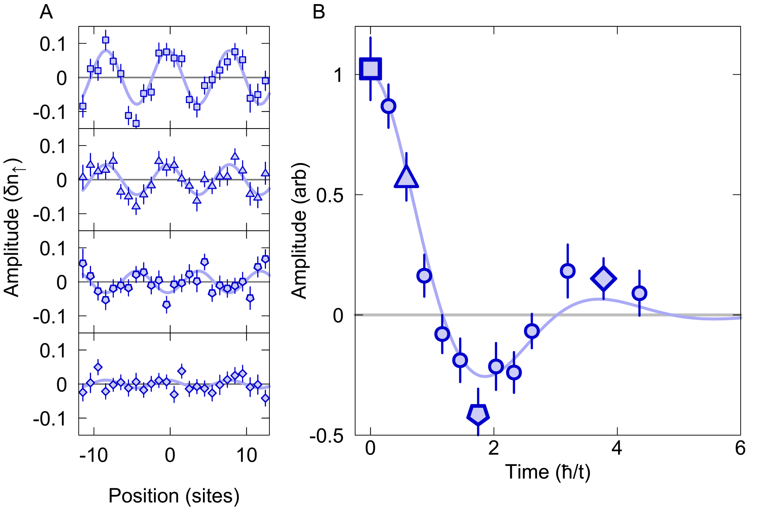
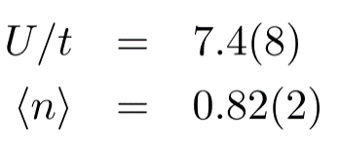
Decaying density modulation
Notes:
Studying system in strongly correlated regime, U/t = 7.5, and near optimal doping in cuprates
We fit the amplitude of sinusoids at different points during the decay. We fix the phase of the sinusoid to match the initial pattern. We expected that the modulation would decay diffusively and we would see an exponential decay of amplitude versus time.
Two deviations from this. (1) at early time, the decay is very flat. It requires a finite amount of time to establish a current, which is not accounted for in the diffusion equation. (2) At some time, the density modulation is 180 degrees out of phase with the initial pattern. In this case, we are exciting an extremely damped soundwave in the system.
We imposed modulations of different period on the system and observed the decay. 5, 10, 15, 20. For the longer wavelengths, the behavior is closer to diffusive (i.e. exponential decay with time constant scalling like k^2)

Slide 15
Decaying density modulation
Not explained by diffusion alone!
Notes:
We fit the amplitude of sinusoids at different points during the decay. We fix the phase of the sinusoid to match the initial pattern. We expected that the modulation would decay diffusively and we would see an exponential decay of amplitude versus time.
Two deviations from this. (1) at early time, the decay is very flat. It requires a finite amount of time to establish a current, which is not accounted for in the diffusion equation. (2) At some time, the density modulation is 180 degrees out of phase with the initial pattern. In this case, we are exciting an extremely damped soundwave in the system.
We imposed modulations of different period on the system and observed the decay. 5, 10, 15, 20. For the longer wavelengths, the behavior is closer to diffusive (i.e. exponential decay with time constant scalling like k^2)

Slide 16
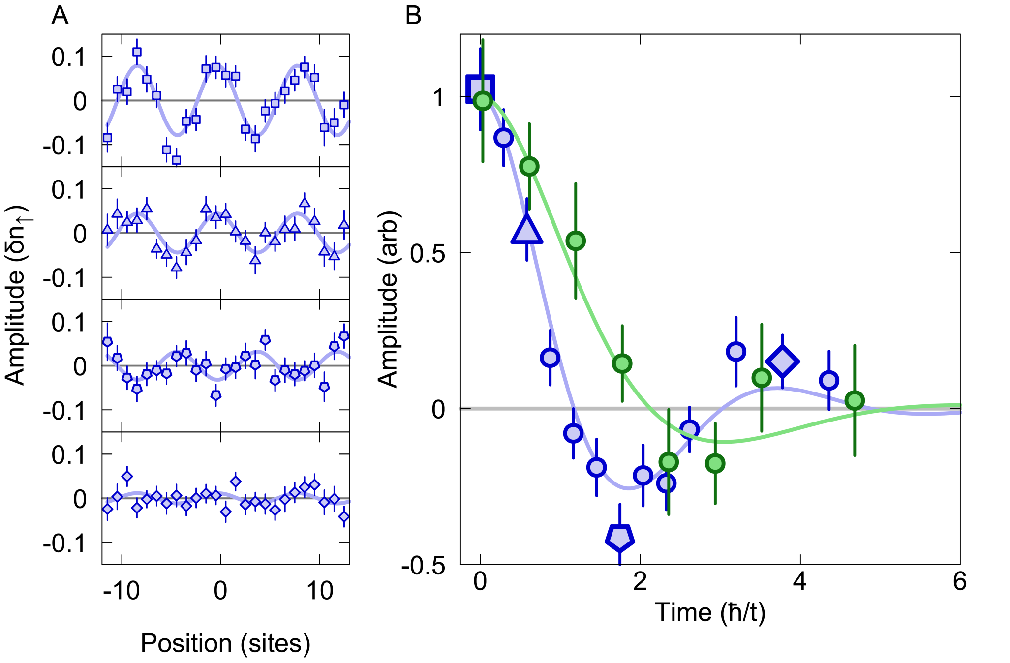
Decaying density modulation

Slide 17
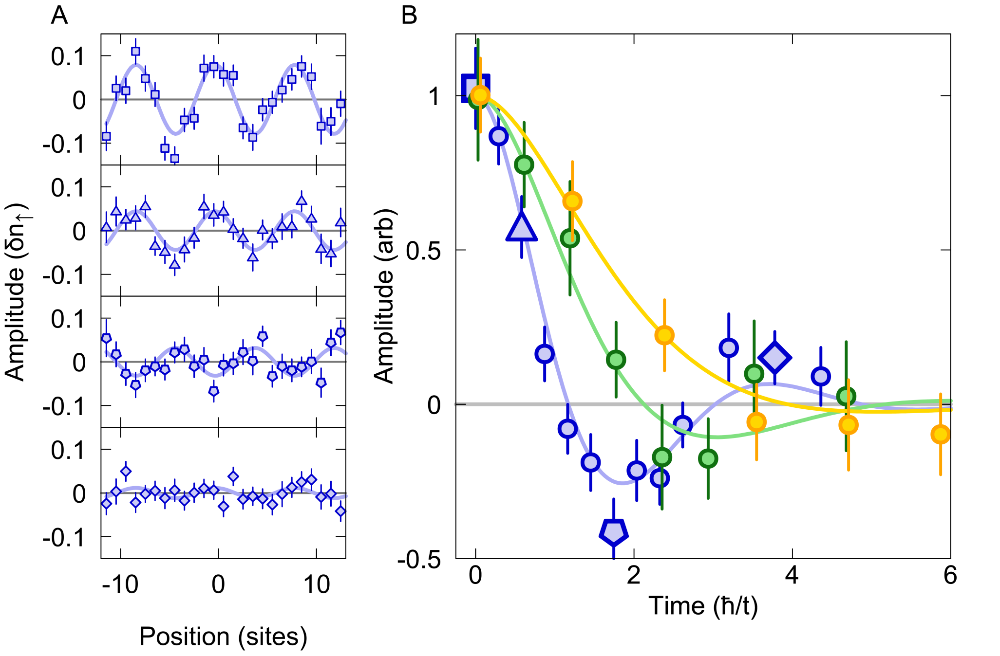
Decaying density modulation

Slide 18
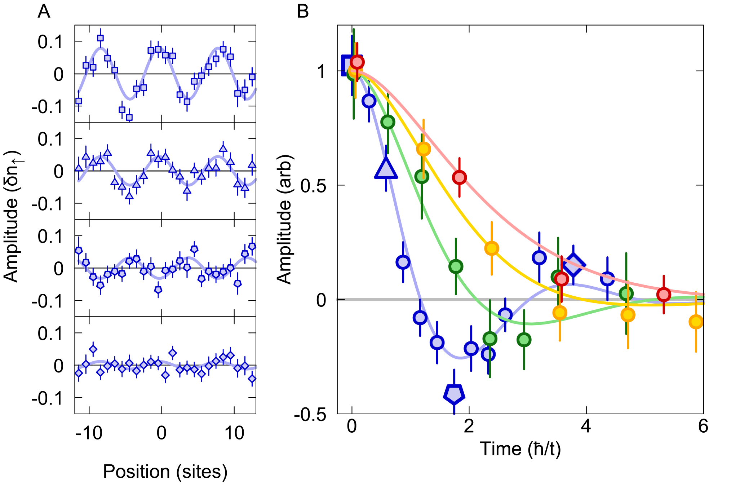
Decaying density modulation

Slide 19
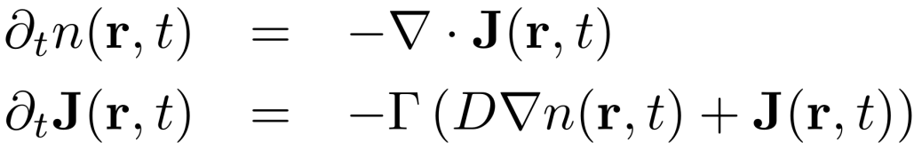
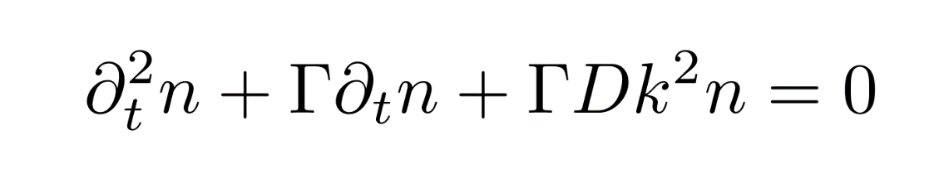
Hydrodynamic Model
“charge” conservation
Diffusion (Fick’s Law) neglects finite time to establish current.
D, diffusion constant
Γ, current relaxation. rate.
Crossover from diffusive mode to sound mode.
Fick’s Law
Notes:
To better quantify what is going on, we developed a hydrodynamic model. As per diffusion, included current conservation and “fick’s law equation”. We later understood that this second equation can also be viewed as a “momentum conservation equation”, like the Navier stokes equation in some approximation (linear reponse, no viscosity, etc). Here D is the diffusion constant, and Γ is the momentum relaxation rate.
This gives a damped harmonic oscillator equation. You have a characteristic frequency, which is really a sound speed, and a decay rate. For very fast decay rate, this is overdamped equation and describes diffusion. In that case, Gamma drops out of the problem entirely. For gamma slow, you have underdamped oscillations, which are decaying sound waves.
Our system is a Hubbard model. We haven’t explicitely included any dissipation. But momentum is not conserved because we don’t have translational invariance. Instead, we have discrete translational invariance with lattice momentum conservation. So in some collisions, momentum will not be conserved up to a reciprocal lattice vector (i.e. lattice absorbs some momentum). This is umklapp scattering.
Possible to include shear and bulk viscosity, but data quality not sufficient to determine

Slide 20
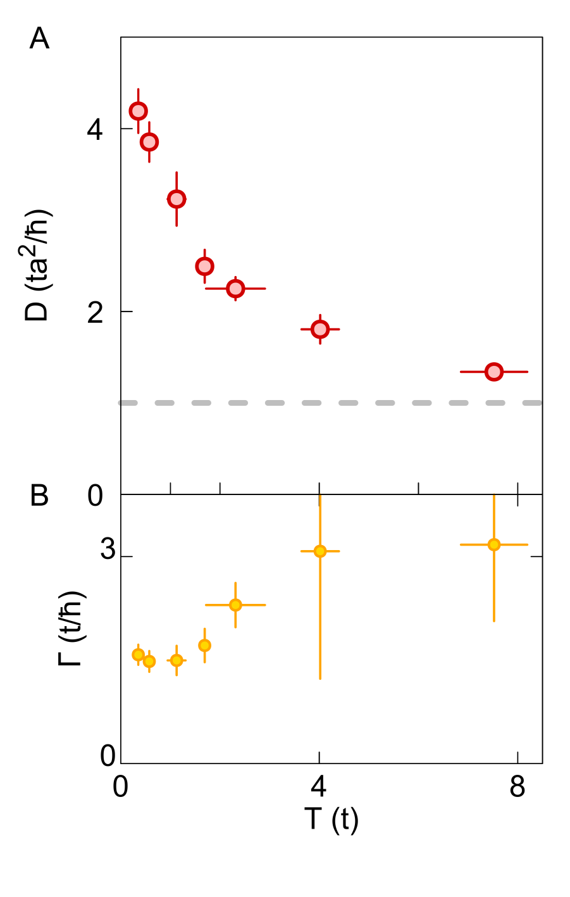
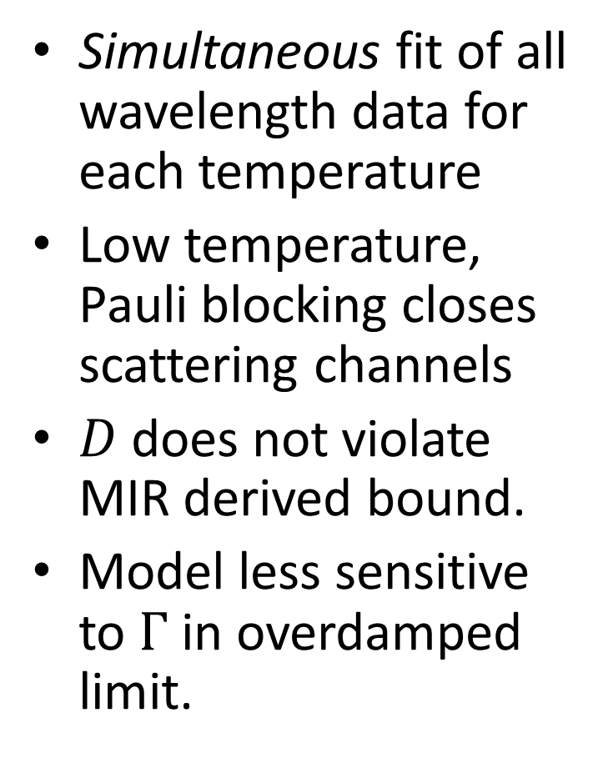

Hydrodynamic Parameters
Notes:
D is a dynamical quantity (as opposed to a thermodynamic), which is difficult to calculate in (exact) theory. Because requires working in the limit as wavelength gets very large, limited to small system sizes in exact diagonalization, dqmc, etc. Even the infinite temperature limiting value is non-trivial to determine. That is still a quantum problem in the single band limit.
On the other hand, Gamma is accessible. Width of the Drude peak in the optical conductivity. We used an exact theory, finite temperature lanczos method. And an approximate theory dynamical mean field theory, which goes down to lower temperatures.

Slide 21
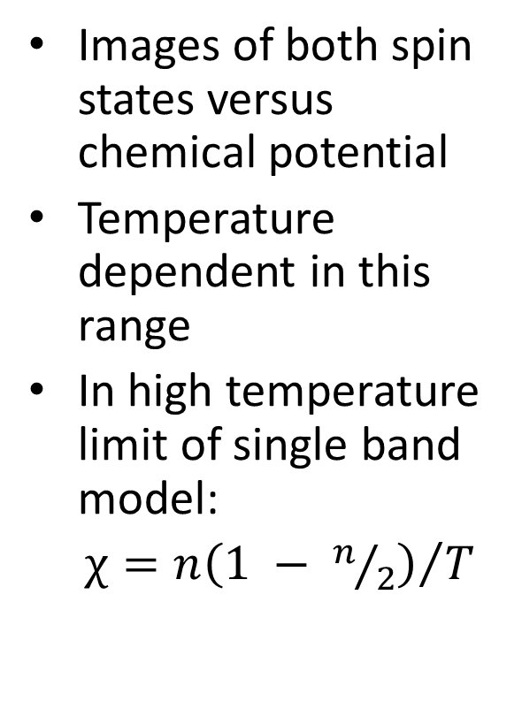
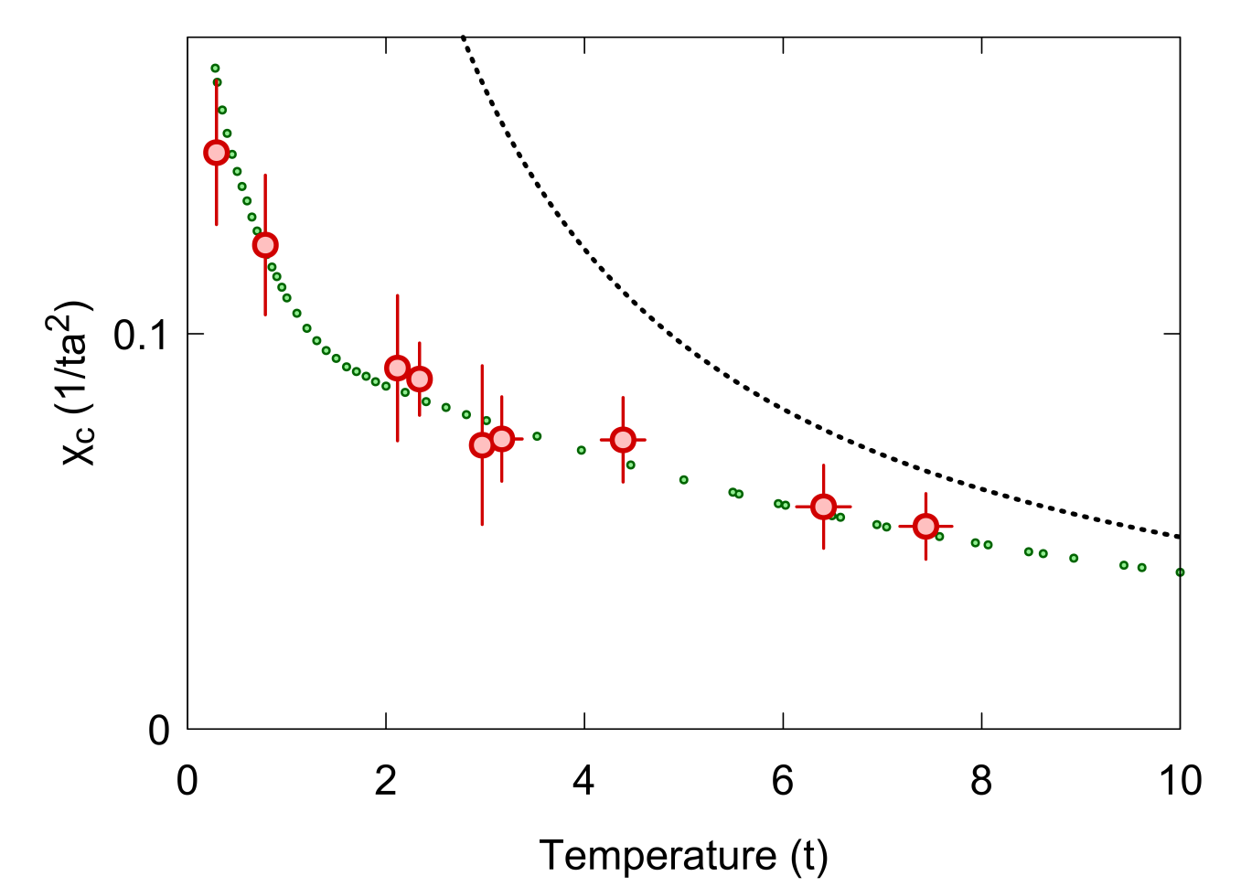
Compressibility
High-T limit
DQMC
Notes:
Compressibility changes with temperature
It has been suggested one simple way to get a linear scaling is to go to the high temperature limit (T >> W) where the diffusion constant has saturated and the compressibility scales like 1/T. We are not in this trivial limit, but some more interesting regime where combined scalling of D and Chi conspires to show linear resistivity scaling.

Slide 22
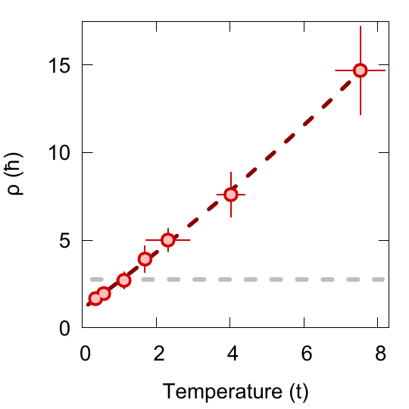
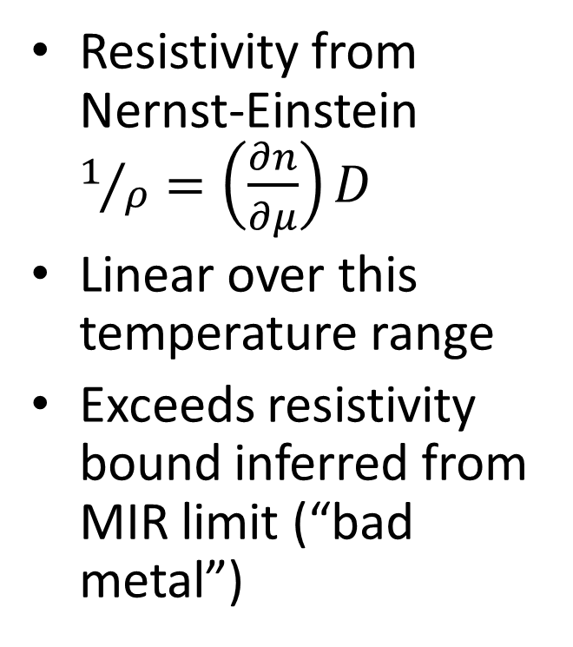
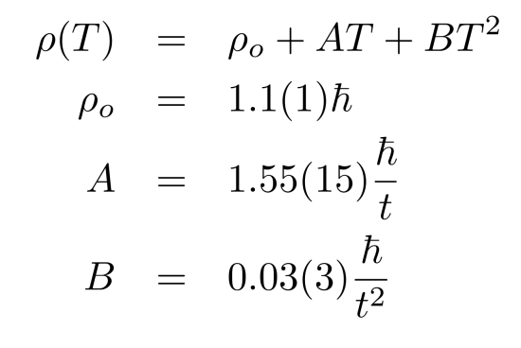
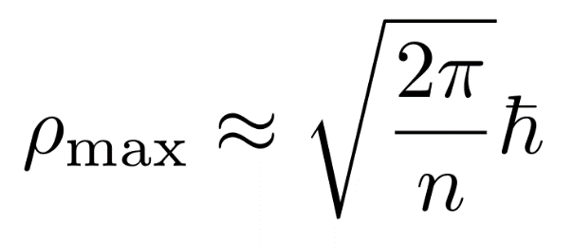
Resistivity Versus Temperature
Brown et. al., Science 363, 379 (2019)
Notes:
Combine two measurements to obtain resistivity.
Fit to polynomial form including both FL quadratic portion and linear portion. Linear to very good approximation.
Reproducing strange metal phenomonolgoy in that sence.
Also violating MIR bound, although unlike in real bad metal we understand the origin of this effect, at least in high temperature limit: temperature dependent compressibility
FTLM agrees reasonable well. Small systematic shift (possible miscalibration in U/t). Did not repeat FTLM b/c full calculation took of order 1 month. FTLM can only reach T/t = 1.
Therefore, also look @ approximate theory. Can go to low temp, but not guaranteed approximation fulfilled. See disagreement even at high T => more theoretical work.
Does suggest one important lesson: quantum simulators can serve as benchmark to theory techniques and test approximation in low temps regime where theory fails.

Slide 23
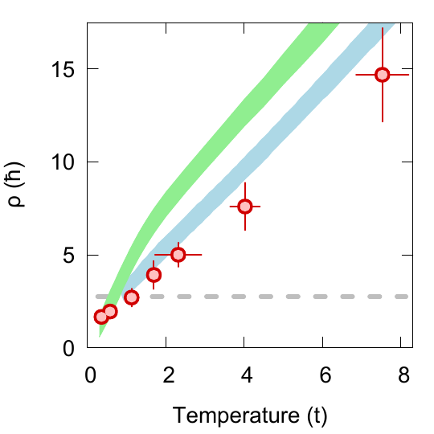
Resistivity Versus Temperature
Brown et. al., Science 363, 379 (2019)
DMFT
(Tremblay)
FTLM
(Kokalj)
Also: Huang et. al., Science 366, 987 (2019)
Notes:
Combine two measurements to obtain resistivity.
Fit to polynomial form including both FL quadratic portion and linear portion. Linear to very good approximation.
Reproducing strange metal phenomonolgoy in that sence.
Also violating MIR bound, although unlike in real bad metal we understand the origin of this effect, at least in high temperature limit: temperature dependent compressibility
FTLM agrees reasonable well. Small systematic shift (possible miscalibration in U/t). Did not repeat FTLM b/c full calculation took of order 1 month. FTLM can only reach T/t = 1.
Therefore, also look @ approximate theory. Can go to low temp, but not guaranteed approximation fulfilled. See disagreement even at high T => more theoretical work.
Does suggest one important lesson: quantum simulators can serve as benchmark to theory techniques and test approximation in low temps regime where theory fails.

Slide 24
Dynamics in strongly tilted, single band Hubbard systems
Non-interacting fermions: Bloch oscillations.
Interacting systems in 1D:
    Claims of MBL in clean tilted systems resulting from energetic constraints:
        E. Nieuwenburg et. al., PNAS 116, 9269 (2019)
        M. Schulz et. al., PRL 122, 040606 (2019)
    Hilbert space fragmentation resulting from “fractonic” physics (charge + dipole conservation), exponentially large number of localized states.
        P. Sala et. al., Phys. Rev. X 10, 011047 (2020)
        V. Khemani & R. Nandkishore, arxiv:1904.04815
Notes:
Combine two measurements to obtain resistivity.
Fit to polynomial form including both FL quadratic portion and linear portion. Linear to very good approximation.
Reproducing strange metal phenomonolgoy in that sence.
Also violating MIR bound, although unlike in real bad metal we understand the origin of this effect, at least in high temperature limit: temperature dependent compressibility
FTLM agrees reasonable well. Small systematic shift (possible miscalibration in U/t). Did not repeat FTLM b/c full calculation took of order 1 month. FTLM can only reach T/t = 1.
Therefore, also look @ approximate theory. Can go to low temp, but not guaranteed approximation fulfilled. See disagreement even at high T => more theoretical work.
Does suggest one important lesson: quantum simulators can serve as benchmark to theory techniques and test approximation in low temps regime where theory fails.

Slide 25
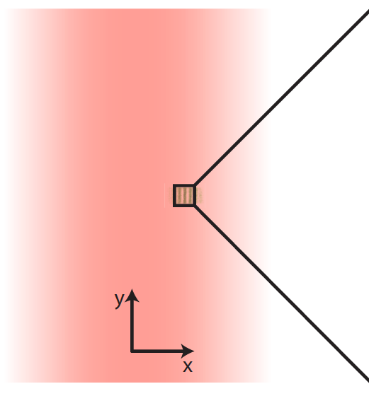
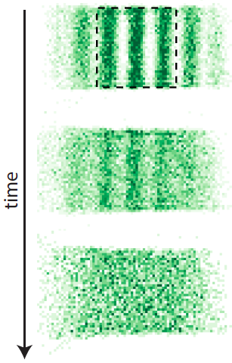
Tilted 2D Hubbard system
Displaced beam provides near uniform gradient a lattice axis.
Hard walls constrain motion in direction orthogonal to gradient.
Notes:
Combine two measurements to obtain resistivity.
Fit to polynomial form including both FL quadratic portion and linear portion. Linear to very good approximation.
Reproducing strange metal phenomonolgoy in that sence.
Also violating MIR bound, although unlike in real bad metal we understand the origin of this effect, at least in high temperature limit: temperature dependent compressibility
FTLM agrees reasonable well. Small systematic shift (possible miscalibration in U/t). Did not repeat FTLM b/c full calculation took of order 1 month. FTLM can only reach T/t = 1.
Therefore, also look @ approximate theory. Can go to low temp, but not guaranteed approximation fulfilled. See disagreement even at high T => more theoretical work.
Does suggest one important lesson: quantum simulators can serve as benchmark to theory techniques and test approximation in low temps regime where theory fails.

Slide 26
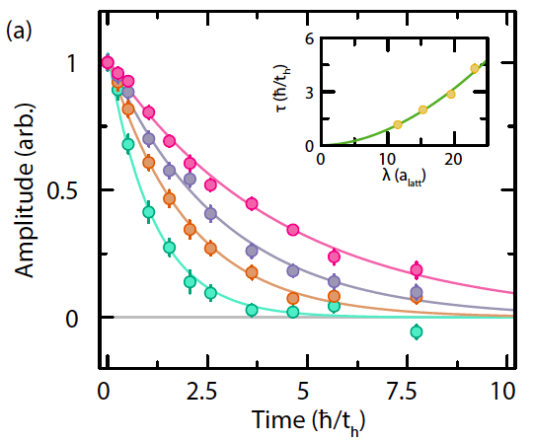
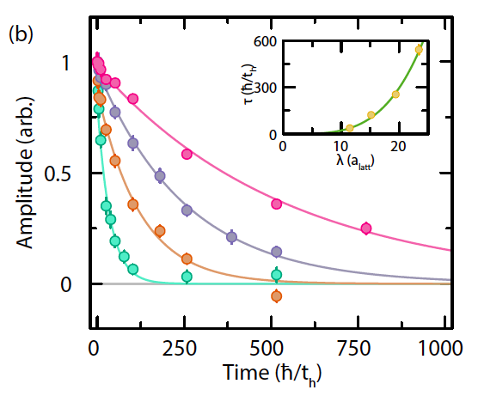
Thermalization in tilted 2D Hubbard system
Hopping orthogonal to gradient enables thermalization.
F/t = 0, U/t = 4
F/t = 2, U/t = 4
Notes:
Combine two measurements to obtain resistivity.
Fit to polynomial form including both FL quadratic portion and linear portion. Linear to very good approximation.
Reproducing strange metal phenomonolgoy in that sence.
Also violating MIR bound, although unlike in real bad metal we understand the origin of this effect, at least in high temperature limit: temperature dependent compressibility
FTLM agrees reasonable well. Small systematic shift (possible miscalibration in U/t). Did not repeat FTLM b/c full calculation took of order 1 month. FTLM can only reach T/t = 1.
Therefore, also look @ approximate theory. Can go to low temp, but not guaranteed approximation fulfilled. See disagreement even at high T => more theoretical work.
Does suggest one important lesson: quantum simulators can serve as benchmark to theory techniques and test approximation in low temps regime where theory fails.

Slide 27
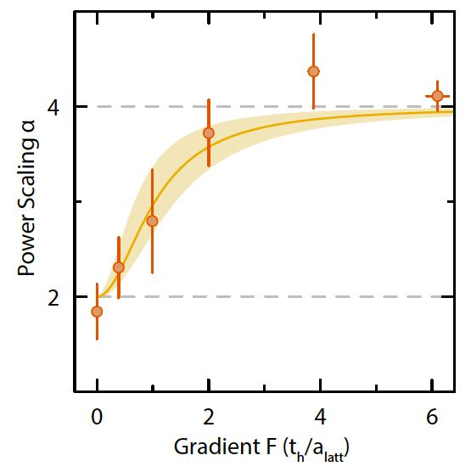

Crossover from diffusive to sub-diffusive transport
Relaxation time
Notes:
Combine two measurements to obtain resistivity.
Fit to polynomial form including both FL quadratic portion and linear portion. Linear to very good approximation.
Reproducing strange metal phenomonolgoy in that sence.
Also violating MIR bound, although unlike in real bad metal we understand the origin of this effect, at least in high temperature limit: temperature dependent compressibility
FTLM agrees reasonable well. Small systematic shift (possible miscalibration in U/t). Did not repeat FTLM b/c full calculation took of order 1 month. FTLM can only reach T/t = 1.
Therefore, also look @ approximate theory. Can go to low temp, but not guaranteed approximation fulfilled. See disagreement even at high T => more theoretical work.
Does suggest one important lesson: quantum simulators can serve as benchmark to theory techniques and test approximation in low temps regime where theory fails.

Slide 28
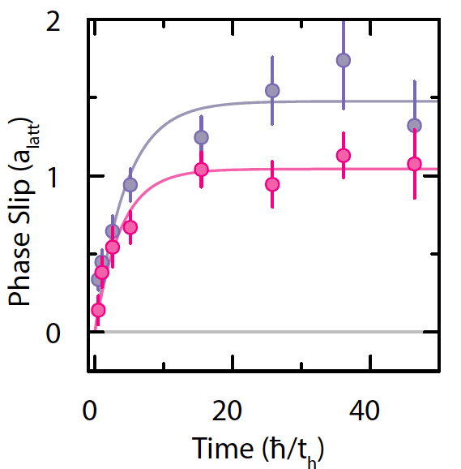



Heating up to near infinite temperature
System can exchange tilt energy with internal energy to maximize entropy. Internal energy is bounded in single-band lattice system.
Pattern quickly slips by about 1 lattice site, heating up to near infinite temperature in the process.
F/t = 1, U/t = 4
Notes:
Combine two measurements to obtain resistivity.
Fit to polynomial form including both FL quadratic portion and linear portion. Linear to very good approximation.
Reproducing strange metal phenomonolgoy in that sence.
Also violating MIR bound, although unlike in real bad metal we understand the origin of this effect, at least in high temperature limit: temperature dependent compressibility
FTLM agrees reasonable well. Small systematic shift (possible miscalibration in U/t). Did not repeat FTLM b/c full calculation took of order 1 month. FTLM can only reach T/t = 1.
Therefore, also look @ approximate theory. Can go to low temp, but not guaranteed approximation fulfilled. See disagreement even at high T => more theoretical work.
Does suggest one important lesson: quantum simulators can serve as benchmark to theory techniques and test approximation in low temps regime where theory fails.

Slide 29

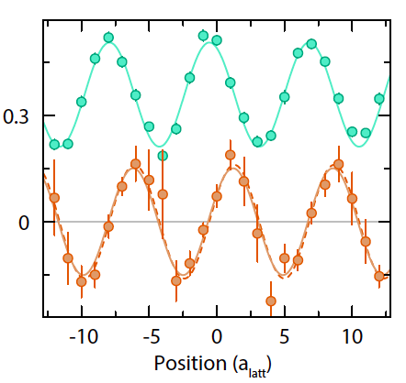
Reaching local equilibrium: this is a heat diffusion problem!
Potential
x
Local equilibration leads to a modulated inverse temperature shifted by 90 degrees relative to density pattern.
Verified by measuring doublon density.
Single component
density
Inverse temperature
βt
Mandt et. al. PRL 106, 250602 (2011)
Notes:
Combine two measurements to obtain resistivity.
Fit to polynomial form including both FL quadratic portion and linear portion. Linear to very good approximation.
Reproducing strange metal phenomonolgoy in that sence.
Also violating MIR bound, although unlike in real bad metal we understand the origin of this effect, at least in high temperature limit: temperature dependent compressibility
FTLM agrees reasonable well. Small systematic shift (possible miscalibration in U/t). Did not repeat FTLM b/c full calculation took of order 1 month. FTLM can only reach T/t = 1.
Therefore, also look @ approximate theory. Can go to low temp, but not guaranteed approximation fulfilled. See disagreement even at high T => more theoretical work.
Does suggest one important lesson: quantum simulators can serve as benchmark to theory techniques and test approximation in low temps regime where theory fails.

Slide 30





Reaching global equilibrium: a hydrodynamic model
Inverse temperature modulation leads to a diffusive heat current
“e” is the local internal (non-tilt) energy, can be related to β using a
a high-temperature expansion.
Energy conservation:
Strong tilt regime: internal energy change is negligible:
Number conservation:
Notes:
Combine two measurements to obtain resistivity.
Fit to polynomial form including both FL quadratic portion and linear portion. Linear to very good approximation.
Reproducing strange metal phenomonolgoy in that sence.
Also violating MIR bound, although unlike in real bad metal we understand the origin of this effect, at least in high temperature limit: temperature dependent compressibility
FTLM agrees reasonable well. Small systematic shift (possible miscalibration in U/t). Did not repeat FTLM b/c full calculation took of order 1 month. FTLM can only reach T/t = 1.
Therefore, also look @ approximate theory. Can go to low temp, but not guaranteed approximation fulfilled. See disagreement even at high T => more theoretical work.
Does suggest one important lesson: quantum simulators can serve as benchmark to theory techniques and test approximation in low temps regime where theory fails.

Slide 31
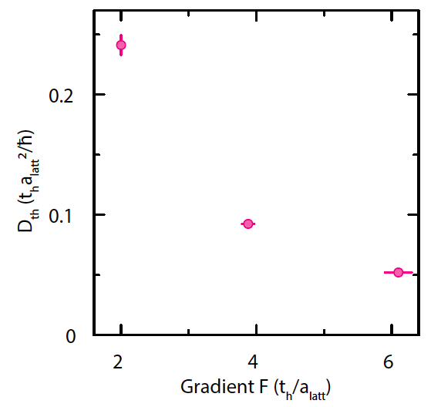
Thermal diffusivity at infinite temperature in tilted Fermi-Hubbard model
Outlook: remove reservoir to explore non-ergodic behavior:
1D tilted system.
2D system with tilt not along lattice axis.
Notes:
Combine two measurements to obtain resistivity.
Fit to polynomial form including both FL quadratic portion and linear portion. Linear to very good approximation.
Reproducing strange metal phenomonolgoy in that sence.
Also violating MIR bound, although unlike in real bad metal we understand the origin of this effect, at least in high temperature limit: temperature dependent compressibility
FTLM agrees reasonable well. Small systematic shift (possible miscalibration in U/t). Did not repeat FTLM b/c full calculation took of order 1 month. FTLM can only reach T/t = 1.
Therefore, also look @ approximate theory. Can go to low temp, but not guaranteed approximation fulfilled. See disagreement even at high T => more theoretical work.
Does suggest one important lesson: quantum simulators can serve as benchmark to theory techniques and test approximation in low temps regime where theory fails.

Slide 32



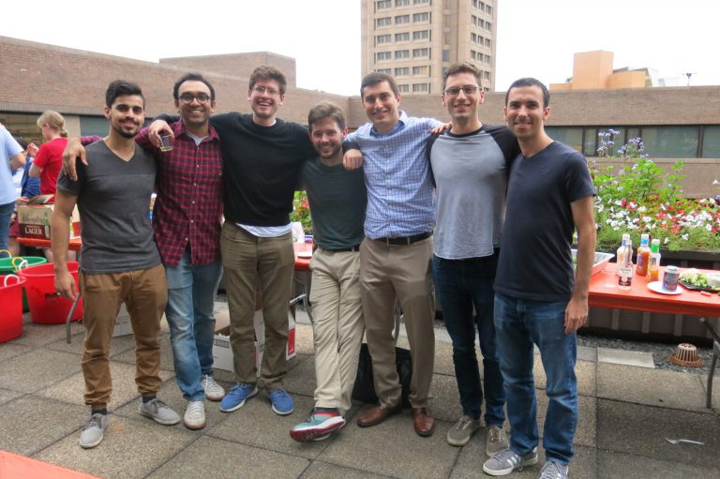


Thank you!
Graduate students
Peter Brown
Debayan Mitra
Elmer Guardado-Sanchez
Lysander Christakis
Jason Rosenberg
Benjamin Spar
Post-docs
Peter Schauss
Stanimir Kondov
Theory support
David Huse (Princeton)
Alan Morningstar (Princeton)
Andre-Marie Tremblay (Sherbrooke)
Jure Kokalj (U. of Ljubljana)
Edwin Huang (Stanford)
Tom Devereaux (Stanford)
Funding

