Slide 1
Technology
SCC

Slide 2
Welcome
We are happy everyone is here.
You should have at least one personal machine by now
Eventually most of you will have both a desktop and a laptop
Some of you may have data you want to import
We can talk about the most efficient way to do this based on the size and type of the data

Slide 3
Organization
Core IT (ITSupport@simonsfoundation.org)
Printers
Office/productivity software license issues
Email problems
General IT problems
Wifi
Scientific Computing (Nick Carriero, Alex Chavkin, Justin Creveling, Ian Fisk, Pat Gunn,Yanbin Liu, Liz Lovero, Andras Pataki, Dylan Simon, Jonathan Tischio, Nikos Trikoupis, Aaron Watters) (scicomp@flatironinstitute.org)
Questions about any of the central Linux clusters
Package and configuration management on cluster
Technical software and performance issues
IO and data storage
Scientific Computing Documentation is here:
https://docs.simonsfoundation.org/index.php/Category:Flatiron_Institute_RC

Slide 4
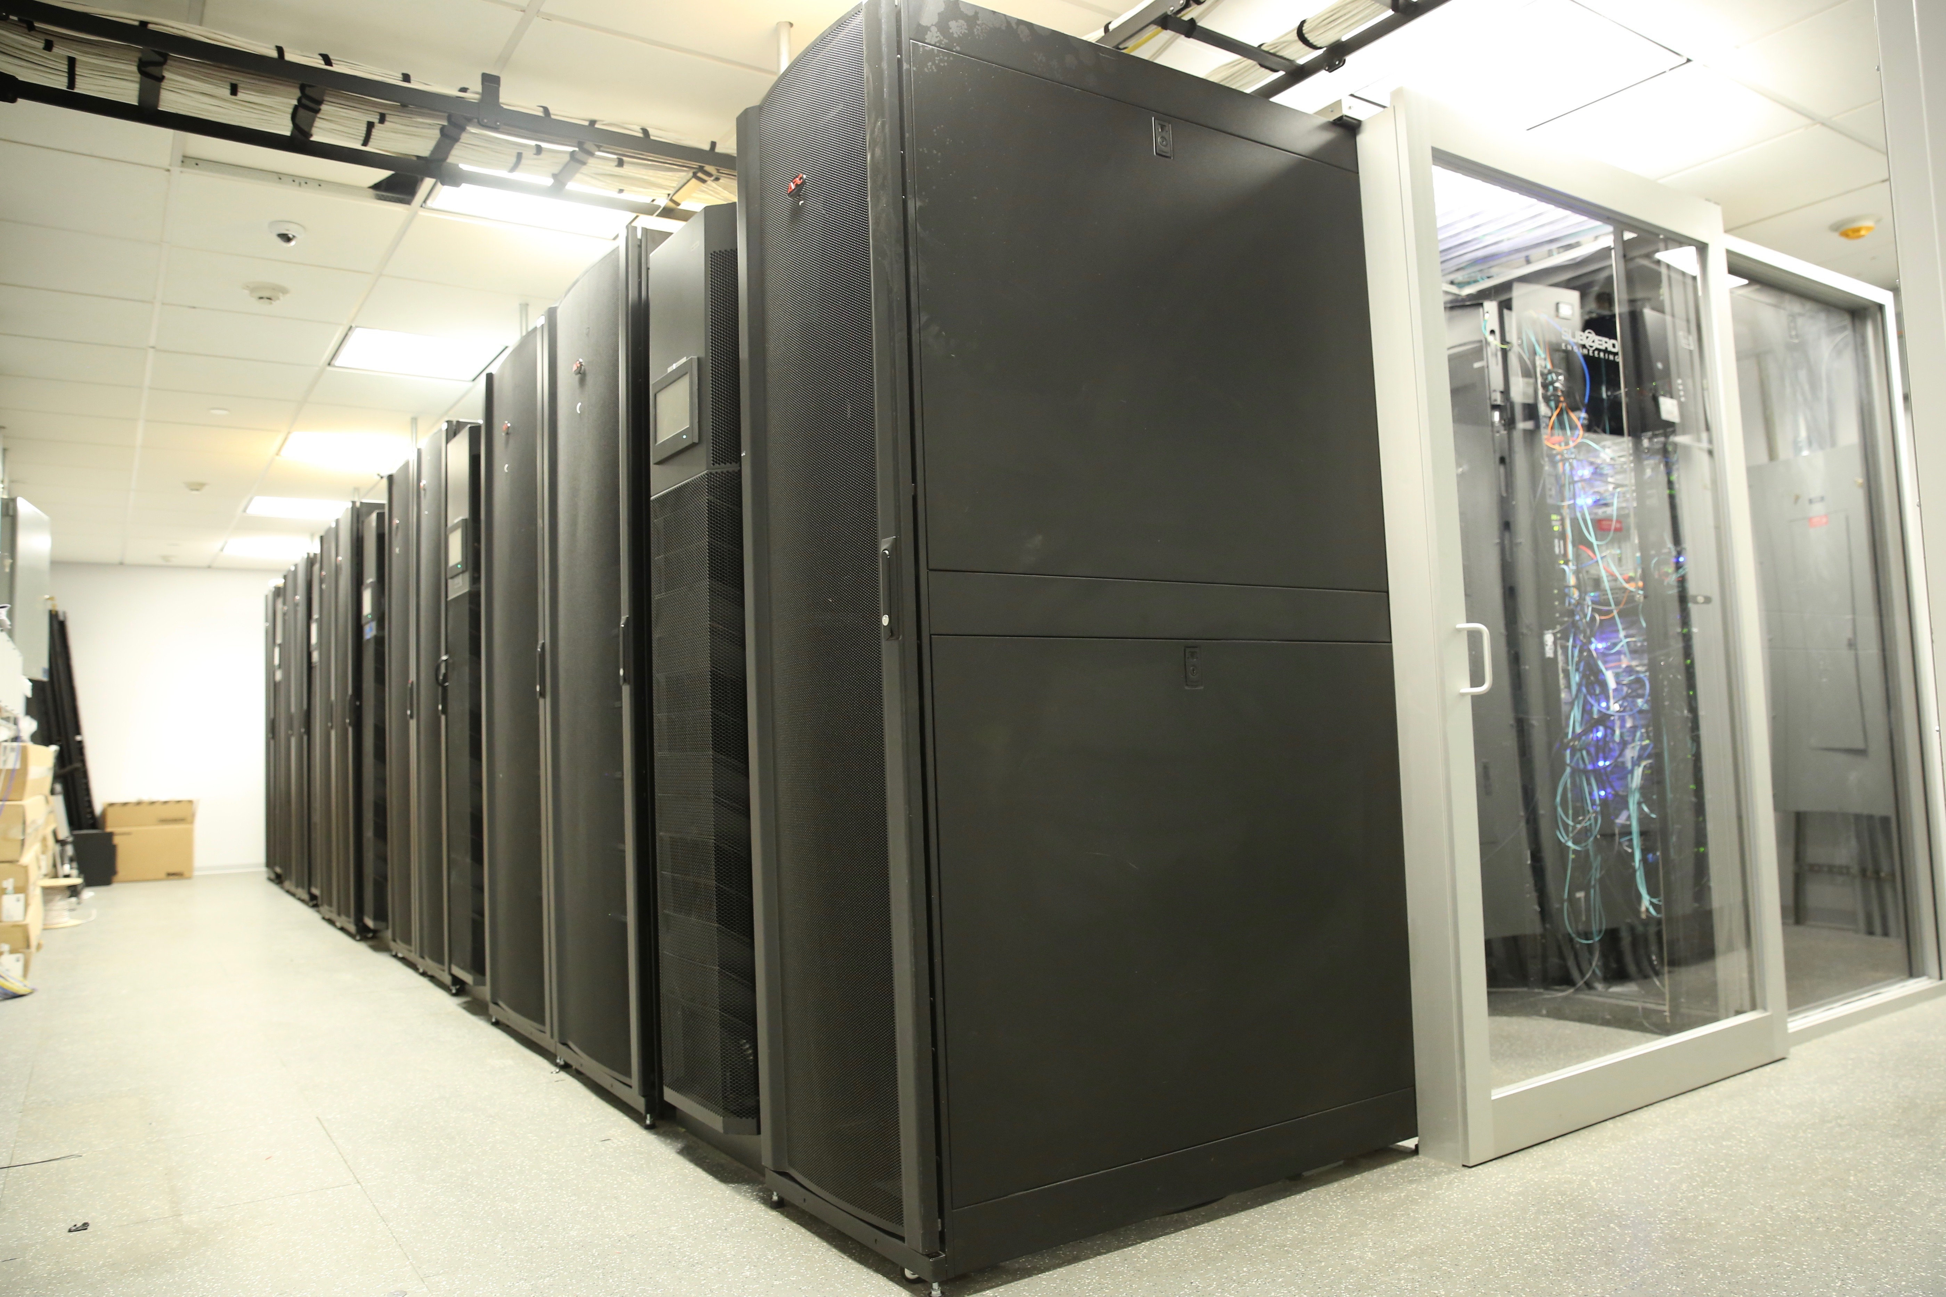
What and where?
We have three computing centers
Here at the Institute in the basement
6700 cores: 240 2x14 Broadwell nodes, 512GB RAM, 10Gb/s Ethernet and 100Gb/s Omnipath
7680 cores: 192 2x20 Skylake nodes 768GB RAM, 10Gb/s Ethernet and 100Gb/s Omnipath
1700 cores: 30 2x14 core nodes, 256GB and 16 2x22 core nodes, 384GB RAM, 40Gb/s InfiniBand and 10Gb/s Ethernet
42 GPU nodes (150 GPUs Mostly v100-32GB)
Co-location at BNL (~3ms, common software and file systems)
4800 cores: 120 2x20 core Skylake nodes, 768GB RAM, 2x10Gb/s Ethernet
Gordon and Popeye at SDSC (~70 ms, independent software and file systems)
16k cores: 1000 2X8 core nodes, 64GB of RAM, InfiniBand Connected
17k cores: 360 2 x 24 core 768GB RAM, EDR InfiniBand
16 GPU nodes (64 v100-32GB)
Rusty
Notes:
First two are collectively known as “rusty”.

Slide 5
ACCOUNTS
Staff have been given Linux cluster accounts. All user accounts are stored in a central system that enforces a consistent user namespace
All home directories for Linux are stored in a GPFS parallel shared file system
250TB of RAID6 with a nightly incremental backup.
If you have a Linux workstation, same credentials and files. That is, your workstation and cluster accounts are indistinguishable.
From the FI network (wired or wireless), access rusty via a round robin balanced login pool (ssh rusty).
Access gordon.sdsc.edu from gateway.flatironinstitute.org (internally, “gateway”).
You can also add an ssh-key and access from anywhere
You need keys to connect to popeye
Note: neither rusty proper nor gateway is intended for compute or memory intensive work.
Notes:
Tmux, screen

Slide 6
Computing
10hp 1000hp
4 core
800 core

Slide 7
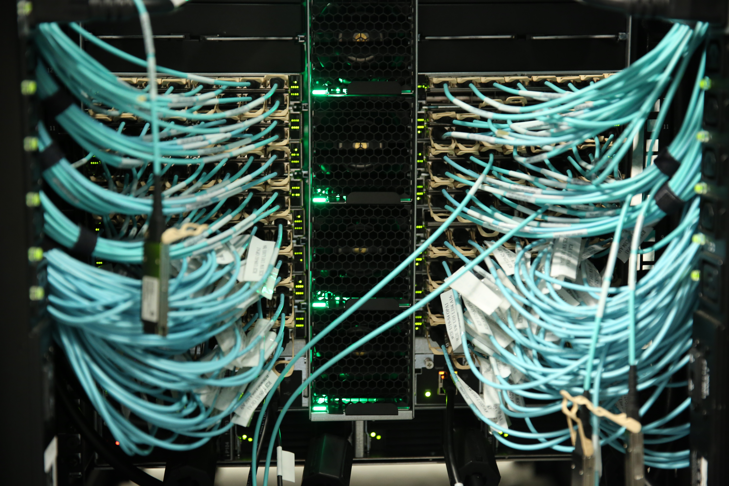
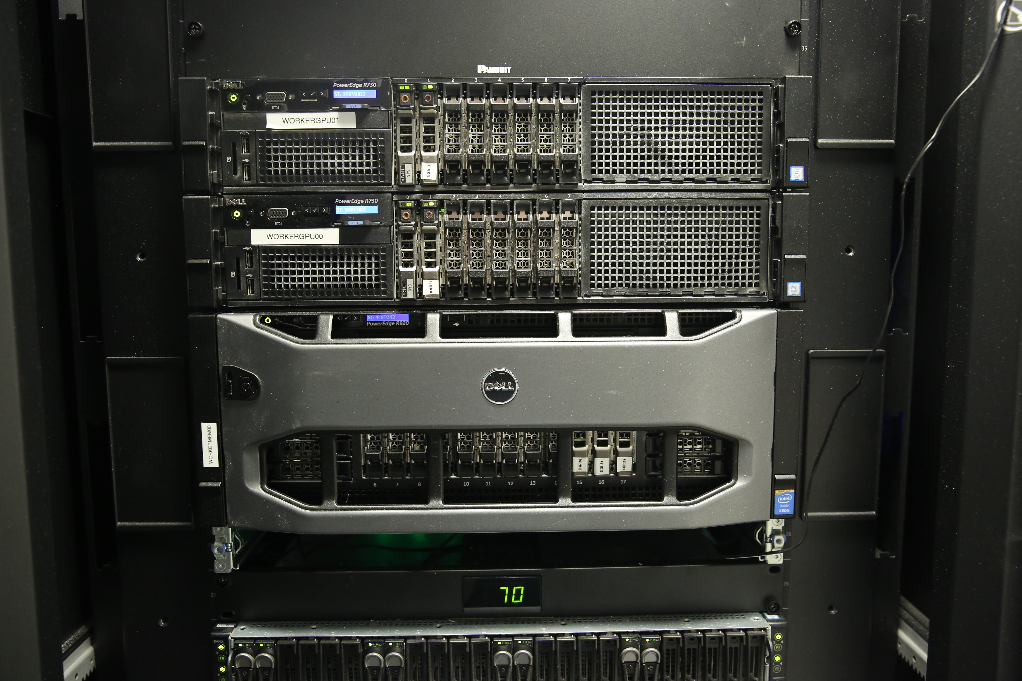
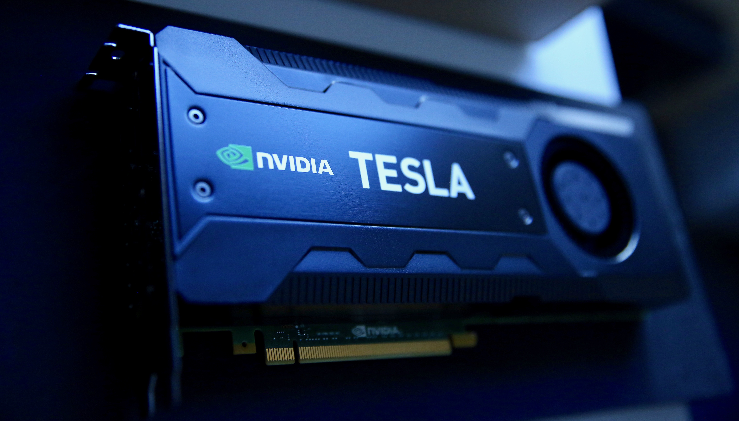
Computing Resources
Computing resources are managed via the SLURM resource control system. Currently users have access to:
A general partition (gen): 4-5 Omnipath connected nodes per user (~160 cores). No time limit.
A genx partition which allows selection a fraction of a machine for small tasks
A center specific partition (cca, ccb, ccq): 20-28 Omnipath connected nodes per user/100 for the center overall. 7 day limit.
An Infiniband partition (ib): 46 nodes, any user can take all of them. 7 day limit.
A preempt partition for all Omnipath nodes (preempt). Any user can take as much as they want, but a job will be killed if its nodes are needed to fulfill a non-preempt request. Good for work that makes incremental progress and can be restarted. 7 day limit.
A GPU partition (gpu): 2 nodes with two Tesla K40s, five with two Pascals, five with two 16GB Volta. 30with quad 32GB volta and NVLink, 7 day limit. (Note: --gres:gpu=2). These are shared
A partition for large memory machines (mem). Currently just one: 96cores, 3TB of RAM.
A BNL partition (bnl). 10 nodes per user (400 cores, ~7 TB RAM in aggregate), 10 day time limit.
Need something different? Talk to us!
Notes:
Do the math: Somewhat over subscribed.

Slide 8
Storage Resources
250TB of GPFS space for home directories
Incremental back-up and RAID6.
Code, docs, notes should live here. If you use more than ~1 TB, we will urge you to clean up and move data to the volumes intended for it.
~15PB of usable space in cephfs (3 copies or erasure encoded)
Data should live here /mnt/ceph/users/
If there is anything you need to keep, but you don’t expect to access for a while, let us know. We have tape archiving resources offsite.
1PB of space in GPFS at BNL (underlying storage is RAID6). This file system is also mounted at FI.
4PB of lustre at gordon.
Try to use the large parallel file system ”closest” to your computations.
Keep in mind that all compute nodes have node-local storage too.

Slide 9
Configuration
All the Linux systems are configured with via centralized management systems.
We are nearly entirely CentOS 7.6 for workers and desktops
If you need a package, please ask. Also feel free to install (non-privileged) software in your own directory.
Modern software environment mostly deployed through modules
module avail
Same environment on desktops and clusters
All Linux home directories are central and anyone can log into most systems (but use your desktop or make a SLURM allocation if you want a resource for significant work).
By keeping the configuration in common management systems and the user info in central file systems we can easy replace hardware when needed.

Slide 10
Connecting
We support two forms of external connections
You can use “FI” or “FI Backup” VPN from your Simons issued laptop.
Use your cluster credentials
There is also an ssh port at gateway.simonsfoundation.org that uses two-factor authentication
Instructions at docs.simonsfoundation.org.
You’ll need google authenticator, or similar software.
There are a variety of wireless domains
FI is, in effect, an extension of our internal network. It is intended for use only by machines that are actively managed by our management system.
The guest network is the only one guests should be given access to.
Each of your desks has a port (lowest right) on the guest wired network, which may be used by visitors or for your personal equipment needing a wired connection.

Slide 11
Moving DATA AROUND
Small quantities of data can be sent with scp and two factor authentication (or sshfs).
Data export can be done with a web interface (we have two mechanisms, please ask if you are interested).
Large quantities of data can be moved around with gridftp and globus. Documentation for how to do this is on the docs.simonsfoundation.org instructions.

Slide 12
SOME NOTES
We use a fifo batch system and we try to keep the wait times short
Try to be a good citizen
Submitting with accurate estimates for time and resources will get resources through faster
Most of the systems are allocated exclusively by default.
This means you get all the cores
There are tools like disBatch that can help you use all the cores
Our systems have a lot of cores and memory
Understand the parallelism of your code
The GPU nodes are shared because there are quad GPUs
If you can’t use all four, allocate one and a reasonable number of cores and memory so that the others can be used by someone else
GPFS is backed-up nightly. It’s intended for code and important persistent things
Intermediate files with a lot of churn belong in ceph
cephfs is a great file system, but the cluster is large and you have enough resources to really hammer things
Always a good idea check the behavior as you increase the scale

Slide 13
Gordon and POPEYE
Gordon is an aging super computer at SDSC
Accessible by connecting to
gateway locally and then
ssh gordon.sdsc.edu
Also uses slurm
Also uses modules
There is 4PB of Lustre file store
scp and GridFTP can be used to replicate file
Popeye is new and the fastest hardware we have
You need to setup keys. The software stack and OS should match the rusty cluster

Slide 14
IF YOU REMEMBER NOTHING ELSE
Scientific Computing Documentation is here:
https://docs.simonsfoundation.org/index.php/Category:Flatiron_Institute_RC
scicomp@flatironinstitute.org
Is the mailing list to write with problems

Slide 15
In General
If you need something please ask
Peripherals
Computing resources
Basics
Software engineering issues
Migrating code from laptops to the cluster
…
We’re on the middle of the north side of FI on just about every floor 4,5,6,7,8,9,10).

