Slide 1
Technology
SCC

Slide 2
Welcome
We are happy everyone is here.
I think you should have at least one personal machine by now
Eventually most of you will have both a desktop and a laptop
Some of you may have data you want to import
We can talk about the most efficient way to do this based on the size and type of the data

Slide 3
Organization
Core IT (ITSupport@simonsfoundation.org)
Printers
Most software license issues
Email problems
General IT problems
Wifi
Scientific Computing (Nick Carriero, Alex Chavkin, Justin Creveling, Ian Fisk, Pat Gunn, Yanbin Liu, Andras Pataki, Dylan Simon, Nikos Trikoupis, Aaron Watters) (scicomp@flatironinstitute.org)
Questions about any of the central Linux clusters
Software performance issues
Package and configuration management on cluster
Storage access
Scientific Computing Documentation is here:
https://docs.simonsfoundation.org/index.php/Category:Flatiron_Institute_RC

Slide 4
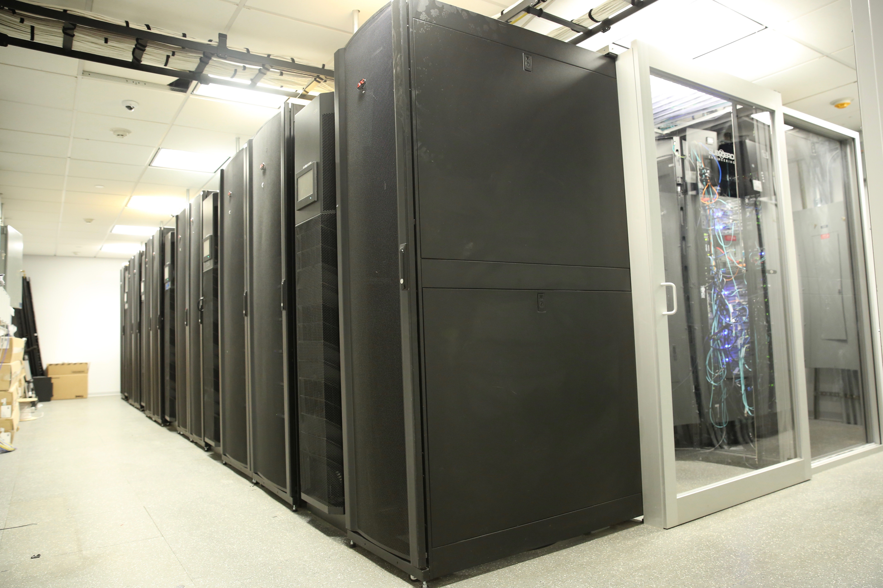
What and where?
We have 3 Computing Centers
Here in at the Institute in the basement
6700 Broadwell Cores over 240 nodes (Dual CPU 14 core systems, 512GB RAM, 2TB local scratch. 10Gb/s Ethernet and 100Gb/s Omnipath)
4800 Skylake Cores over 120 nodes (Dual CPU 20 core systems, 768GB of RAM 2TB local scratch. 10Gb/s Ethernet and 100Gb/s Omnipath)
1700 Cores on InfiniBand over 48 nodes (Dual 14 and Dual 22, 256GB and 384GB RAM, 40Gb/s InfiniBand and 10Gb/s Ethernet)
Co-Location at BNL
4800 cores of Skylake cores
Gordon at SDSC
16k cores on 1000 systems (dual 8 core, 64GB of RAM, InfiniBand Connected)

Slide 5
Computing Resources
You have all been given Linux cluster accounts. All user accounts are stored in a central LDAP that enforces a consistent UID namespace
Do not add local accounts to computers
IT has manually set the Mac UIDs to match the cluster, so you can mount central storage to the Mac, though we recommend using sshfs
All home directories for Linux are stored in GPFS
250TB of RAID6 with a nightly incremental backup
There is a round robin balanced login pool (ssh rusty)

Slide 6
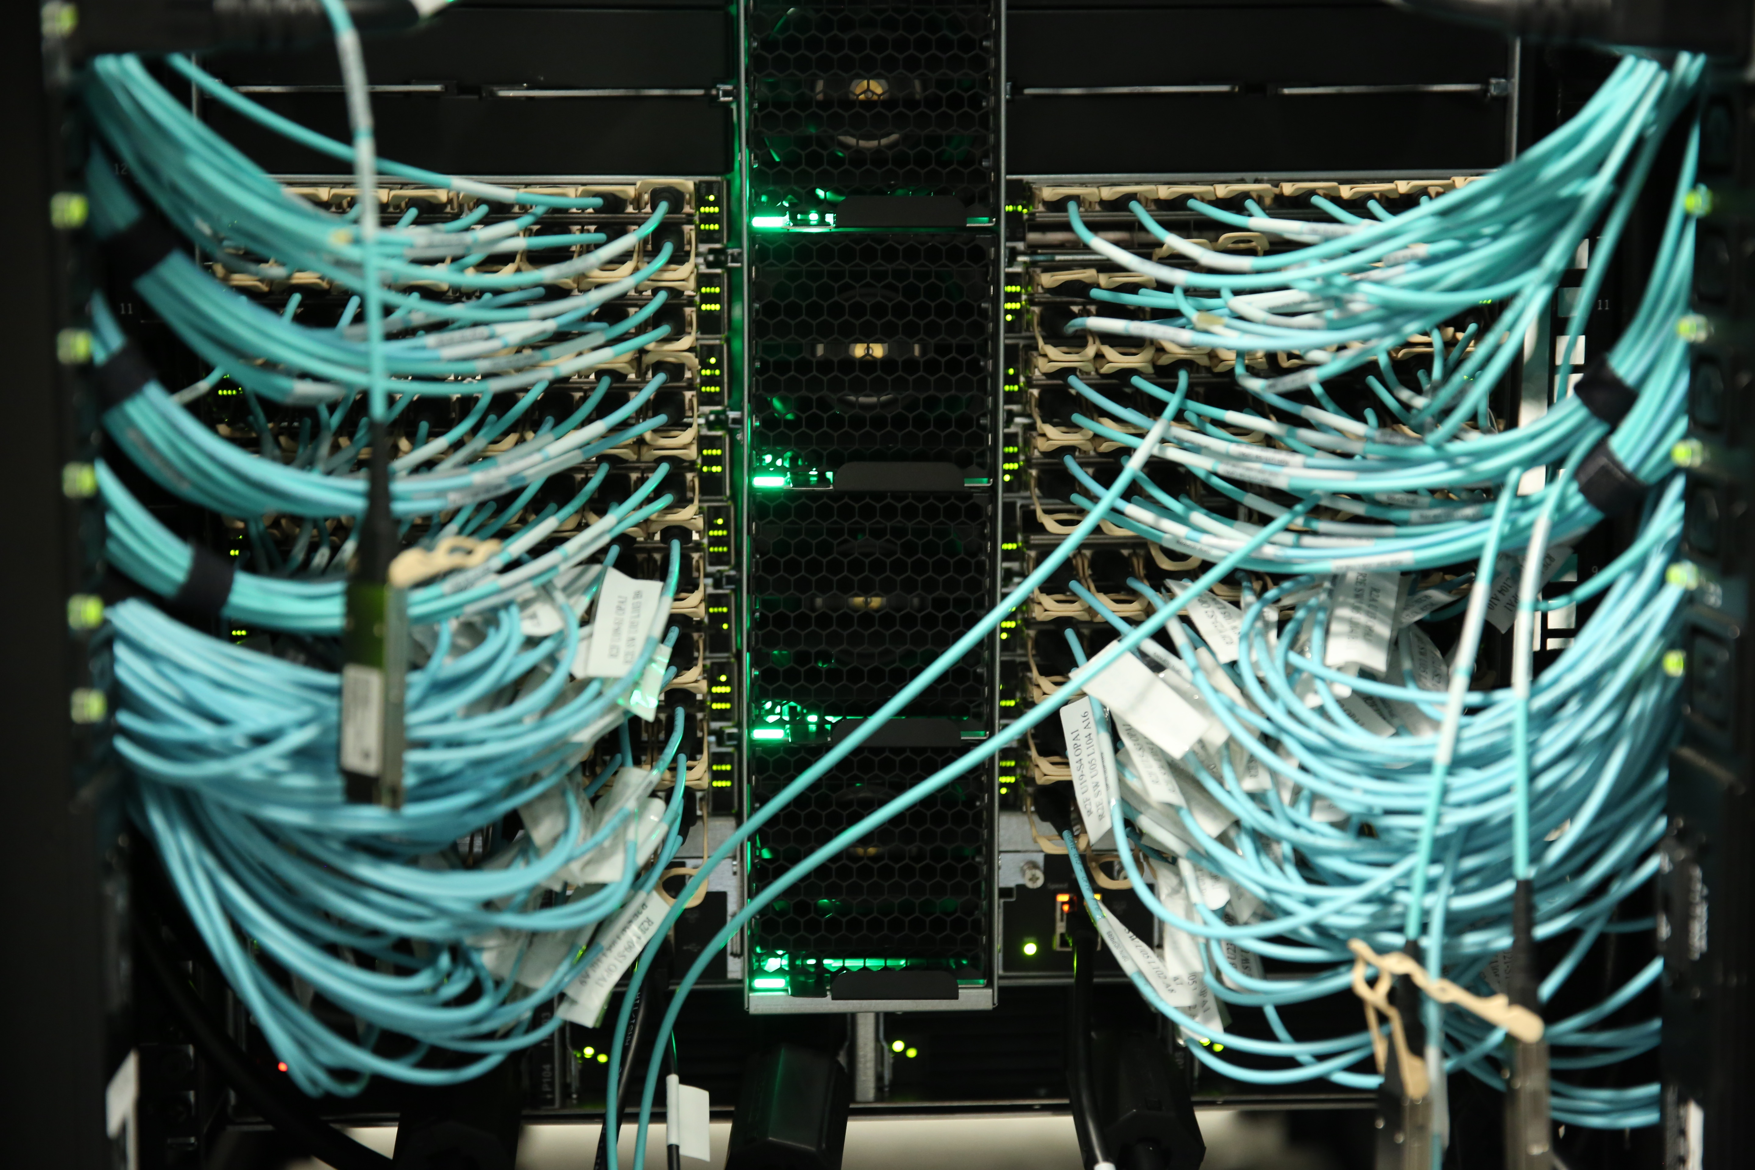
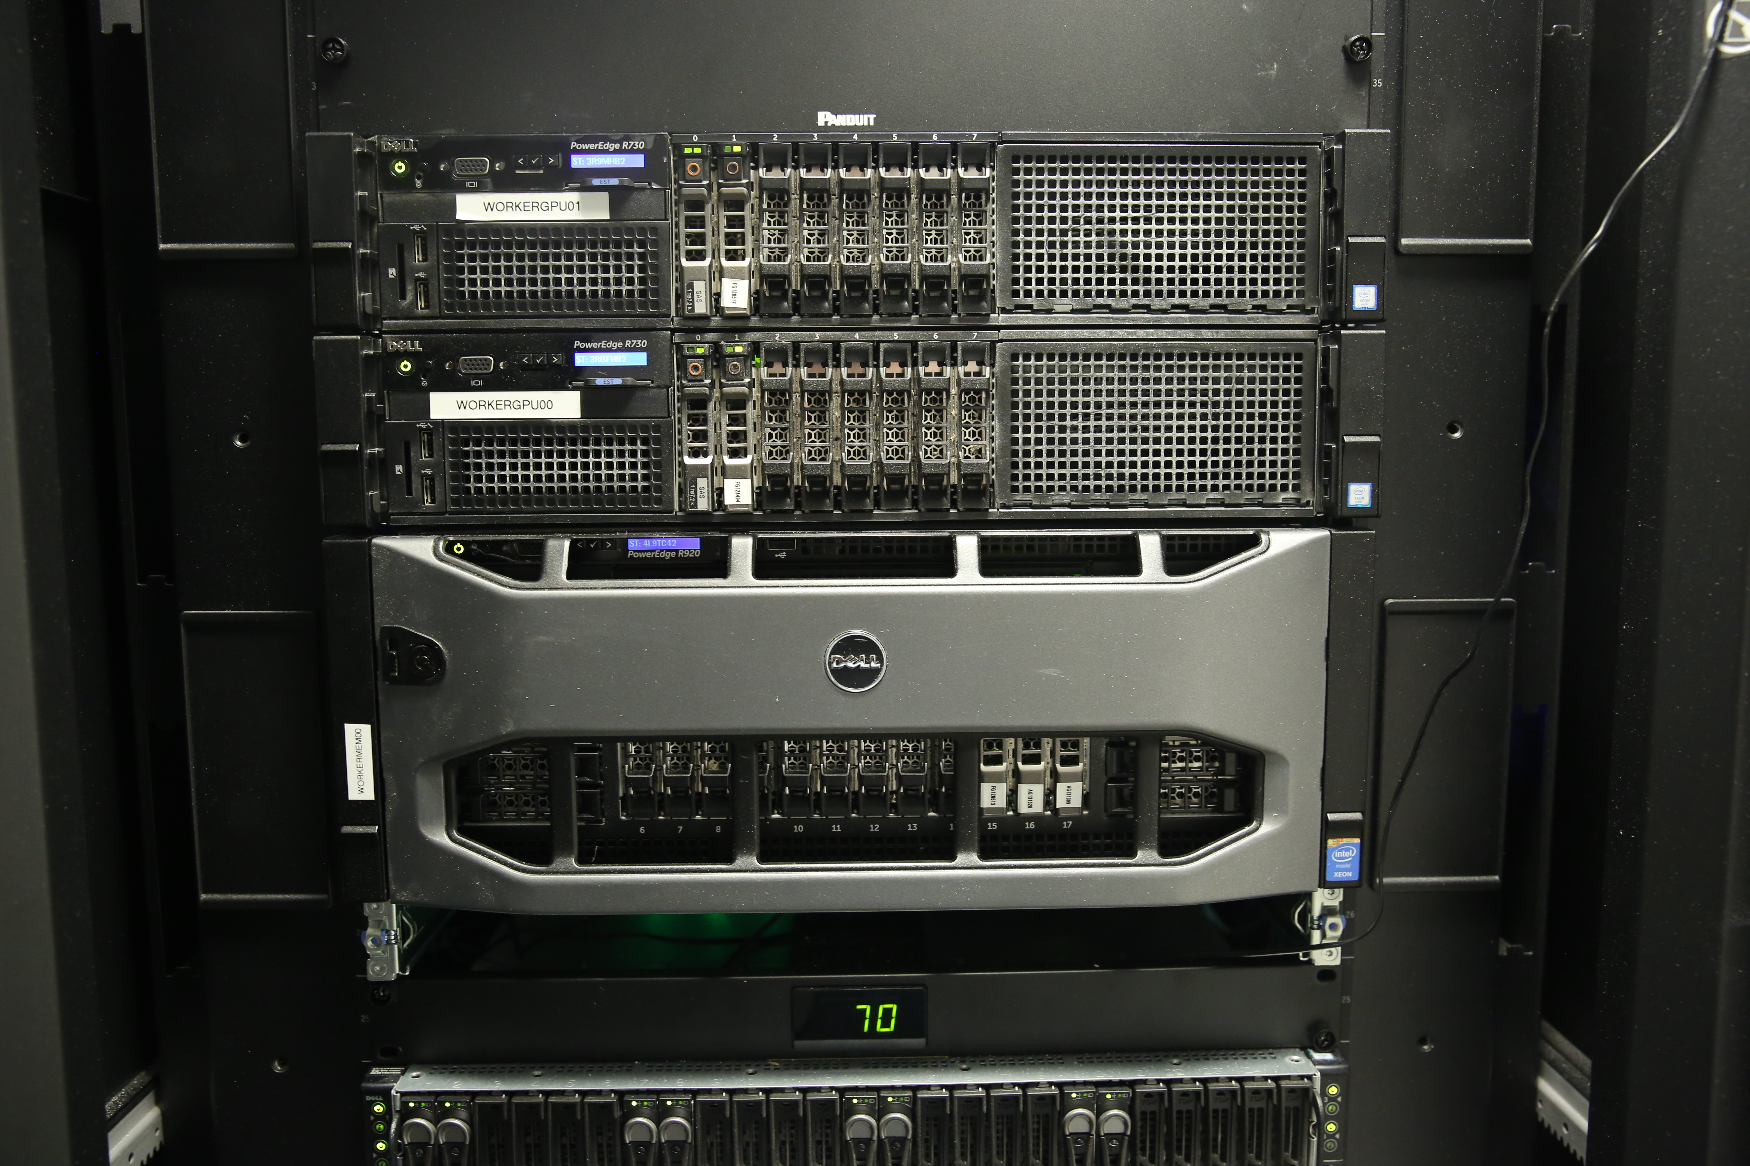
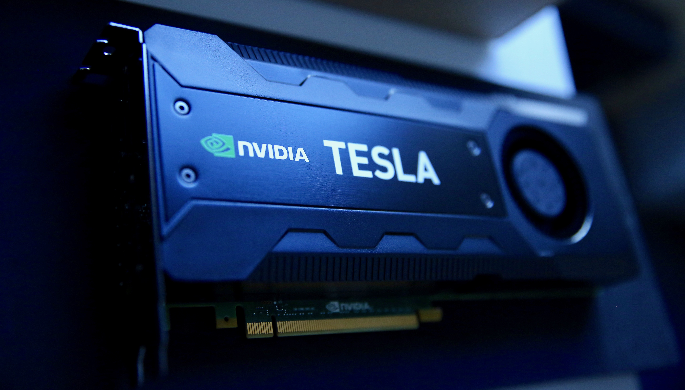
Computing Resources
Locally we have several processing resources in 7 SLURM partitions
The general queue on the Omnipath cluster which is nodes per person (~100 cores). No time limits.
Each center has a Partition for it’s members. 20 nodes each person and a maximum of 120 nodes per center. 7 day time limit (cca, ccb, ccq)
The Infiniband Partition with 48 nodes and anyone can take all of them (ib)
A preempt queue on Omnipath. Any person can take as much as they want but other work kicks out the jobs. Good for checkpointable things (preempt)
A GPU queue with nodes with 2 GPUs each: 3 nodes Tesla K40 GPUs (gpu). 5 Pascals. 5 Dual Voltas, 6 Quad Voltas with NVLink
A mem queue with access to one machine with 1.5TB of RAM. Matlab installed (mem)
A bnl queue that goes to BNL. Each user can have 10 machines for 10 days

Slide 7
Storage Resources
250TB of GPFS space for home directories
Incremental back-up and RAID6
Code should live here. If any one person write more than a couple of TB, we will ask if it can live in the volumes intended for data
~6PB of usable space in cephfs (3 copies for redundancy)
Data lives here
If there is anything you need to keep, but you don’t expect to access we have tape archiving resources offsite
1PB of space in GPFS at BNL (underlying storage is RAID6)
Both CEPH and GPFS have reasonable performance and reliability
Both work better in the respective locations

Slide 8
Configuration
All the Linux systems are configured with Puppet
We are nearly entirely CentOS 7.4 for workers and desktops
If you need a package, please ask. Just takes a few minutes
Modern software environment mostly deployed through modules
module avail
Same environment on desktops and clusters
All home directories are central and anyone can log into most systems
Please make a SLURM allocation if you want a resource so that it’s yours
By keeping the configuration in Puppet and the user info in central file systems we can change out hardware transparently when needed

Slide 9
Gordon
Gordon is an aging super computer at SDSC
Accessible by connecting to
voms locally and then
ssh gordon.sdsc.edu
Also uses slurm
Also uses modules
There is 4PB of Lustre file store
scp and GridFTP can be used to replicate files

Slide 10
Connecting
We support two forms of external connections
The is VPN based on your cluster password
There is also an ssh port that uses 2 factor authentication
Instructions are on the TWIKI for both
Set up google authenticator
Please VPN from your Simons issued laptop
There are a variety of wireless domains
FI can connect to the central systems
The guest network is the only one guests should be given the access code to
Each of your desks had a port on the guest Wired network, which is for visitors and personal equipment needing a wired connection

Slide 11
Moving DATA AROUND
Small quantities of data can be sent with scp and two factor authentication
Data export can be done with a web interface
Large quantities of data can be moved around with gridftp and globus only
Documentation for how to do this is on the docs.simonsfoundation.org instructions

Slide 12
In General
If you need something please ask
You have a keyboard you particularly like
You need more memory
Your application is slow
You need a specific piece of hardware
Etc.

