Slide 1
Learning to Cooperate and Compete in Diplomacy
Noam Brown

Slide 2
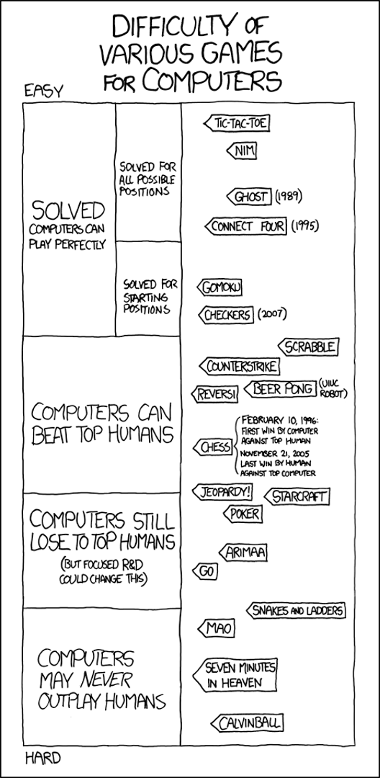

Slide 3
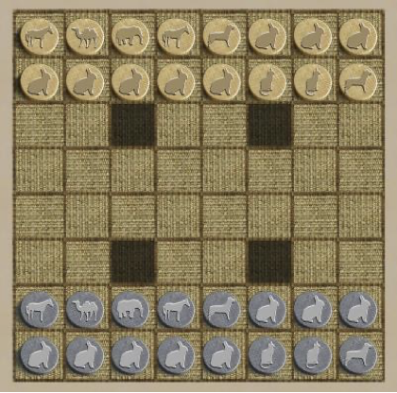
2015

Slide 4
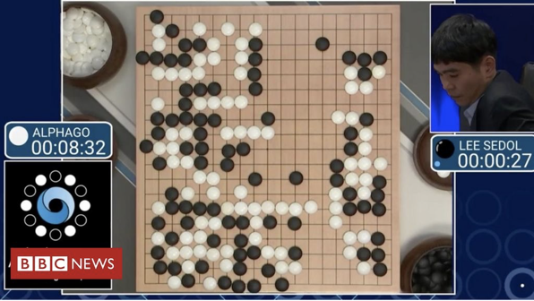
2015
2016

Slide 5

2017/2019
2015
2016

Slide 6
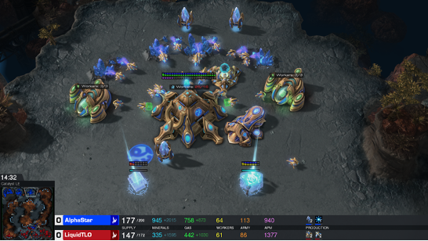
2019
2017/2019
2015
2016

Slide 7
What’s next?
Hanabi?
  February 2019: DeepMind publishes “The Hanabi Challenge: A New Frontier for AI Research” [Bard et al. AI Journal-20]
  December 2019: FAIR publishes a paper showing superhuman performance in self-play Hanabi [Lerer, Hu, Foerster, Brown AAAI-20]
Mahjong?
  April 2020: MSR Asia publishes “Suphx: Mastering Mahjong with Deep Reinforcement Learning” [Li et al. arXiv-20]
First-Person Shooters?
  Counter-Strike bots have been superhuman since 1999
  (Bots are very good at precision)

Slide 8
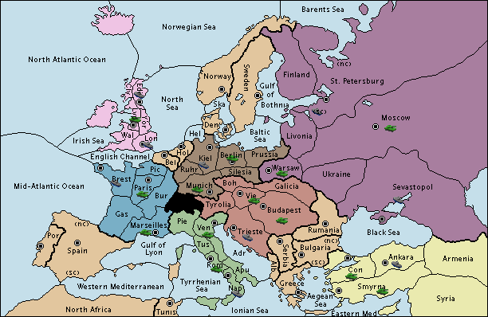
Why Diplomacy?
7 players
Combinatorial action space
Simultaneous moves (imperfect info)
Popular among humans
Support is key!
Actions coordinated via private natural language

Slide 9
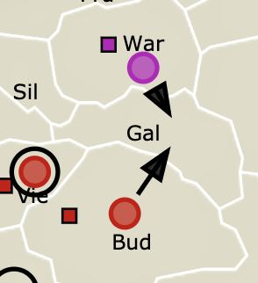
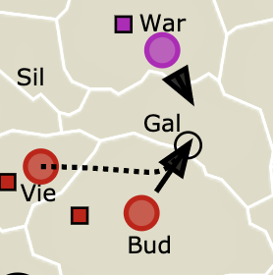
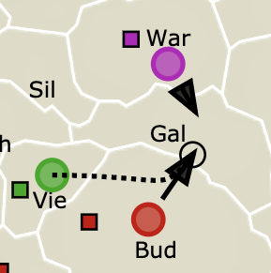
Why Diplomacy?
1v1
FAILS
2v1
SUCCEEDS
2v1
SUCCEEDS
7 players
Combinatorial action space
Simultaneous moves (imperfect info)
Popular among humans
Support is key!
Actions coordinated via private natural language

Slide 10
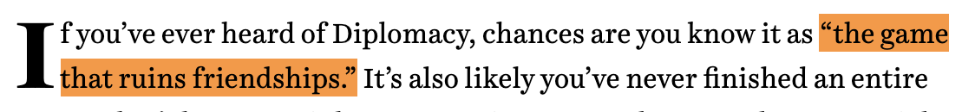


Why Diplomacy?

Slide 11
Why Diplomacy?
“Diplomacy is ultimately about building trust in an environment that encourages you to not trust anyone.”
-Andrew Goff
3-Time Diplomacy World Champion
Notes:
Now based on that description you might think Diplomacy sounds like a pretty evil game filled with backstabbing and betrayal. But if you talk to top Diplomacy players they see it very differently. They will tell you that Diplomacy is ultimately a game about building trust in an environment that encourages players to not trust anyone.
And that’s why we think Diplomacy is an important problem to work on. Building a bot that can win at Diplomacy means building a bot that can establish trust with humans in a challenging environment. But in order to build trust effectively we need to understand that a person might lie to us, and we need to understand that the other person might suspect we’re lying to them. So overcoming that mistrust is the real challenge of Diplomacy.

Slide 12
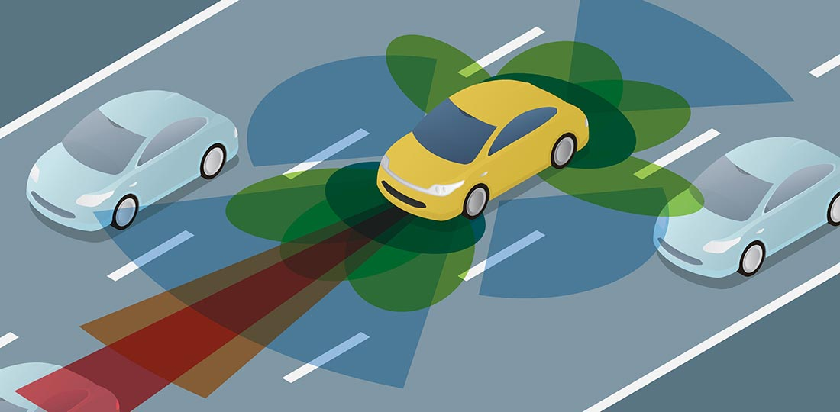
“Gunboat” (No Language) Diplomacy
Coordination and alliances still a big factor!
Self play is not enough!
[Bakhtin, Wu, Lerer, Brown NeurIPS-2021]
Need to understand the “human” equilibrium
Humans aren’t always rational
Is game theory even useful here?
We show that assuming some rationality leads
to better performance against real humans
Notes:
Now we recognize that what we’re proposing is a huge challenge, so we set up a number of milestones for ourselves. The first one was to develop a human-level bot for the “gunboat” version of the game where players cannot send messages to each other. This version of the game is obviously much simpler, but is still widely played and has a number of difficult challenges.
There have actually been a few papers from other labs on gunboat Diplomacy but none of them have reached human-level performance. But I’m happy to say that we have a paper under review now at ICLR on a bot we made for gunboat Diplomacy that reaches human-level performance for the first time. I’ll spend a little time discussing how we achieved this.
%Even though players can’t send natural language messages to each other, they can still communicate implicitly through their moves. For example, if I move my units away from your border then I’m implicitly signaling to you that I’d like to establish an alliance. The game also has a huge action space that’s orders of magnitude bigger than Go, and because everyone’s moves are simultaneous you need to have mixed strategies in order to be unpredictable.

Slide 13
Prior Work: Before Deep Learning
Long-standing challenge problem with decades of research
Kraus & Lehmann IEEE-1988
Kraus et al. JETAI-1995
Johansson & Håård AAMAS-2005
Ferreira et al. ICAART-2015
Past approaches took a relatively heuristic approach

Slide 14
Prior Work: Supervised Learning on Human Data [Paquette et al. NeurIPS-2019] (MILA)
Supervised learning on ~5 million state-action pairs, filtered by player rating (thanks to webdiplomacy.net !!)
First good Diplomacy bot! (Called DipNet)
Average human level
Very exploitable
Current State
GCN Encoder
Location Embeddings
LSTM Decoder
France Orders
Previous Orders

Slide 15
Prior Work: Supervised + Reinforcement Learning
[Anthony*, Eccles*, et al. NeurIPS-2020] (DeepMind)
Initialize policy with supervised learning
Do policy iteration for one player each iteration, playing against opponents’ average policy (equivalent to fictitious play)
1 RL agent vs. 6 DipNets scores ~20% (14.3% would be tying)
1 DipNet vs 6 RL agents scores ~0.8%

Slide 16
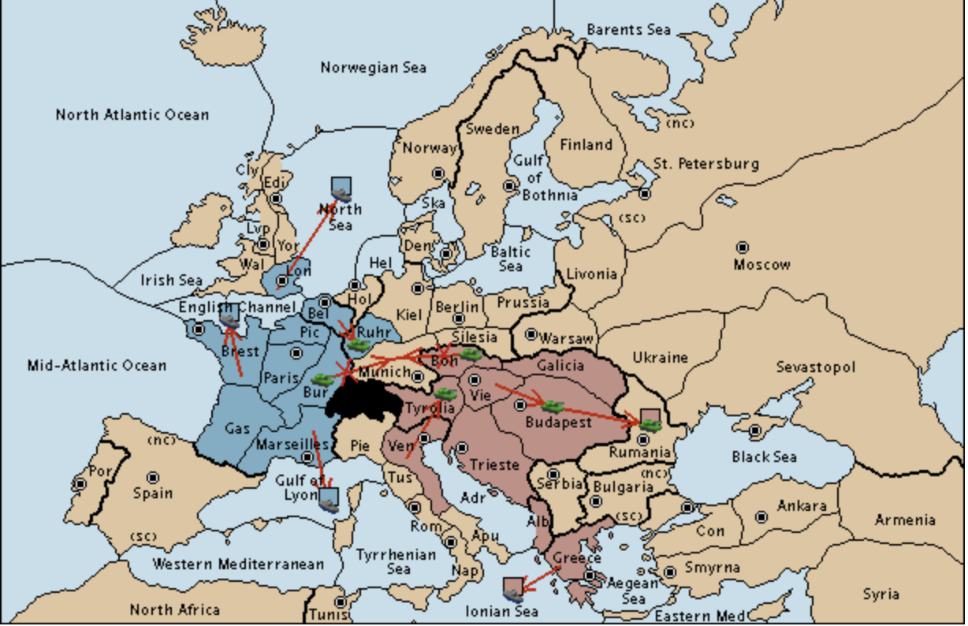
Our work: Supervised Learning + Equilibrium Search [Gray*, Lerer*, Bakhtin, Brown ICLR-2021] (FAIR)
Train value function V_{θ}(s) on human data
On each turn:
  Construct a matrix game using V_{θ}
  Solve the matrix game via regret minimization
  Sample an action from our part of the equilibrium
 | a¹ | a² | a³ | a⁴ | a⁵ | a⁶ | ...
a¹
a²
a³
...
V_{θ}(a,a)

Slide 17


Nash Equilibrium
Nash Equilibrium: a set of strategies in which no player can improve by deviating
In two-player zero-sum games, playing a Nash equilibrium ensures you will not lose in expectation
Exploitability: How much we’d lose to a best response
 | Round 1 | Round 2 | Round 3
Us
Best Response
Our Exploitability = 1

Slide 18
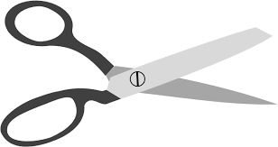
Nash Equilibrium
Nash Equilibrium: a set of strategies in which no player can improve by deviating
In two-player zero-sum games, playing a Nash equilibrium ensures you will not lose in expectation
Exploitability: How much we’d lose to a best response
 | Round 1 | Round 2 | Round 3
Us
Best Response
Our Exploitability = 1

Slide 19
Nash Equilibrium
Nash Equilibrium: a set of strategies in which no player can improve by deviating
In two-player zero-sum games, playing a Nash equilibrium ensures you will not lose in expectation
Exploitability: How much we’d lose to a best response
Critical assumption: Our strategy is common knowledge, but the outcomes of random processes are not common knowledge

Slide 20


Nash Equilibrium
Nash Equilibrium: a set of strategies in which no player can improve by deviating
In two-player zero-sum games, playing a Nash equilibrium ensures you will not lose in expectation
Exploitability: How much we’d lose to a best response
 | Round 1 | Round 2 | Round 3
Us
Best Response
Our Exploitability = 0

Slide 21
Nash Equilibrium
“Poker is simple, as your opponents make mistakes, you profit.”
-Ryan Fee’s Poker Strategy Guide
 | Round 1 | Round 2 | Round 3
Us
Best Response
Our Exploitability = 0

Slide 22
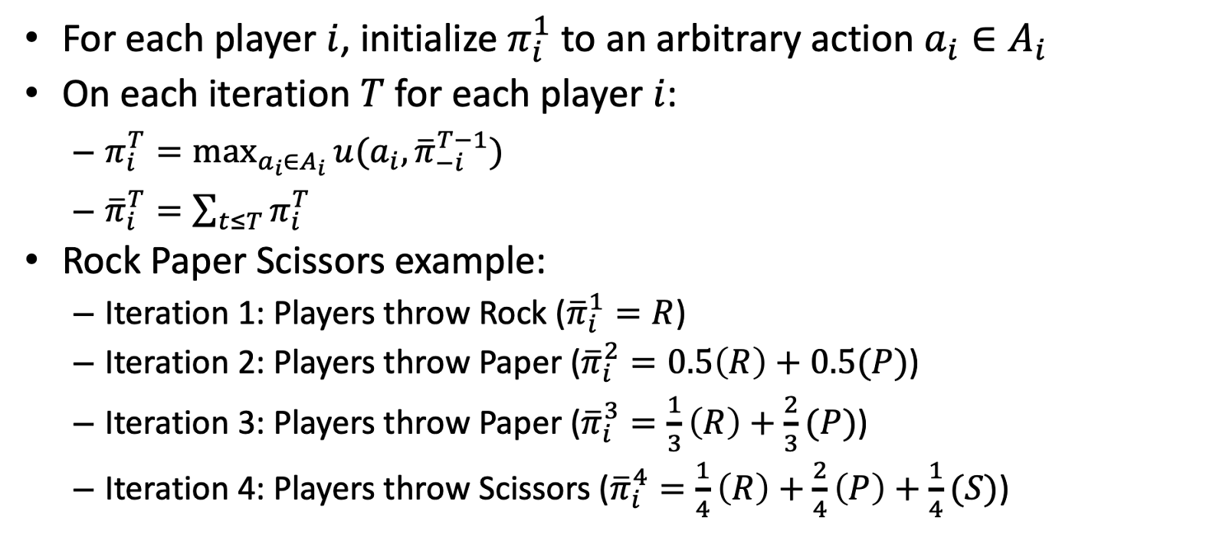
Fictitious Play

Slide 23
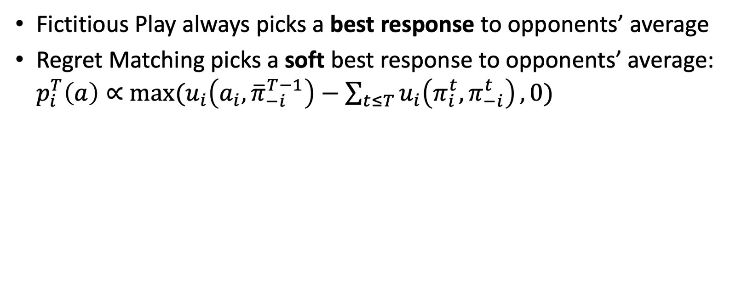
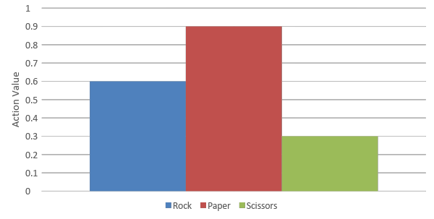


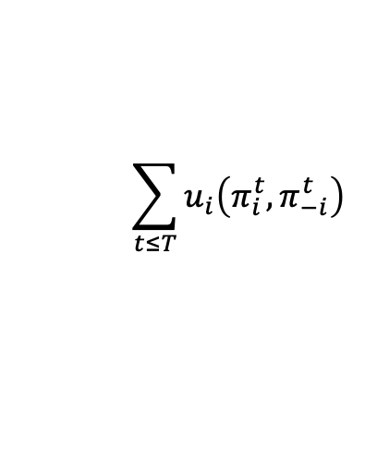
Regret Matching

Slide 24
Our work: Supervised Learning + Equilibrium Search [Gray*, Lerer*, Bakhtin, Brown ICLR-2021] (FAIR)
Train value function V_{θ}(s) on human data
On each turn:
  Construct a matrix game using V_{θ}
  Solve the matrix game via regret matching
  Sample an action from our part of the equilibrium
 | a¹ | a² | a³ | a⁴ | a⁵ | a⁶ | ...
a¹
a²
a³
...
V_{θ}(a,a)

Slide 25
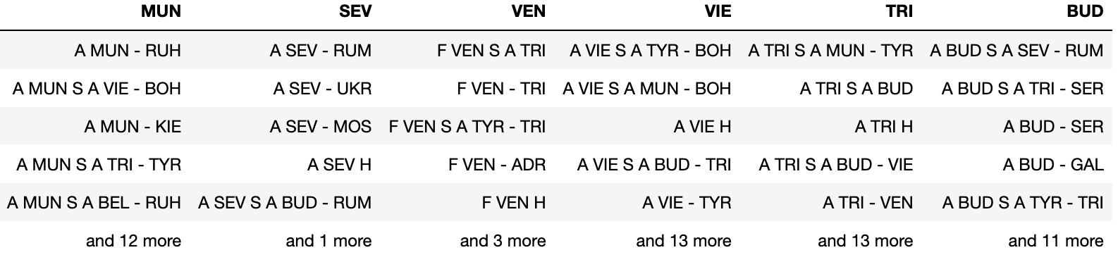
Problem: Combinatorial action space in Diplomacy
Commonly up to 10^20 actions!

Slide 26
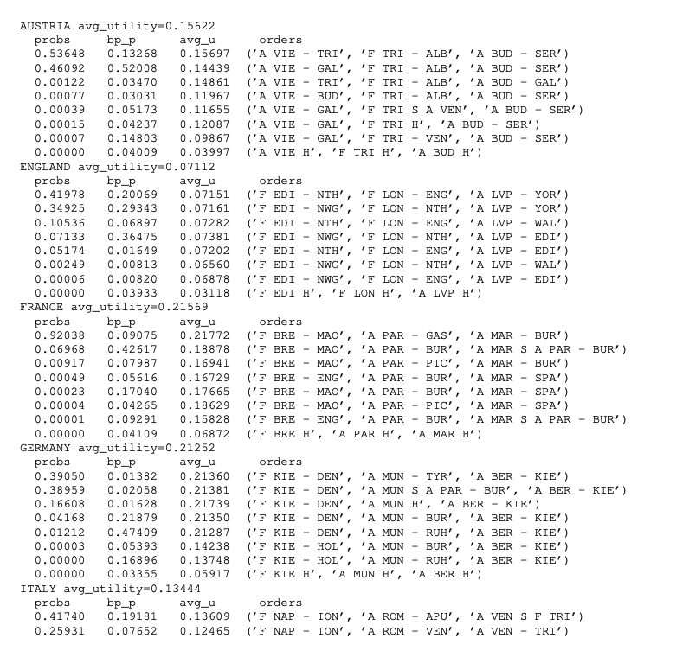
Use neural net to:
Choose top-k actions for each power to search over
Use neural net to:
Predict utility of actions for all players
Use regret matching to:
Compute equilibrium distribution over actions

Slide 27
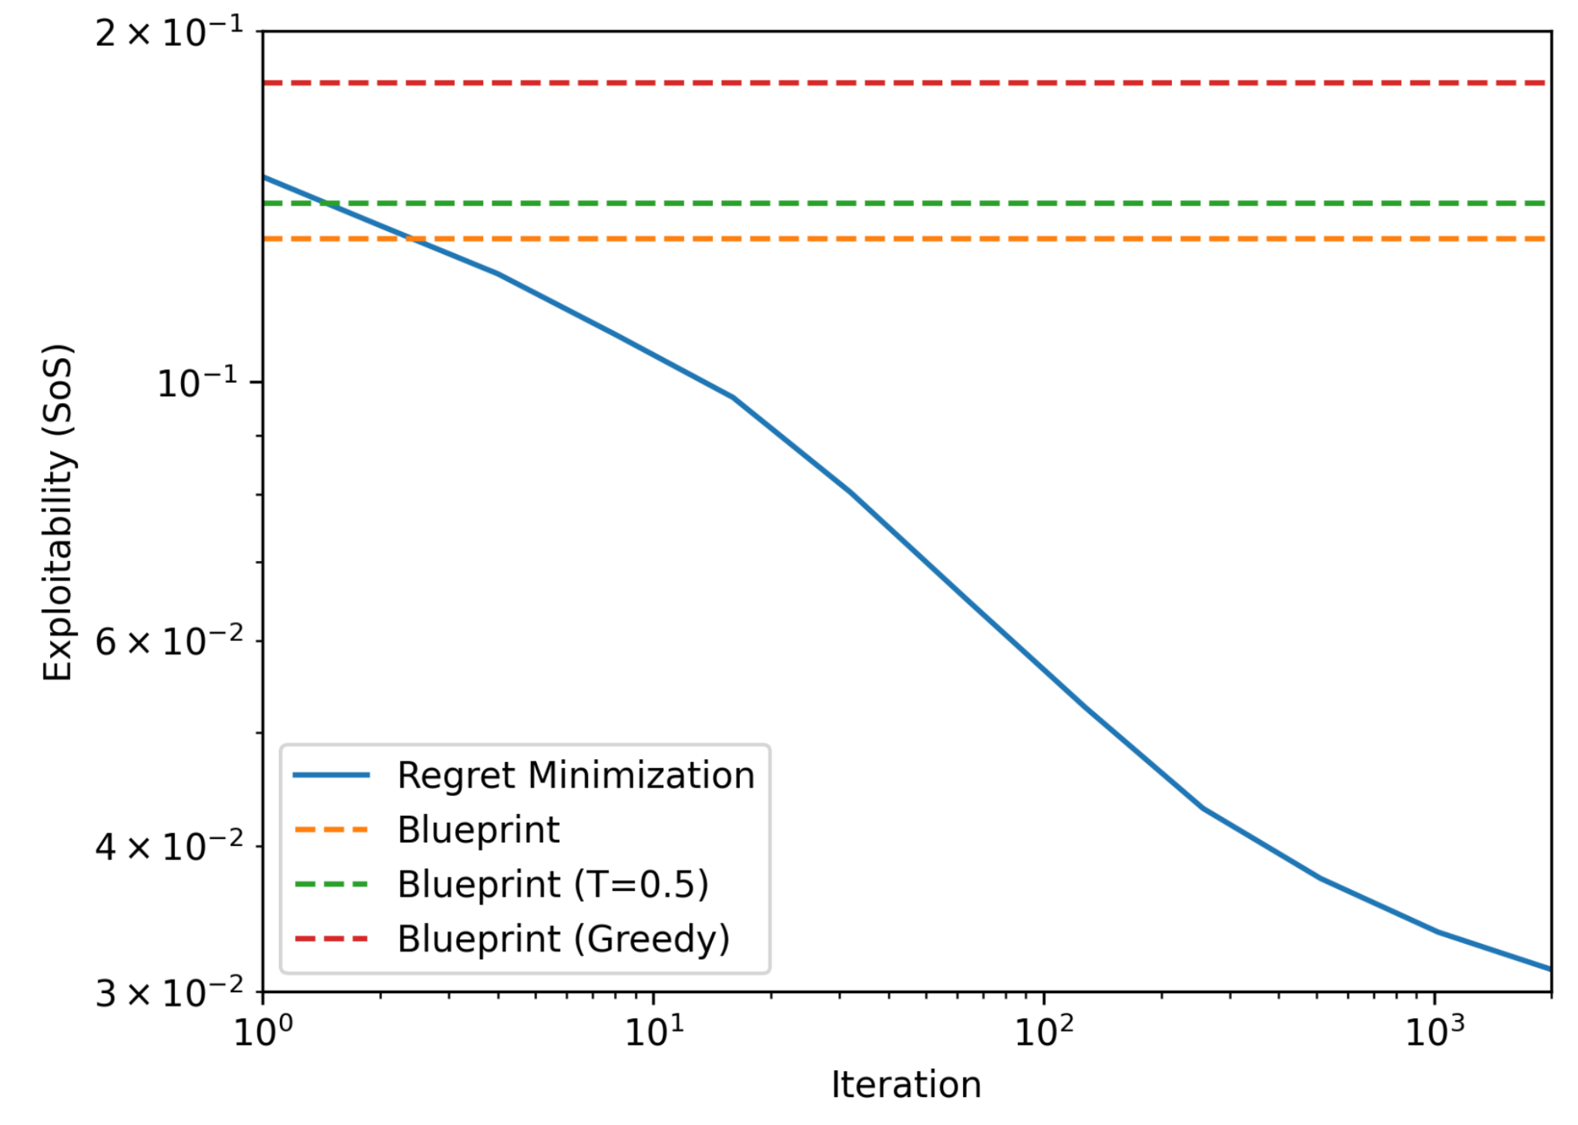
Empirical Convergence of Regret Matching to Nash

Slide 28
Three Types of Evaluation
Anonymous games against humans on webdiplomacy.net
Performance against prior bots
Repeated games against expert humans

Slide 29
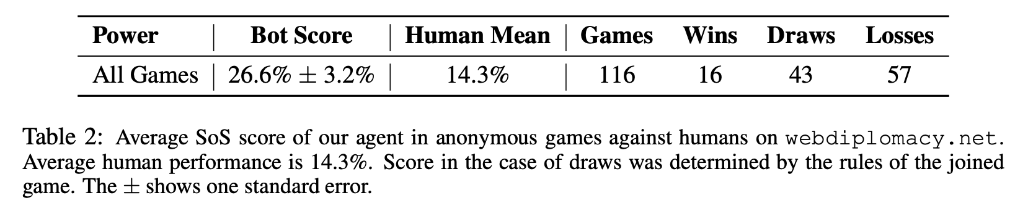
Evaluation: against humans on webdiplomacy.net
Ghost rating (like Elo): top 2%
Very good, but not superhuman

Slide 30
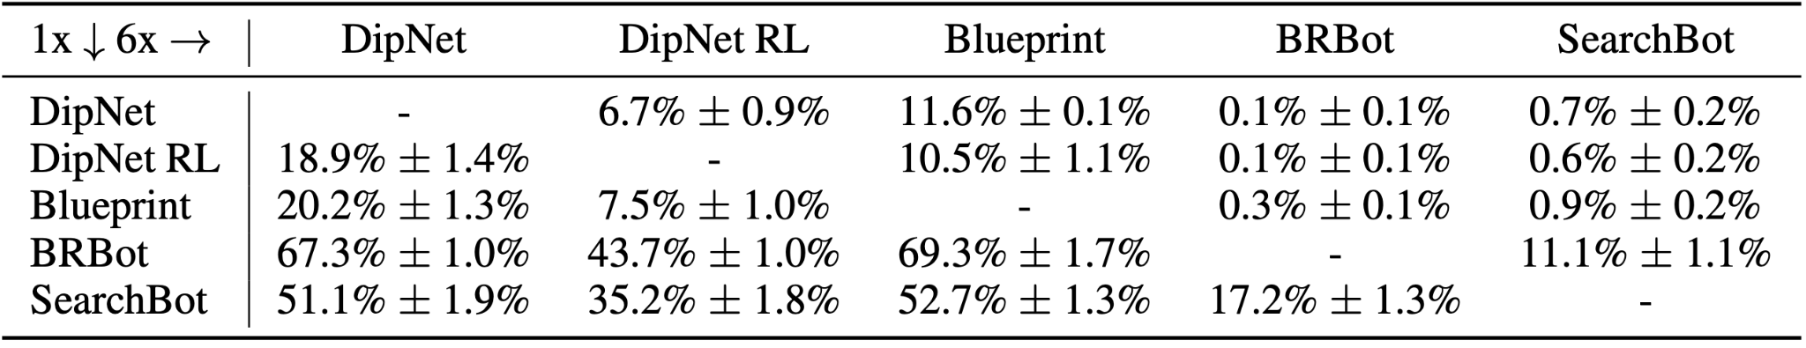
Evaluation: against Dipnet

Slide 31
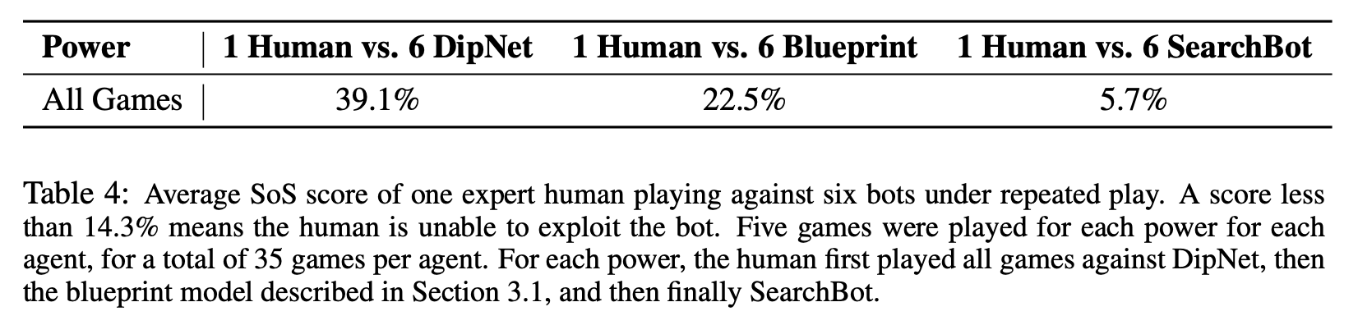
Evaluation: against expert humans
Expert humans unable to exploit SearchBot

Slide 32
Takeaways
Regret matching works well despite not being two-player zero-sum
Top 2% of players on webdiplomacy.net: strong human level but far from superhuman

Slide 33
Going further
Natural follow-up: can we iteratively improve via RL, AlphaZero-style?
Answer: It’s complicated.

Slide 34
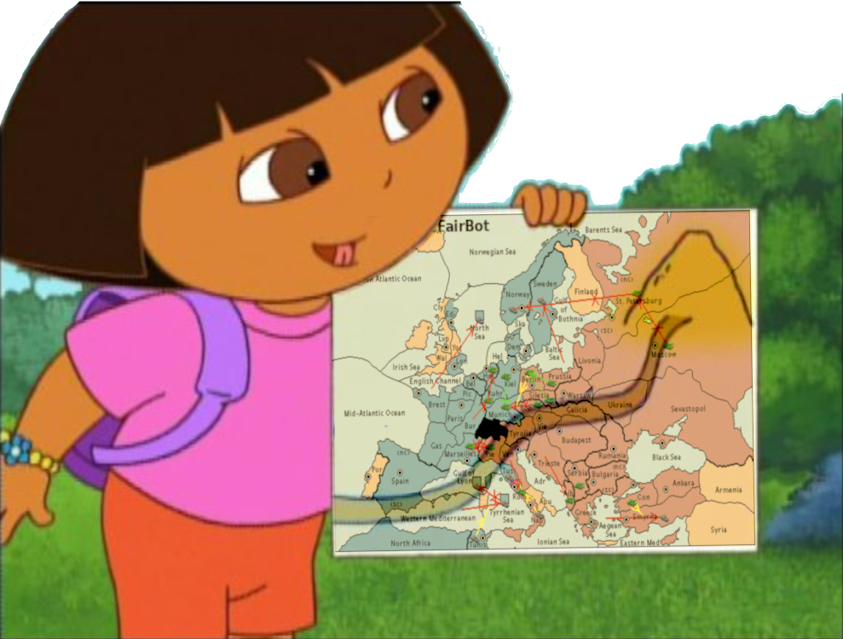
Our work: Double Oracle RL for Action exploration (DORA)
[Bakhtin, Wu, Lerer, Brown NeurIPS-2021] (FAIR)
DORA repeatedly plays the game similar to SearchBot
Update the value net after each game
Uses a novel double oracle algorithm
to explore the huge action space
Convergence guarantees for
two-player zero-sum games!

Slide 35
Results (1 vs 1 Diplomacy)
DORA vs Top humans. Those players were ranked 1st, 8th, 16th, 22nd, and 29th in 1v1 among all players
Win rate: 86.5% +- 6.1%

Slide 36
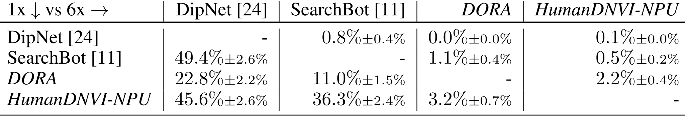
Results (7p)
The method could be extended to the 7-player game:
Notes:
Neither SearchBot nor DORA has an advantage when playing against a population of opponents. That suggests that they play according to different conventions.

Slide 37
Takeaways
DORA, trained from scratch, is superhuman in 1v1 Diplomacy
DORA doesn’t do as well when playing with 6 human-like bots
Strongly suggests that self play from scratch is insufficient in Diplomacy
  Need to understand the “human” equilibrium
  Self play initialized from human data diverges from human equilibrium

Slide 38



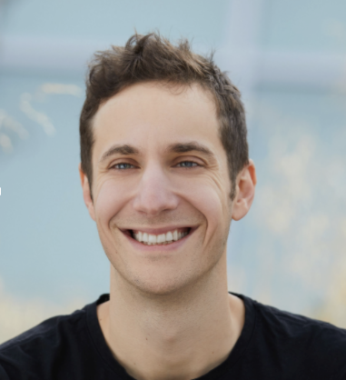

Our work: Building Strong and Human-Like Agents with KL-Regularized Search
Athul P. Jacob*
FAIR, MIT
David Wu*
FAIR
Gabriele Farina*
CMU
Adam Lerer
FAIR
Anton Bakhtin
FAIR
Jacob Andreas
MIT
Noam Brown
FAIR
*Equal Contribution

Slide 39
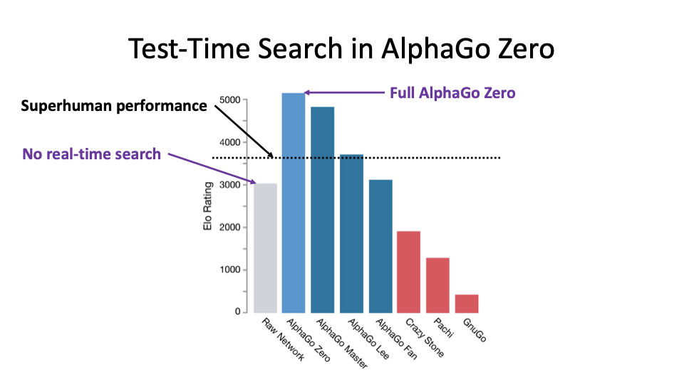

Slide 40
Training on Expert Human Data in Chess
MAIA [McIlroy-Young et al. KDD-20] is a chess bot trained on hundreds of millions of human chess games
Different models for different Elo ratings
Achieves SOTA accuracy in predicting human moves, including experts
For high-Elo models, MAIA is 100-300 Elo below the target Elo rating

Slide 41
Training on Expert Human Data in Chess
MAIA [McIlroy-Young et al. KDD-20] is a chess bot trained on hundreds of millions of human chess games
Different models for different Elo ratings
Achieves SOTA accuracy in predicting human moves, including experts
For high-Elo models, MAIA is 100-300 Elo below the target Elo rating
Hypothesis: approximating human planning is hard for neural nets

Slide 42
Training on Expert Human Data in Chess
MAIA [McIlroy-Young et al. KDD-20] is a chess bot trained on hundreds of millions of human chess games
Different models for different Elo ratings
Achieves SOTA accuracy in predicting human moves, including experts
For high-Elo models, MAIA is 100-300 Elo below the target Elo rating
Hypothesis: approximating human planning is hard for neural nets
There is one version of chess with no MAIA Elo gap: bullet chess

Slide 43
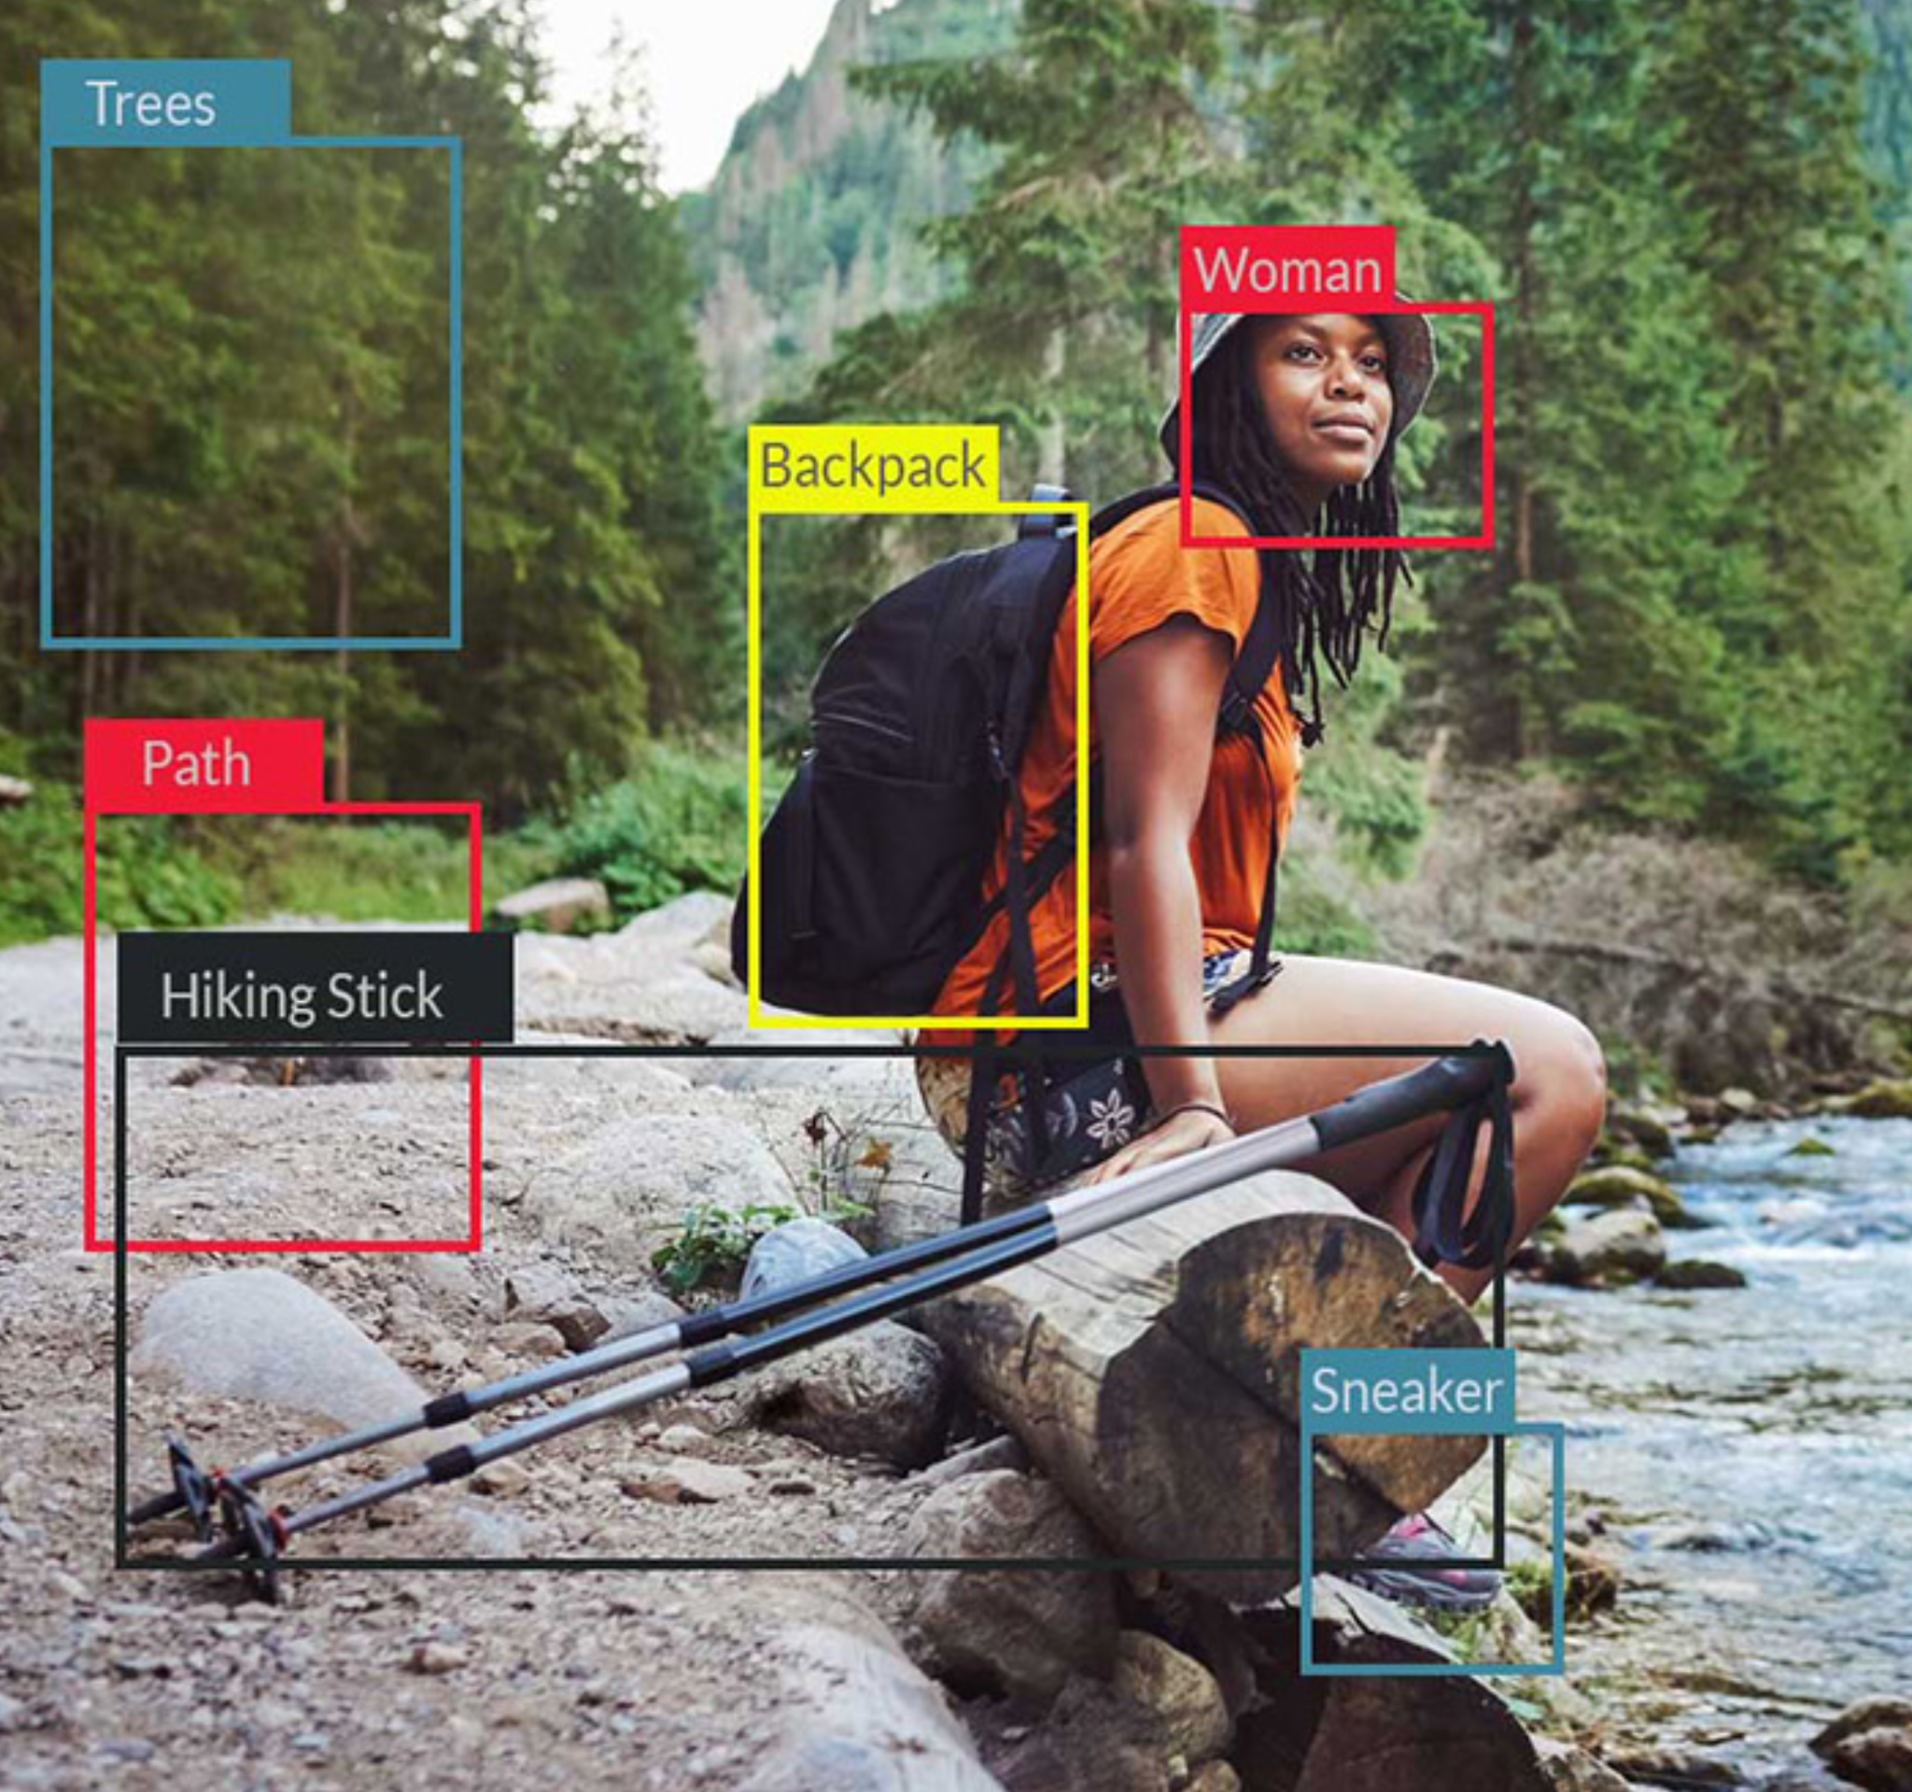
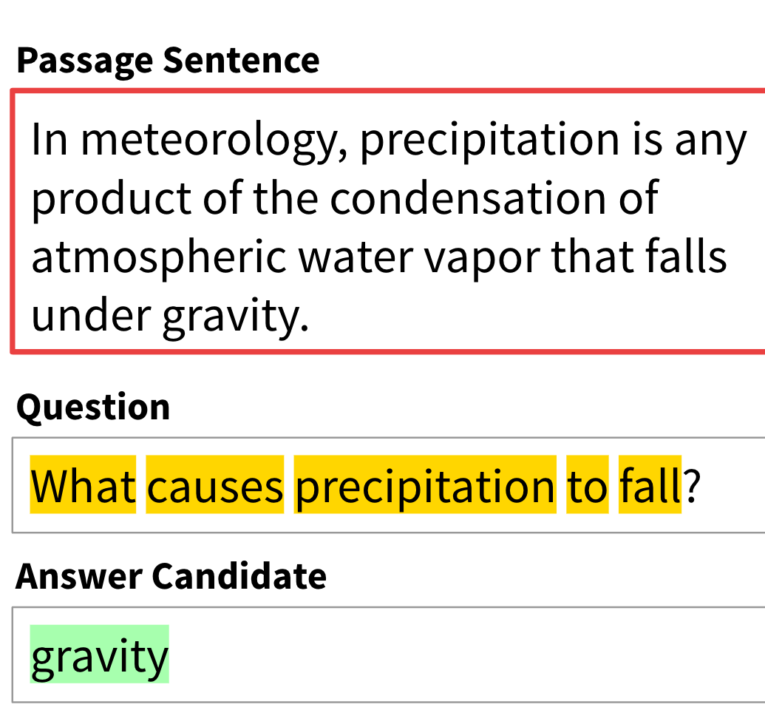

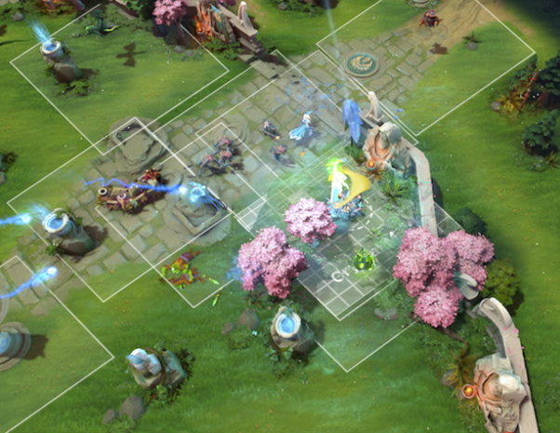

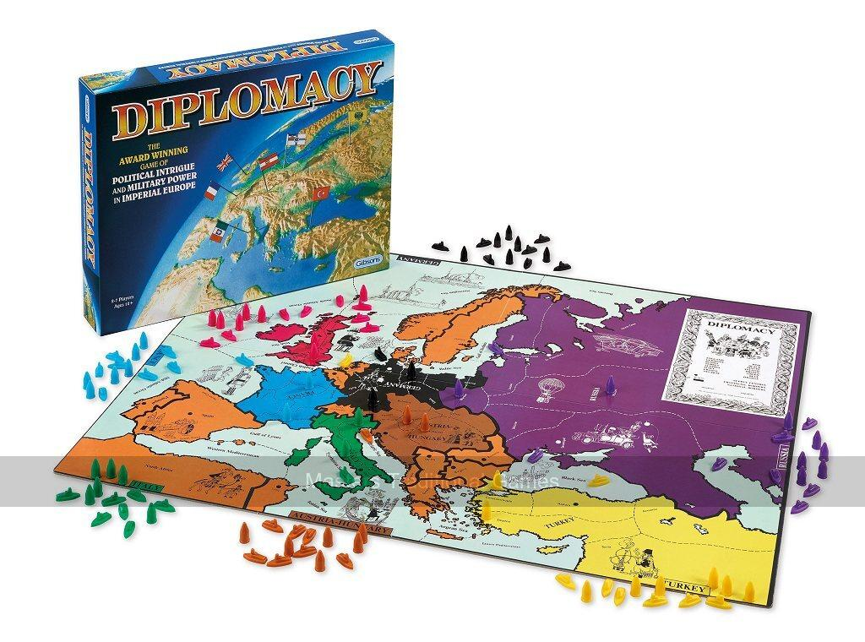
Intuition vs. Planning
Hypothesis: Search is more important for modeling human behavior in situations in which humans spend more time planning
More Intuition/Reflex
More Planning/Reasoning
Poker
Chess
Real-Time Games
Image Recognition
NLP
Diplomacy

Slide 44
Self-Play RL+Search vs. Supervised Learning
Supervised Learning on Human Data (DipNet)
High human prediction accuracy (53% top-1 accuracy for DipNet)
Mediocre performance
Self-Play RL+Search (AlphaZero, DORA)
Very strong
Very inhuman (41% top-1 accuracy for SearchBot, 44% for HumanDNVI, 36% for DORA)

Slide 45
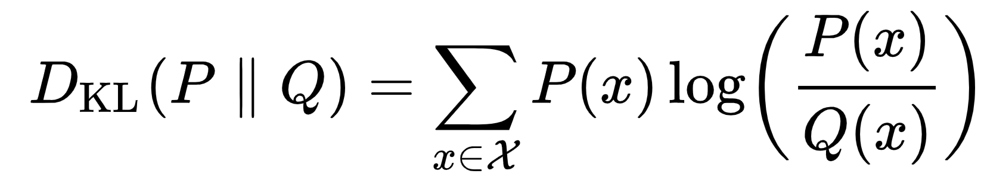
KL-Regularized Search in Perfect-Information Games
Idea: regularize search with a penalty based on KL-divergence from human supervised learning (anchor) policy
A parameter λ controls the magnitude of the penalty
This is implicitly what MCTS already does! [Grill et al. ICML-2020]
Has also been widely used in RL (e.g., AlphaStar [Vinyals et al. Nature-2019])
Our policy
Anchor policy

Slide 46
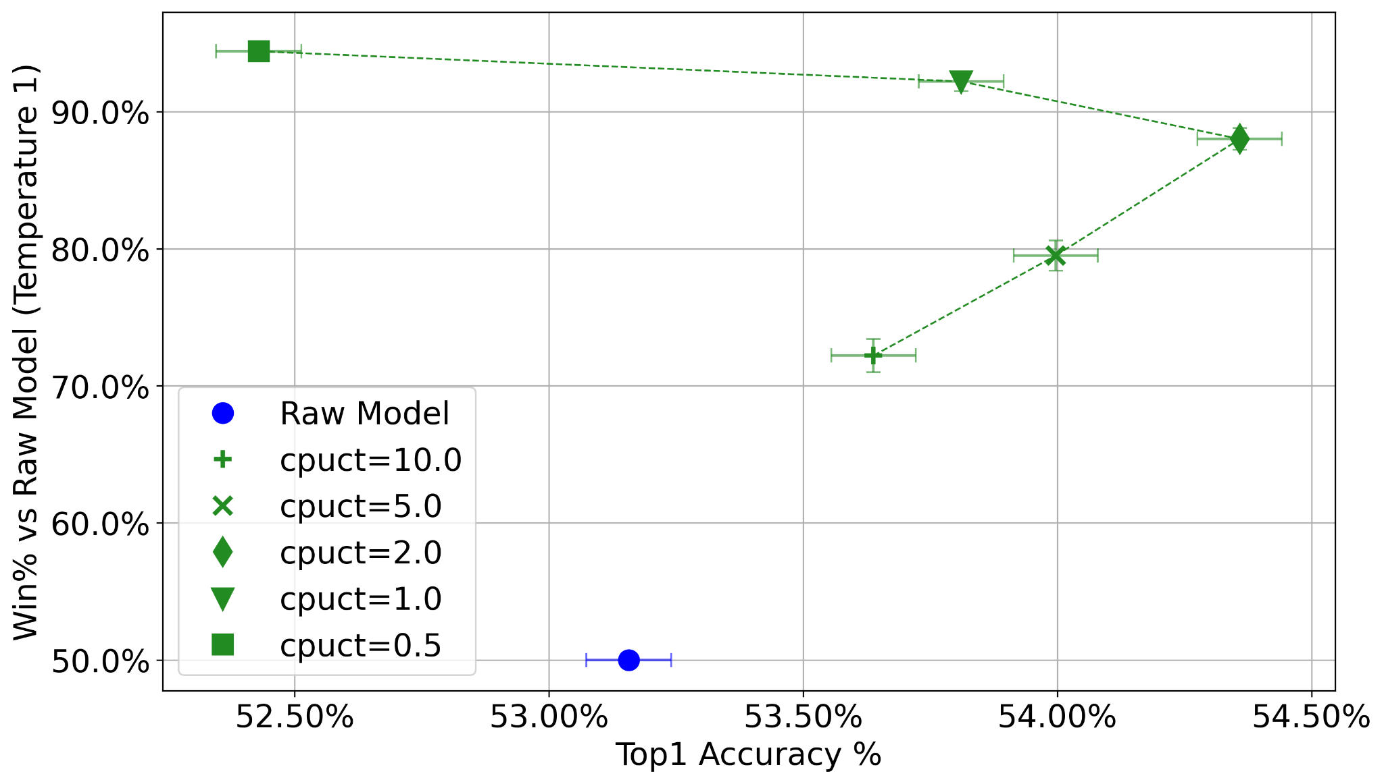
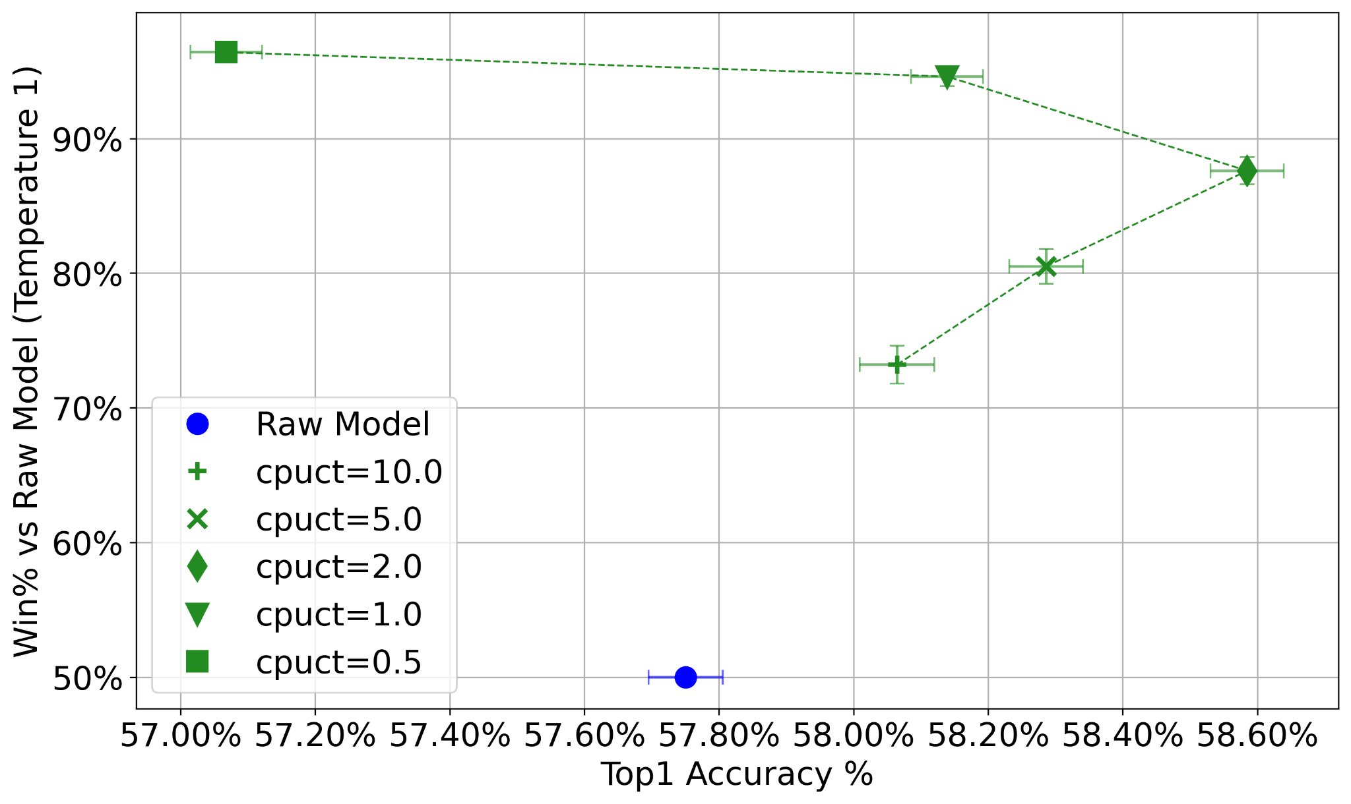
KL-Regularized Search in Perfect-Information Games
Idea: regularize search with a penalty based on KL-divergence from human supervised learning (anchor) policy
Chess
Go

Slide 47
KL-Regularized Search in Imperfect-Info Games
Idea: regularize search with a penalty based on KL-divergence from human SL (anchor) policy
Regret matching formula is P(i)∝Σmax(R_{i} , 0)
  Many actions have zero probability
Replace with hedge: P(i)∝exp(ηR_{i}) where η is a temperature parameter
  No action ever has zero probability

Slide 48
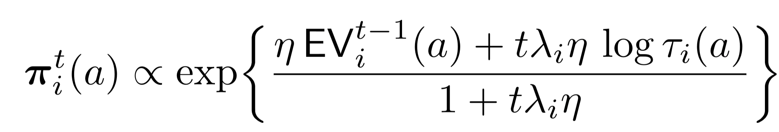
KL-Regularized Search in Imperfect-Info Games
Idea: regularize search with a penalty based on KL-divergence from human SL (anchor) policy
piKL-Hedge: Hedge regret minimization algorithm with a KL-divergence penalty

Slide 49
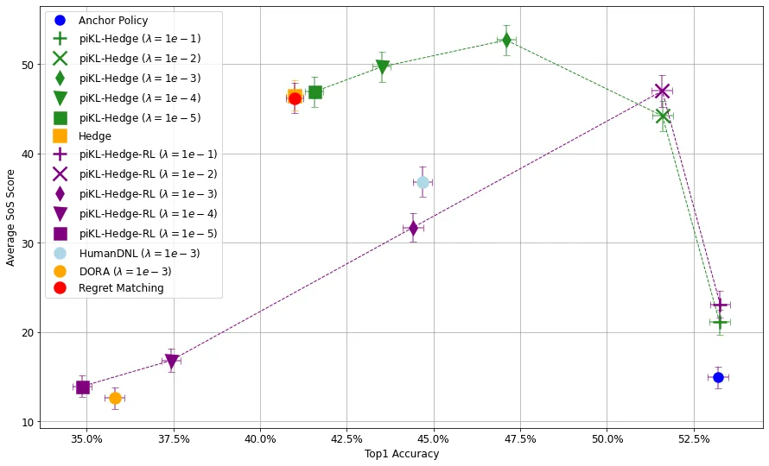
KL-Regularized Search in Imperfect-Info Games

Slide 50
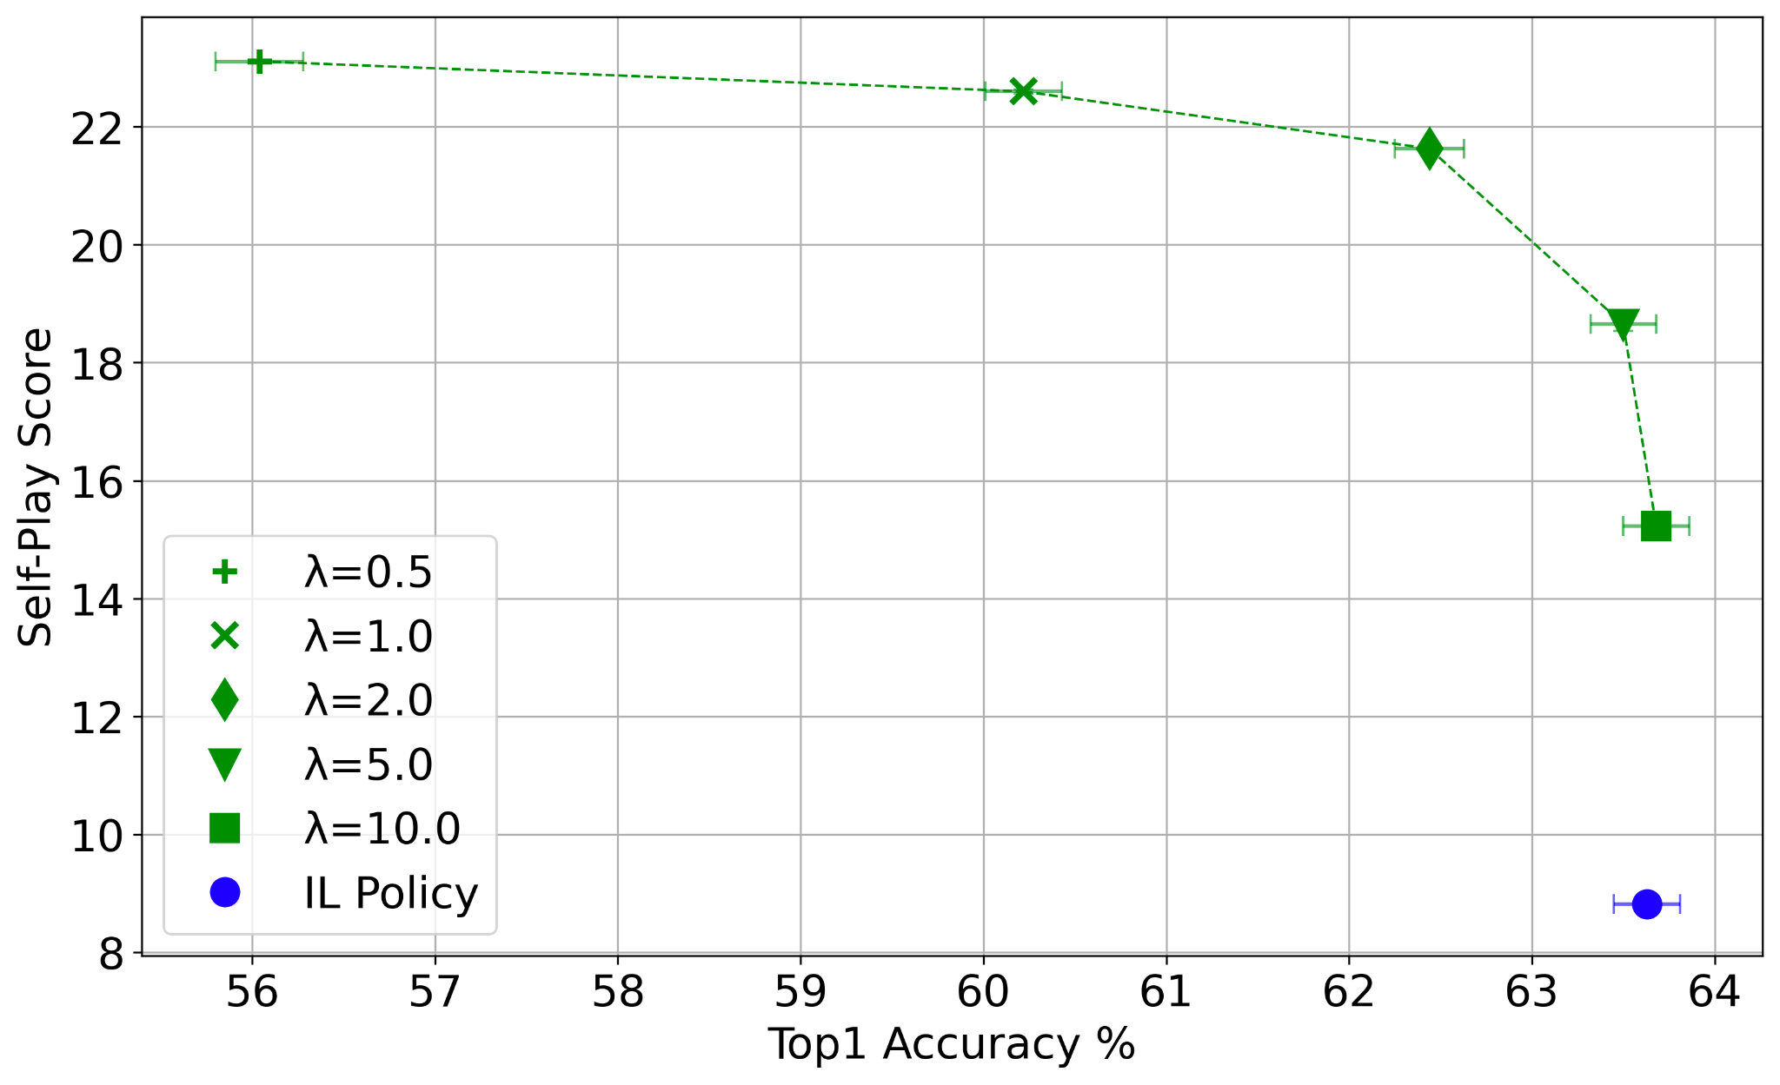
KL-Regularized Search in Hanabi

Slide 51
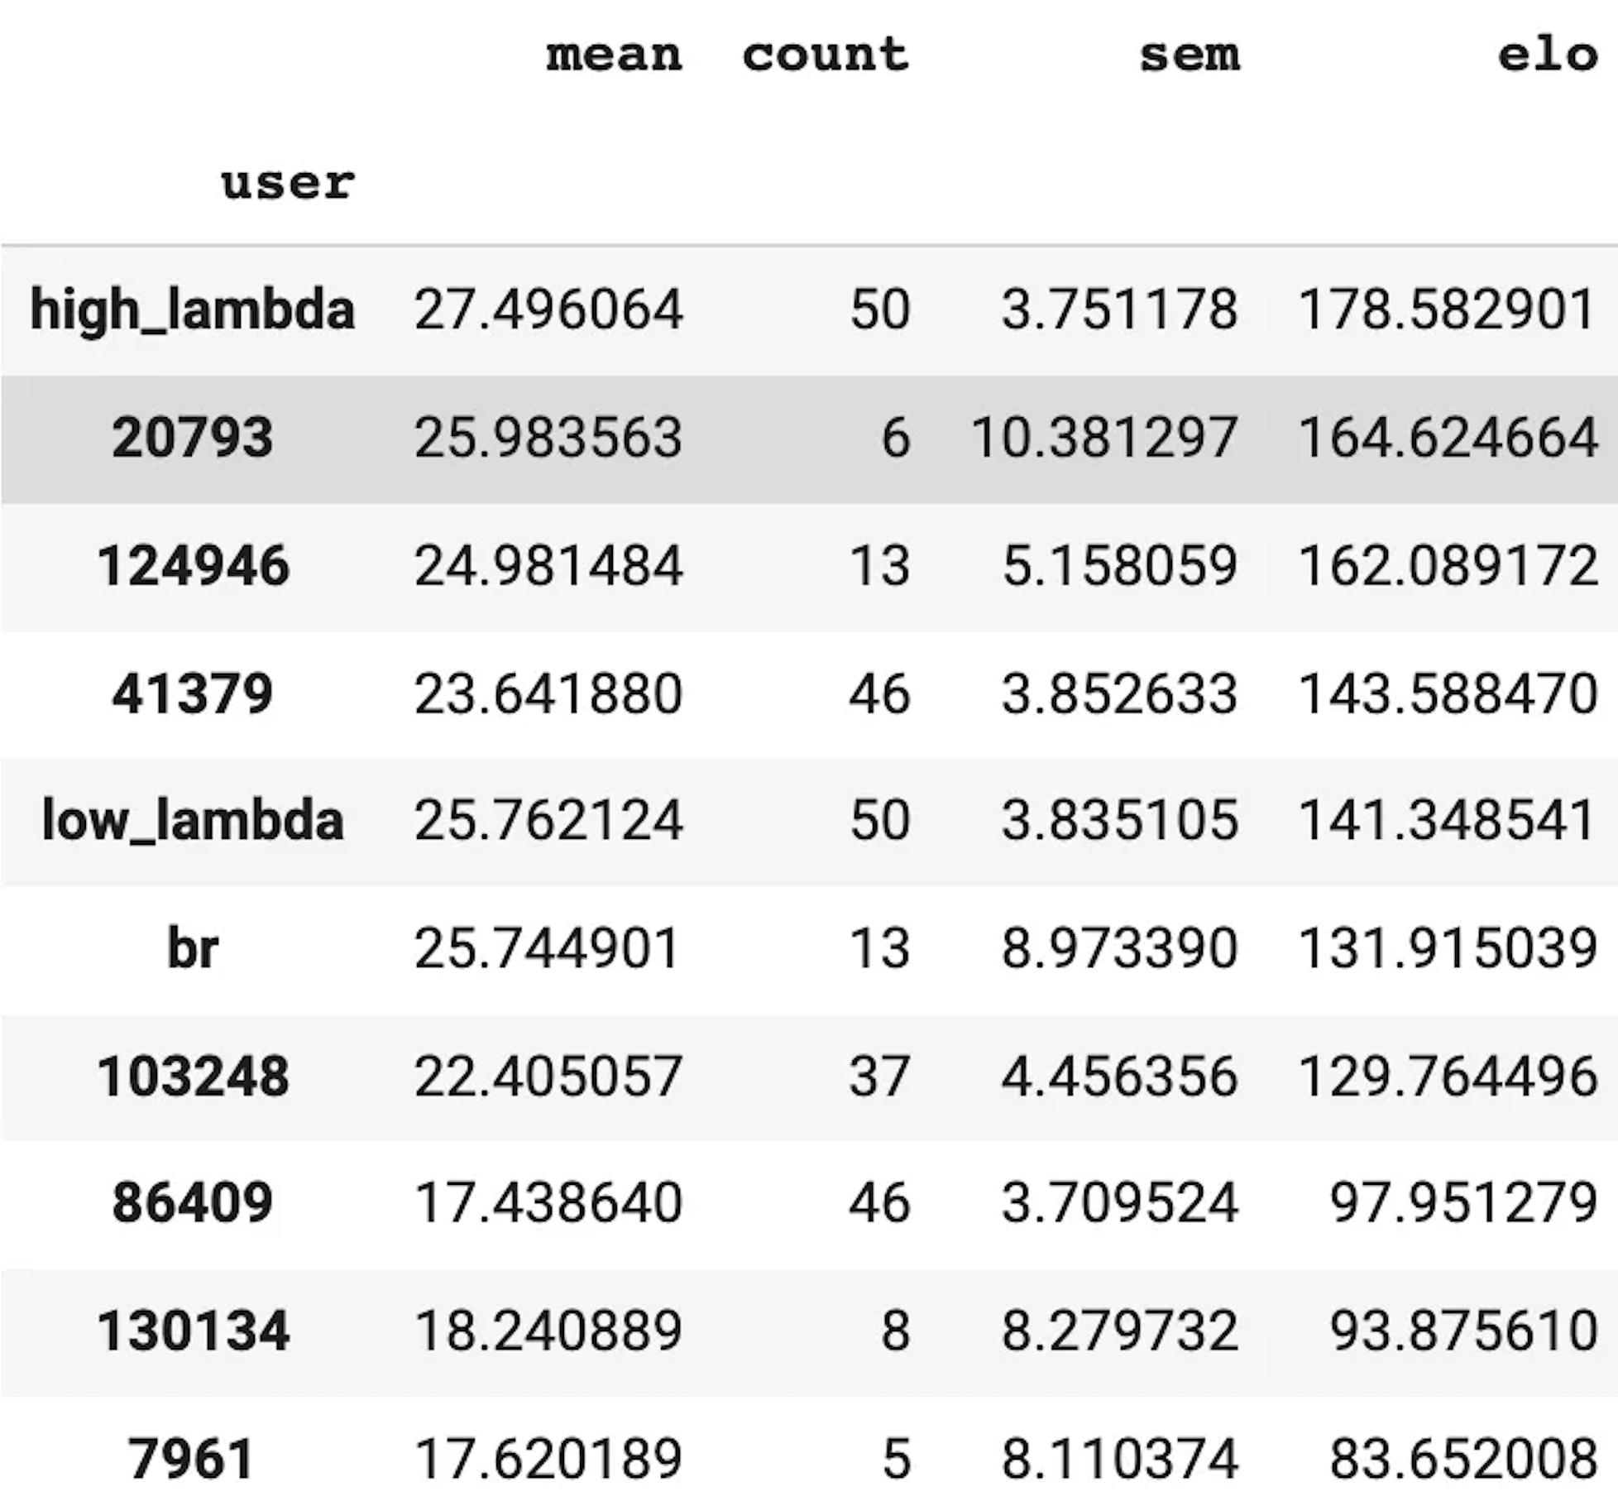
Performance of KL-Regularized DORA in Diplomacy
Launched a tournament on webdiplomacy.net to test our bot
Over 50 human participants
Skill levels vary from weak to expert
Each game has 1 bot and 6 humans
Bot came in first place
Qualitative assessment from expert humans: bot is at least expert-level

Slide 52
Takeaways
KL-regularized search + supervised learning beats supervised learning alone at human prediction accuracy in Chess and Go
In no-press Diplomacy, KL-regularized hedge better models humans than any prior approach
  Best responding to this model produces an expert-level bot
Suggests that KL-regularized search may be generally useful for modeling human behavior
  Similar preliminary results in the AI benchmark of Hanabi

Slide 53
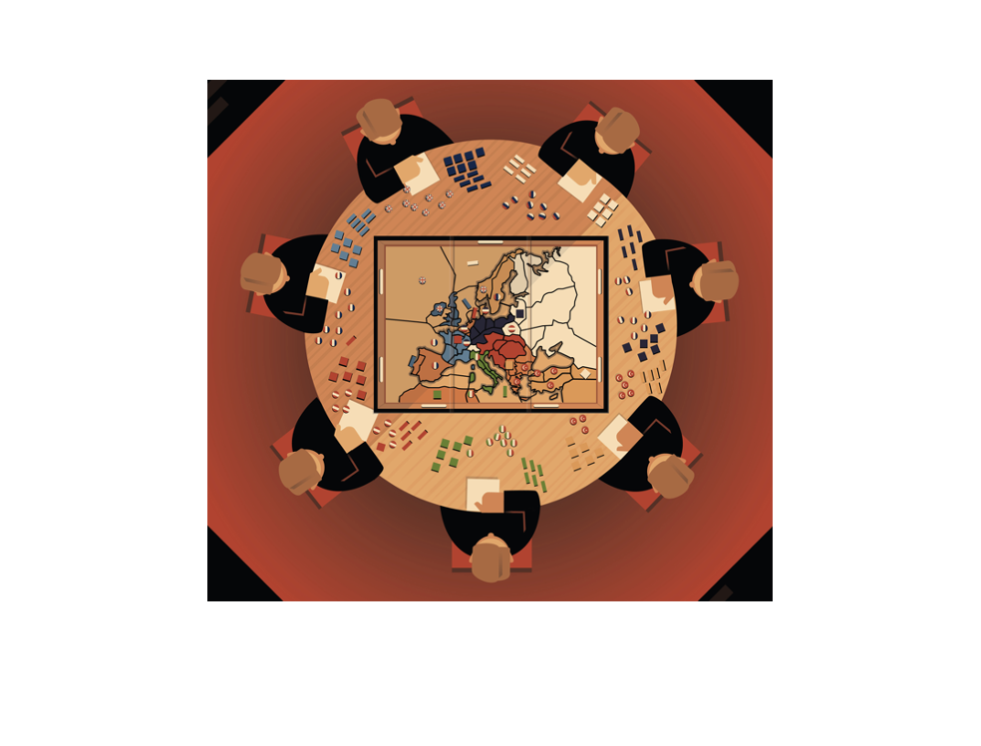
Looking ahead
No-Press Diplomacy is just the start
What happens when players can privately coordinate?
What happens when negotiations are unstructured?
How do we ground free-form communication to game states/actions?

Slide 54
Motivating Example
Three players: A and B vs. C
Left/Left/Left is a Nash equilibrium and correlated equilibrium
Not a realistic solution concept!
C goes Left
C goes Right
A↓ B→ | Left | Right
Left | 1, 1, -2 | -1, -1, 2
Right | -1, -1, 2 | -1, -1, 2
A↓ B→ | Left | Right
Left | -1, -1, 2 | -1, -1, 2
Right | -1, -1, 2 | 1, 1, -2

Slide 55
Diplomacy as a benchmark for AI research
A real game played by real humans, spanning beginners to experts
Easy to score
Not a cherry picked domain
Lots of data from motivated humans (not Turkers)
Complexity comes from multi-agent interaction, not the environment
Our ICLR-2021 bot required no training and runs on 1 GPU
Growing community consensus: FAIR, DeepMind, MILA, MIT, Oxford, UMD
Plenty of resources and relatively cheap for research
All our code and models for published papers are open-sourced

