Slide 1
The Impact of Large-Scale Environment on Galaxy Evolution in CAMELS
Xavier Sims
University of Connecticut
Collaborators: Jonathon Mercedes-Feliz, Daniel Angles-Alcazar, Katarina Kraljic, Romeel Dave, and the CAMELS Team

Slide 2
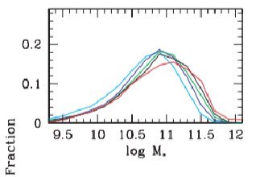
Introduction
Investigating the relationships between SFR, Stellar Mass, and Galaxy Densities, is important to understand the main factors driving galaxy evolution.
We can use CAMELS to study the impact of environment on galaxy evolution and how it depends on feedback parameters and model implementation
Kauffmann G., White S. D. M., Heckman T. M., Ménard B., Brinchmann J., Charlot S., Tremonti C., Brinkmann J., 2004, MNRAS, 353, 713
“The fraction of the total stellar mass in the local Universe contained in galaxies as a function of log $M_{∗}$.” “The different colour lines represent the different density bins as follows: cyan, 0 or 1 neighbour; blue, 2–3 neighbours; green, 4–6 neighbours; black, 7–11 neighbours; red, more than 12 neighbours.”

Slide 3
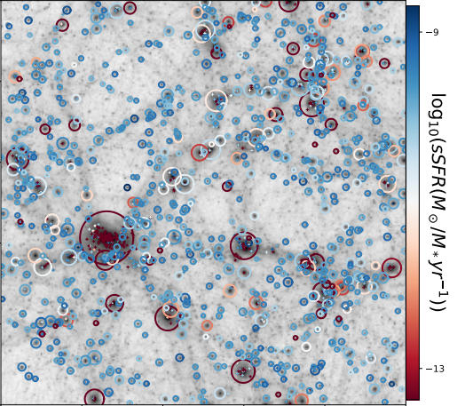
SIMBA 1P_5
The plot represents the impact of environment for a representative CAMELS-SIMBA simulation
Colors represent galaxy sSFR, circles represent the virial radii of central galaxies, and + signs represent satellites
The most massive halos and their satellites tend to be quenched

Slide 4
Defining Galaxy Overdensity
Used to quantify a galaxy’s proximity to its nearest neighbor galaxies
We first measure the distance between a galaxy and its 10th nearest neighbor, R
R is then considered the radius of a hypothetical sphere which encompasses the galaxy’s 10 nearest neighbor galaxies.
$ρ_{10}=\frac{10 galaxies}{\frac{4}{3}πR^{3}}$
We normalize this quantity by dividing by the average galaxy density of the full simulation volume, $ρ_{all}$
$ρ=\frac{ρ_{10}}{ρ_{all}}$
van de Voort, F., Bah´e, Y. M., Bower, R. G., et al. 2017, MNRAS, 466, 3460

Slide 5
Galaxy Overdensity Trends
SIMBA CV Set: Combining 27 simulations with fiducial parameters and different initial conditions
Galaxies of similar mass and lower overdensity have higher star formation rates than their high overdensity counterparts.
The trend becomes less clear in bins higher than ${10}^{11}$solar masses. Likely due to not having much data for galaxies that massive

Slide 6
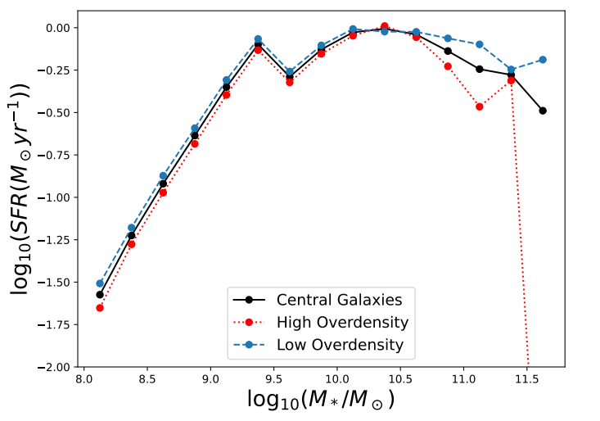
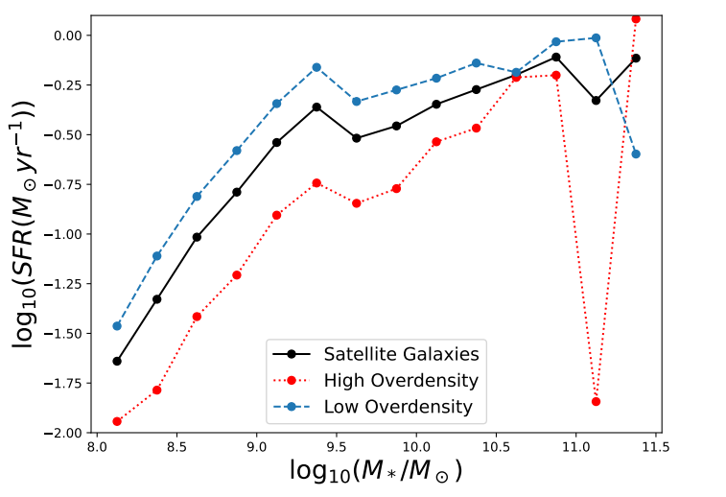
Centrals vs. Satellites
When investigating this relationship for only satellites and only centrals, the trend still holds.
The difference in SFR for central galaxies is notably less significant

Slide 7
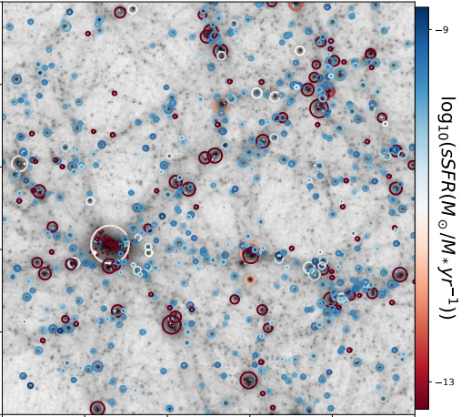
SIMBA 1P_5 vs. IllustrisTNG 1P_5

Slide 8
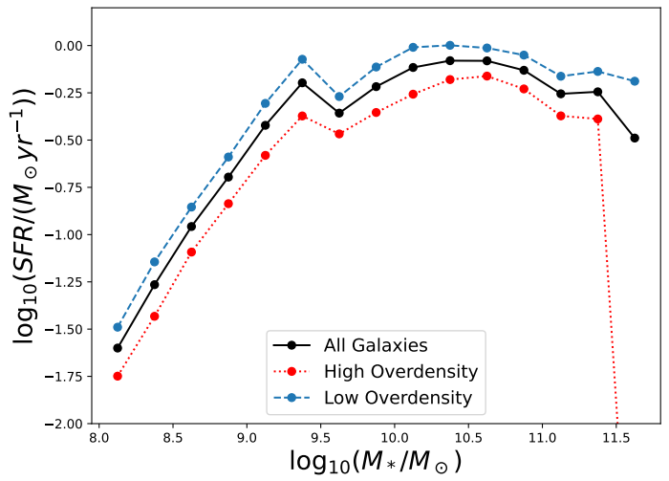
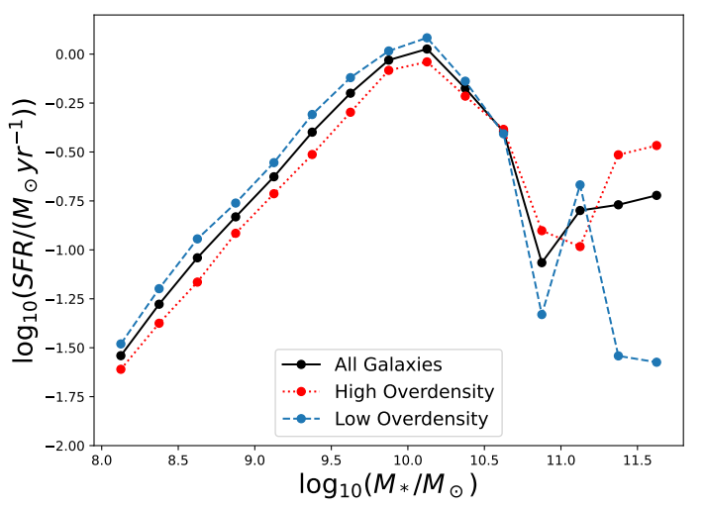
SIMBA vs. IllustrisTNG
The trend does not appear to be dependent on the model that we use, but it is less clear for galaxies above ${{10}^{10.5 }M}_{\text{⊙}}$ in the TNG simulations
The noise in the TNG simulations is likely due to not having a lot of data for high mass galaxies
The magnitude of overdensity dependence is higher in SIMBA than in TNG

Slide 9
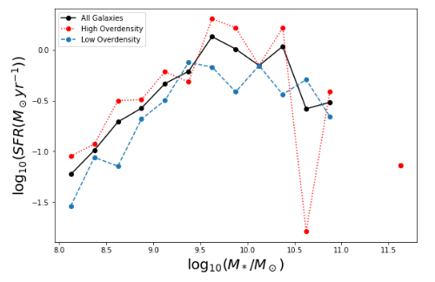
Changes in Cosmology Parameters
SIMBA 1P_1_n5: 1P set simulation with the smallest value of $Ω_{M}$
When we decrease $Ω_{M}$ enough, the overdensity trend can flip.
When $Ω_{M}$=0.1, galaxies with high overdensity tend to form stars faster than galaxies with low overdensity and similar mass

Slide 10
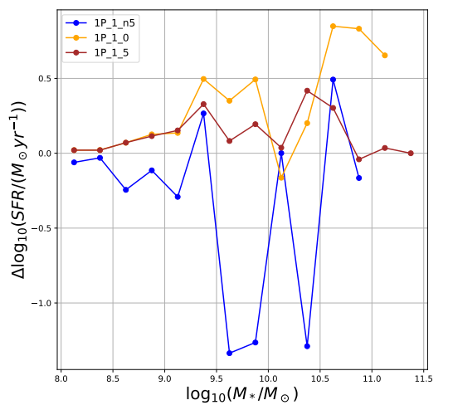
Changes in Cosmology Parameters
Δ refers to subtracting High Overdensity from Low Overdensity SFR
There does not appear to be a strong $Ω_{M}$ dependence for the trend once it reaches a certain value.

Slide 11
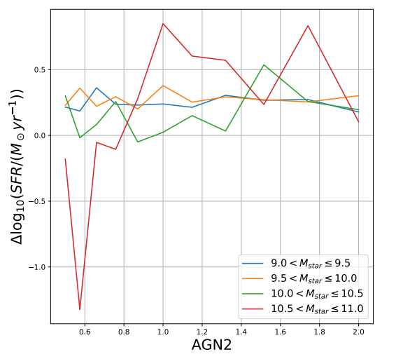
Changes in Feedback Parameters
Δ refers to subtracting High Overdensity from Low Overdensity SFR
As we increase the stellar mass of the galaxies, AGN2 feedback becomes increasingly effective

Slide 12
Cosmic Web Filaments
SIMBA CV_0
We are also investigating the correlation between a galaxy’s SFR and its proximity to its closest cosmic web filament

Slide 13
Cosmic Web Filaments
SIMBA CV_0
We have also investigated the correlation between a galaxy’s SFR and its proximity to its closest cosmic web filament
This plot depicts the skeleton of filaments for the snapshot

Slide 14
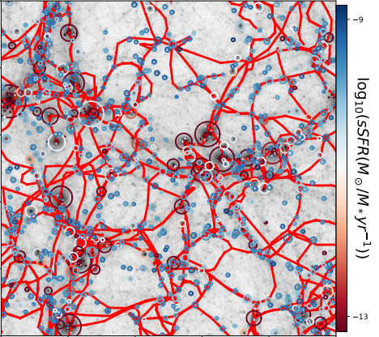
In order to investigate SFR as a function of location in the cosmic web, we find the distance between each galaxy and its nearest neighbor filament segment.
To find this distance, we take the position of a segment to be that of its midpoint
We then separate the galaxies into two categories: Closer to its nearest filament and farther from its nearest filament relative to the median distance in each mass bin

Slide 15
SIMBA CV 0
Galaxies who live farther away from their nearest neighbor filament have higher SFR
This parallels the overdensity trend
Results are still in the early stages, and we plan to average the data from all 27 CV simulations

Slide 16
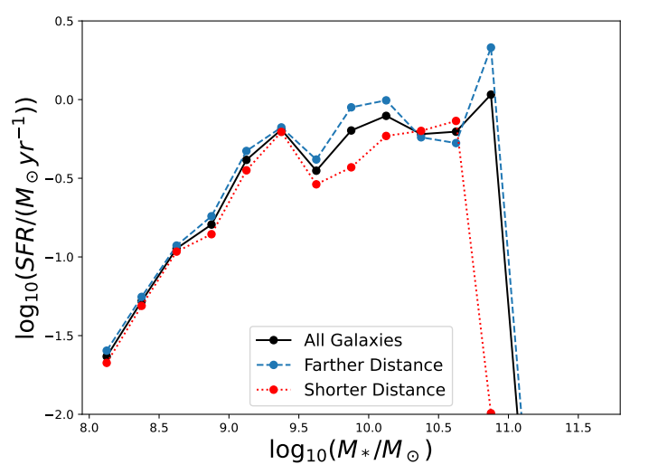
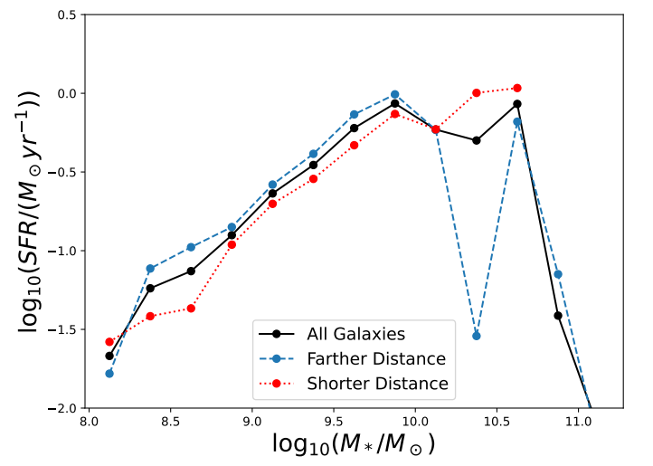
SIMBA vs IllustrisTNG
Comparing CV_0 sims for SIMBA and TNG
The trend appears to be stronger for the TNG simulation

Slide 17
Conclusions
We have found direct correlations between galaxy SFR and large-scale environment as well as how these correlations are affected by varying initial conditions using CAMELS
We also wish to further investigate how the previously depicted relationships between SFR and large-scale environment are affected by changes in cosmological and feedback parameters besides $Ω_{M}$ and AGN2.
Future work will involve investigating the alignments between cosmic web filaments and galaxy spin

