Slide 1
Using the Thermal Sunyaev Zel’dovich Effect to Distinguish AGN Feedback Models
Skylar Grayson¹, Evan Scannapieco¹, Romeel Davé²
¹Arizona State University ²University of Edinburgh

Slide 2
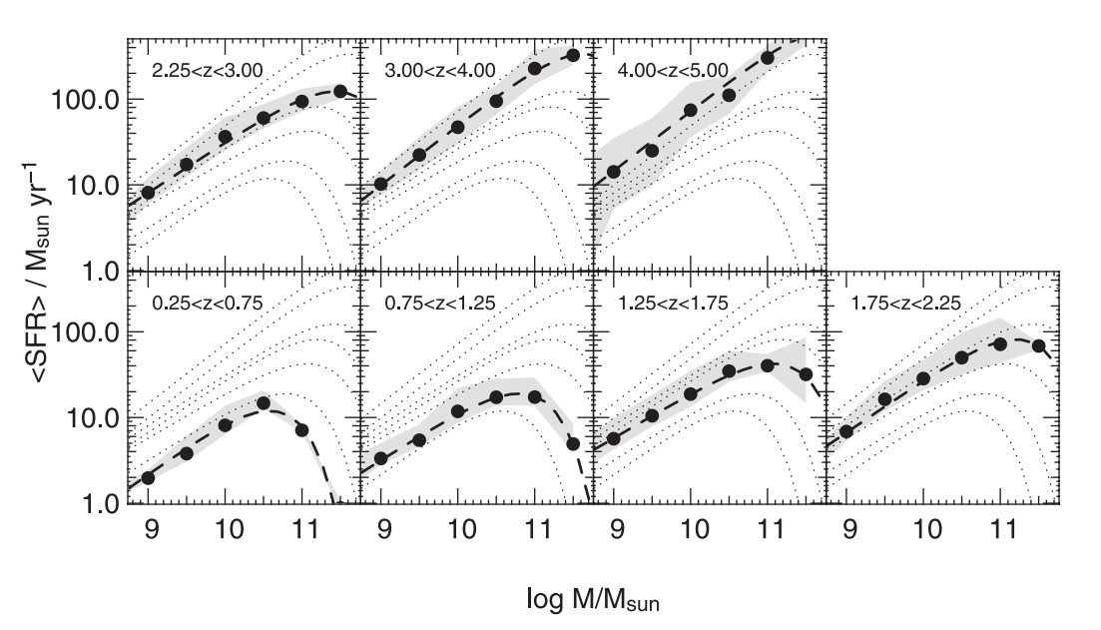
Cosmic Downsizing
Lambda CDM predicts the characteristic mass of star-forming galaxies should increase over cosmic time
This is not observed!
Drory & Alvarez 2008
Notes:
Flattens out because that’s the highest mass they probe

Slide 3
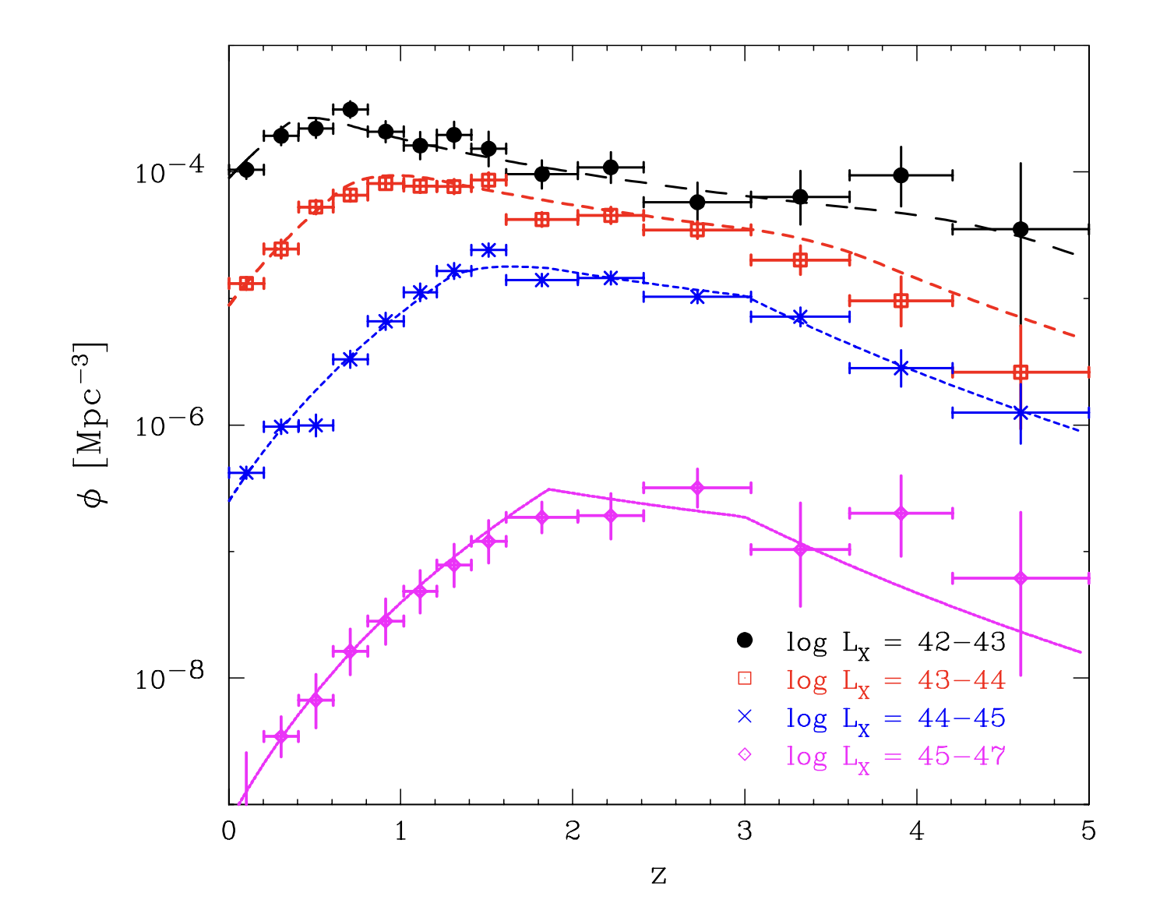
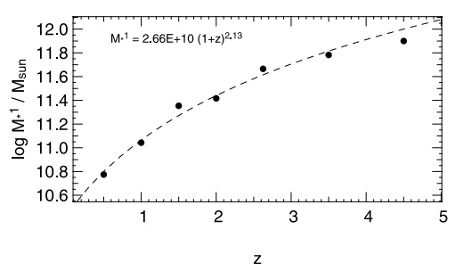
Star Formation
Active Galactic Nuclei
Drory & Alvarez 2008
Ueda et al. 2014

Slide 4
AGN Feedback
Heat up gas in and around a galaxy
AGN can
Remove star-forming material from the galaxy
Reproduce observed stellar mass distributions in simulations
Fabian 2012, Heckman & Best 2014, Schaye et al. 2015, Harrison 2017, Springel et al. 2017, Davé et al. 2019

Slide 5
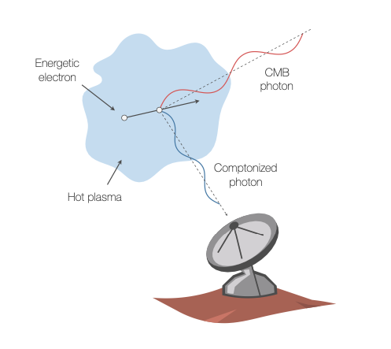
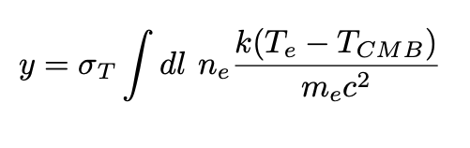
Thermal Sunyaev Zel’dovich Effect
L. van Speybroeck adapted by J. E. Carlstrom

Slide 6
This Work:
Use SIMBA to understand how AGN feedback impacts the tSZ signal
Determine what redshifts matter the most, and compare against observations at z~1 and z~0.5
Make predictions for tSZ observations at higher resolutions and varying redshifts

Slide 7
Methods

Slide 8
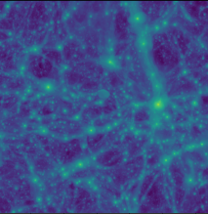
Used yt to generate projection of Compton-y parameter

Slide 9
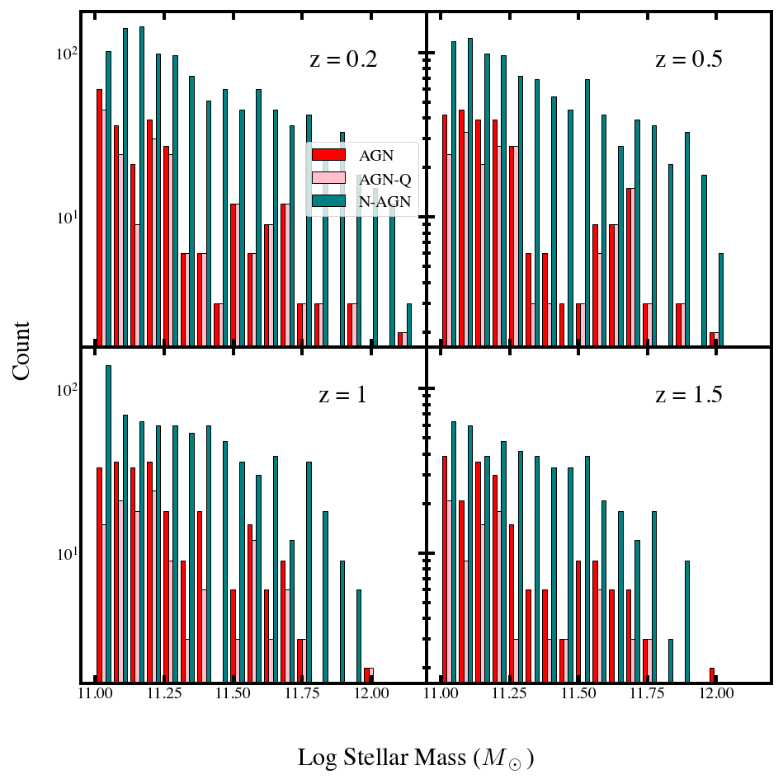
Galaxy Samples
AGN:
M* > 10¹¹ M☉
AGN-Q :
M* > 10¹¹ M☉, sSFR < 0.01 Gyr⁻¹, age > 1 Gyr
N-AGN:
Maximum M* (AGN) > M* > 10¹¹ M☉

Slide 10
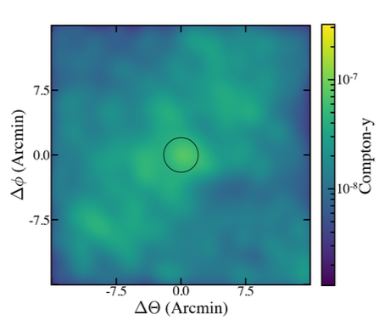
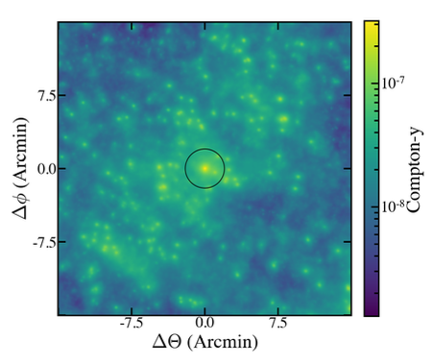
2.1’
Atacama Cosmology Telescope
9.5”
TolTEC-Large Millimeter Telescope

Slide 11
Results

Slide 12
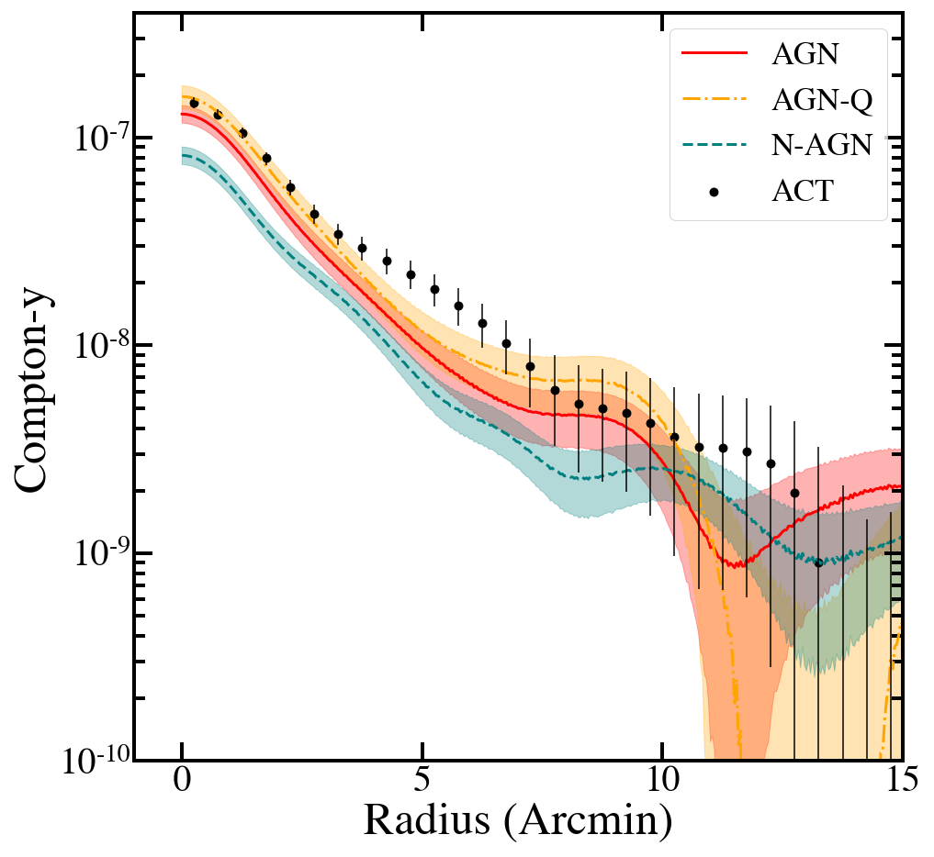
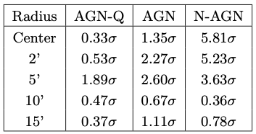
Observational Comparison z = 1
Meinke et al. 2023

Slide 13
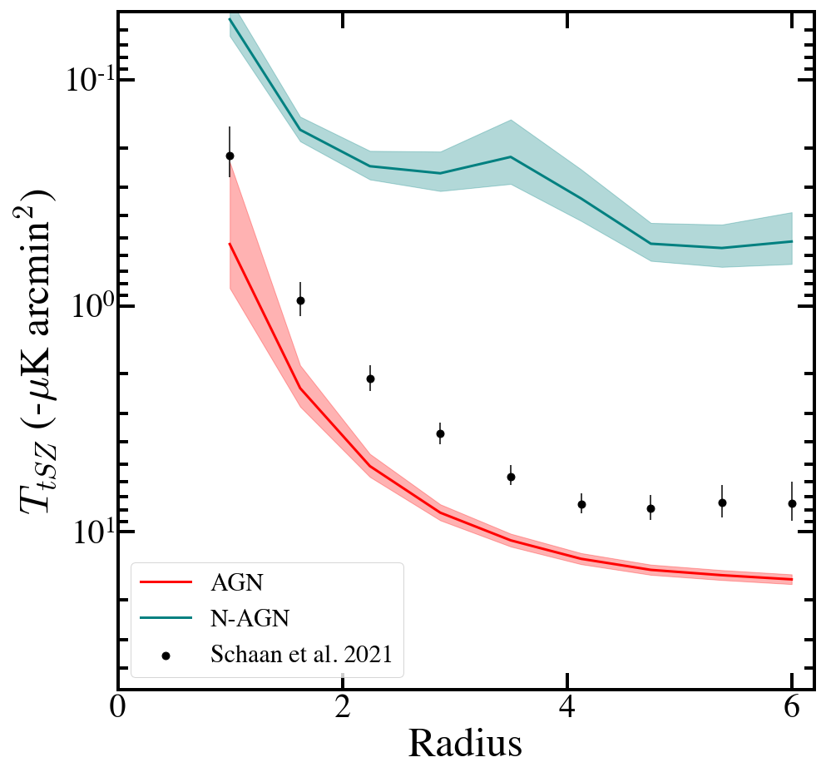
Observational Comparison z = 0.5
Schaan et al. 2021

Slide 14
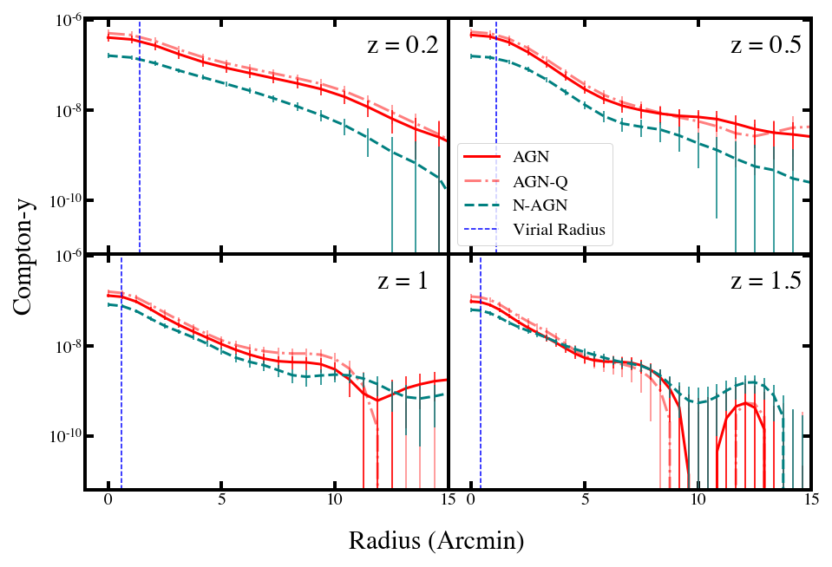
ACT Beam

Slide 15
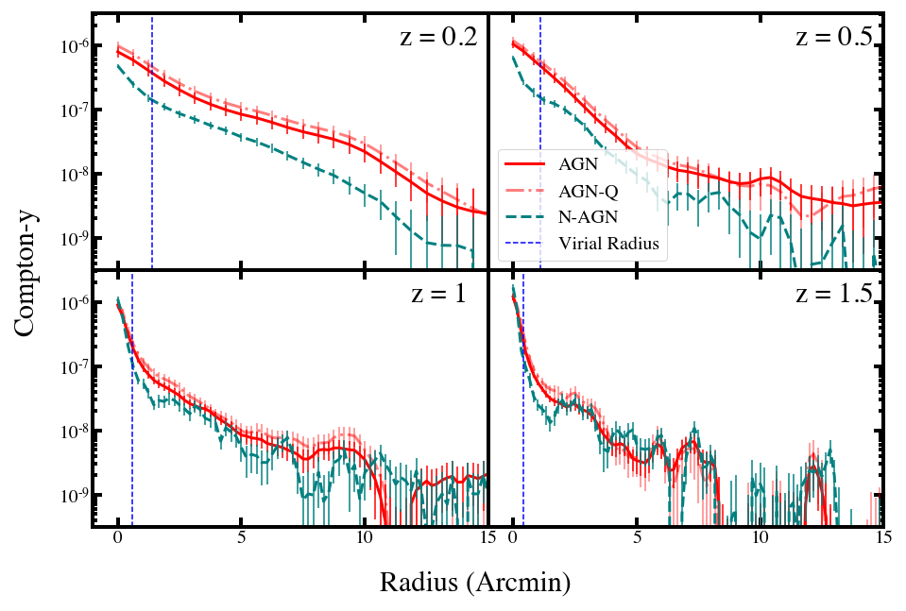
TolTEC Beam

Slide 16
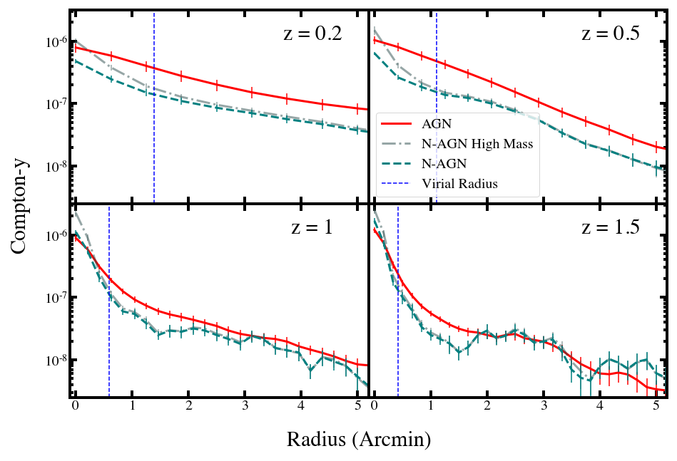
TolTEC Beam

Slide 17
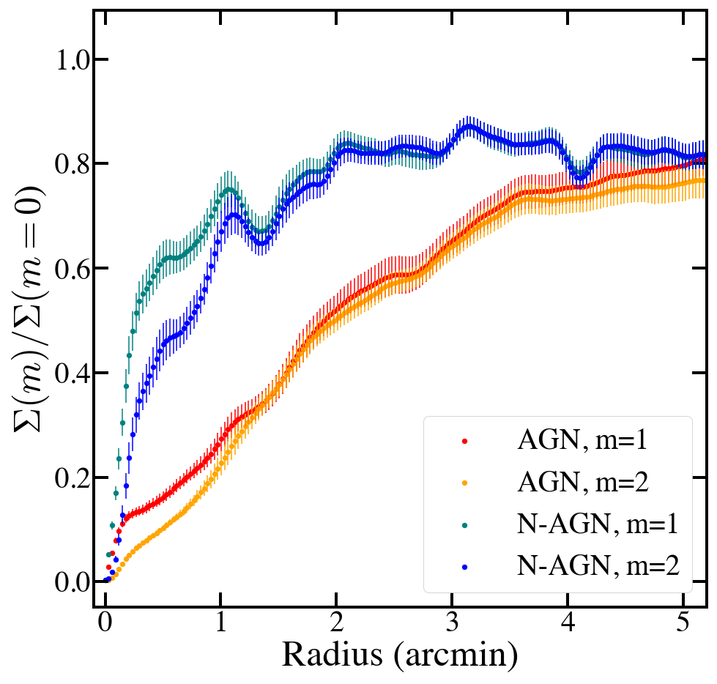
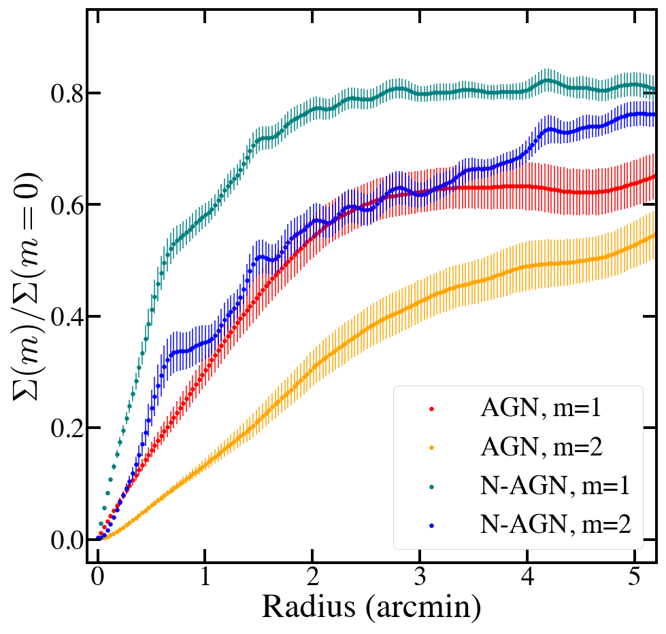
Moments
z=1
z=0.5

Slide 18
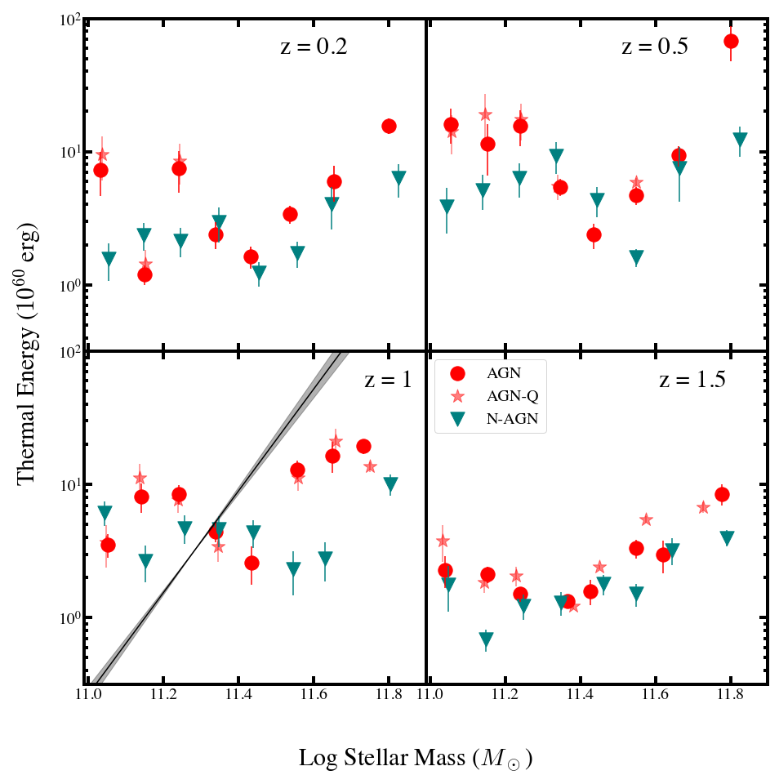
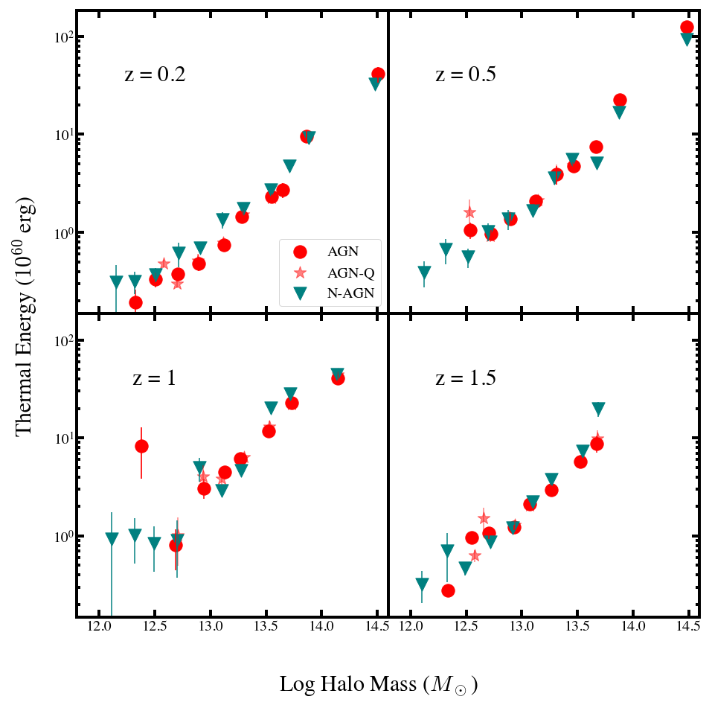
Thermal Energy

Slide 19
Conclusions
SIMBA’s treatment of AGN aligns well with ACT observations at z~1, not as well at z~0.5
Radial profiles are more useful than thermal energy calculations for distinguishing between feedback models
At high redshifts, there is not a very large difference between runs with/without AGN, regardless of resolution
Moments could be a useful way to trace asymmetries and compare to observation w/out knowing orientation

Slide 20
Questions?

Slide 21
Next Steps and
Future Work
Probe AGN Feedback by stacking X-ray emission
Modify feedback behavior in SIMBA
- Can probe AGN feedback with X-ray emission
- At high z, luminosities are low and a stacking approach must be used.
-Some initial work modelling halo stacks, but not galaxies
-Once AGN parameters are tuned from tSZ data, can use SIMBA to make X-ray predictions
- Explore input parameters of radiative wind mode
- Generate extensive set of models w/varying physics+parameters to compare against observation
-Compare against feedback behaviors in other simulations ie EAGLE+IllustrisTNG
Explore dust signals in SIMBA
Generate tSZ data from TolTEC
- Observationally determining tSZ signal requires subtracting dust effects
- Model dust profiles using SIMBA for further comparison and understanding of contamination
Submit paper with these results
-Once TolTEC data is available.
-Can use methods outlined in Meinke et. al. 2021
-May/June

Slide 22
Extra Slides

Slide 23
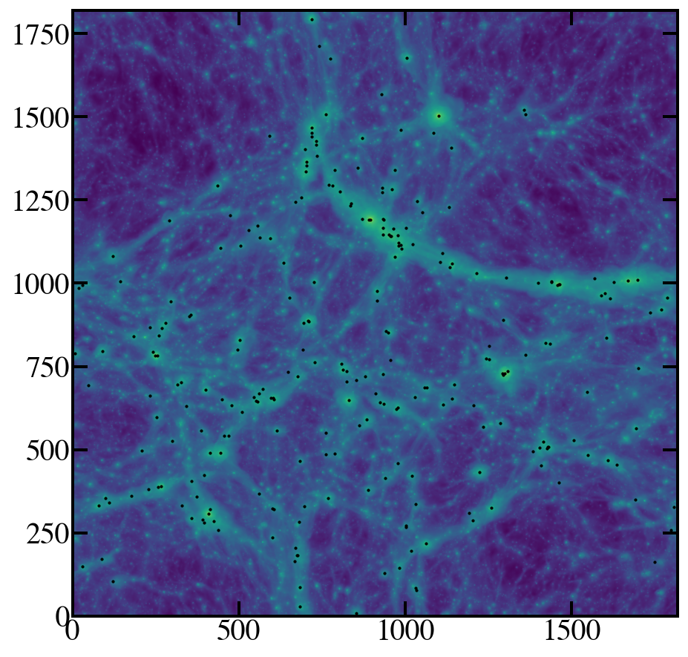
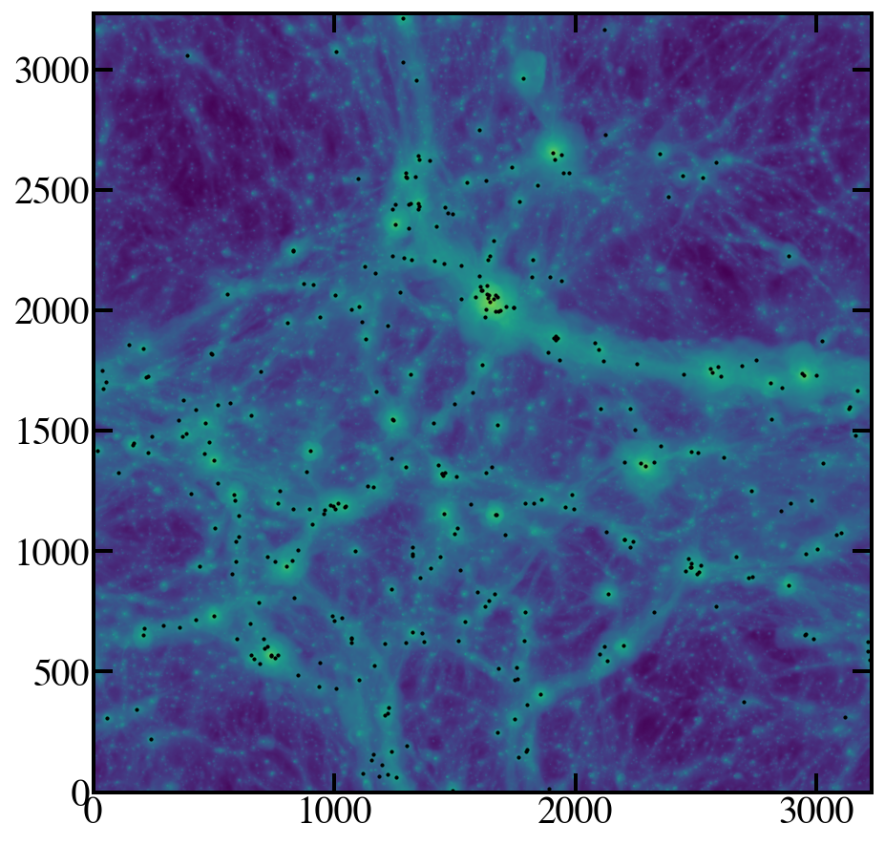

Slide 24
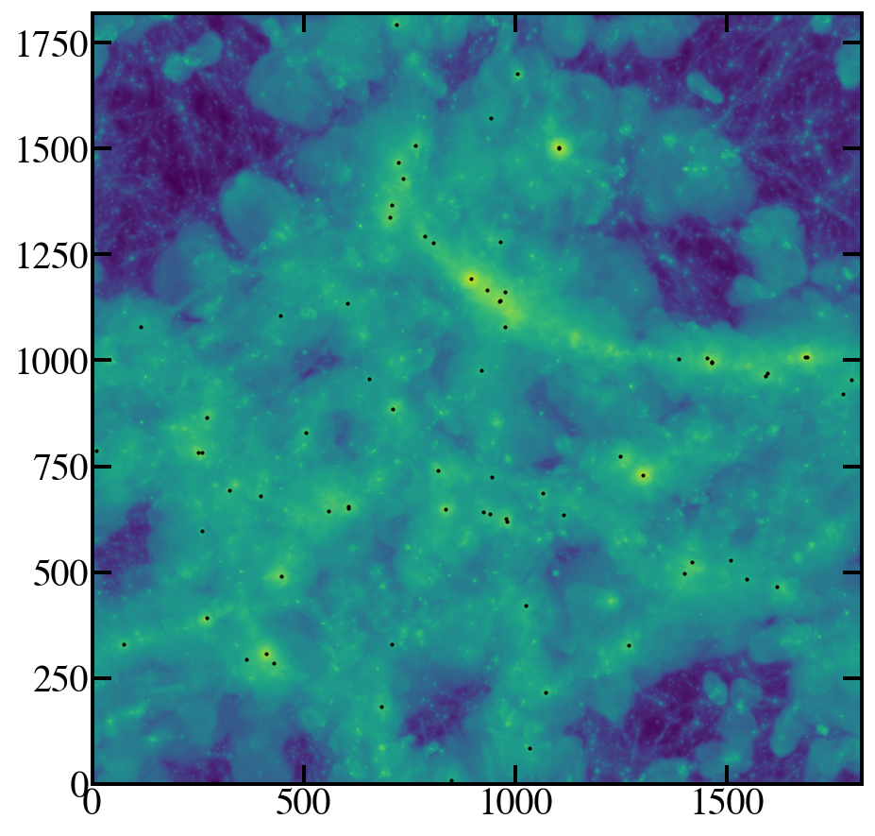
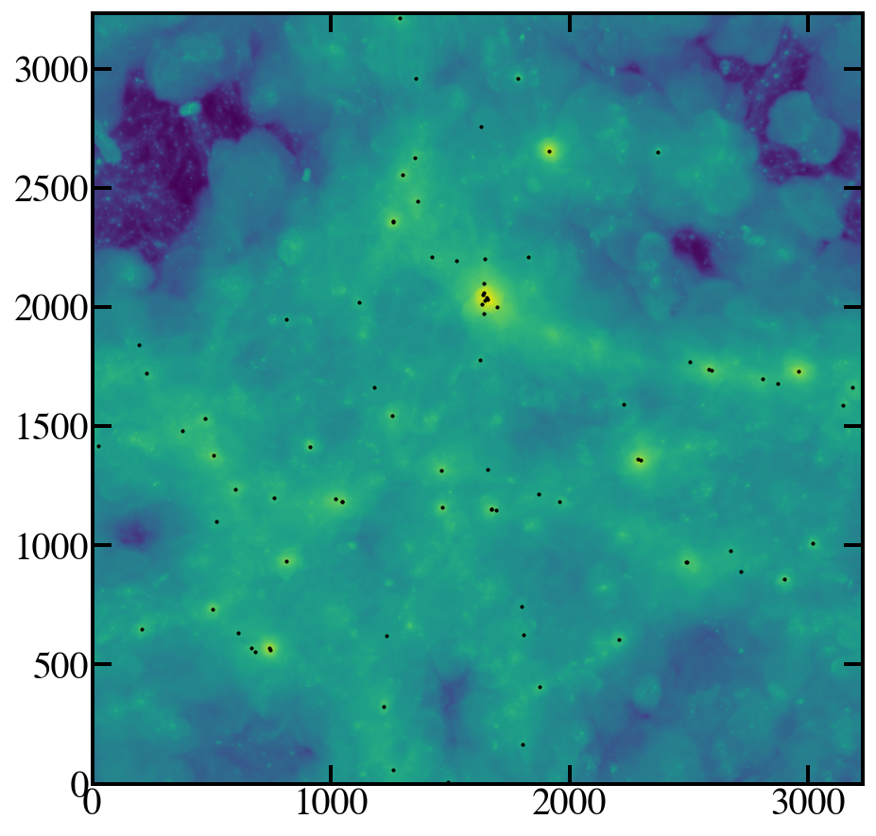

Slide 25
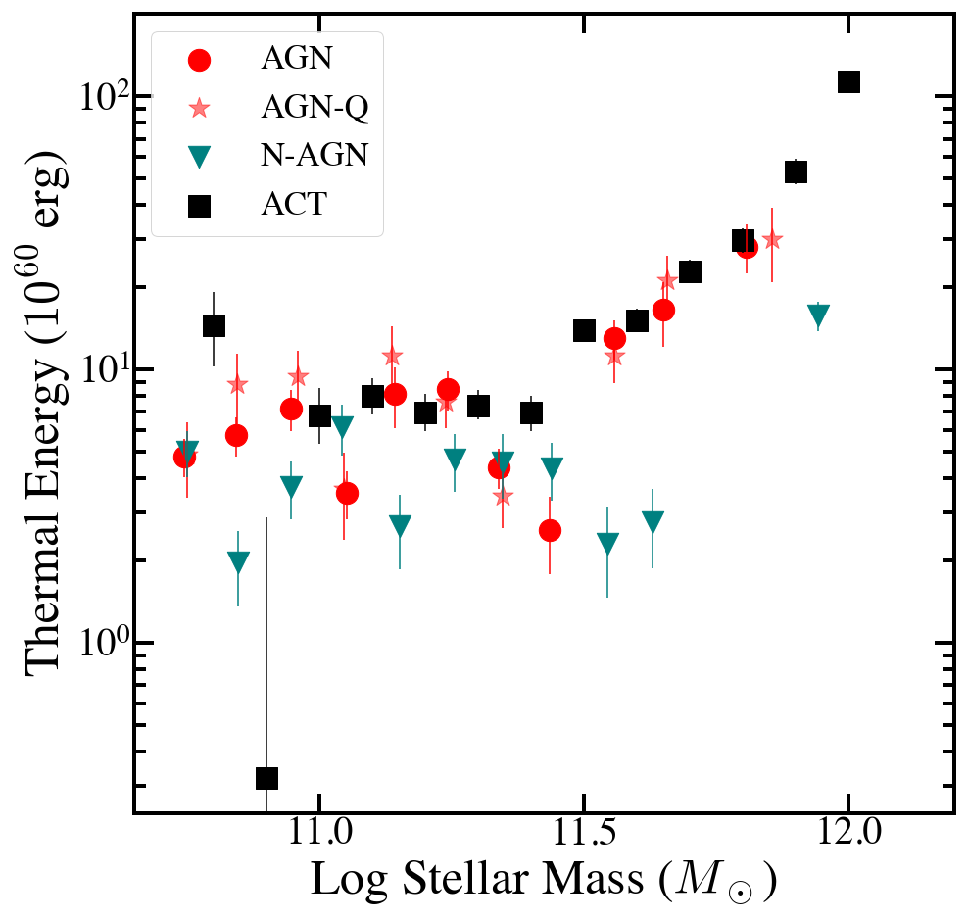

Slide 26
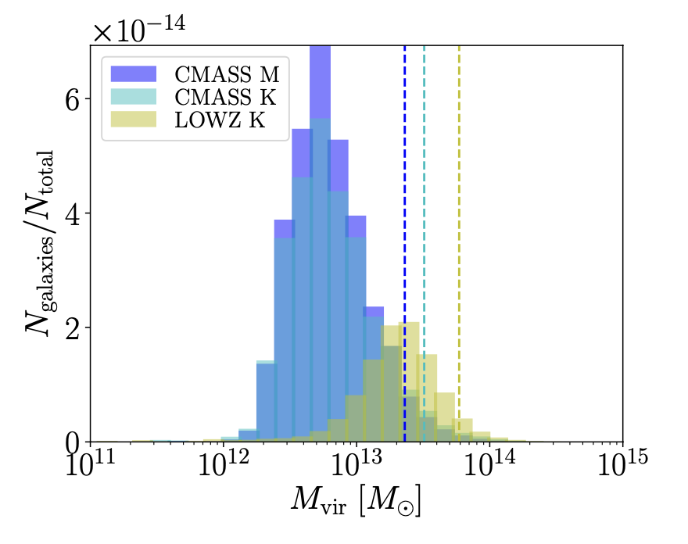
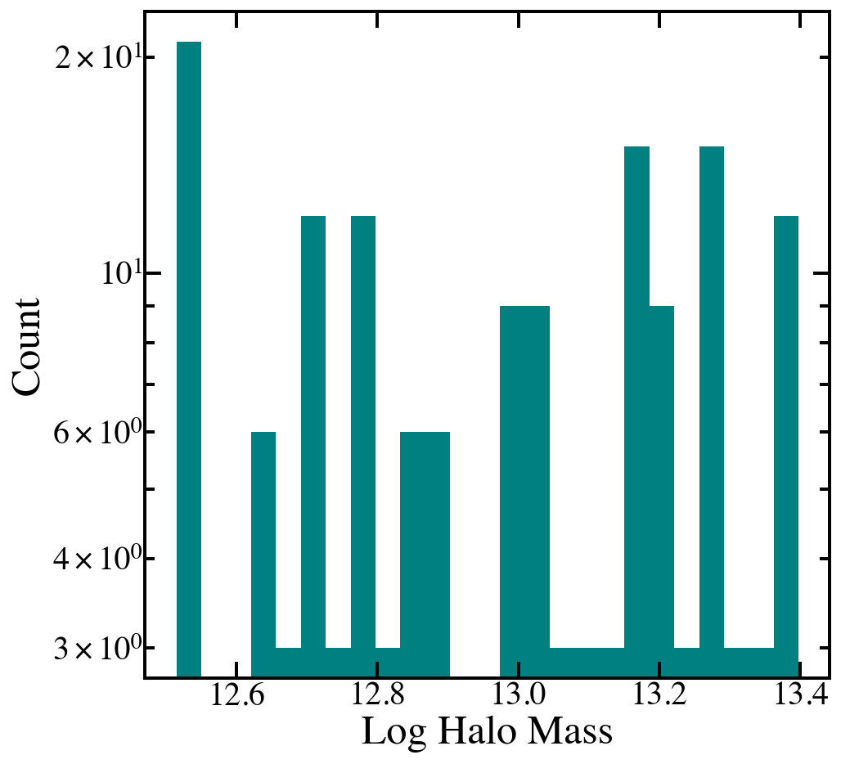
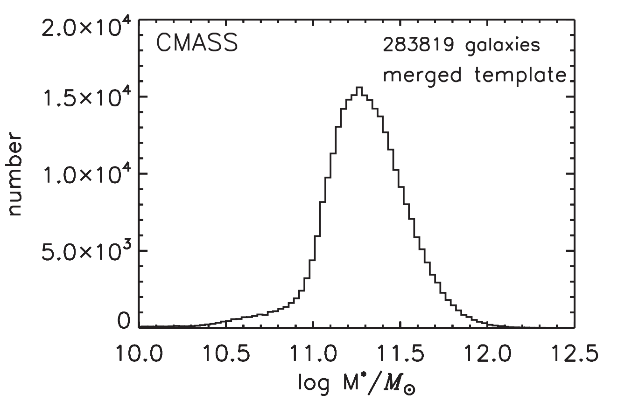
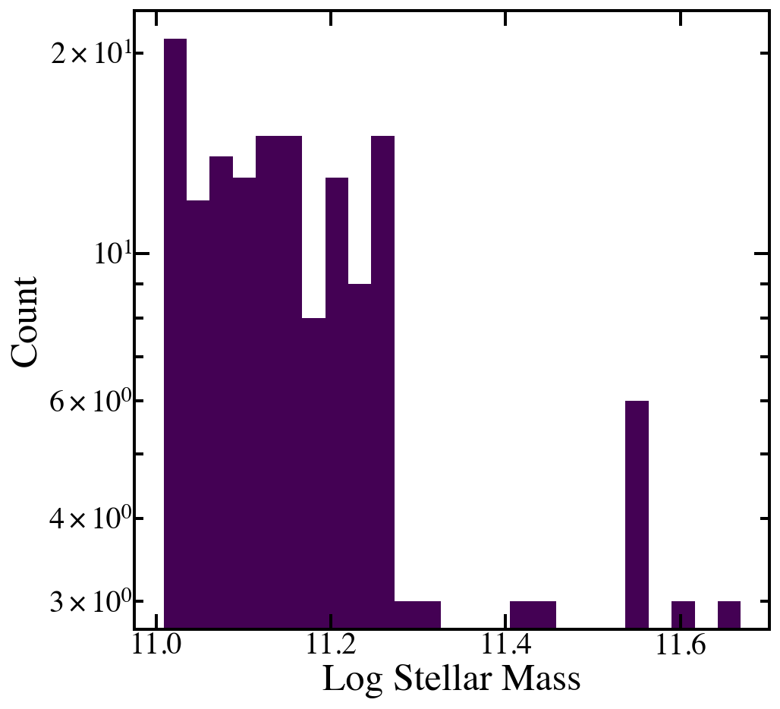
Schaan Sample Distribution

Slide 27
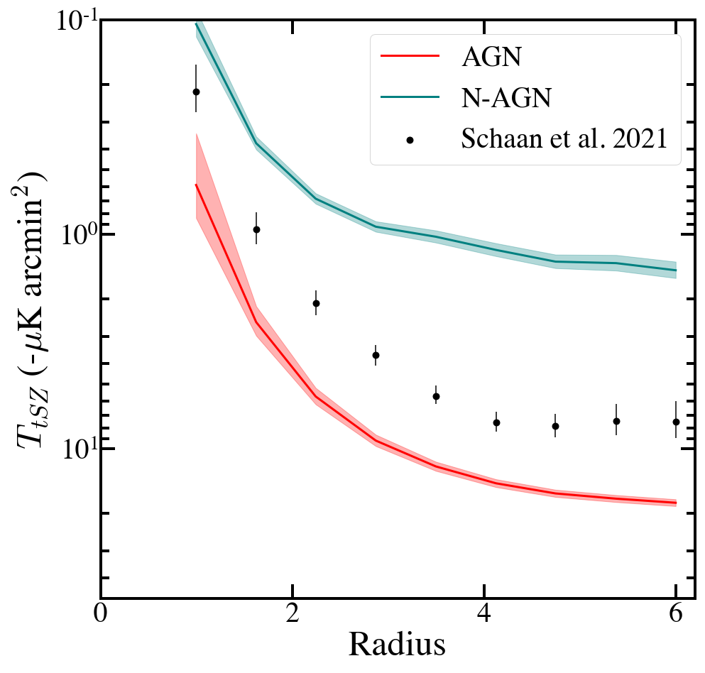
Observational Comparison z = 0.5
Schaan et al. 2021

Slide 28
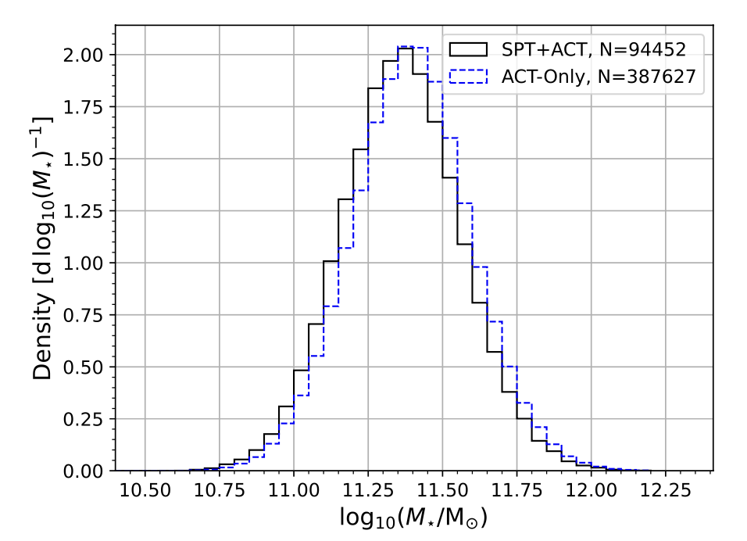
Meinke Sample Distribution

