Slide 1
ISM evolution in the SIMBA cosmological simulation
Galaxies in cluster environment
Giuliano Lorenzon, National Center for Nuclear Research (NCBJ)
Ul. Ludwika Pasteura 7, Warszawa (Poland)
giuliano.lorenzon@ncbj.gov.pl
Image Credits: Krzysztof Lisiecki

Slide 2
A fast introduction to the ISM
Everything that lays between stars in a galaxy: gas, dust, cosmic rays, E.M. radiation, dark matter
In our Galaxy ~10% of baryonic matter is contained in ISM
Different phases:
Hot Ionized Medium
HII regions
Warm Ionized Medium
Neutral gas
Molecular gas

Slide 3
Why looking at the ISM?
The evolution of a galaxy is strongly linked to the ISM
Molecular gas is the fuel for the formation of stars
Dust acts as a catalyst for the formation of H₂ and its condensation in dense and cold clouds
Chemical and physical composition of the ISM change as it is reprocessed through stellar activity and other forms of feedback (AGNs, SNe, …)
ISM has a major role in deciding upon the life and death of a galaxy

Slide 4
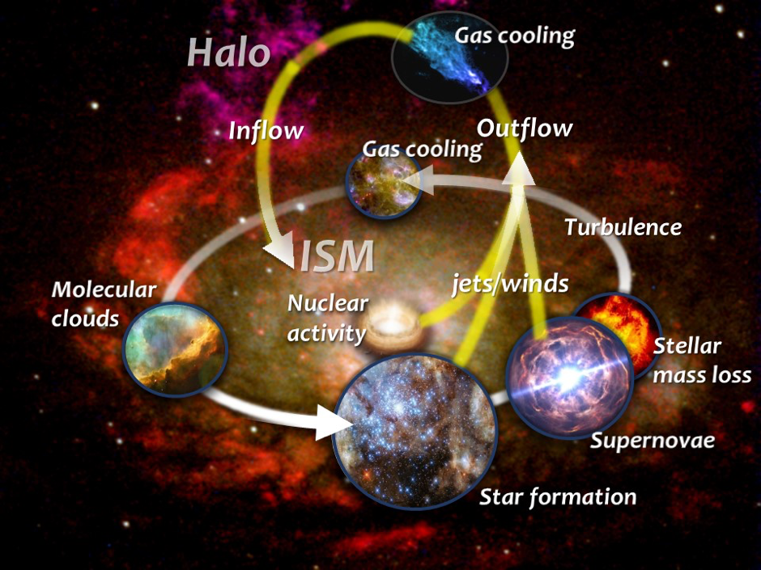
What can influence the ISM evolution? Everything!
Galaxies can constitute a very violent home for the ISM and this changes with time and environment
AGN activity can eject part of the ISM and inject in it enormous amount of energy
SN explosions blow away the gas and destroy very efficiently the dust
Tidal forces can heat up the ISM preventing it from forming new stars (environment!)
ISM can be stripped away due to interaction with other diffuse medium (environment!)
All of these mechanisms work out together!
Galactic baryon cycle. Credits: SPICA

Slide 5
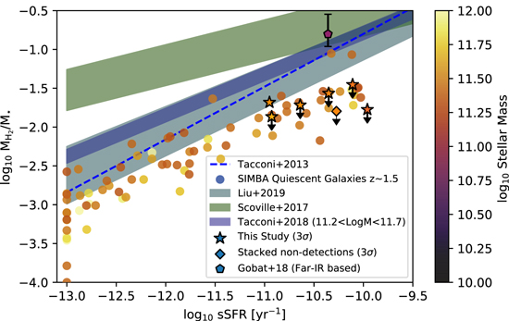
Relying on simulations: SIMBA
The best way to narrow down how ISM evolves is through the study of the quenched phase of galaxies
However observations of ISM in quenched galaxies is very hard
Simulations can help, providing a large statistical sample in which every aspect of the galaxy can be studied
SIMBA is a state of the art simulation that already demonstrated its power in matching observed features of the ISM:
Metal lines contribution in CGM (Appleby at al. 2021)
Dust fractions (Donevski et al. 2023)
Gas fractions (Williams et al. 2021)
Williams et al. 2021

Slide 6
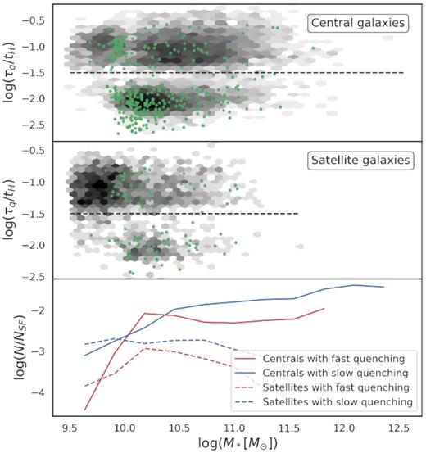
Different mechanisms, different quenching
Mechanisms responsible for the quenching of galaxies act at different timescales
SIMBA shows a distinct division between timescales of quenching (Montero et al. 2019, Zheng et al. 2022) but not direct connection between timescales and occurrence of major mergers
Fast quenching seems prevalent for galaxies in the mass range of 10¹⁰ ≤ M* ≤ 10^{10.5} M_{sun} for which AGN are effective
Montero et al. 2021

Slide 7
Divide et impera
The picture is very complex: we need to break the problem into small bites
We avoid the chaotic active phase of galaxies and only exhamin the quenched phase
We want to quantify how the ISM properties evolves during this phase
We want to provide relations to explore with observations
Dividing the galaxies in field and cluster galaxies we can check additional environmental effects

Slide 8
How?
Clusters are selected as halos of M₂₀₀ ≥ 10¹⁴ M_{sun} at z = 0
25 clusters in the full physics SIMBA simulation (from a non-public catalog by Christopher Lovell)
(100 Mpc/h)³ volume and 2x1024³ particles
~4500 galaxies in cluster environment
~45000 galaxies uniformly sampled from the field
Traced back the progenitors of each galaxy up to z~2

Slide 9
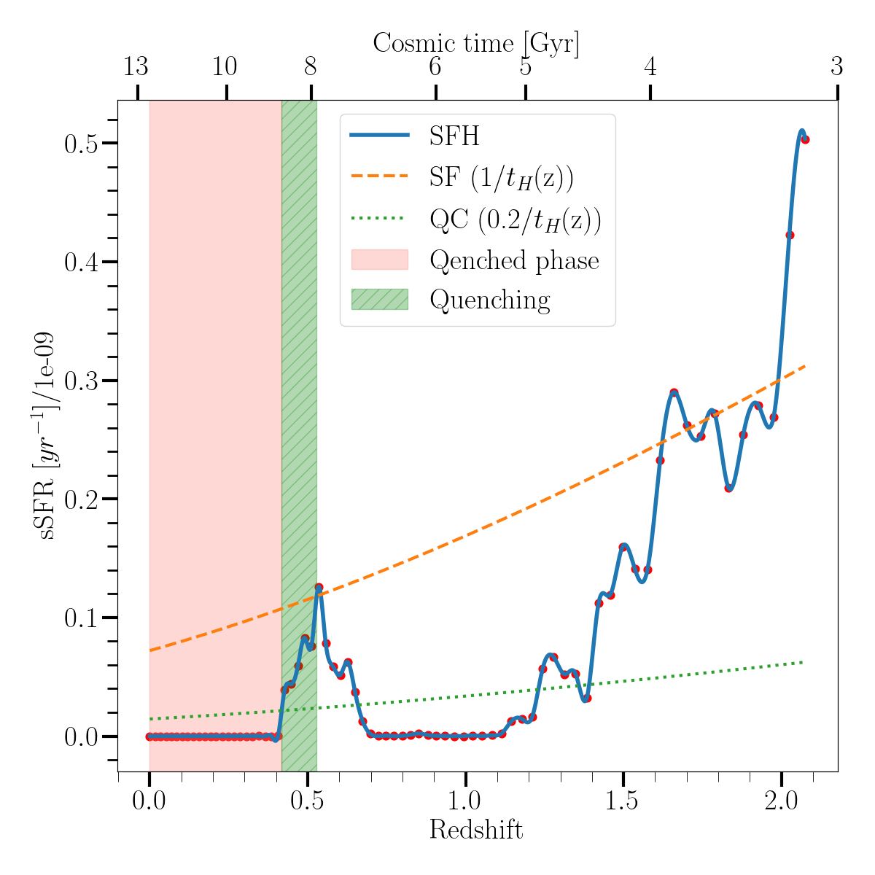
Methodology
Quenching is recovered directly from the SFH (Montero et al. 2019)
Galaxy is quenched when its sSFR goes below 0.2/τ(z), where τ(z) is the Hubble time at redshift z
The threshold for star formation is 1/τ(z)
A galaxy must stay below the SF threshold for at least 0.2*τ(z_{q}) to be quenched

Slide 10
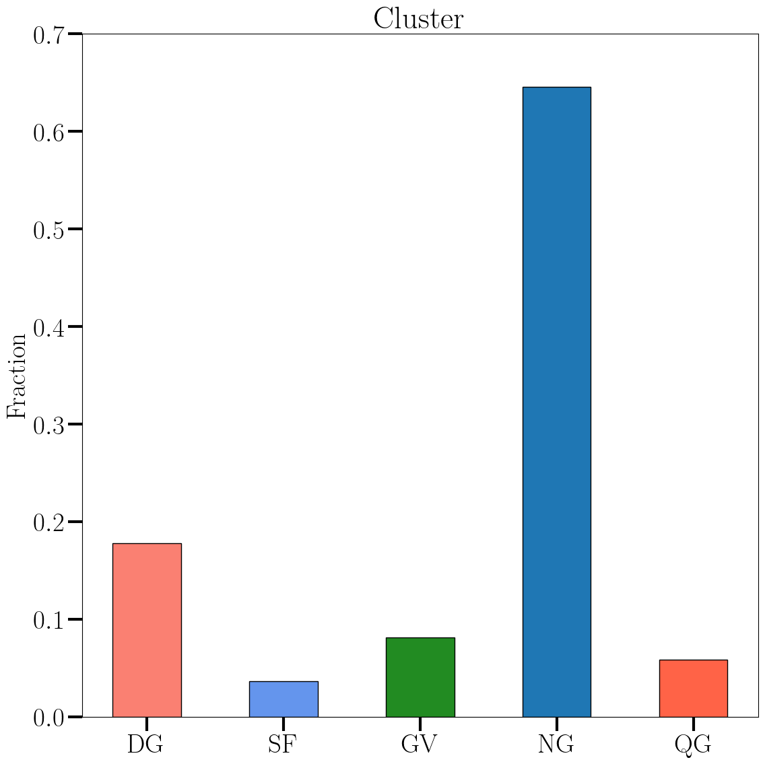
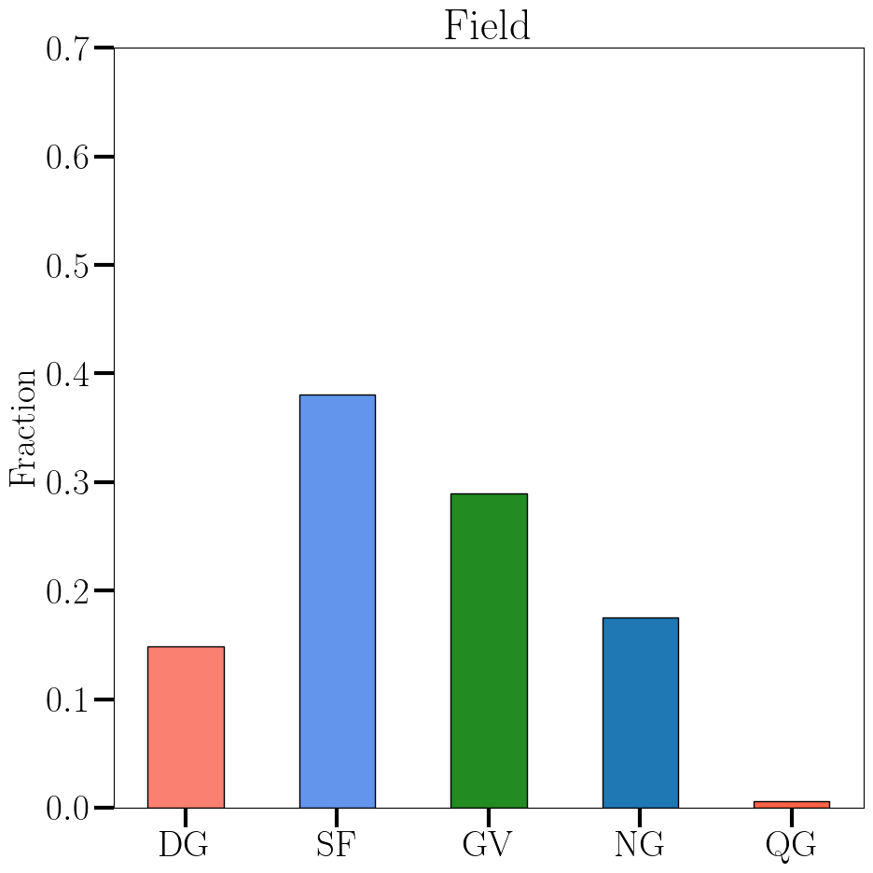
Some statistics on the full sample
DG = Dead, they quench at z ≥ 2
SF = Still star forming at z~0
GV = In the green valley at z~0
NG = Quench in the range 0 ≤ z ≤ 2
QG = Non star forming at z ≥ 2
The amount of galaxies still star forming at z=0 is much larger in the field
The fraction of galaxies that quenched at z > 2 is quite similar

Slide 11
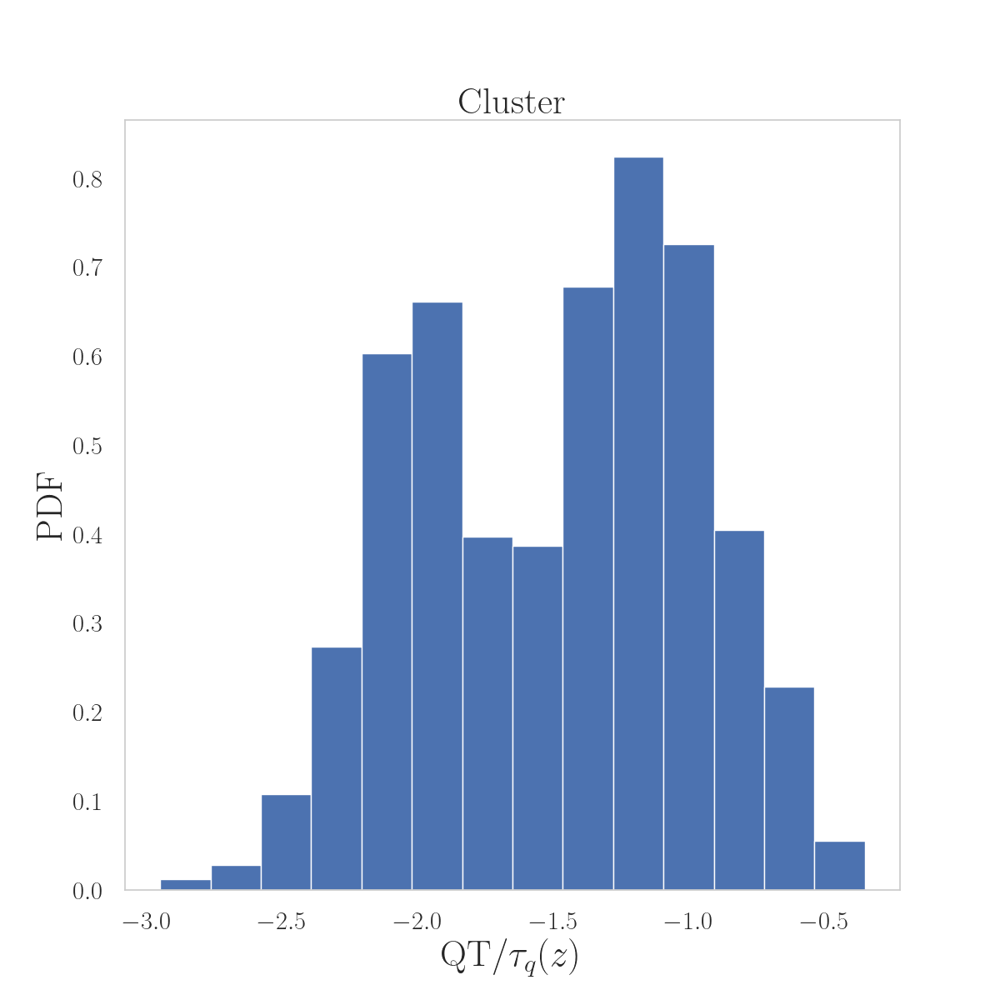
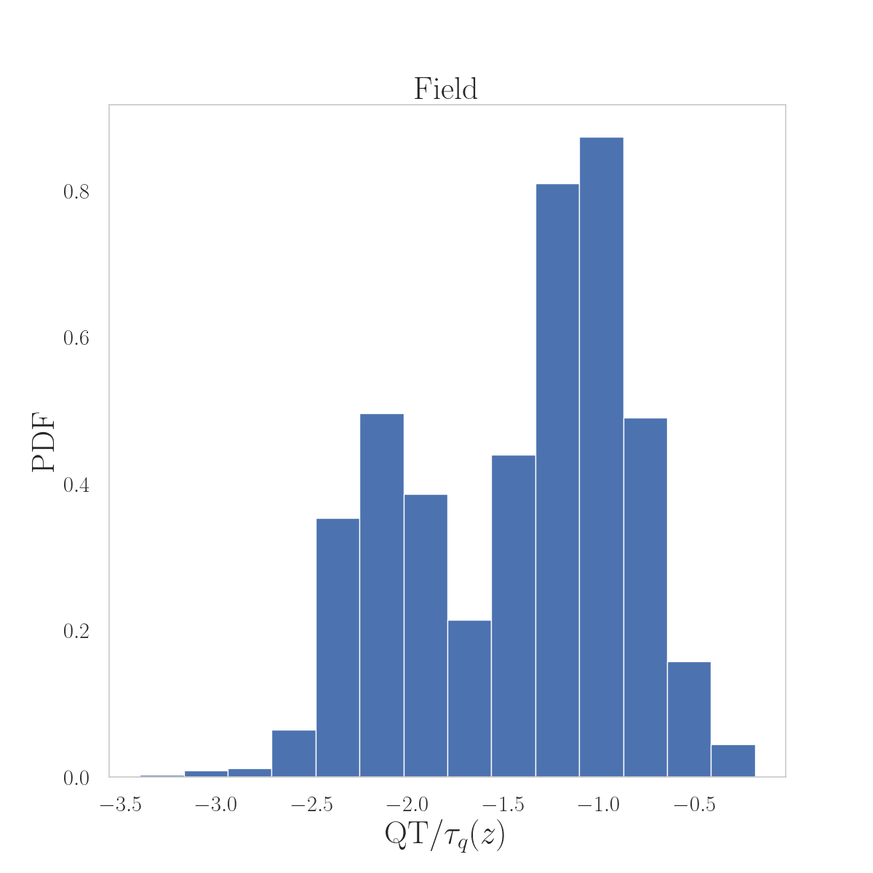
Fast and slow quenchers
Distribution of quenching time QT over the cosmic time at quenching τ(z_{q})
In both environments the peaks are at the same position, consistent with Montero+19 and Zheng+22
Larger fraction of slow quencher in the field
The dotted line represents the threshold for fast/slow quencers

Slide 12
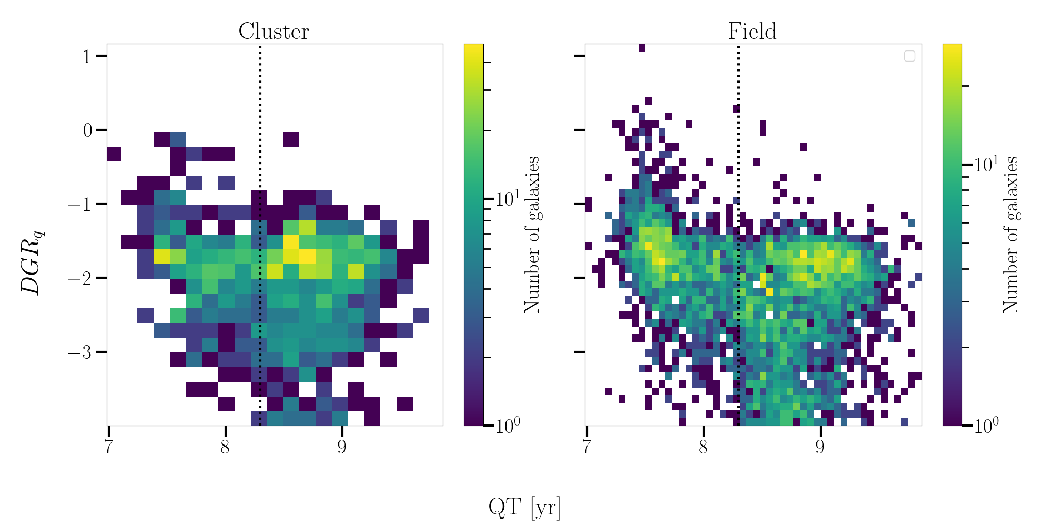
How does QT influences DGR?
On x-axes the quenching time (QT)
On the y-axes the Dust to Gas Ratio (DGR) right after the quenching
Two distinct regions are visible at the typical value of DGR of 0.01
There is an effect of QT!
What are the two clumps?

Slide 13
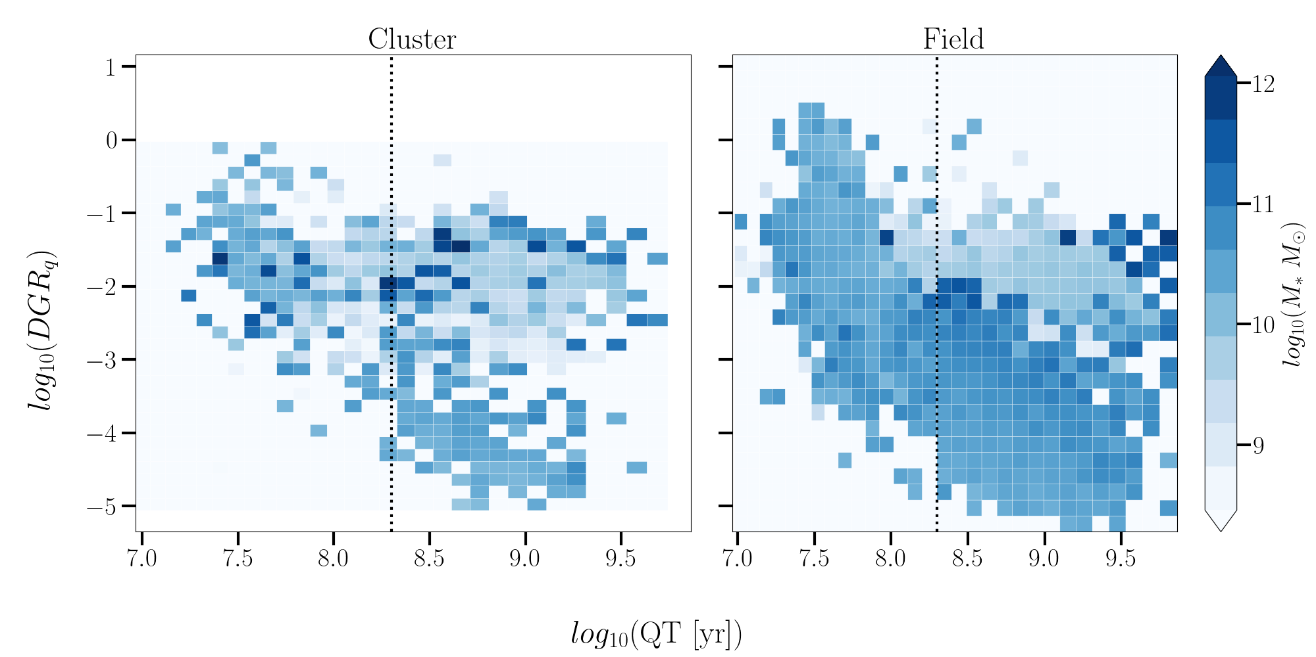
…Masses! Are they the key?
On the colorbar now there is the median value of the stellar mass
Net distinction form masses lower than 10¹⁰ M_{sun}
Low mass galaxies have typical values of DGR and quench slowly
Does the DGR evolve?

Slide 14
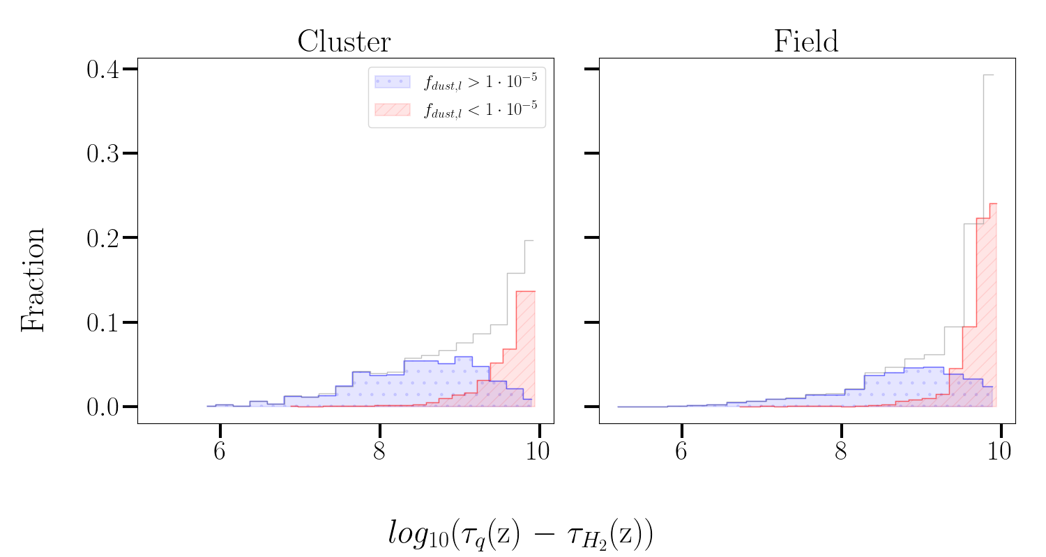
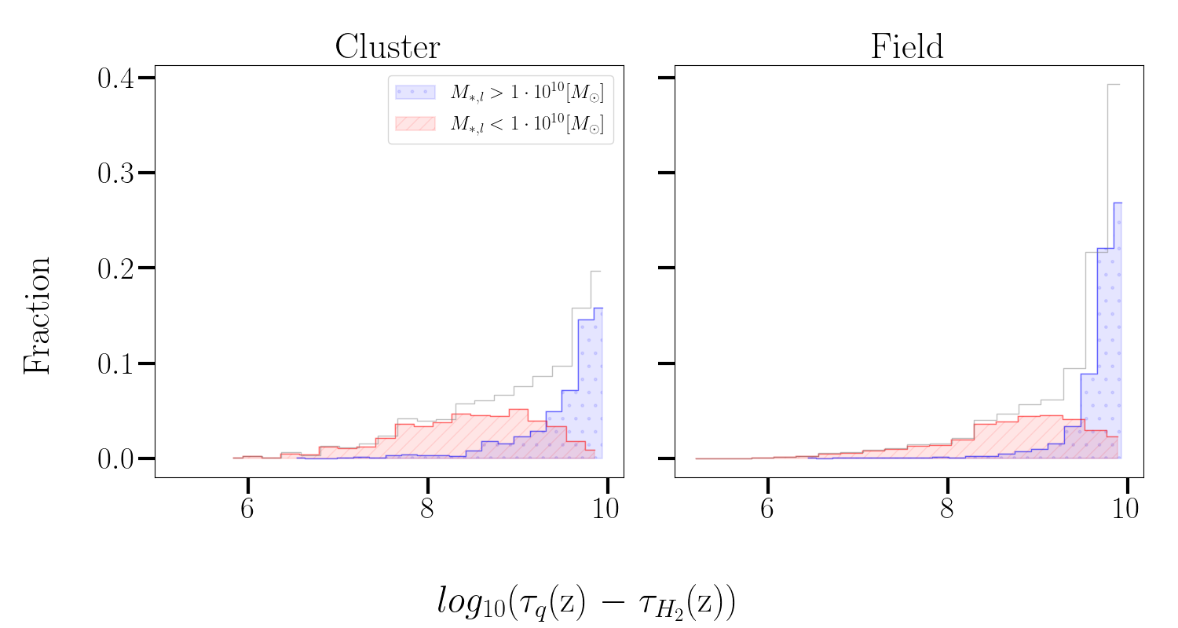
Measuring the last breath
How long does it take for a quenched galaxy to completely exhausting the H₂?
τ_{q}(z) = cosmic time at quenching
τ_{H2}(z) = cosmic time at H₂ exhaustion
Lower dust fractions are reached with longer timescales
Higher mass galaxies reach lower dust fractions

Slide 15
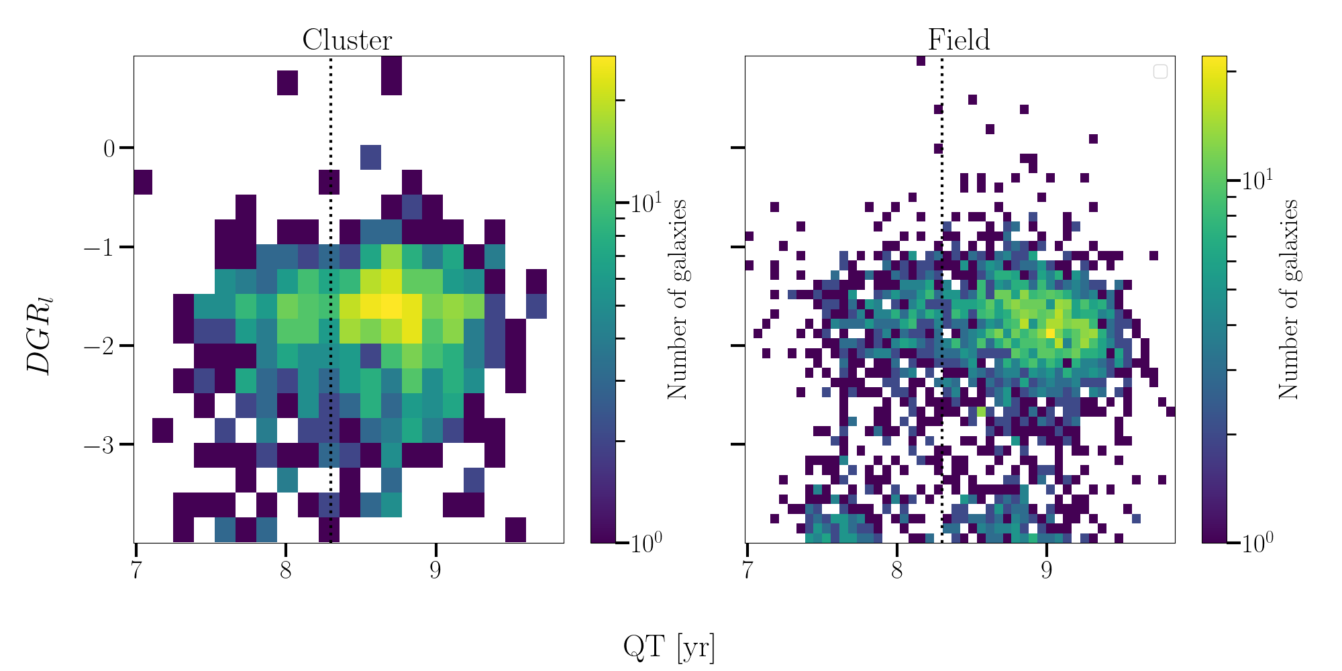
The situation at the galaxy’s death
Galaxies are already quenched
No measurable fraction of H₂
slow quenching galaxies are still largely populating the normal DGR region
The tail of fast quenchers with high dust content and high mass disappeared

Slide 16
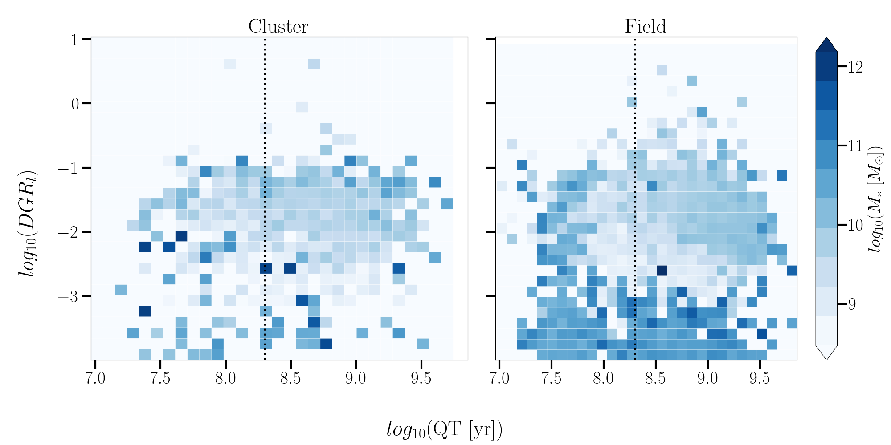
Does the mass distribution still holds?

Slide 17
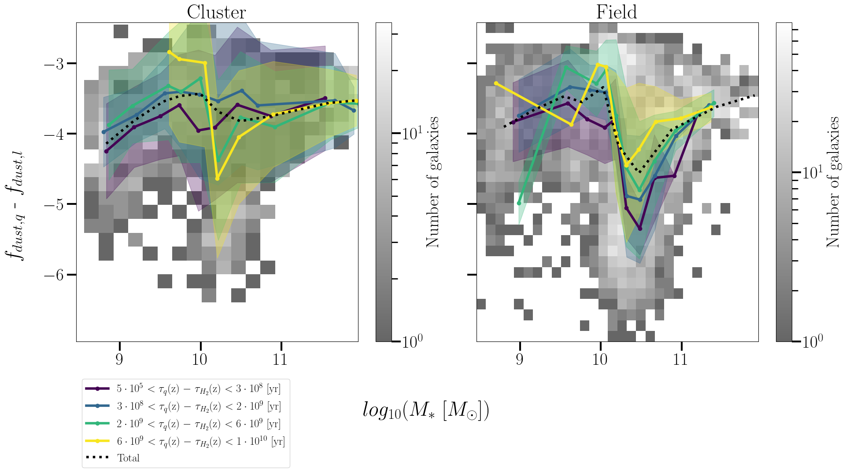
What about the dust?
Molecular gas fraction is decreasing
Again two distinct regions affected by the mass
Galaxies with 10¹⁰ ≤ M_{sun} ≤ 10¹¹ can have stable fraction of dust while exhausting H₂
No dependence with time!

Slide 18
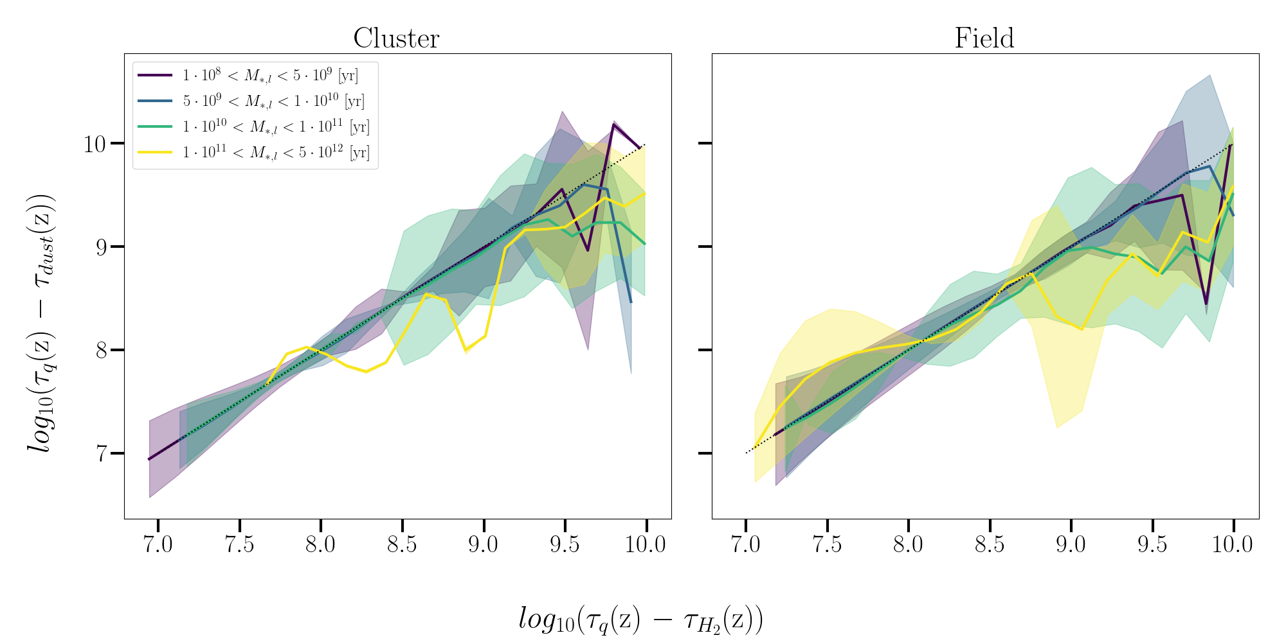
Is dust destroyed more efficiently than gas?
Deviation from linearity at large times for exhaustion
Larger masses seem to destroy dust more efficiently
Again no net difference between clusters and field

Slide 19
Let’s put some numbers together
 | Clusters (%) | Field (%)
Quenched | ~64 | ~18
Slow quench | ~58 | ~65
Fast quench | ~42 | ~35
Mergers (0 ≤ z ≤ 2) | ~46 | ~43
Mergers (in QG phase) | ~31 | ~22
Rejuvenations | ~7 | ~5
Measurable DGR at z = 0 | ~8 | ~9

Slide 20
Future goals
How do these galaxies appear? We need to produce SED to understand what we can expect from observations
Ruling out the cause: We will do the same analysis on different versions of SIMBA to specifically exclude some feedback mechanisms
Observe! Observe! Observe! Simulations are nice to work with, but they are only an approximation of the real thing: we need to compare our analysis with real samples of galaxies!

Slide 21
Thank you!
But before leaving there is something you should see…

Slide 22
Krzysztof Lisiecki
National Center for Nuclear Research (NCBJ)
Ul. Ludwika Pasteura 7, Warszawa (Poland)
krzysztof.lisiecki@ncbj.gov.pl

Slide 23
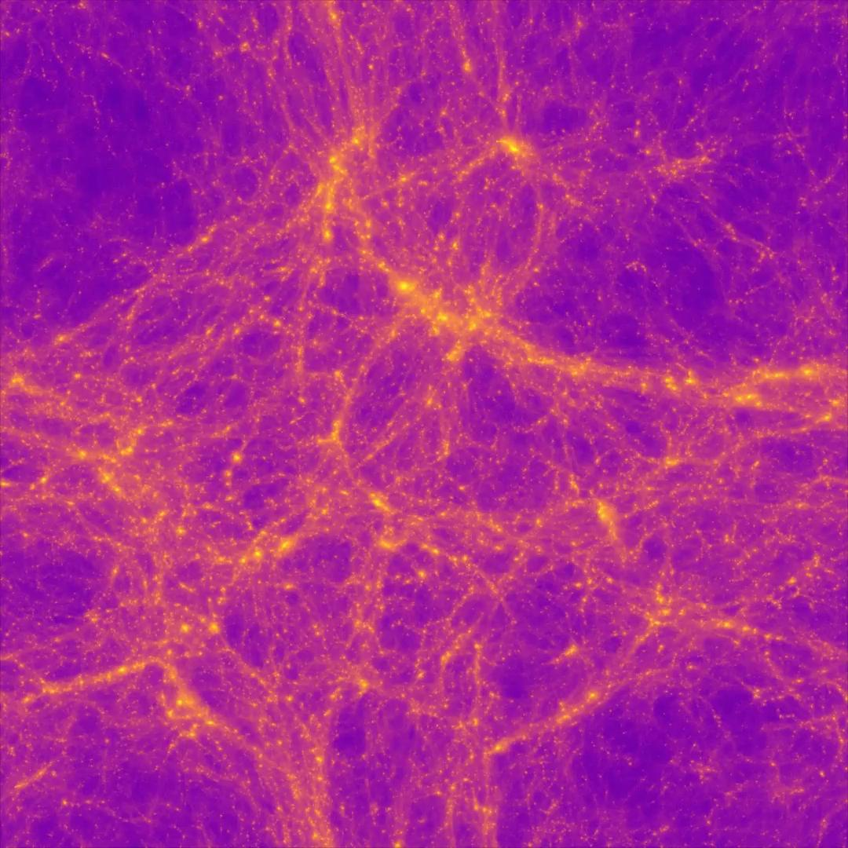

Slide 24
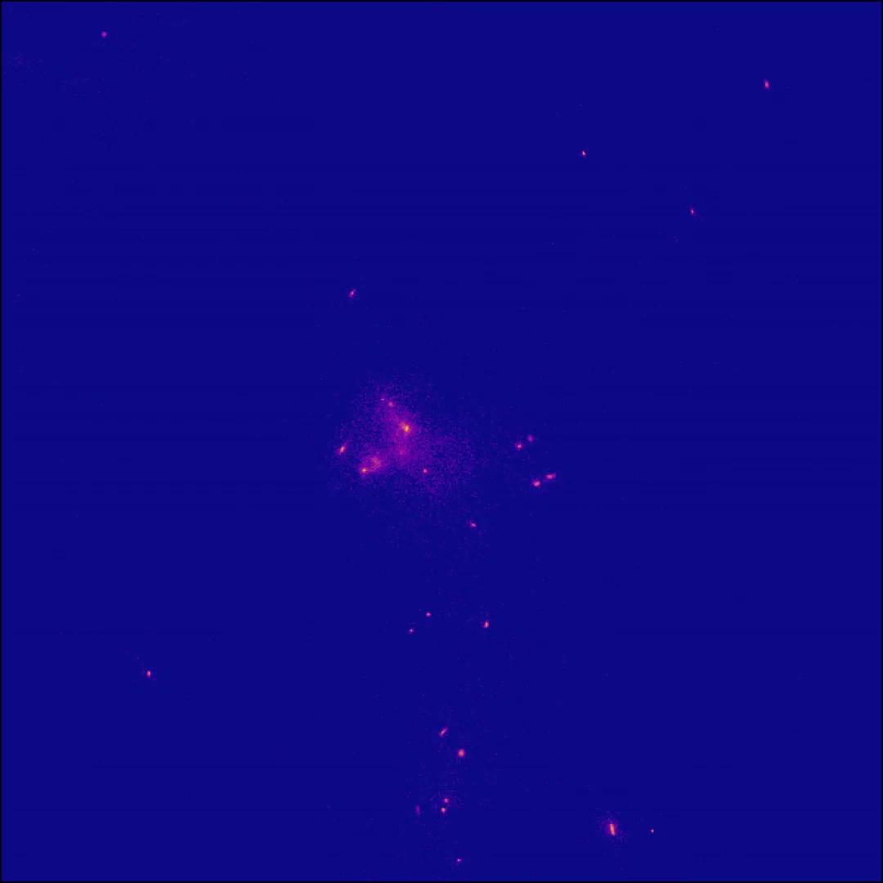

Slide 26
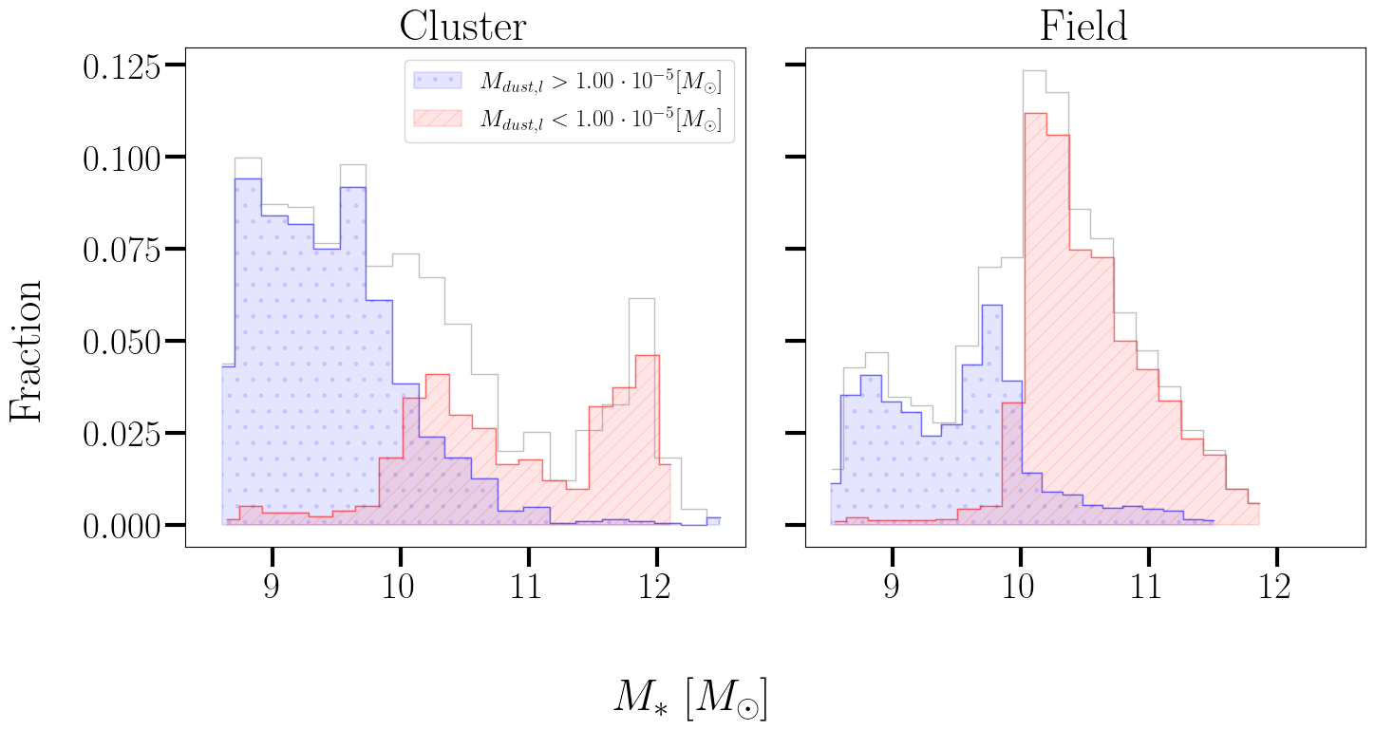
The mass has a key role

