Slide 1
Revealing the subtle differences in the stellar-to-halo mass relationship between different models through subhalo tracking
Austen Gabrielpillai, Weiguang Cui, rachel somerville, Romeel Dave,
Benedikt Diemer, et al.

Slide 2
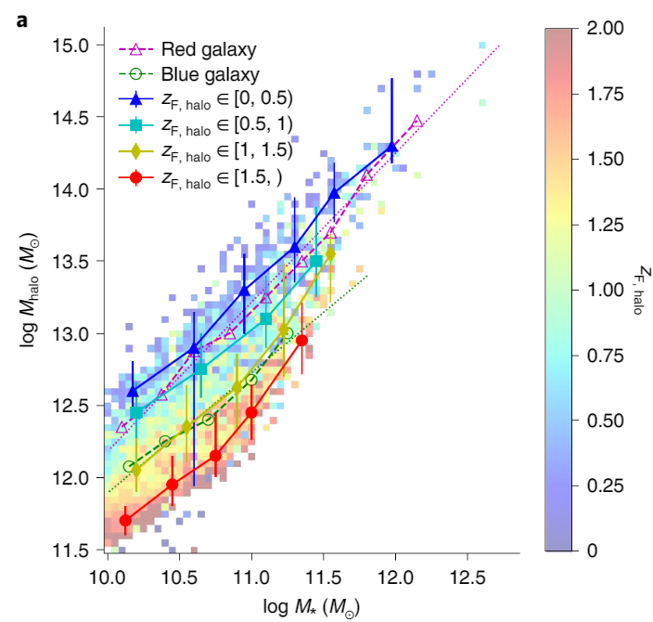
Background: Cui et al. 2021
SIBMA reproduces the color bimodality (blue star-forming galaxies, and red non-star forming galaxies) seen in observations - why?
Found that halos that formed earlier have blue galaxies, halos that formed later have red galaxies
This is due in combination to the gas contents and black hole feedback of the galaxies
Credit: Cui+21

Slide 3
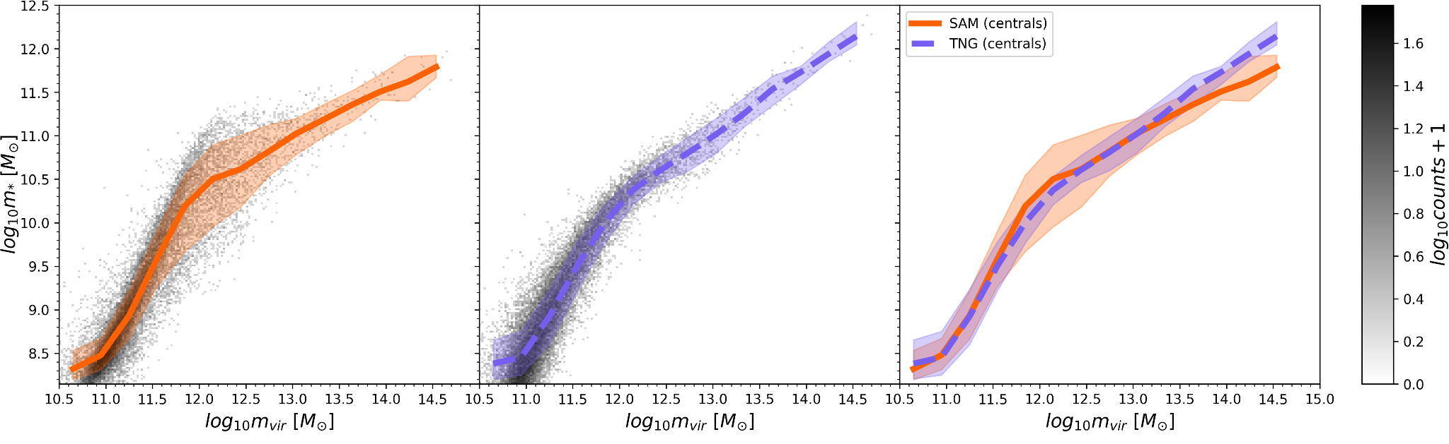
Background: Gabrielpillai et al. 2022
Santa Cruz semi-analytic model runs on IllustrisTNG dark matter-only ROCKSTAR and Consistent-Trees catalogs
Found that z = 0 SMHM relationship residuals correlated with halo concentration (and also formation time (Matthee+17))
This can be explained that earlier formed halos have higher cold gas fractions and late formed have lower (Cui+21)
Credit: Gabrielpillai+22

Slide 4
Objective and Analysis Strategy
Question:
What drives the subtle differences in the z = 0 SMHM relationship when comparing different models?
Analysis strategy:
Central galaxy properties: m*, m_{BH}, m_{HI}, m_{H2}
Sanity checks: z = 0 scaling relationships
z = 6 - 0 history tracks (function of m_{halo})
z = 6 - 0 MMP assembly histories (function of t_{age,universe})

Slide 5
Simulations and Data
One semi-analytic model - Santa Cruz SAM
Runs on IllustrisTNG DMO ROCKSTAR and Consistent-Tree catalogs
Same cosmology as TNG (Plank+16)
Three hydrodynamic simulations - SIMBA, IllustrisTNG, EAGLE
Hydro sim properties below
 | N_{DM} | Cosmology | L_{Box} [Mpc] | m_{DM} [M☉] | m_{baryon} [M☉] | m_{BH,seed} [M☉]
IllustrisTNG | 1820³ | Plank+16 | 110 | 7.6 x 10⁶ | 1.4 x 10⁶ | 1.2 x 10⁶
SIMBA | 1024³ | Plank+16 | 147 | 9.6 x 10⁷ | 1.8 x 10⁷ | 1.5 x 10⁴
EAGLE | 1504³ | Plank+13 | 100 | 9.7 x 10⁶ | 1.8 x 10⁶ | 1.5 x 10⁵

Slide 6
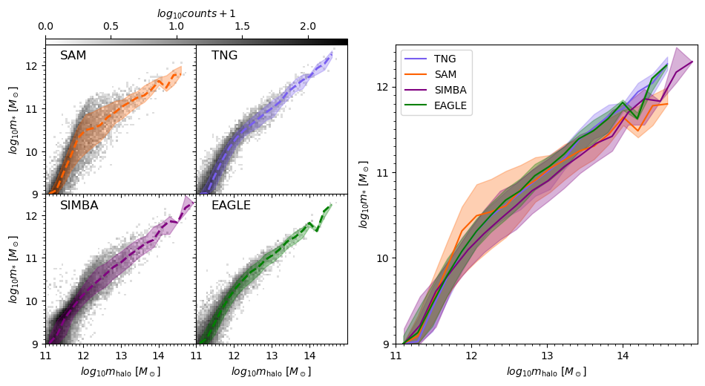
The z = 0 SMHM relationship: scatter and scaling
(Our best friend)
Validation plot for comparing all four models. Generally good agreement
Wider 16-84th percentile dispersion in the SAM between 11.6 < log₁₀ m_{halo} < 12.5

Slide 7
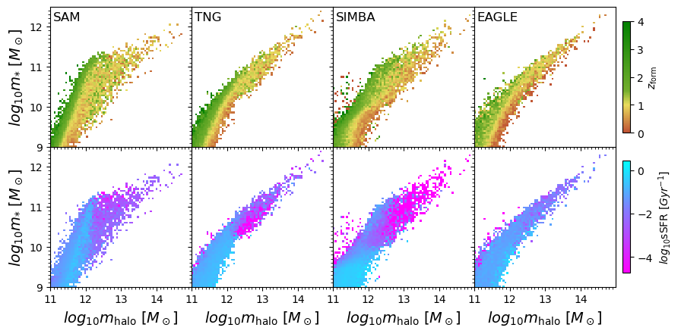
The z = 0 SMHM relationship: z_{form} and sSFR populations
Colored the heatmap distribution based on (top) halo formation time and (bottom) specific star formation rate
sSFR is a proxy for blue (star-forming) and red (quenched). Star forming region matches well to early formation time.
Clearer separation in sSFR populations in some models vs. others (e.g. SAM vs. EAGLE)

Slide 8
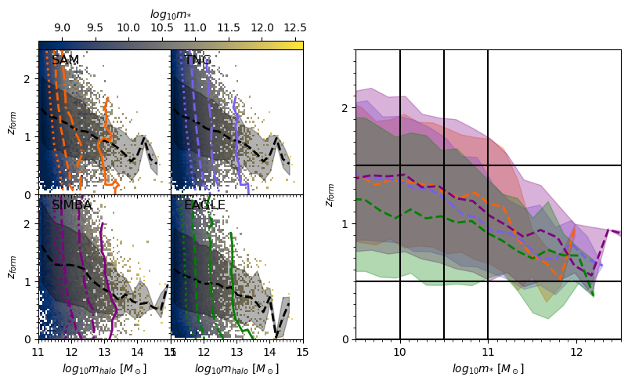
Sampling procedure for evolution tracks and histories
We want to compare tracks of galaxies with similar halo assembly histories:
Identify log m* contours in z_{form}-log m_{halo} space for each model
Compute best fit lines of z_{form} = A(log m_{halo}) + b for each log m* bin contour [9.5, 10, 10.5, 11] via least square solution
Select populations between z_{form} and best-fit m* bins

Slide 9
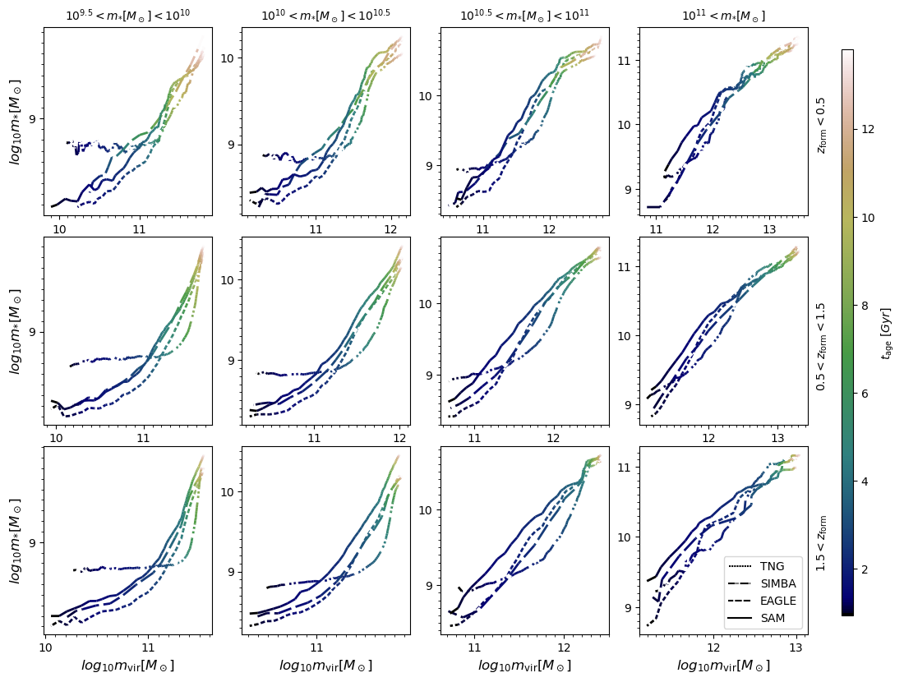
In progress results: stellar mass-halo mass mass tracks
Example of full 12-panel plot of m*-m_{halo} tracks for all z_{form}-m* bins
For each timestep, the median stellar mass is plotted against the median halo mass. Lines segments are colored by t_{age,universe}

Slide 10
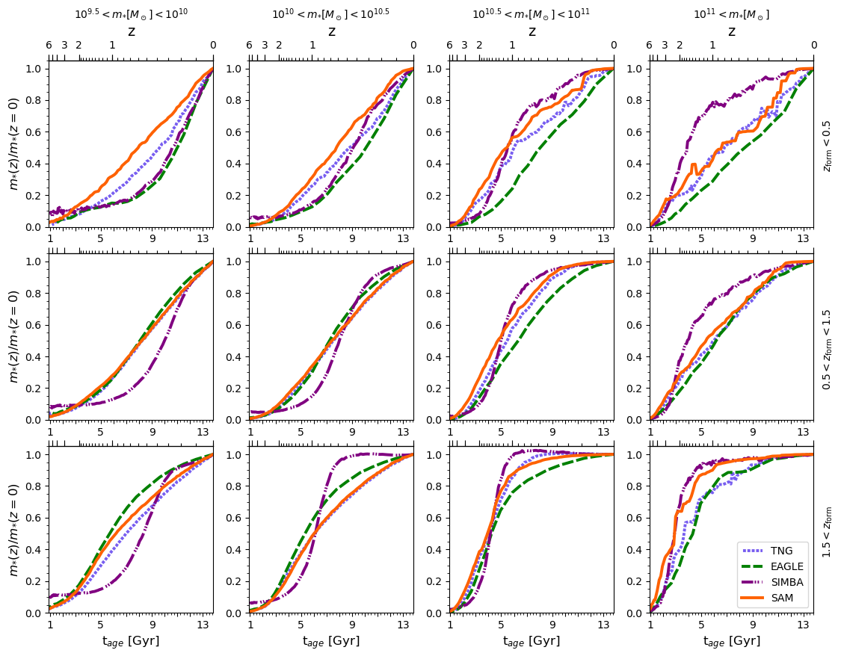
In progress results: stellar mass assembly histories
Example of full 12-panel plot of stellar mass assembly history for all bins
Each history is normalized by the z = 0 value. The median at the timestep is subsequently calculated and plotted
Will show both this and the previous plot for a handful of bins

Slide 11
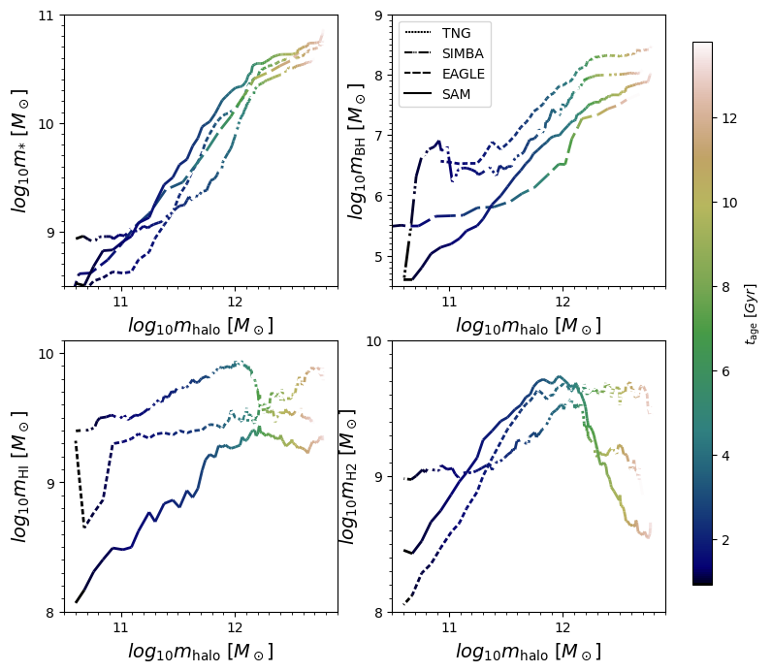
Bin: z_{form} < 0.5, 10.5 < log₁₀ m* < 11.0 (tracks)
m*: all models start slowing down stellar mass growth around a halo mass of ~10^{12.1} M☉
m_{BH}: slow down similar to above
m_{HI}: TNG’s consistent between halo masses 10¹¹ - 10¹² M☉ while SAM and SIMBA are building up
m_{H2}: SAM and SIMBA have a similar decrease at approx. same halo mass, TNG does not

Slide 12
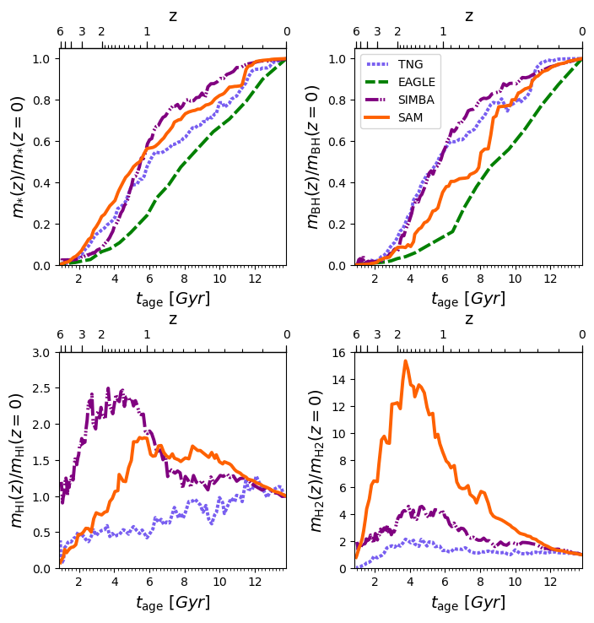
Bin: z_{form} < 0.5, 10.5 < log₁₀ m* < 11.0 (assembly)
m*: SAM, TNG, and SIMBA have similar growth rates. SIMBA and SAM have slowed down star production. TNG is slowing down. EAGLE keeping steady
mBH: SIMBA and TNG have similar growth. TNG black hole growth has come to a crawl. SAM and SIMBA are slowing down growth. EAGLE keeping steady.
mHI: TNG maintains a consistent build up. SIMBA peaked earlier than the SAM
mH2: SAM and SIMBA peaks are at a similar time, albeit different heights

Slide 13
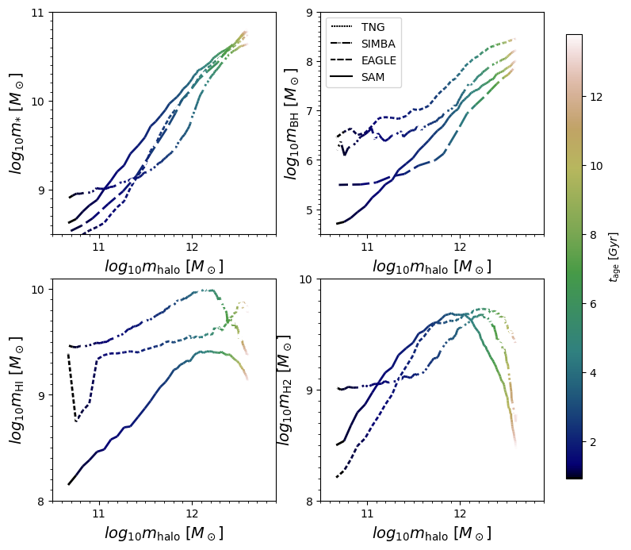
Bin: 0.5 < z_{form} < 1.5, 10.5 < log₁₀ m* < 11.0 (tracks)
m*: all models again agree pretty well at m_{halo} ~ 10^{12.2} M☉
m_{BH}: black hole growth again slowing down at m_{halo} ~ 10^{12.1} M☉
m_{HI}: TNG similar to previous bin. Dropoff now seen both in SIMBA and SAM
m_{H2}: all three models are losing gas mass

Slide 14
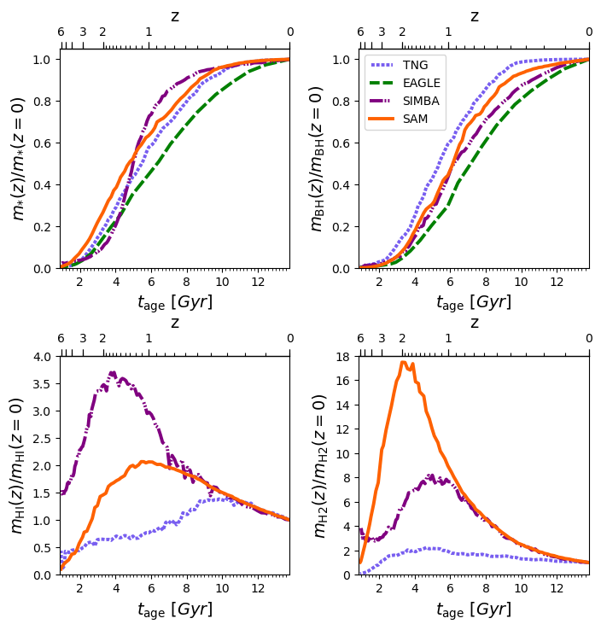
Bin: 0.5 < z_{form} < 1.5, 10.5 < log₁₀ m* < 11.0 (assembly)
m*: SIMBA, SAM, TNG level off similarly. EAGLE does later
mBH: TNG’s black holes stop growing first, followed by SAM, SIMBA, and lastly EAGLE
mHI: SIMBA peaks earlier than the SAM by a bit, similar loss rates
mH2: SAM peaks earlier than SIMBA, similar loss rates

Slide 15
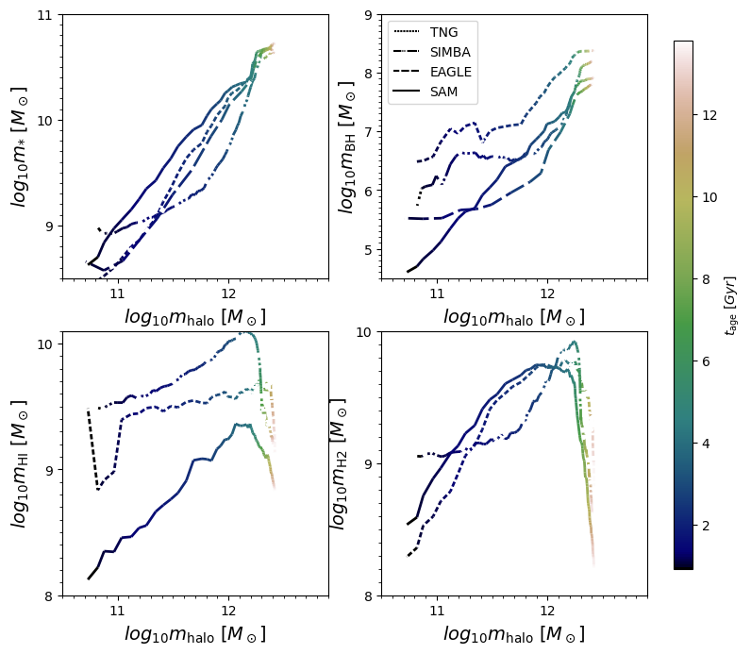
Bin: z_{form} > 1.5, 10.5 < log₁₀ m* < 11.0 (tracks)
m*: appears to be low growth in both stellar mass and halo mass
mBH: similar to above
mHI: Similar to previous bin but now all three models lose gas mass
mH2: all three models appear to undergo a very similar downturn at approximately the same halo mass

Slide 16
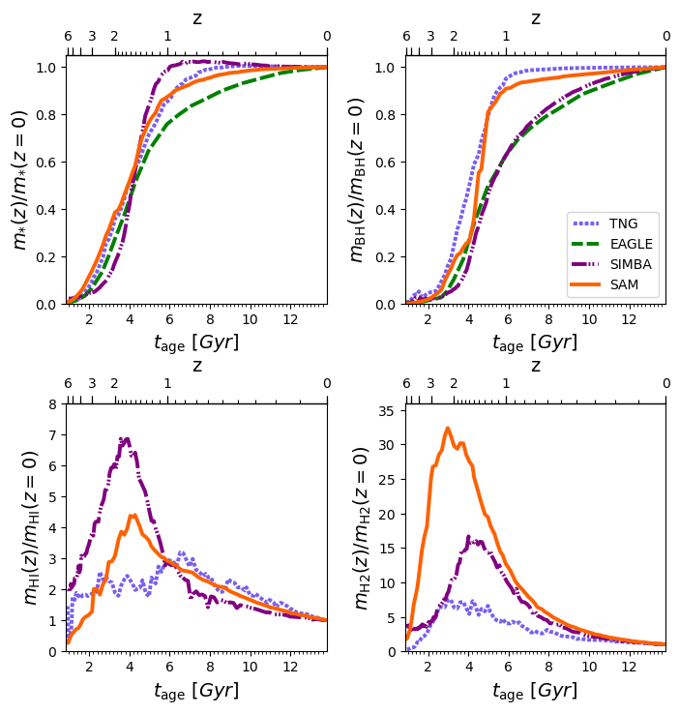
Bin: z_{form} > 1.5, 10.5 < log₁₀ m* < 11.0 (assembly)
m*: SIMBA has stopped forming stars first, followed by TNG, SAM, and last EAGLE
mBH: TNG’s and SAM’s growth has stopped fairly early, EAGLE and SIMBA are fairly similar
mHI: SIMBA and SAM peak nearly same time. All three are losing mass
mH2: SAM, TNG, and SIMBA peak somewhat similarly. SAM > SIMBA > TNG in height. Similar consumption in SAM and SIMBA

Slide 17
Thoughts & next steps
Understanding the physical models in detail
The potential culprit - difference in AGN feedback models?
Check gas fractions, (re-)add EAGLE cold gas measurements
Audience thoughts are welcome!

