Slide 1
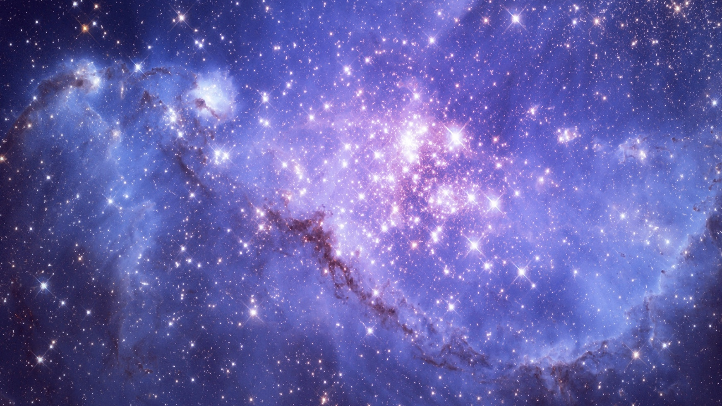
Using CNN to Predict Galaxy Properties
Jinoo Kim Josh Speagle, Kartheik Iyer, Lamiya Mowla

Slide 2
Motivation
Too much data! Might not fully utilize data we acquire​
Galaxy properties/parameters are often computationally expensive
Check if CNN can be employed to solve these issues​

Slide 3
Convolutional Neural Network (CNN)
Convolutional layer: A layer with multiple filters convolving across the input images and capturing key features
Max Pooling layer: A layer that decreases size of the convolution and helps to capture larger features in next convolutional layer
Fully Connected layer: Usually the last layer of CNN. It takes information from previous layers and predicts output

Slide 4
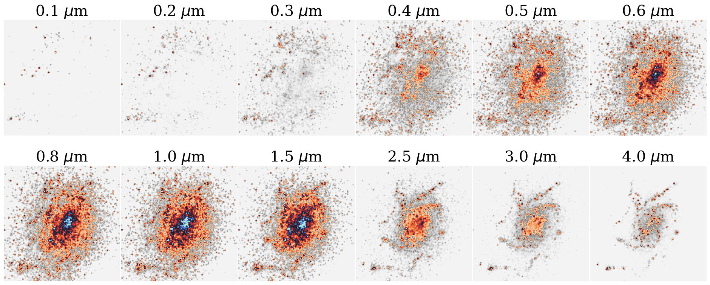
What data am I using?
Images of SIMBA galaxies produced by PowderDay, an open source 3D dust radiative transfer package
Images from 0.215mic to 860mic
Galaxies at redshift 0.5, 1, 2, 3

Slide 5
Performance of CNN

Slide 6
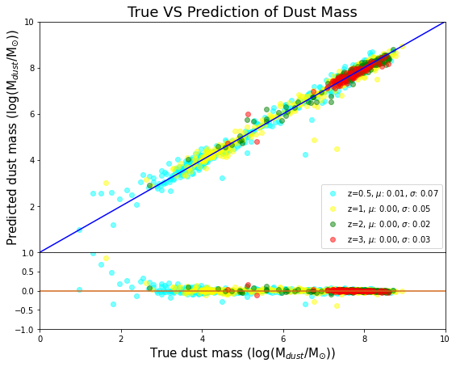
How good are predictions?
Top: True VS Prediction
Bottom: Fractional residual
Fractional residual = $\frac{Prediction − True value }{True value}$
CNN is performing well but is it actually more helpful than using the raw data?

Slide 7
UMAP: a dimension reduction method

Slide 8
UMAP: What is it?
Source: Understanding UMAP - https://pair-code.github.io/understanding-umap/

Slide 10
Information CNN takes

Slide 11
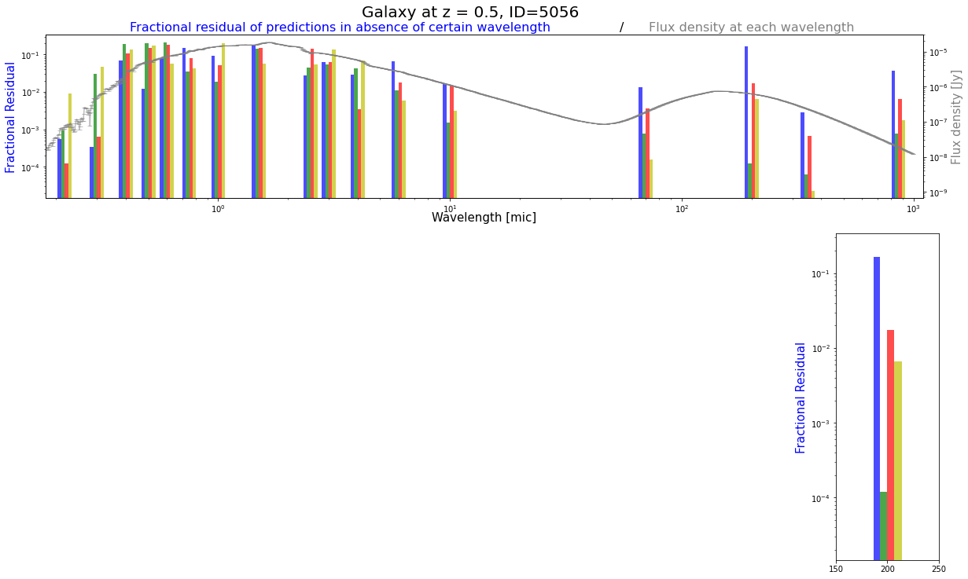
Grey line: SED of a sample galaxy
Bar charts: Fractional residuals of predictions
Dust mass, Gas mass, SFR, half-stellar mass radius
$Fractional residual of predictions =$
$$\frac{|Original Prediction −Prediction without a wavelength|}{Original Prediciton}$$

Slide 12
Spatial information the CNN looks at

Slide 13
Conclusion and Future Prospect
Current results show that CNN is not a black box system
We know convolutions are effective, which wavelength information CNN takes, and where it looks
Knowing how CNN works, other approaches can be taken
Analyzing real galaxy images and/or images from other simulations
More detailed analysis; when does CNN look at surrounding or the center of galaxies? Any tendency on importance of certain wavelengths?

