Slide 1
Zoomed-in simulations with SIMBA
Al(most)l Preliminary results!
Weiguang Cui
in collaboration with SIMBA developers
Fred Jennings (for HYENAS galaxy groups)
and Qingyang Li with the300 collaboration (for the300 galaxy clusters)
02/05 SIMBA Collaboration Meeting @ Flatiron Institute's Center for Computational Astrophysics

Slide 2
Why do we want to do zoomed-in simulations?
Resolution matters!
HOW do we select zoomed-in objects?
High HPC cost for cosmology hydrodynamic simulations.
High resolution to resolve/investigate the non-linear regions
Statistics!
A fair sample to represent the whole population – The HYENAS groups
Select all mass complete sample – The300 galaxy clusters

Slide 3
Quiz 1

Slide 4
Resolution matters! – galaxy groups

Slide 5
Resolution matters! – disk galaxy

Slide 6
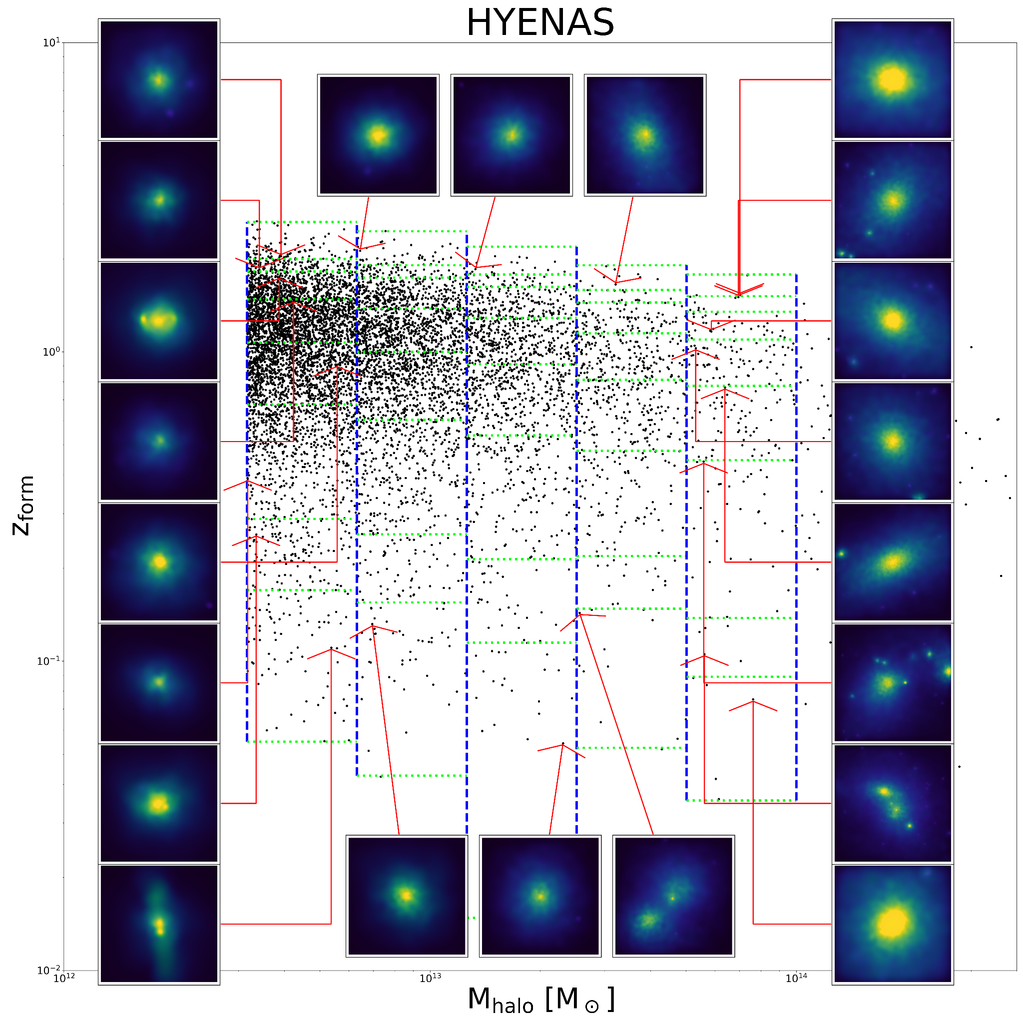
The HYENAS project
Parent DMO simulation (same res as SIMBA-100)
200 Mpc/h volume
2048^3 dm particles – 7.75381X10^7 Msun/h
Planck-like cosmology parameters
Selection Criteria
5 halo mass bins
8 z_form bins, why z_form?? See Cui+21 and Austen’s talk
2-5-20-50-80-95-98 in percentiles
3 isolated halos in each region**
Final sample: 120 halos selected for zoomed-in ICs
Three levels of resolutions: L0, L1, L2, each is 8X higher resolution than its previous level.
Great thanks to Fred!
** Isolation criteria: No neighbours with M200m>10^12.3 Msun/h in 4*R200m

Slide 7
The HYENAS project : more details
Using MUSIC to generate these zoomed-in ICs:
Grid level 11 white noise from m200n2048 simulation is used to make sure the same initial seeds
All FoF halo particles are traced back to the IC to get the high-res region, centre is the median of <5 kpc/h halo center (min pot) particle positions at IC, radius is 2* maximum particles distance to the centre
Lower resolution region down to grid level 7.
L0 ICs (high-res region) have the same res as the parent m200n2048 simulation but including gas particle mass: ~1.2X10^7 Msun/h
L1 ICs have max grid level 12: gas particle mass: ~1.5X10^6 Msun/h
L2 ICs have max grid level 13: gas particle mass: ~1.9X10^5 Msun/h
L0, L1 and L2 all have DMO-counterpart ICs

Slide 8
The HYENAS project : status
Updated GIZMO-SIMBA code, but still not SIMBA-C (see Renier’s talk)
L0 is done
L1 is selected 30 Elite sample is done.
Only one L2 group is done.
Paper to be finished.
Happy to share these ICs/simulation results to anyone who is interested.

Slide 9
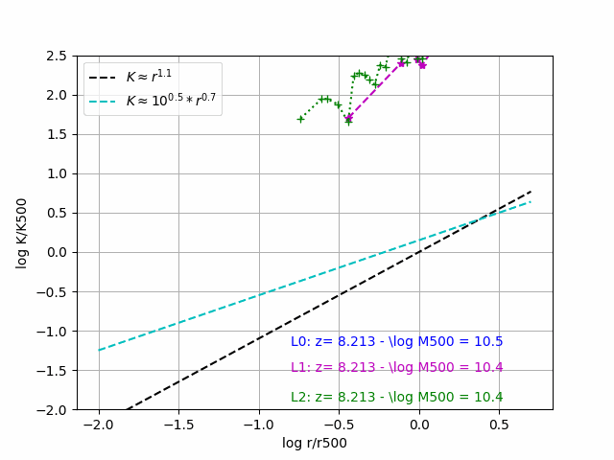
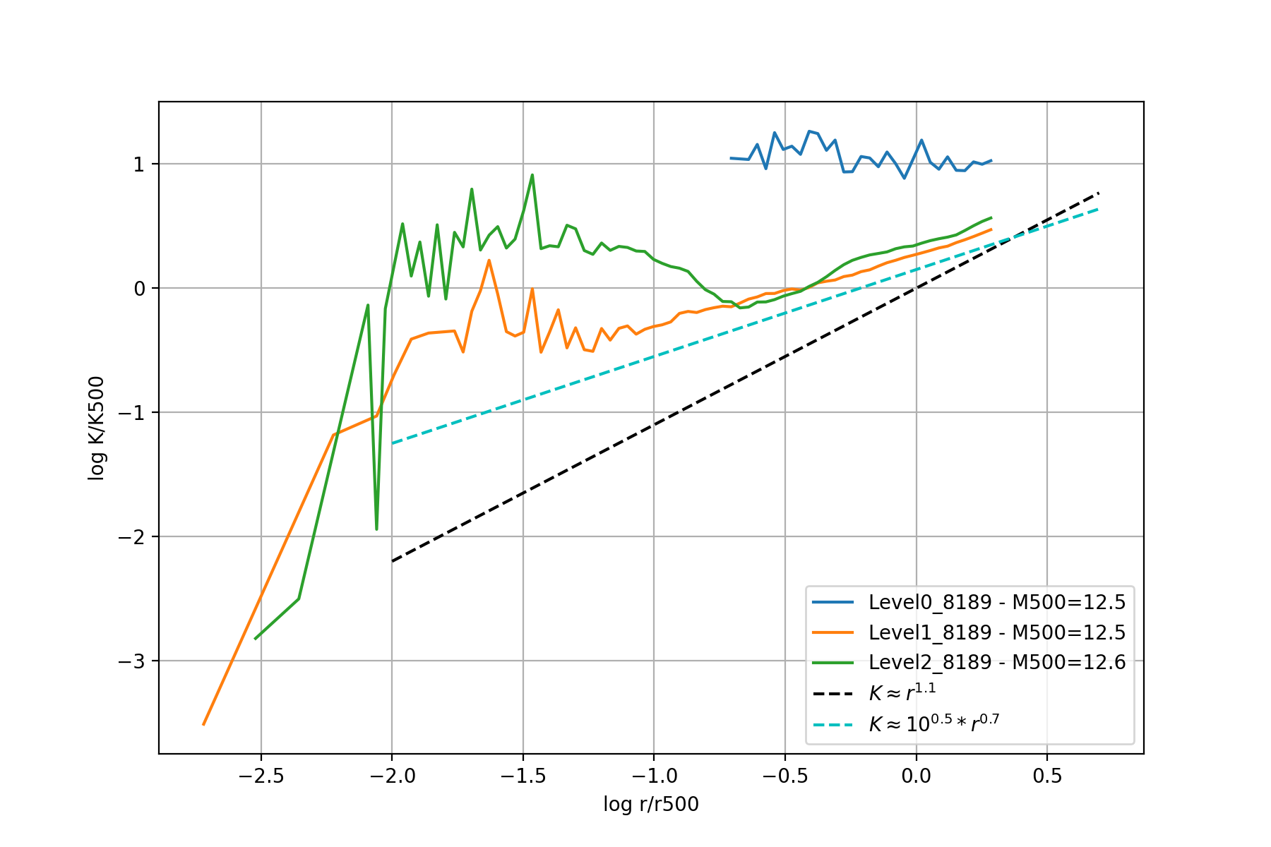
The HYENAS project – resolution matters
The entropy profile

Slide 10
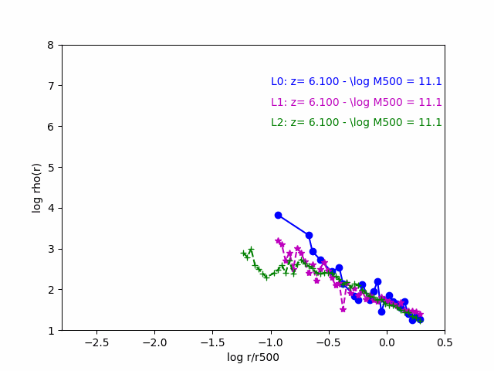
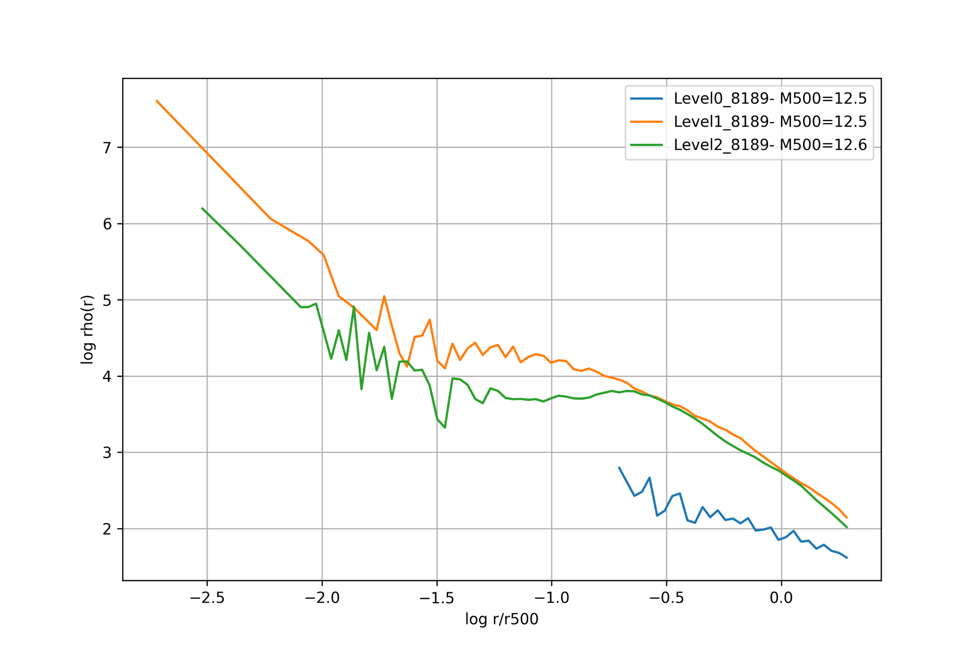
The HYENAS project – resolution matters
gas density

Slide 11
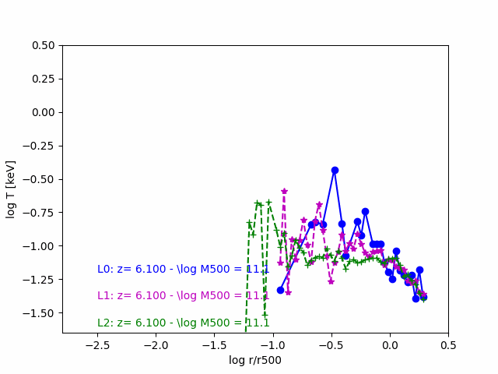
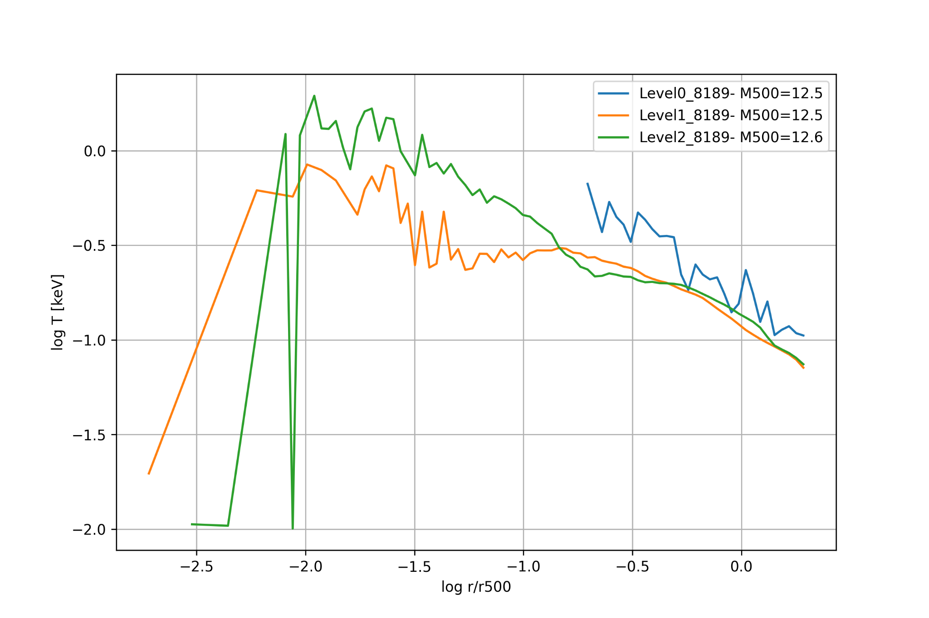
The HYENAS project – resolution matters (not for everyone)
Gas Temperature

Slide 12
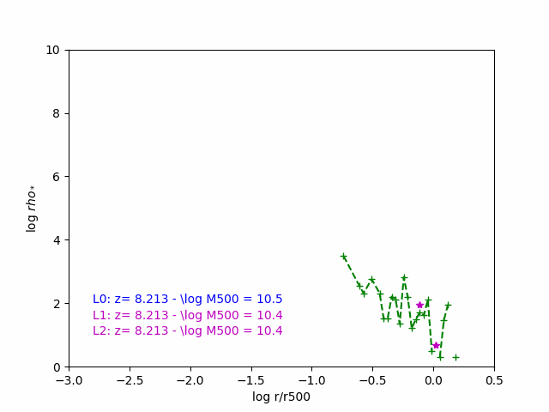
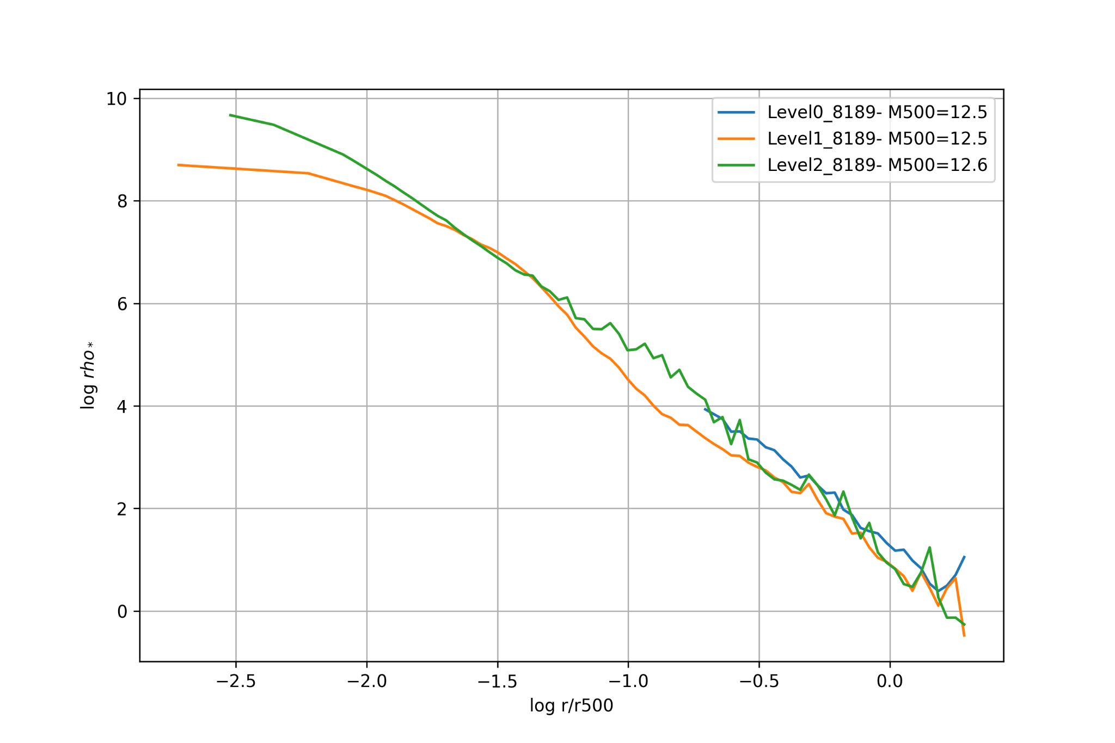
The HYENAS project – resolution matters (not for everyone)
Stellar density

Slide 13
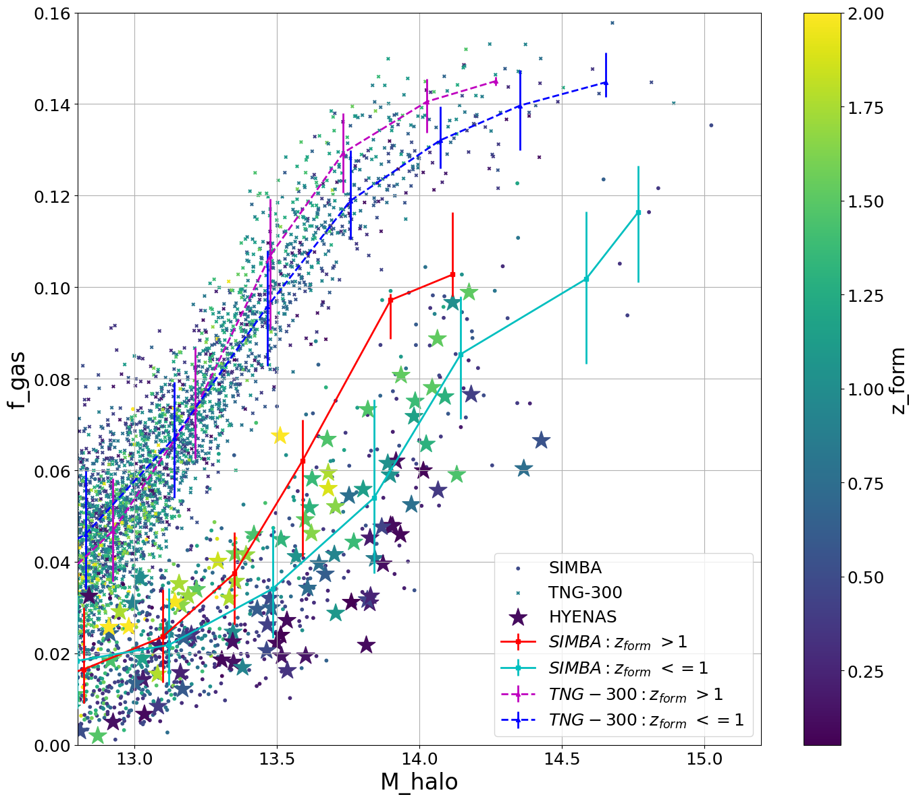
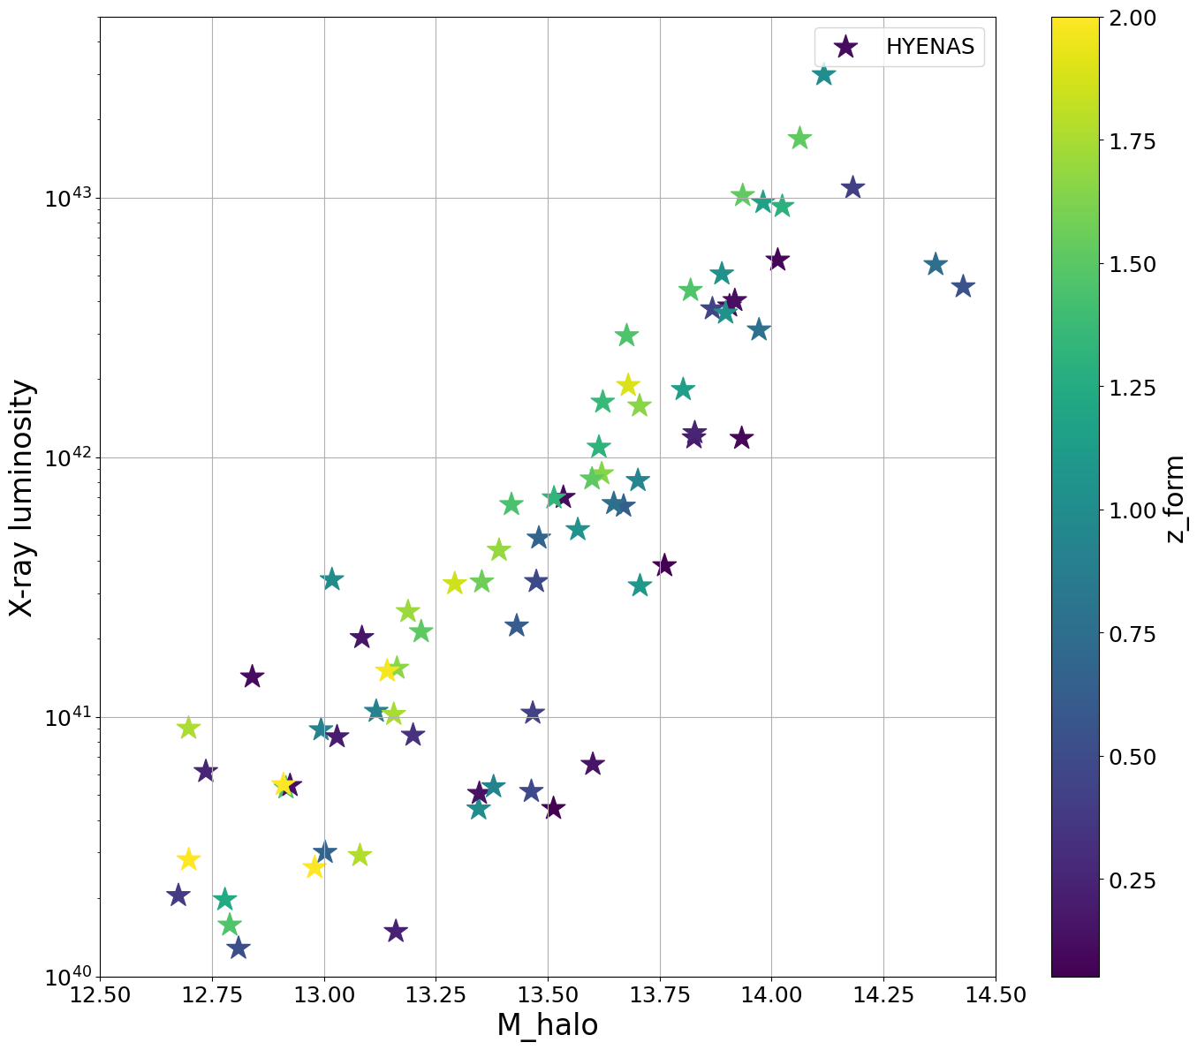
The HYENAS project – formation time matters

Slide 14
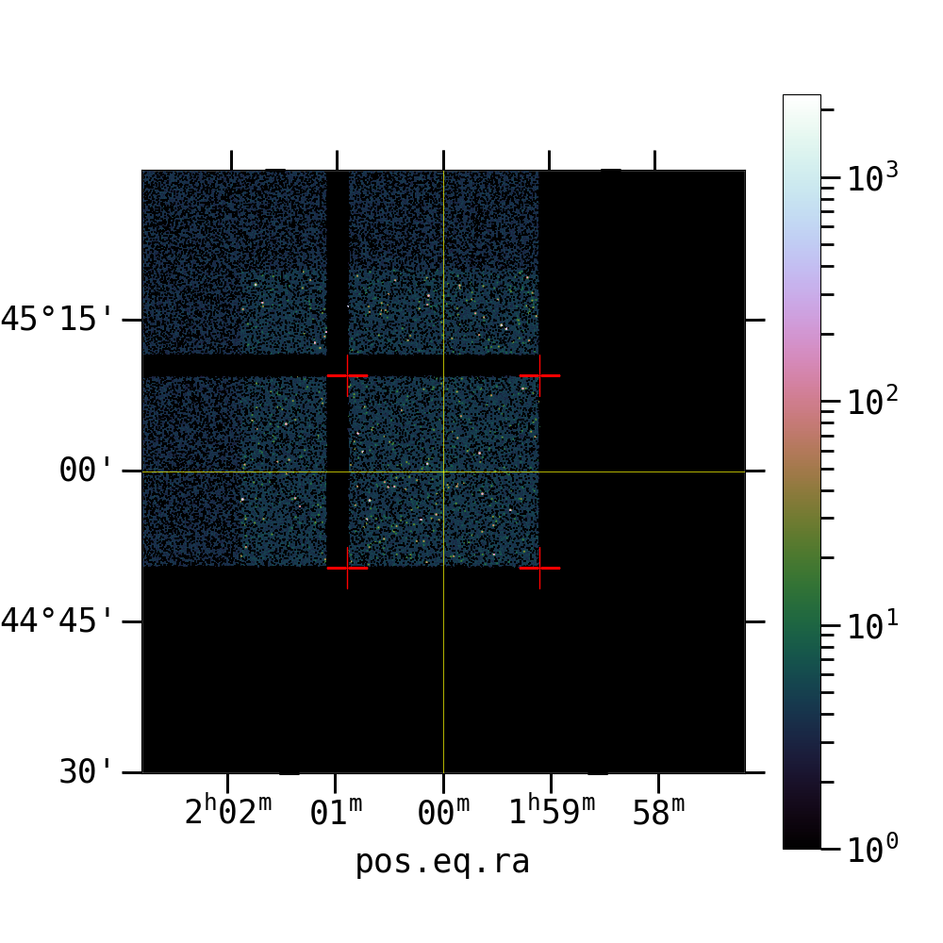
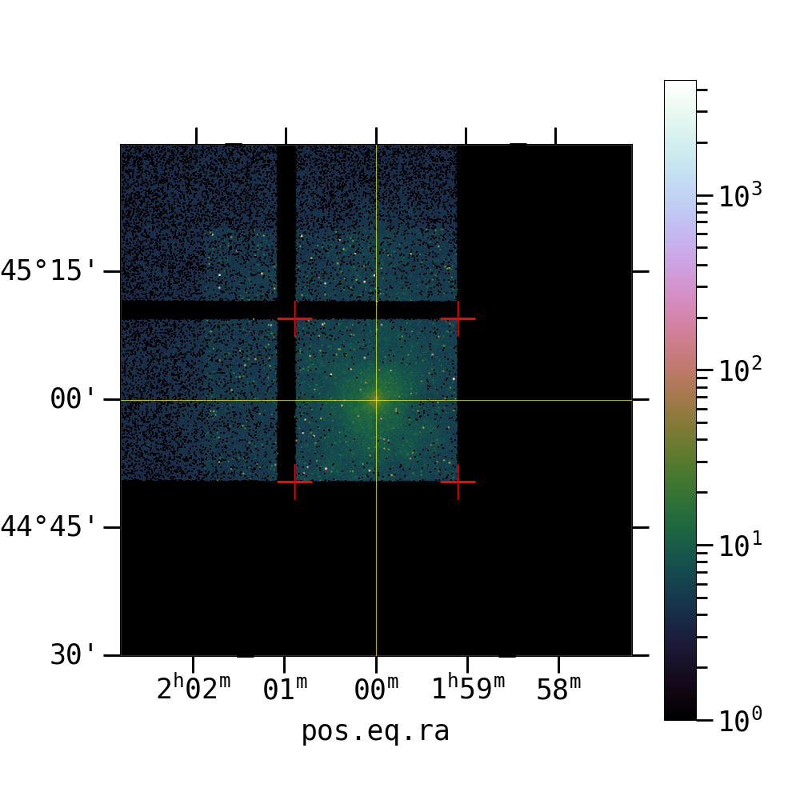
Xray Lum: 4.44e+40, Z_form: 0.05, \log M_halo= 13.5
Xray Lum: 3.25e+41, Z_form: 1.85, \log M_halo= 13.3

Slide 15
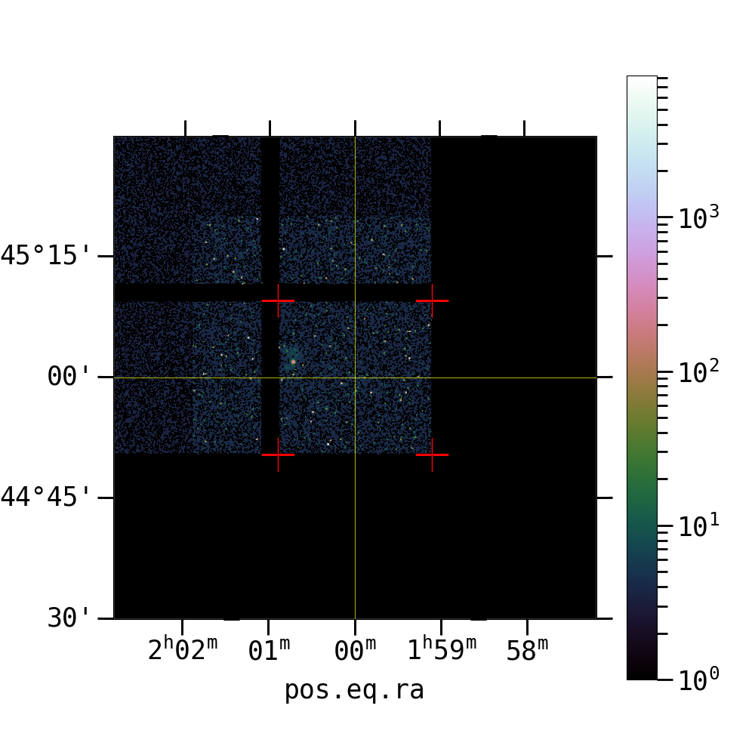
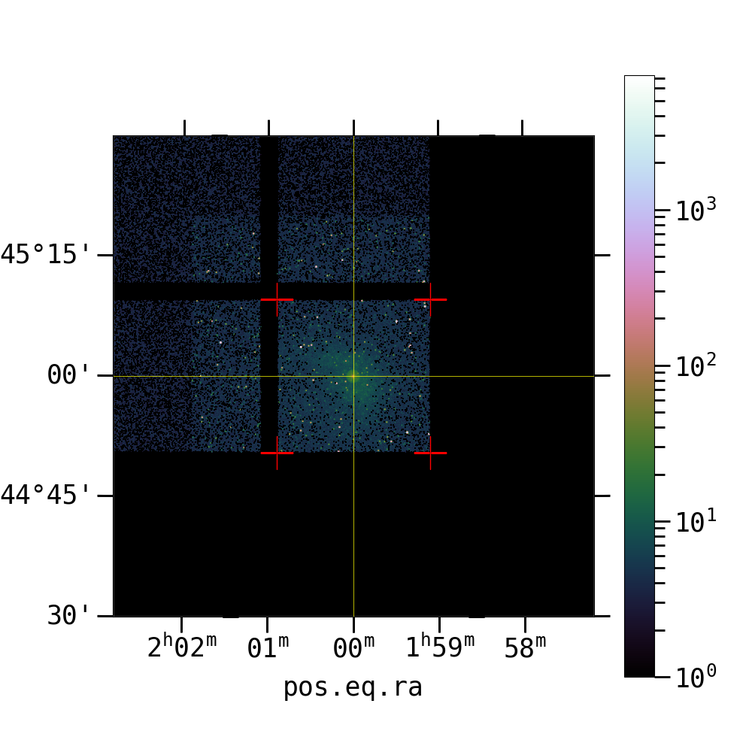
Compare similar luminosity
Xray Lum: 1.42e+41, Z_form: 0.11, \log M_halo= 12.8
Xray Lum: 1.54e+41, Z_form: 1.66, \log M_halo= 13.1

Slide 16
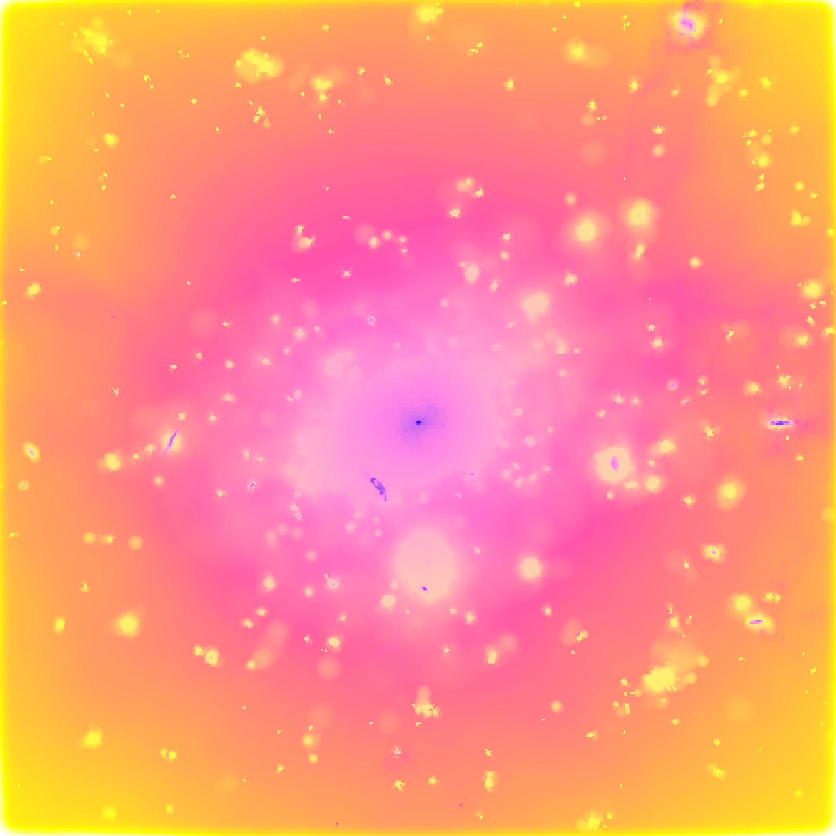
Mass matters – The300 project
Quiz 2

Slide 17
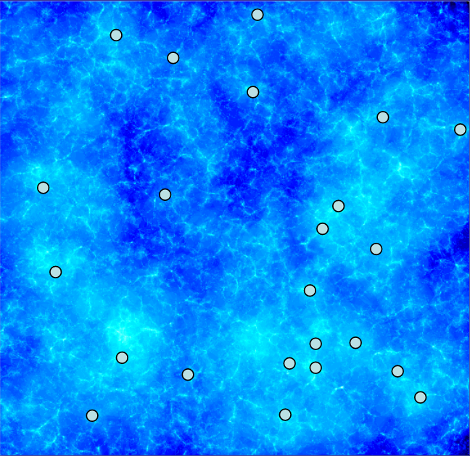
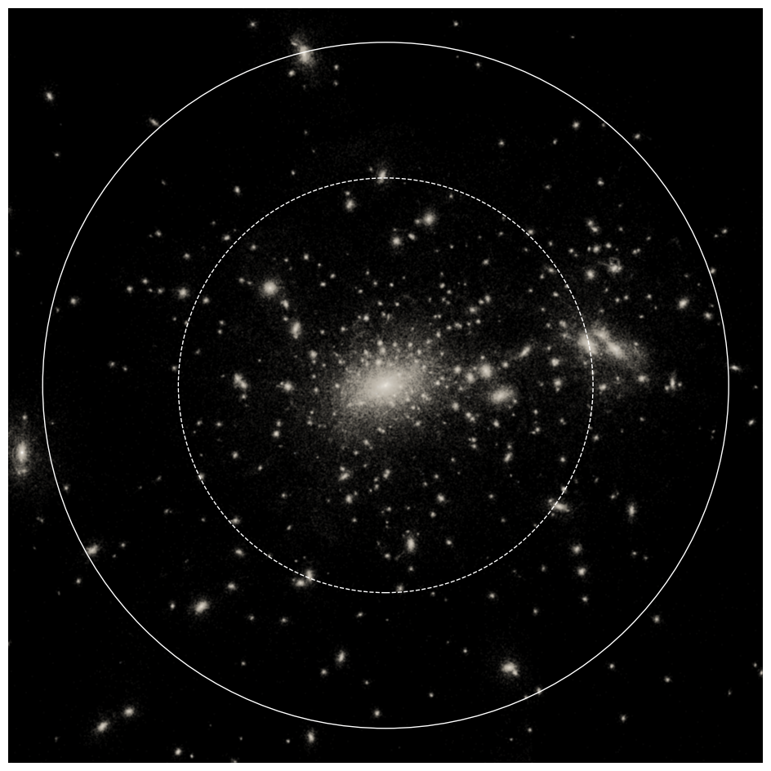
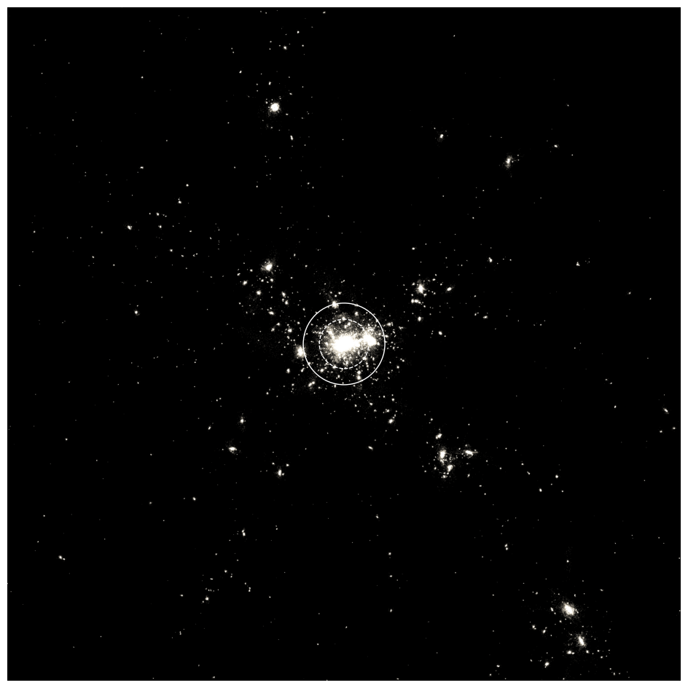
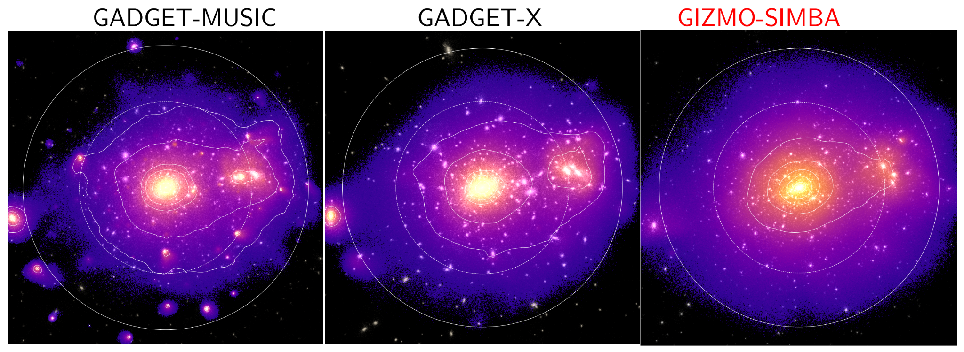
Mass complete samples
R500/R200 ~ 2Mpc/h
15 Mpc/h
Resolution: gas particle mass ~ 2e8 M☉/h

Slide 18
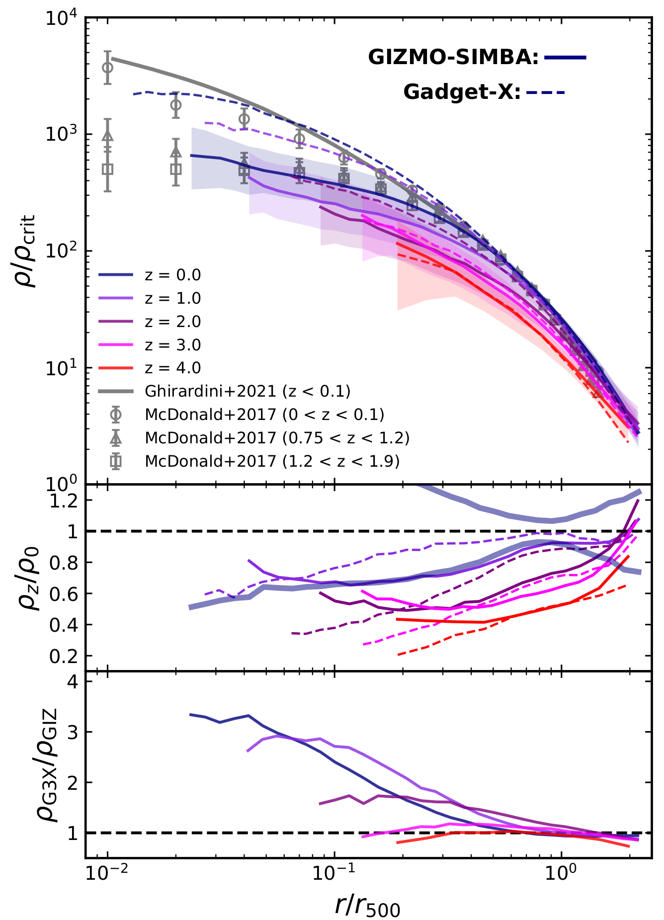
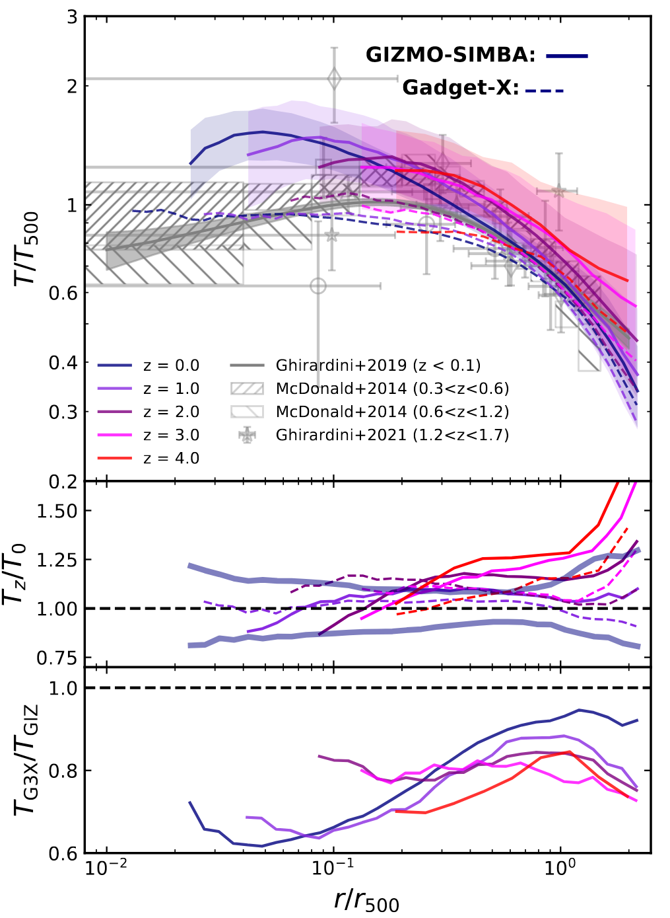
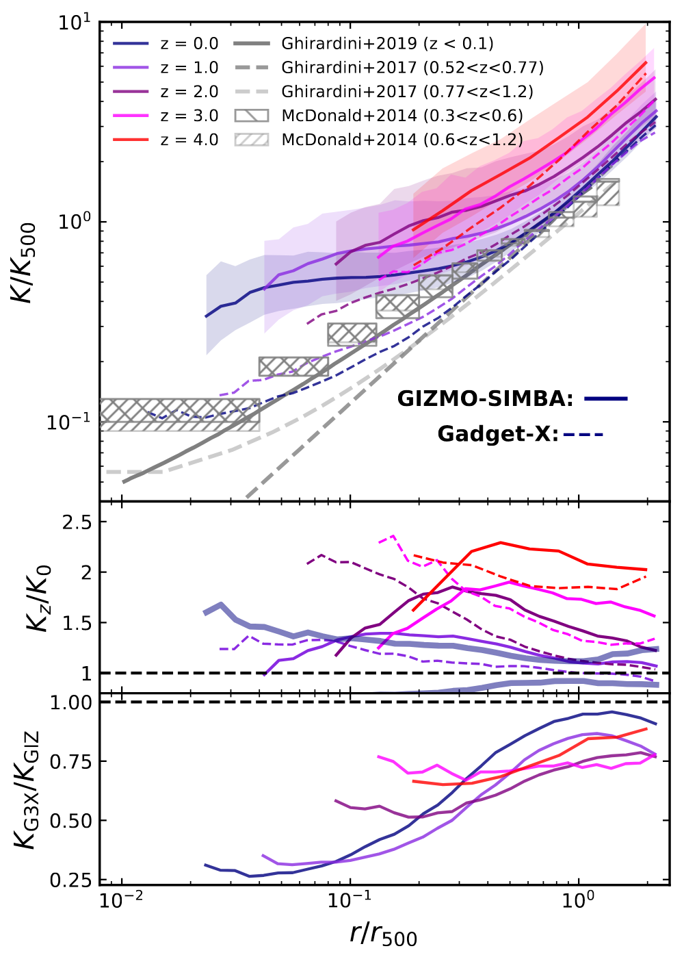
The300: Gizmo-Simba – See Cui et al. 2022
More details about the SIMBA run can be found also at https://weiguangcui.github.io/assets/presentations/The_Three_Hundred_Presentation_STSci.pdf
The300 SIMBA run was calibrated by galaxy/stellar properties… But
Li et al. submitted

Slide 19
The300: Simba-C with HR ICs ~10^7 M☉/h for gas mass
SIMBA-C, see the talk given by Renier
Expanding over the knee

Slide 20
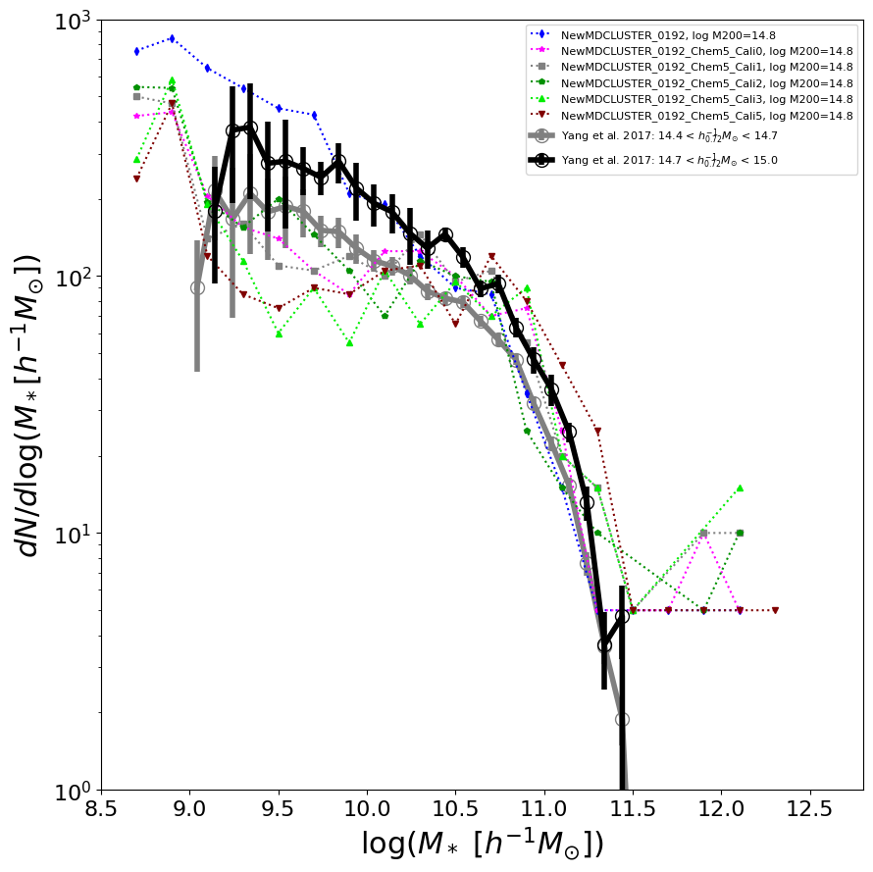
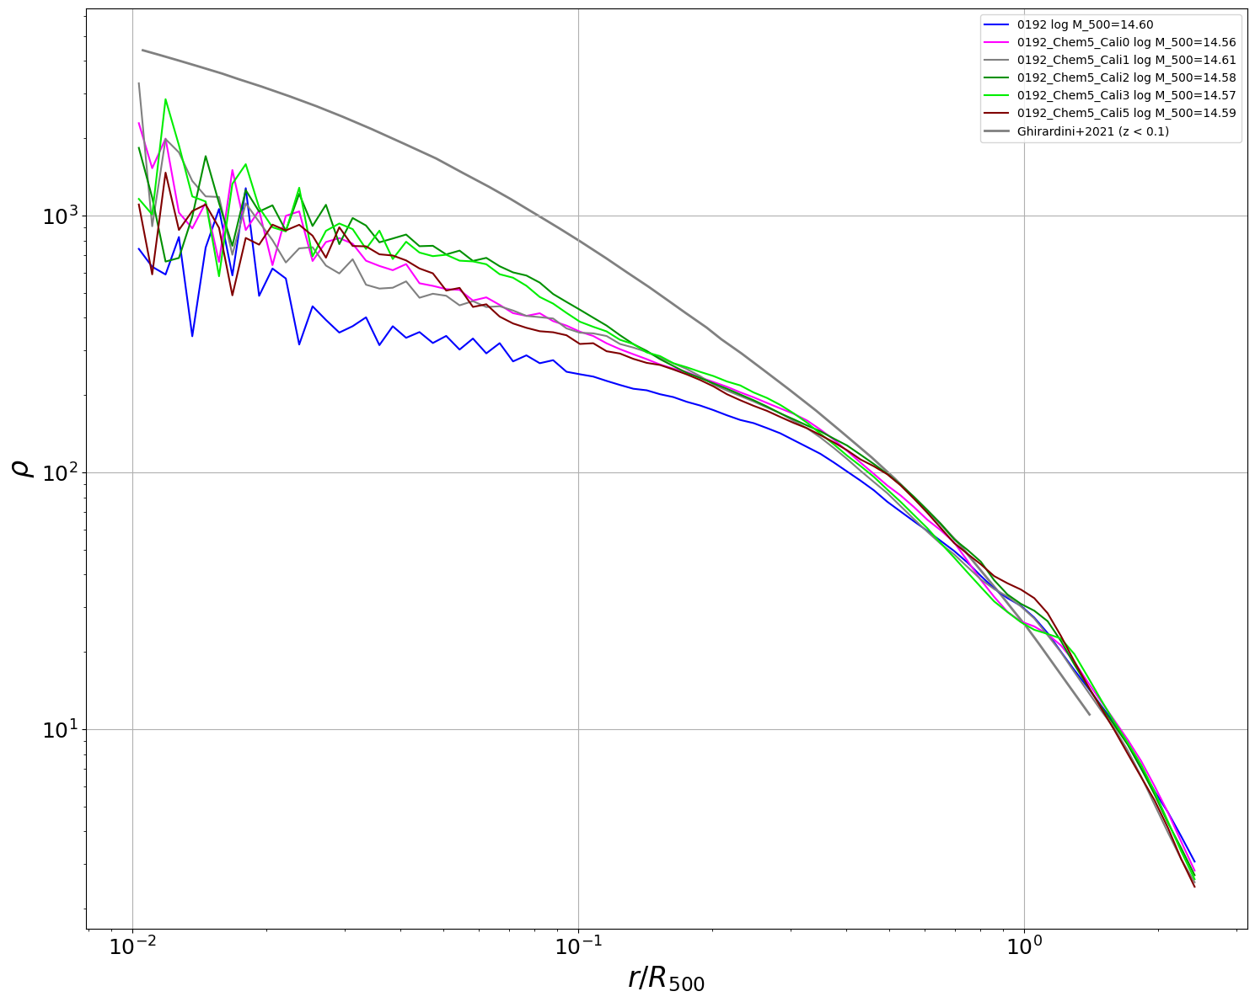
The300: Simba-C Calibration problems

Slide 21
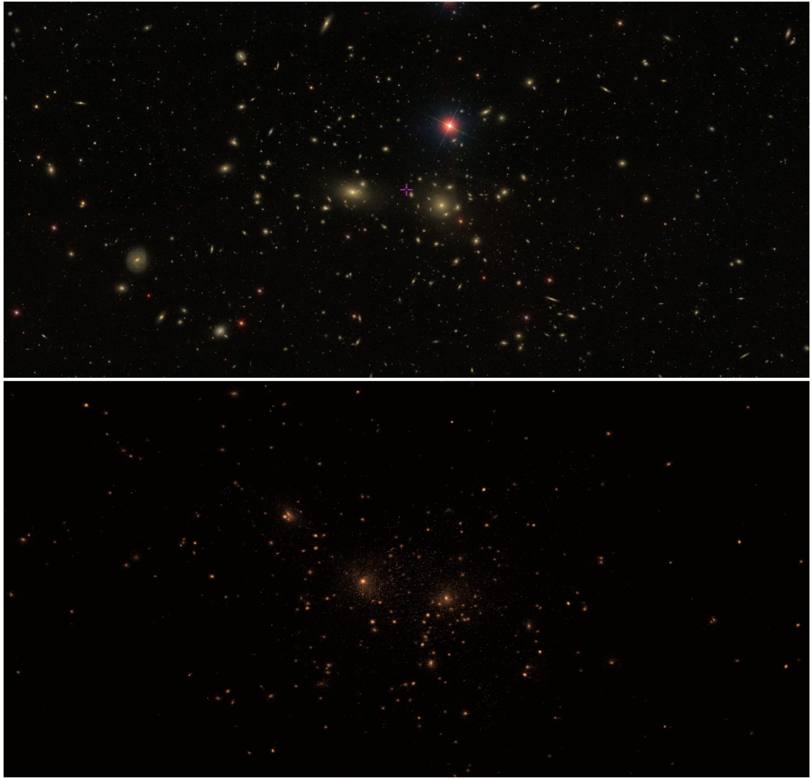
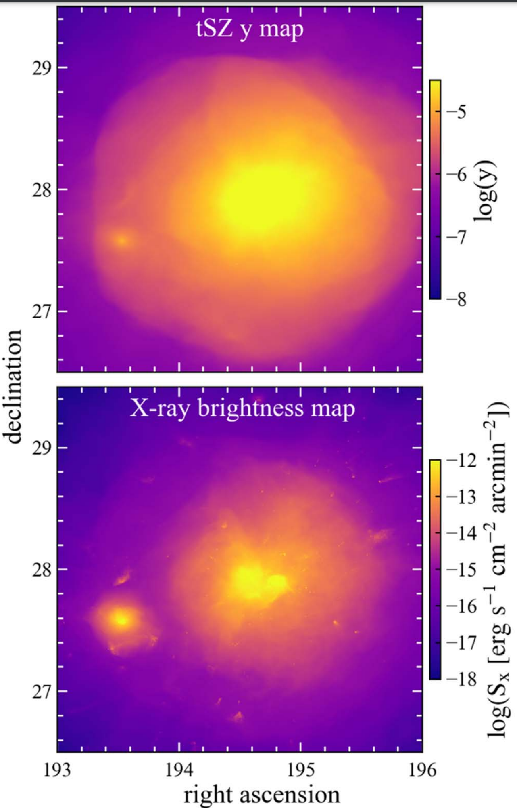
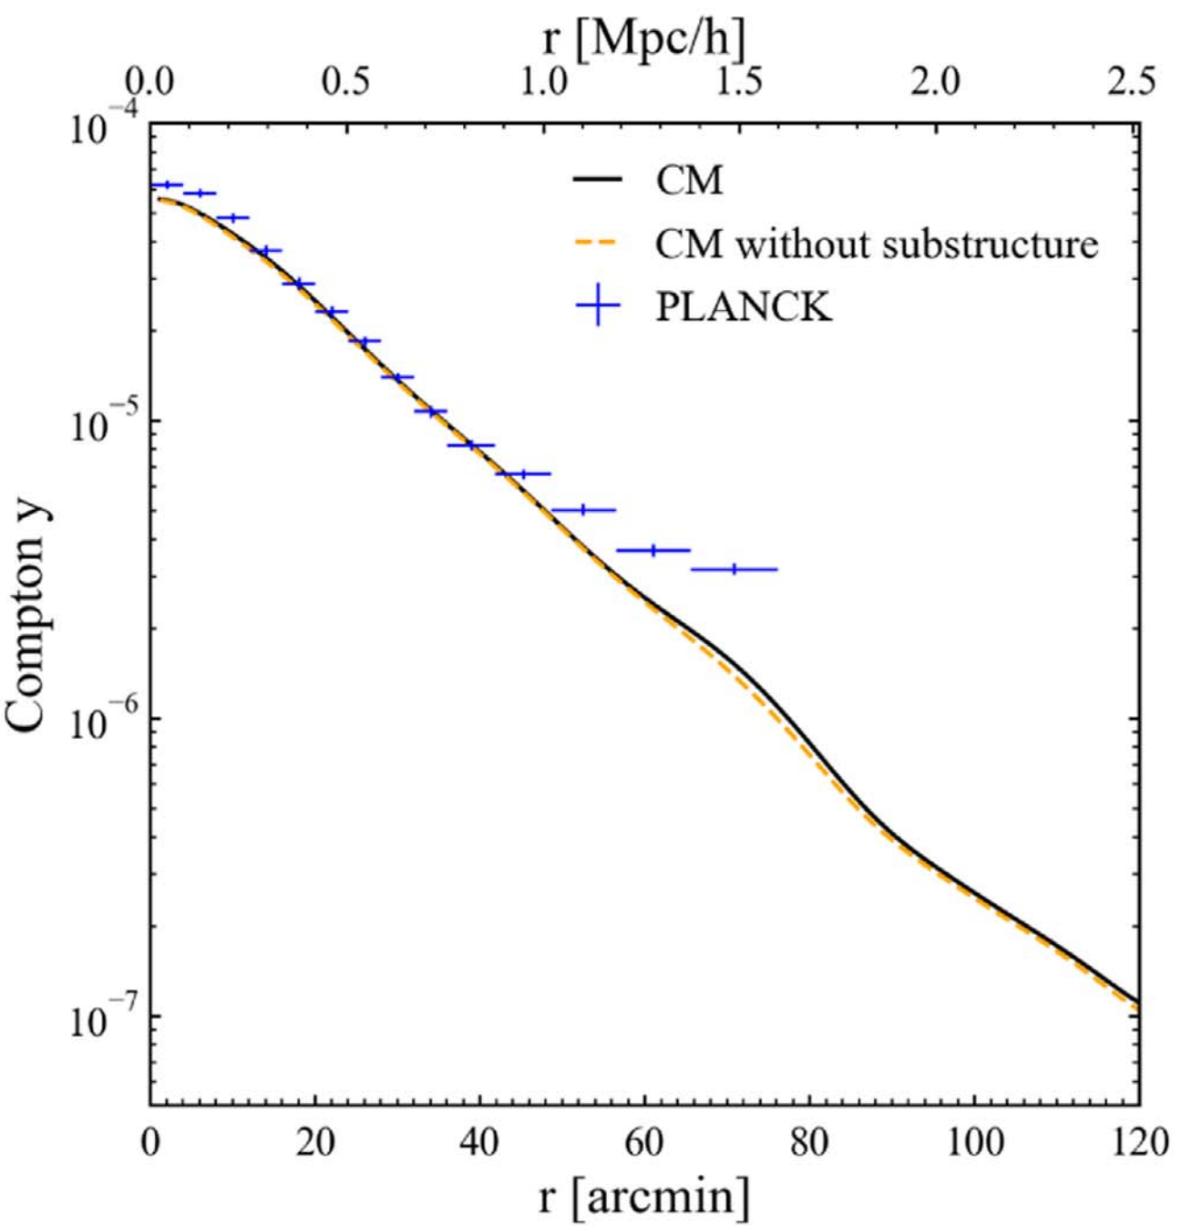
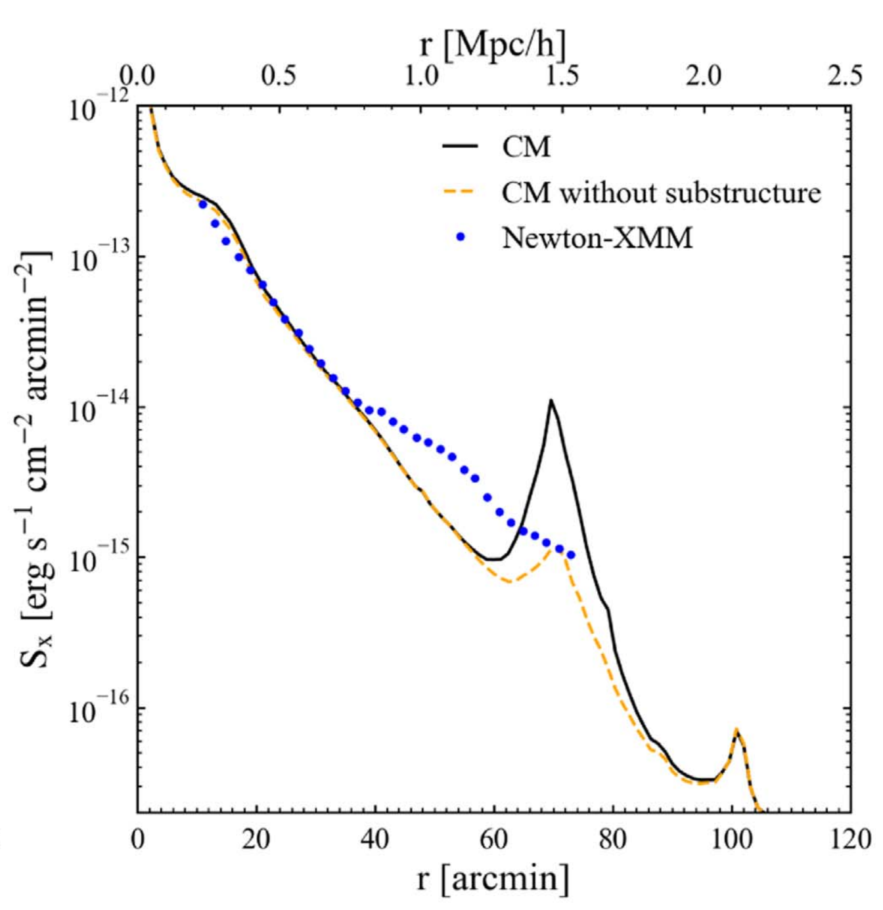
Case study – Coma cluster in collaboration with ELUCID
Li et al. 2022

Slide 22
Conclusions
A lot of things matter in hydro-simulations, some are good, some are not.
I think many problems are deep down to the combination of
Resolution
Baryon model
Parameter
Maybe ML?

Slide 23
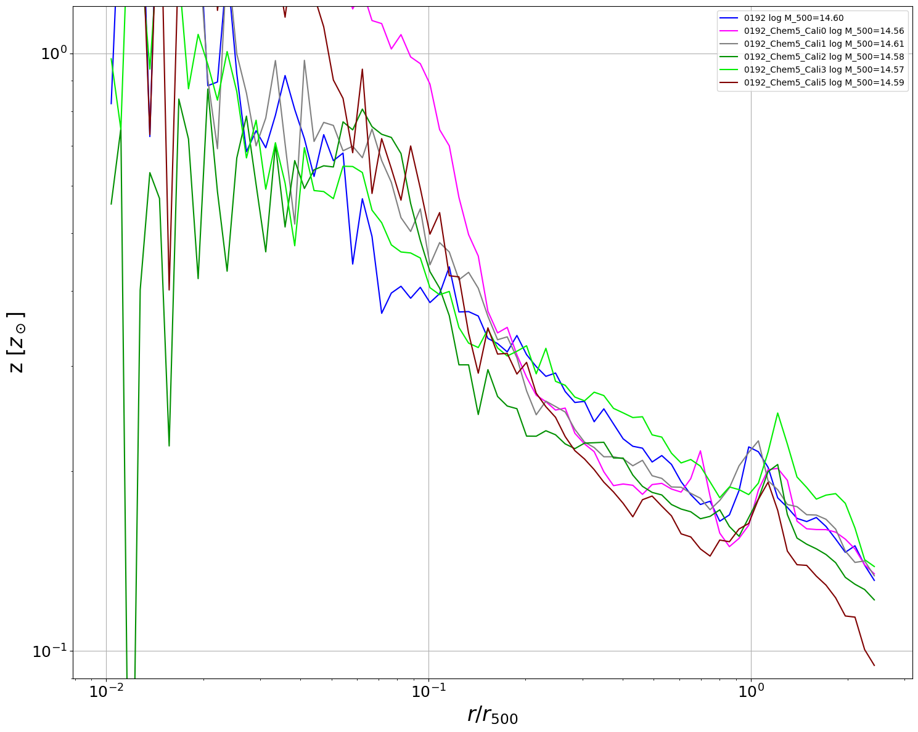
Gas metallicity

Slide 24
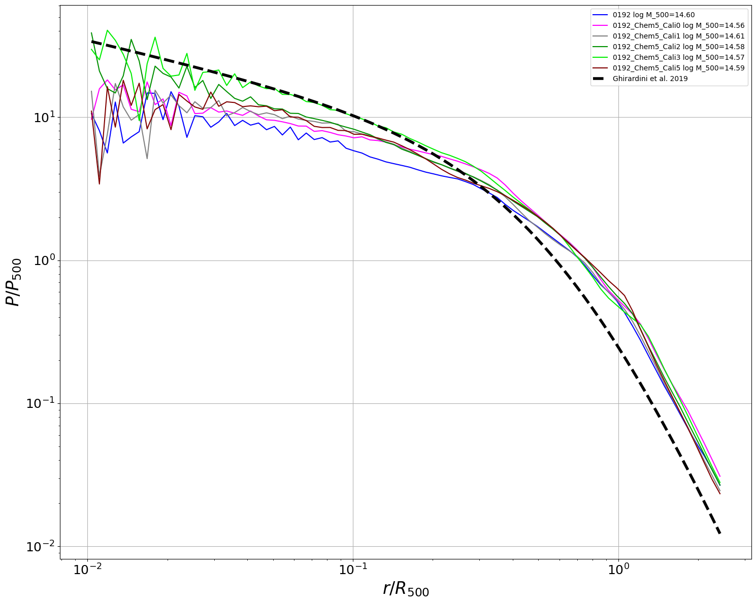
Pressure

Slide 25
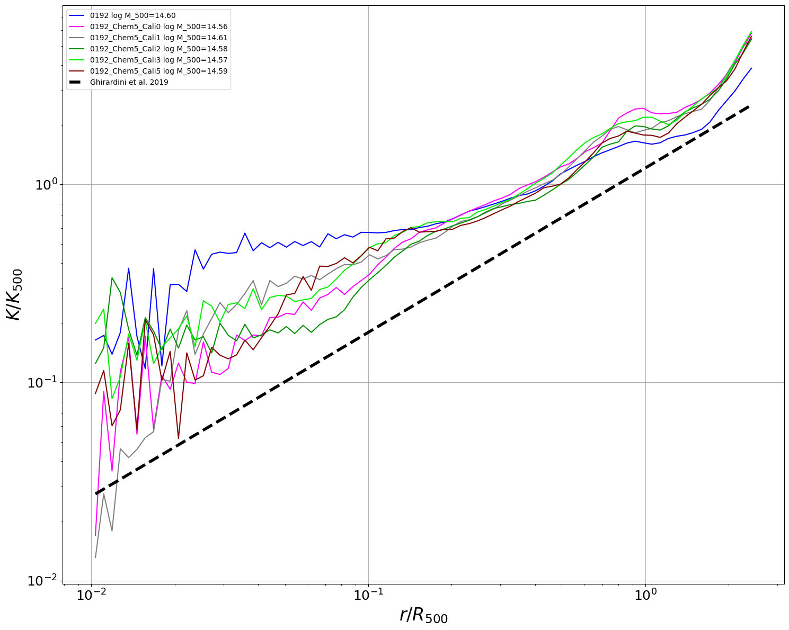
Entropy

Slide 26
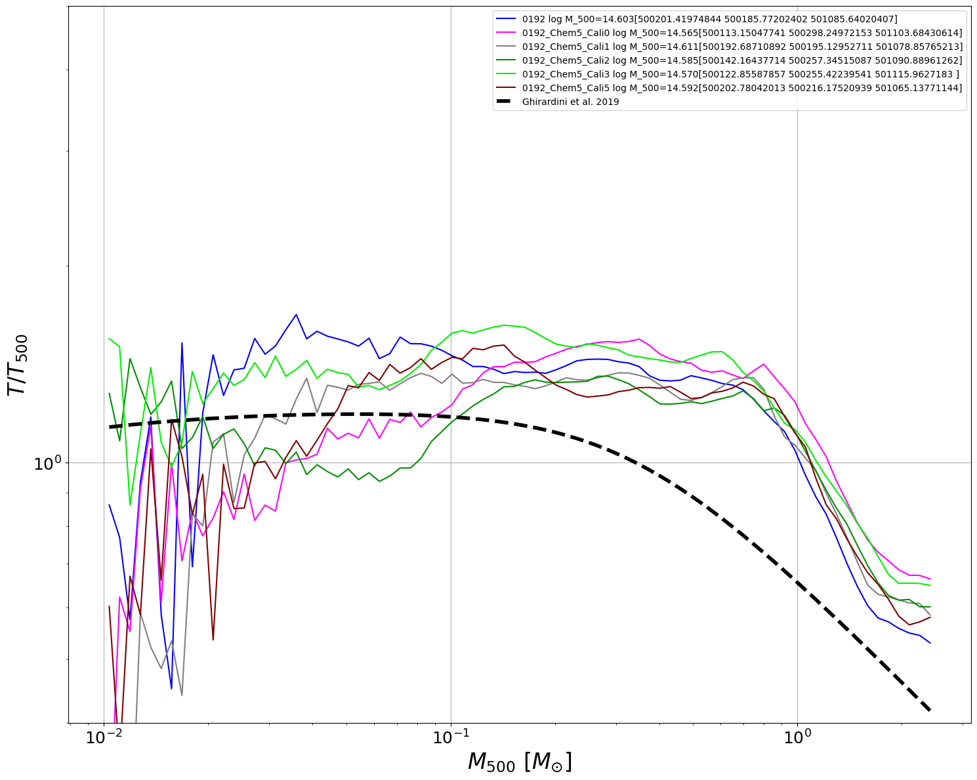
Temperature

Slide 27
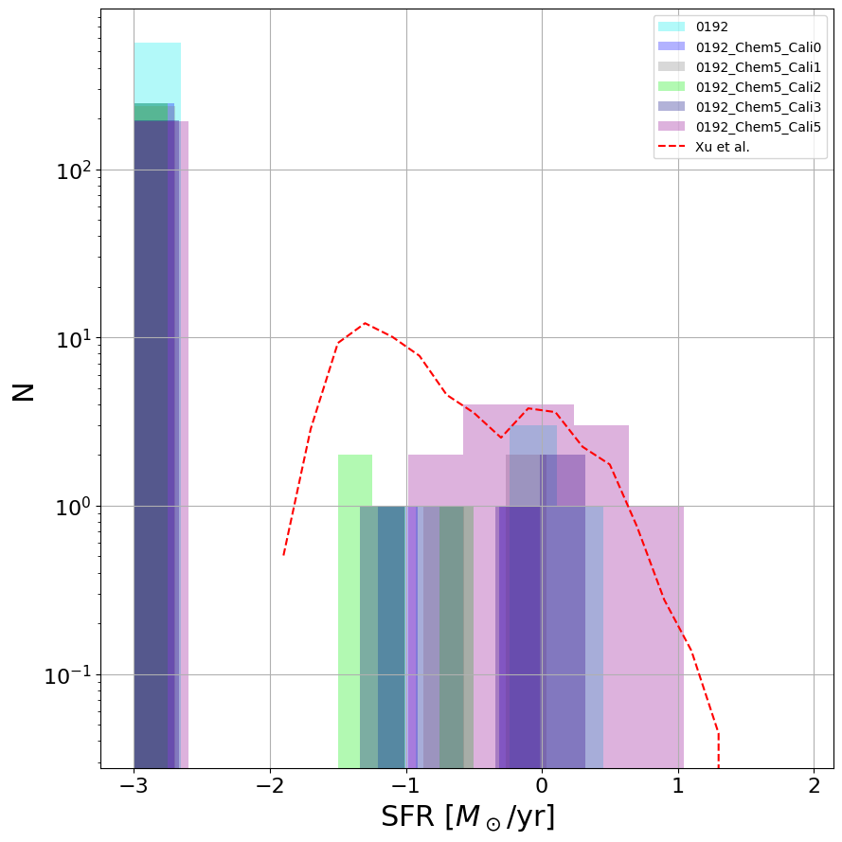
Quenching function

Slide 28
