Slide 1
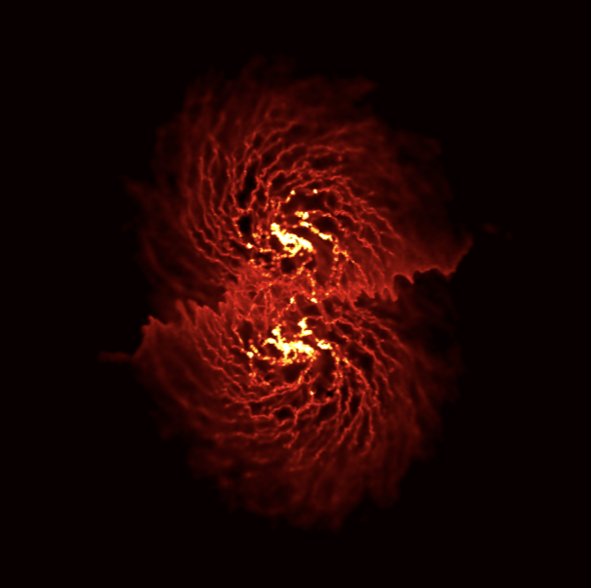
Romeel Davé, Doug Rennehan, et al
PAH emission in a merger
D. Narayanan

Slide 2
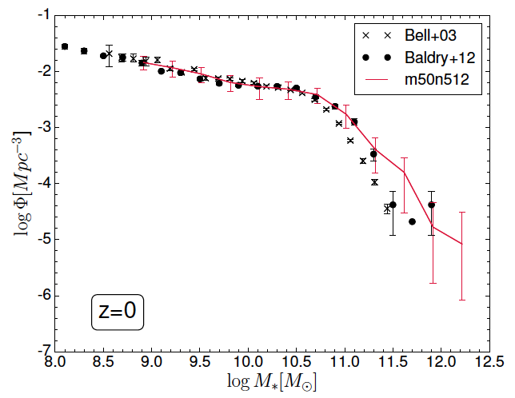
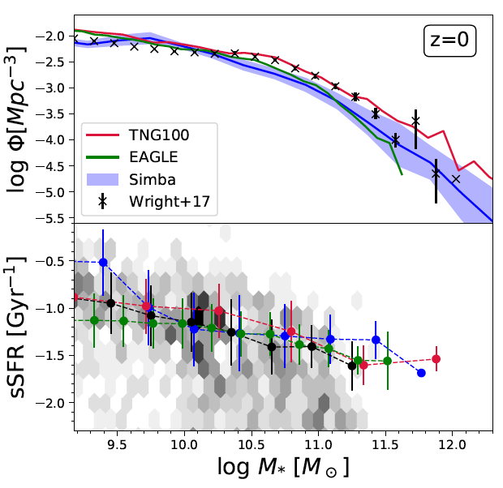
The Simbaverse, so far
Mufasa (2016): Gizmo/MFM, Grackle-2, KMT H₂ SF, FIRE winds, AGN ”feedback” via halo heating, no BH, no dust, 512³.
Simba (2019): Grackle-3, +Torque/Bondi BH growth, +rad/jet/X-ray BH feedback, +dust growth+destruction, 1024³.
Kiara (2024?)…
Mufasa

Slide 3
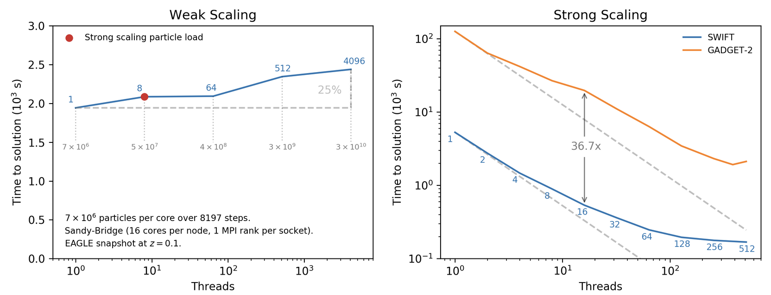
Code Base Changed to SWIFT
Modularity: (mostly) interchangeable subgrid models (e.g. EAGLE/GEAR)
Speedup of factors of many over Gadget/Gizmo
Much improved scalability
Generally easier to develop… unless you want to do something complicated.
EAGLE snap

Slide 4
Swimba (SWIFT-Simba): On the road to KIARA
All of Simba physics except the dust, within SWIFT:
Grackle-3.1 cooling
SF with KMT H₂
Decoupled winds with FIRE scalings using on-the-fly FoF
Torque (sort of) and Bondi accretion
Radiative/Jet/X-ray AGN feedback
Some updated physics (lower-mass BH seeding with growth suppression, scaling v_{jet}(M_{BH}), wind heating from Pandya+)
Some under-the-hood implementation differences.

Slide 5
Kiara: Beyond Swimba
chem5 chemical evolution model (tbc), tracking only 11 Simba elements (for memory reasons). Completed.
Grackle-3.2: Co-evolve dust+H2 within subgrid ISM model as described by Ewan J. Completed?
Hydro: Rosswog’s MAGMA-2 SPH? Suppresses unwanted dissipation at the expense of high-order kernels w/lots of neighbors. Implemented in SWIFT by Zhen Xiang. TBD.
*** This is KIARA ***
Note: SWIFT is a fully public code. So eventually this will all be public.

Slide 6
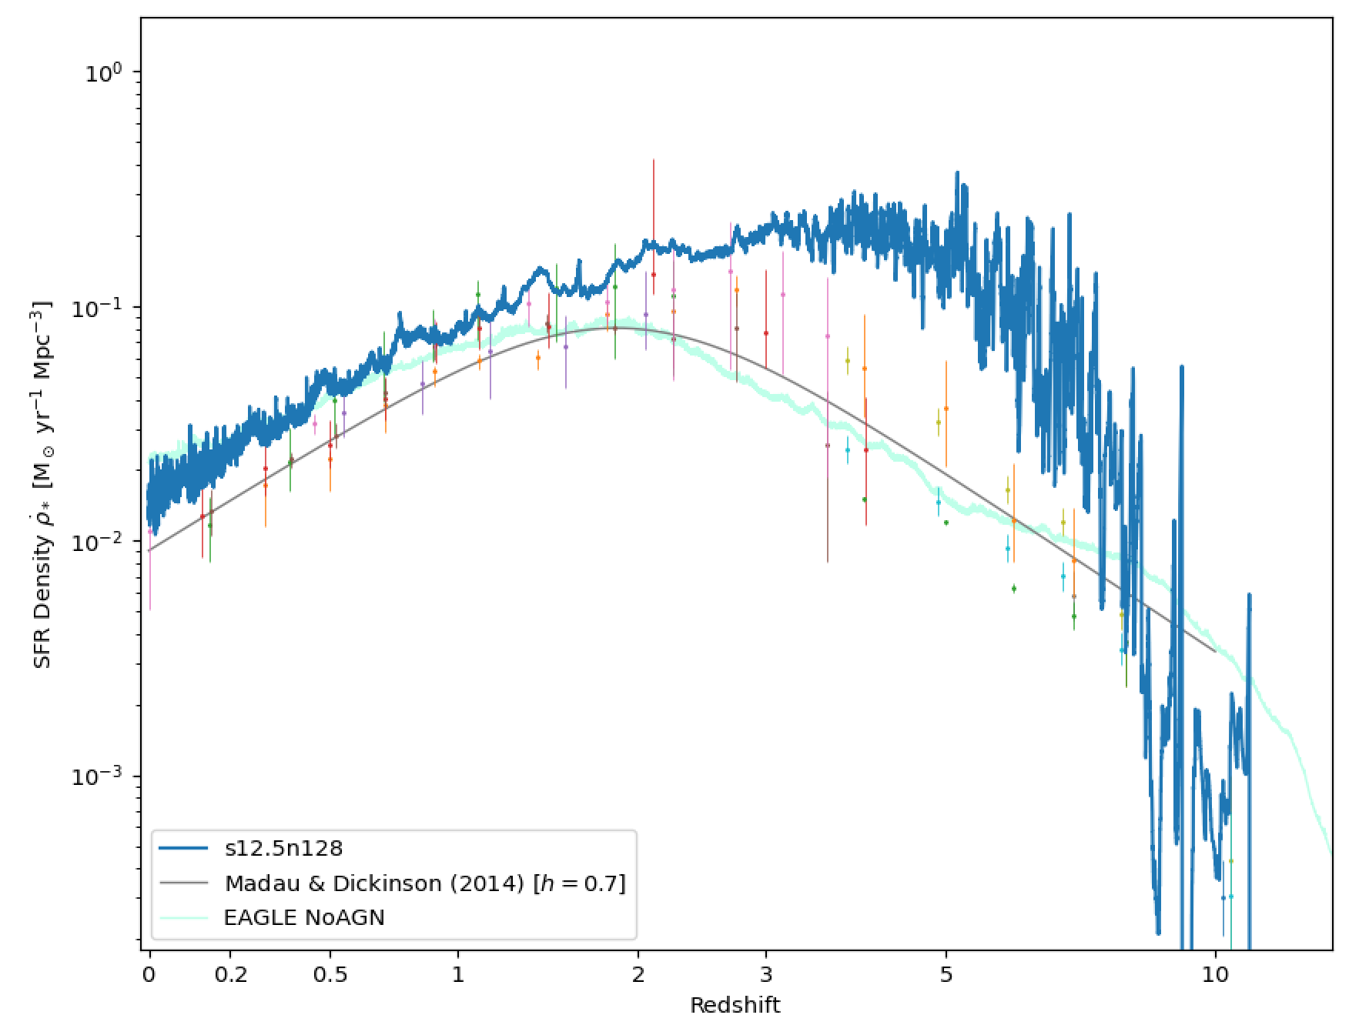
Kiara is born!
~5x faster than Gizmo
Not significantly longer w/Grackle-3.2

Slide 7
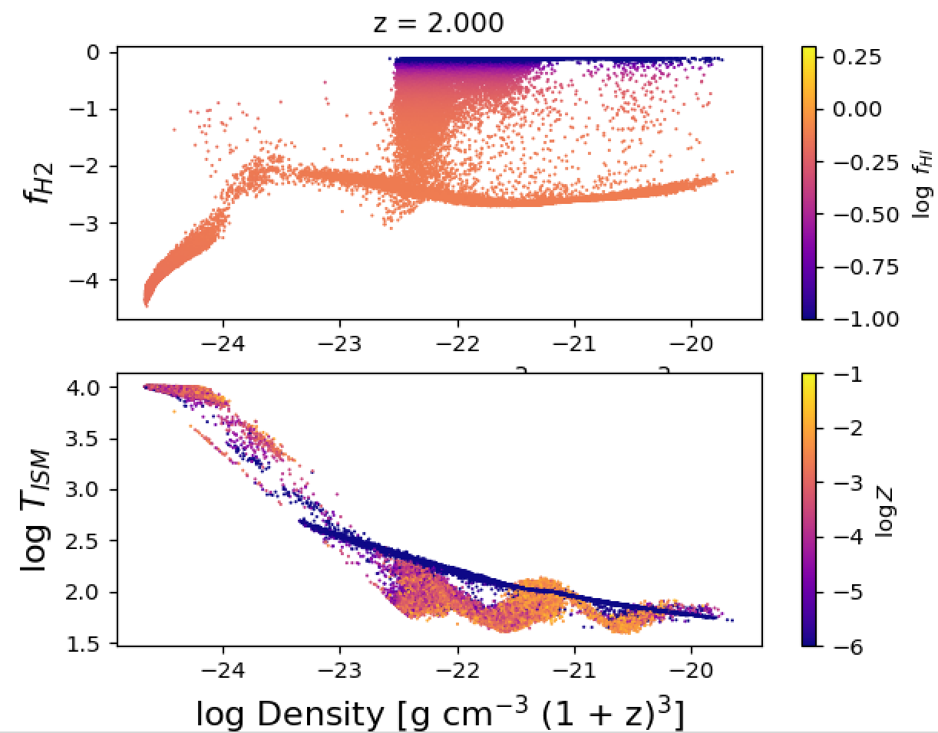
ISM properties? Hmm.

Slide 8
Calibration
Use Josh B’s tool to explore key parameters constraining to:
GSMF evolution (z=0-2)
M_{BH}-M* relation (torque accretion param)
Quenched fractions, if we need to.
No galaxy sizes, no gas properties to be used.
Analysis: Doug R yt-swift works with SWIFT/Swimba outputs, so can run Caesar. Also Josh’s swiftsimio.
Then we will be ready to run big sims. DiRAC? Prace? CCA?

Slide 9
Nominal plan for runs
Kiara suite – mimics Simba, but 8 x larger volumes, to z=0.
2 x 2048^3 runs: 200 Mpc/h, 100 Mpc/h, 50 Mpc/h (to z=1?)
2 x 1024^3 runs with individual feedback modes turned off.
Before this we will have 512^3 runs at these resolutions; will likely need to recalibrate the higher-res runs.
Zooms: 300 clusters, CAMELS, ELUCID, Hyenas, FLARES II, …

Slide 10
Longer term plan
Kiara-RT: Add M1 RT and run EoR sims (PhD of Zhen Xiang).
Add PhEW / PhEW-like model (MSc of Fernando Hidalgo).
Add more sophisticated dust modeling, e.g. a grain size distribution, PAHs, active dust (Desika’s group).
Improved BH growth & feedback modeling, particularly jets (Doug R).
[…Your idea here…]

