Slide 1
Embracing ambiguity in the taxonomic classification of microbiome sequencing data
Nidhi Shah
University of Maryland
Notes:
Hi, Good morning. I first want to thank the organizers of this meeting for inviting me here. I am Nidhi Shah, a graduate student in the computer science department at the University of Maryland working with Dr. Mihai Pop, who is here too.

Slide 2
Microbes are everywhere...
Notes:
I don’t think I need to say it to this crowd, but really Microbes are everywhere. They are In on and around us. Over the last decade or so, with the advances in amplicon sequencing and whole metagenome sequencing has enabled us to study these communities in detail

Slide 3
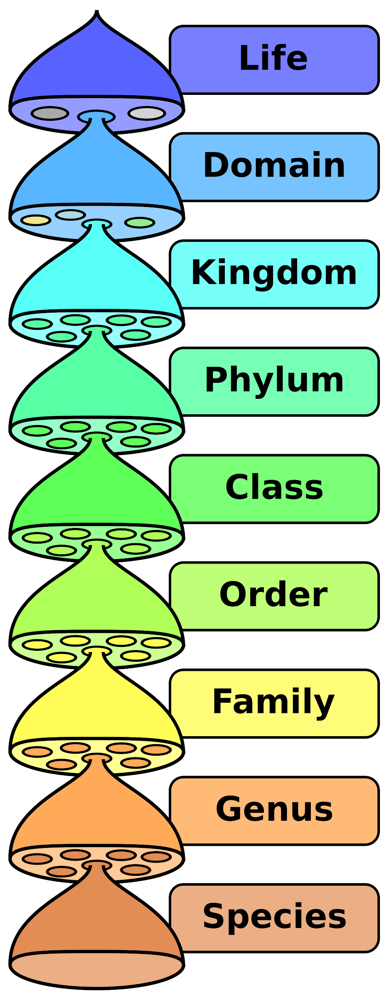
What is in my microbial community sample?
Taxonomy - Classification of organisms, typically arranged in hierarchical ranks (e.g. kingdom, phylum, class, order, genus, species)
What is each fragment in my sequencing dataset?
Notes:
One of the most important task in any microbiome study is to figure out what organisms are present and in what proportion.
This process is formally called Taxonomic classification
Taxonomy is basically a system to classify and organize these organisms. It is typically arranged in a hierarchical ranks (from kingdom, phylum, class.. All the way to species and strains. Such a system helps organize the knowledge of known organisms in an interpretable and easy way

Slide 4
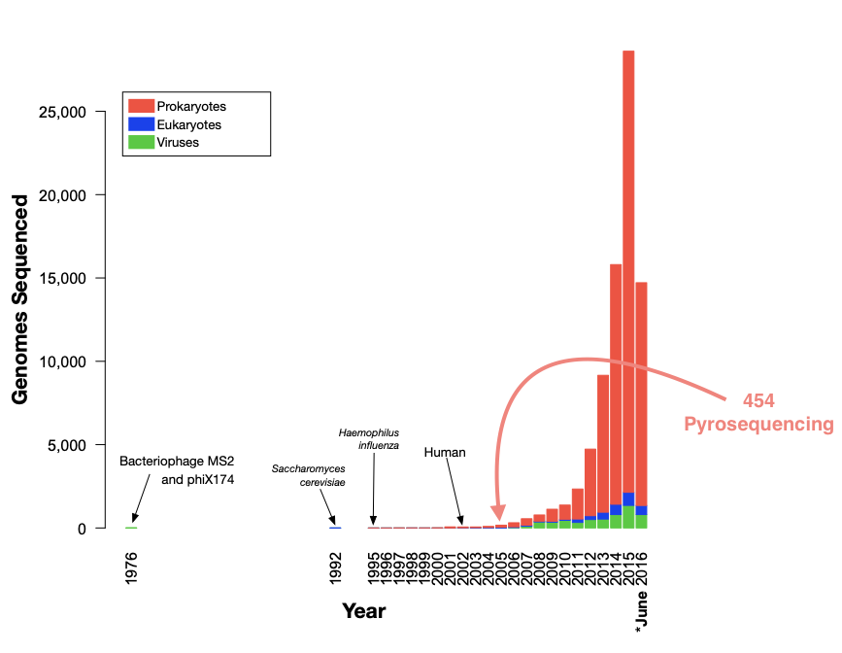
An overwhelming number of genomes being sequenced annually
Number of genomes sequenced annually roughly doubles
Produced from NCBI GenBank files June 2016 - DJ Nasko
Notes:
More and more genomes are being sequenced every year because of the decreased cost of sequencing
For the same reason, there are also lot of microbial samples being sequenced and analyzed.
The plot here was made couple years ago by Dan Nasko – it still shows the trend of upward growth in the sequences in our databases.

Slide 5
An overwhelming number of genomes being sequenced annually
Number of genomes sequenced annually roughly doubles
There is still a lot more microbial diversity that is unrepresented in our databases
Produced from NCBI GenBank files June 2016 - DJ Nasko
Notes:
Biases in reference database
Uncaptured diversity
Overrepresentation of well-studied population

Slide 6
Google: "taxonomic annotation"
Database of known pages
Report all that contain keyword
Ranking important (which of the thousands is most relevant)
from Mihai Pop
Notes:
Ideally, construct a phylogenetic tree
Too expensive
Instead search against a database
Think like a search engine

Slide 7
Our "keywords"
>F4BT0V001CZSIM rank=0000138 x=1110.0 y=2700.0 length=57
ACTGCTCTCATGCTGCCTCCCGTAGGAGTGCCTCCCTGAGCCAGGATCAAACGTCTG
>F4BT0V001BBJQS rank=0000155 x=424.0 y=1826.0 length=47
ACTGACTGCATGCTGCCTCCCGTAGGAGTGCCTCCCTGCGCCATCAA
Reference databases
E.g. SILVA, Greengenes, NR, NT
Look through database for sequence
Report all organisms that contain it
Rank list by ?? (most relevant to least relevant)
Notes:
Draw parallels to web search

Slide 8
Landscape of Taxonomic annotation Approaches
runtime
~ sensitivity
k-mer counting
kraken
k-mer stat model
RDP
Sequence Alignment
blast
usearch
diamond
Phylogenetic
pplacer
TIPP
Assume taxonomically related sequences have similar k-mer frequencies
Assume taxonomically related sequences are similar
Simulate evolution
Notes:
Composition based methods run rapidly
Sequence alignment are sensitive than composition based methods but have higher runtime
Phylogenetic methods in theory provide accurate annotation but have prohibitive computational requirements

Slide 9
Phylogenetic placement
Input: Backbone alignment and backbone tree on full-length sequences, and a set of query sequences (e.g. reads in a sample from the same gene)
Output: Placement of query sequence on backbone tree
Note: if the backbone tree is a Taxonomy, then the placement gives taxonomic information about the query sequences
from Tandy Warnow
Notes:
The two basic steps in phylogenetic placement are align and then place the fragment.
align each fragment independently into the backbone tree.
We then take each extended alignment and place each fragment independently into the backbone tree.

Slide 10
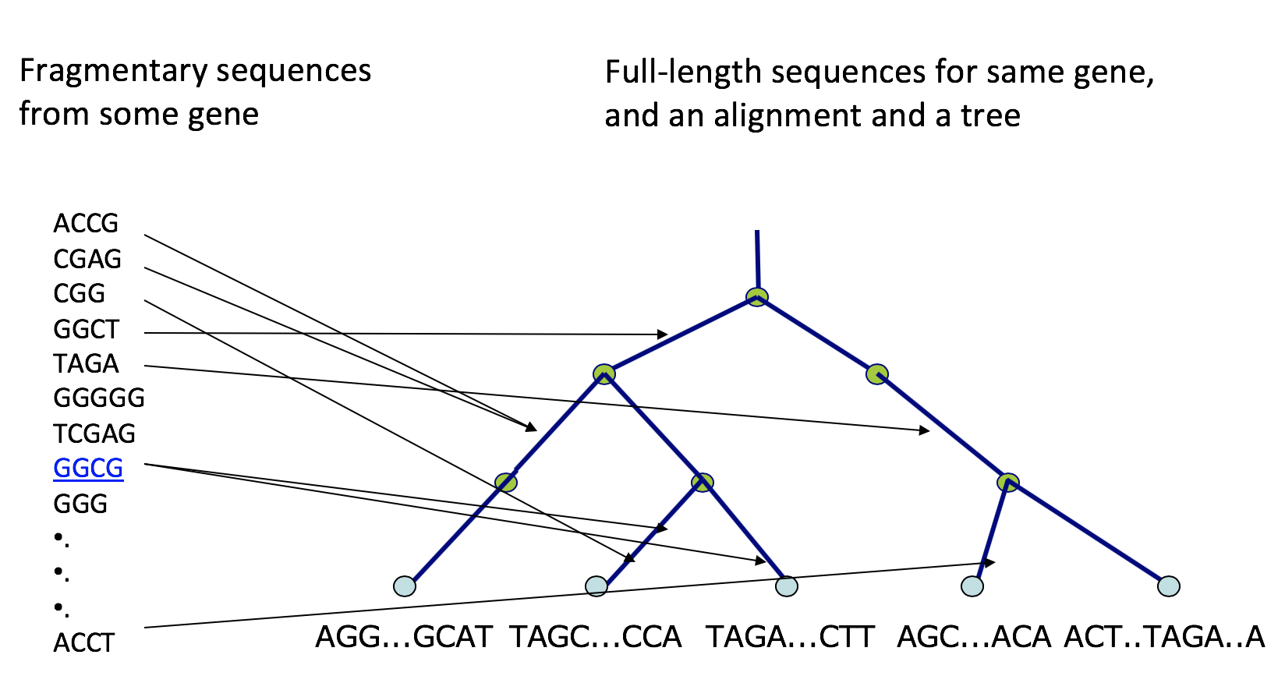
Phylogenetic placement
from Tandy Warnow
Notes:
The two basic steps in phylogenetic placement are align and then place the fragment.
align each fragment independently into the backbone tree.
We then take each extended alignment and place each fragment independently into the backbone tree.

Slide 11
Challenges to Taxonomic Assignment
Resolution of different methods-- ie. certain hypervariable regions of the 16S gene cannot distinguish between E. coli and Shigella spp.,
Computational bottlenecks
Computational reproducibility
No ground truth
Reference database coverage and completeness
Notes:
There are many challenges, we’ll focus on Reference database coverage and completeness

Slide 12
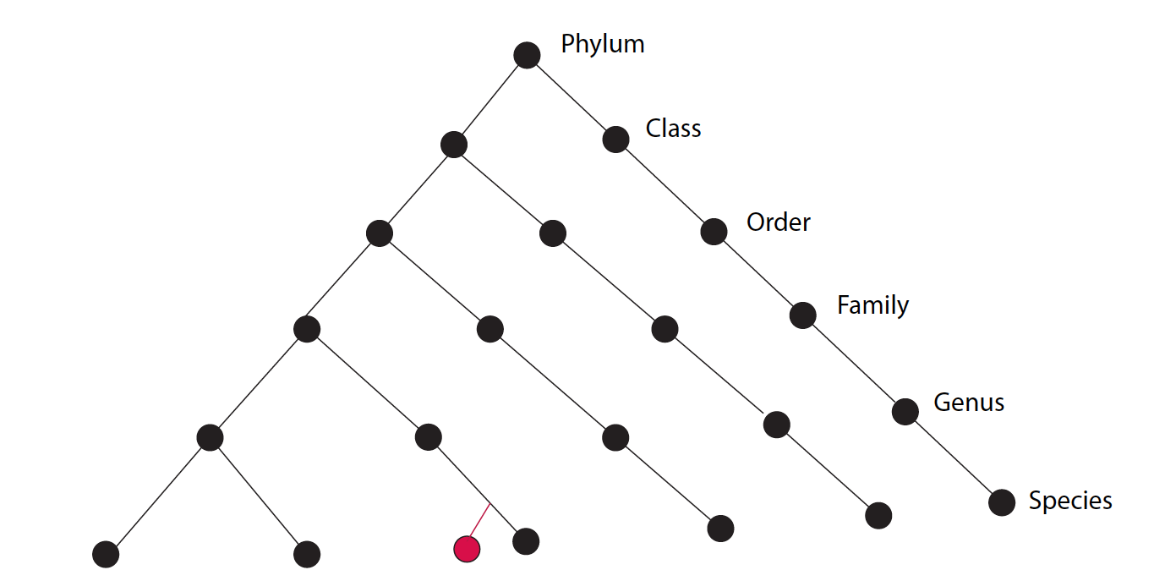
When does taxonomic annotation work well?
Notes:
When you have just one closest neighbor in the tree, then transferring annotation is easy

Slide 13
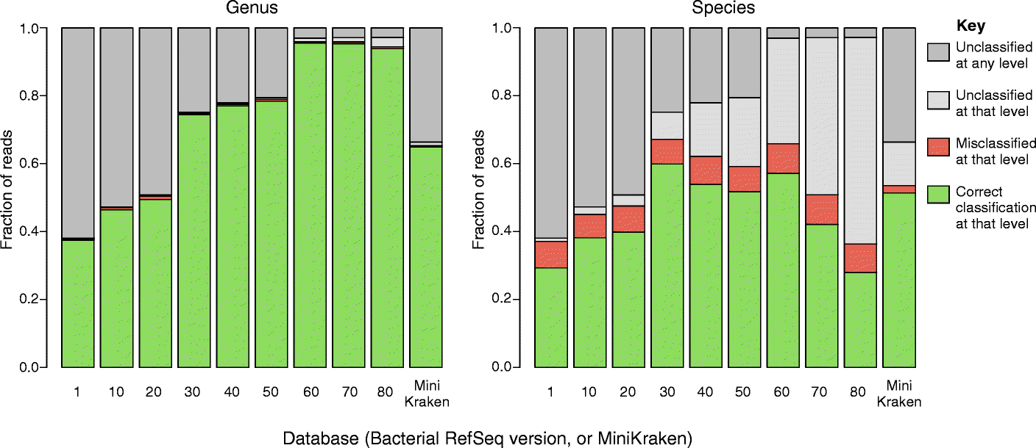
What if you have too many close relatives in the tree?
Nasko, Daniel J., et al. "RefSeq database growth influences the accuracy of k-mer-based lowest common ancestor species identification." Genome biology 19.1 (2018): 165.
Notes:
But what if the read aligns perfectly well to many sequences --
Dan’s findings -- more strains of same species in the database → difficult to get species level assignment
The reason ? Most methods use latest common ancestor approach
Makes annotation coarse grained
Wouldn’t it be nice to know exactly which species are plausible as opposed to just giving genus level assignment
Clinical setting - Commensal vs. pathogen

Slide 14
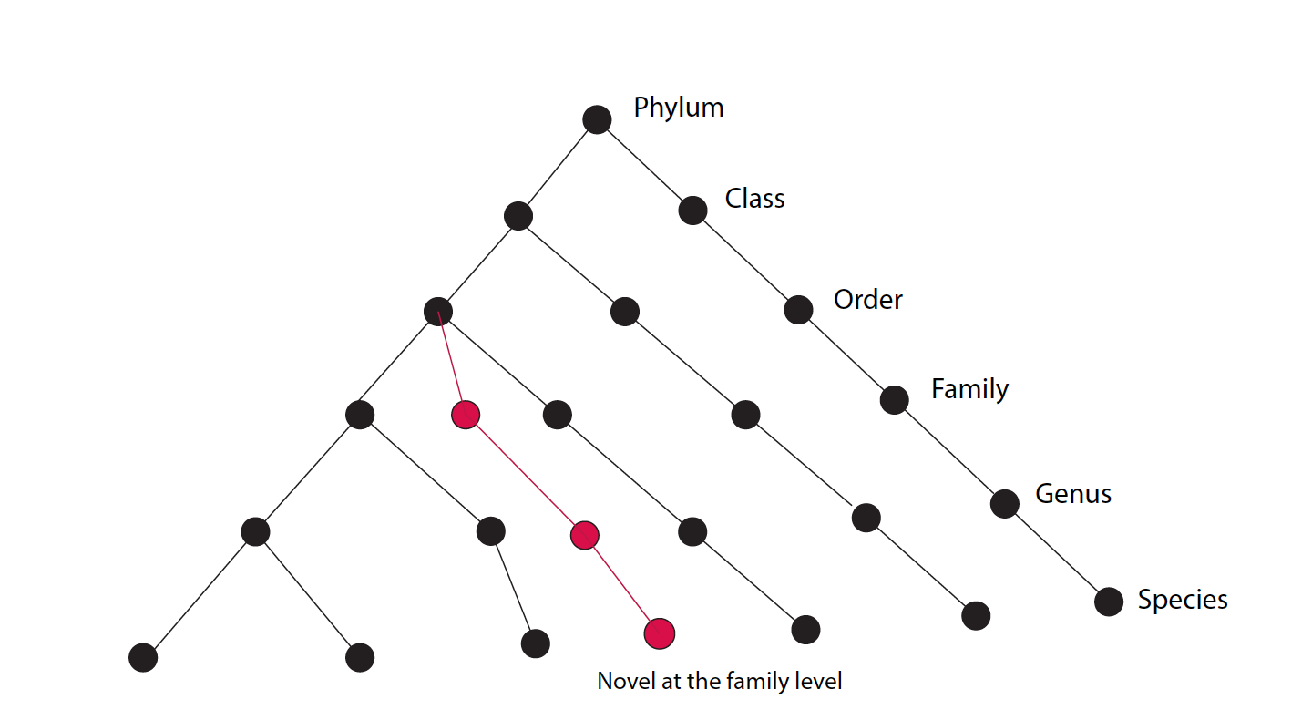
What if I’ve sequenced something novel?
Notes:
No near neighbors -- only bet is to use phylogenetic methods
Too expensive

Slide 15
Can we extract enough information from sequence alignment to achieve accuracy close to phylogenetic methods?

Slide 16
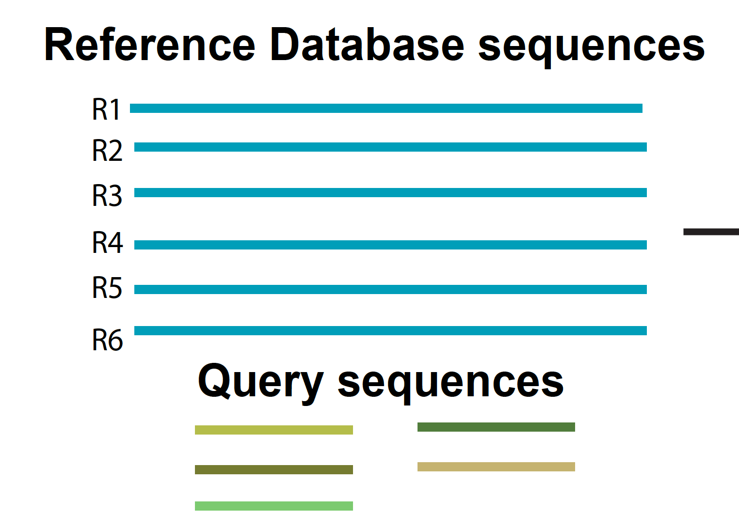
ATLAS:
Ambiguous Taxonomy eLucidation by Apportionment of Sequences
Step 1: Run BLAST
Input:
Notes:
The input is a set of annotated known reference sequences and the uncharacterized reads from the sample.
We use BLAST to align query sequences
MENTION MARKER GENE SEQUENCING

Slide 17
BLAST can have multiple, valid top hits
Notes:
Statistics like E-value, bitscore, perc identity
How to select which of these top hits are relevant?

Slide 18
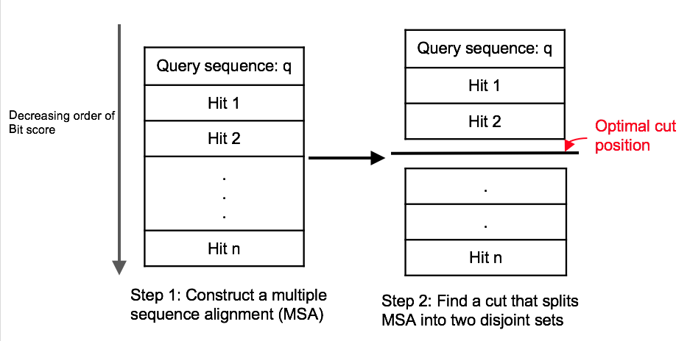
ATLAS
Step 2: Run BLAST outlier detection algorithm
Shah, N., Altschul, S. F., & Pop, M. (2018). Outlier detection in BLAST hits. Algorithms for Molecular Biology, 13(1), 7.
Notes:
In brief, BLAST outlier detection method basically constructs a multiple sequence alignment with query sequence and all the hits using BLAST-generated pairwise alignments. It then uses the Bayesian integral log odds score to determine whether the multiple sequence alignment can be split into two groups that model the data better than the single group. This process identifies significant BLAST hits for the query sequences, without resorting to ad hoc cut-offs on percent identity, bit-score, and/or E-value.
Modify add

Slide 19
ATLAS
Step 3: Create a confusion graph and partition it
Notes:
Once you have the set of related database sequences for all query sequences, we create a confusion graph and partition it

Slide 20
ATLAS
Step 3: Create a confusion graph and partition it
Step 4: Assign reads to partition
Notes:
In this graph, nodes are reference database sequences and the edges are weighted by the number of query sequences for which the two database sequences are present together in the outlier set.
We use Louvain community detection to find tightly knit sub-communities in this graph.
These partitions of database sequences attempt to capture the most accurate granularity of taxonomic assignment without relying solely on the main taxonomic levels
The last step is to assign reads to these partitions.
A query sequence is assigned to a partition if a certain user-defined percentage of sequences in the outlier set are present in that partition.

Slide 21
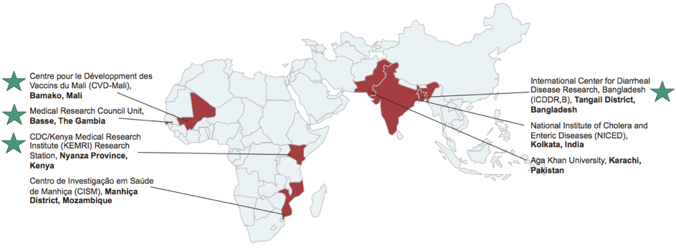
The Global Enteric Multicenter Study (GEMS) was created to characterize important pediatric diarrheal pathogens
Pop, M., Walker, A. W., Paulson, J., Lindsay, B., Antonio, M., Anowar Hossain, M., et al. (2014). Diarrhea in young children from low-income countries leads to large-scale alterations in intestinal microbiota composition. Genome Biol. 15, R76
Notes:
We use data from the Global Enteric Multicenter Study or GEMS, a highly-powered case/control study funded by the Bill and Melinda Gates foundation to identify pathogens significantly contributing to diarrheal disease in children under 5. These samples came from children in west and east Africa, and southeast Asia.

Slide 22
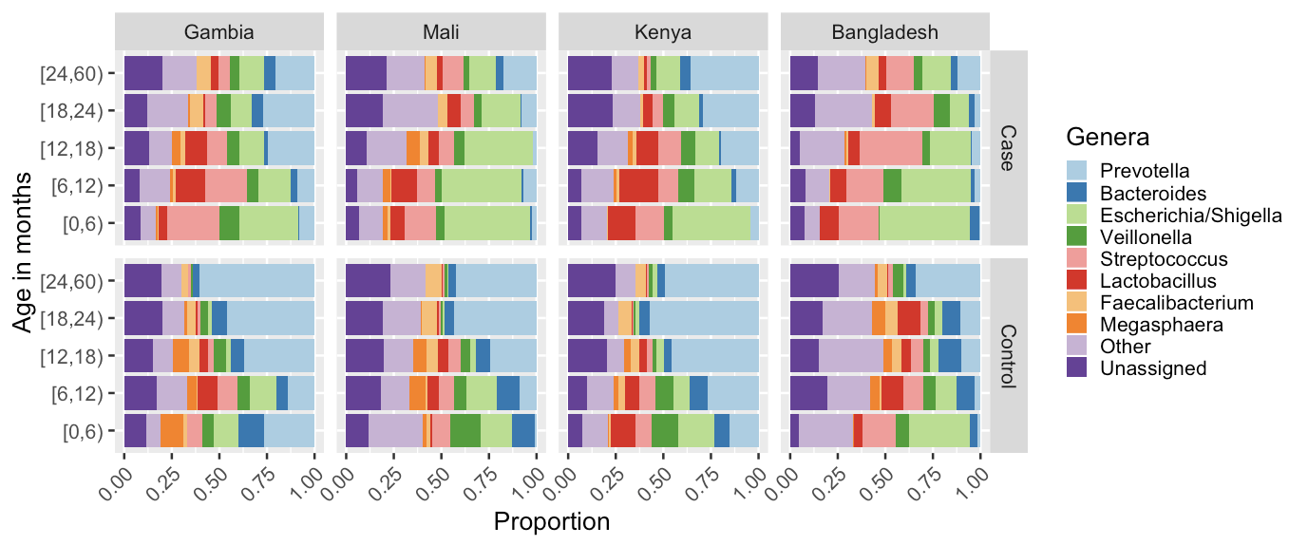
Diarrhea in young children from low-income countries leads to large-scale alterations in intestinal microbiota composition
Notes:
This is from the initial paper. Contains lots of diversity, 22.76% of OTUs had no phylum level classification

Slide 23
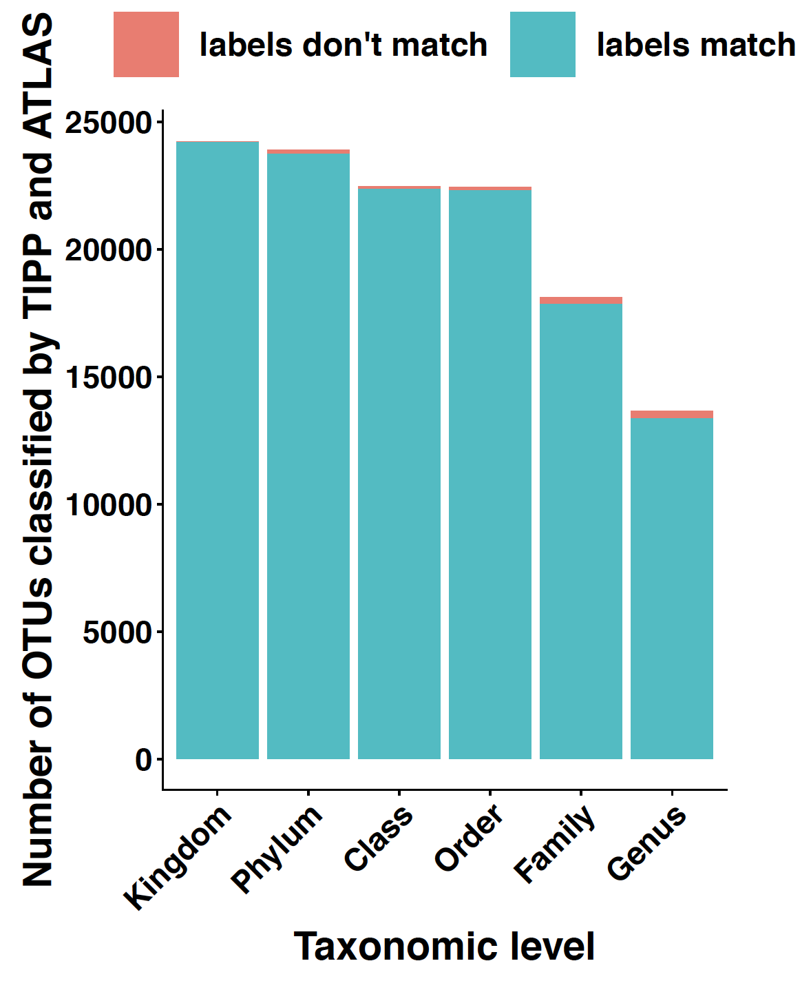
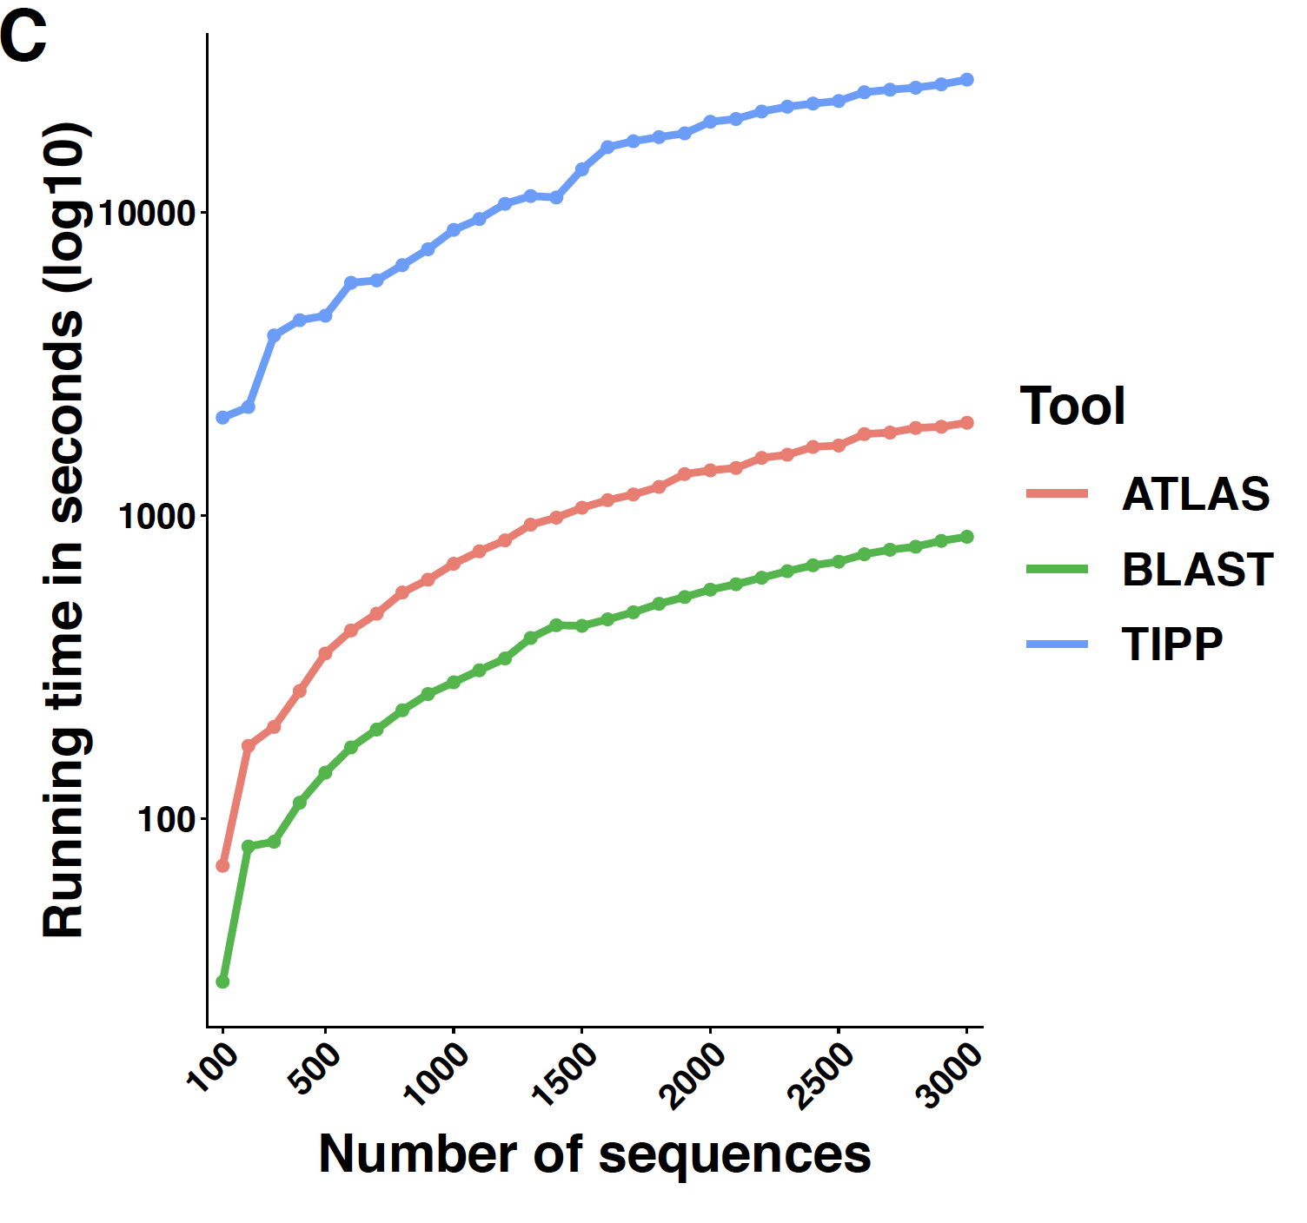
ATLAS achieves similar results as phylogenetic placement method (TIPP)
Notes:
achieves similar accuracy with higher computational efficiency.

Slide 24
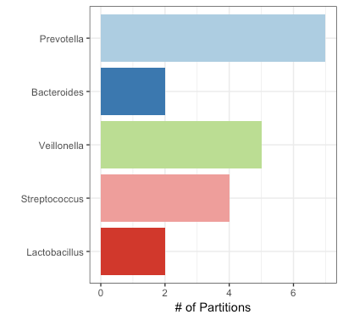
ATLAS captures sub-genera level partitions
Notes:
LCA of most partitions are at the genus level
The picture on the right shows the partitions in five abundant genera in the GEMS case/control study
These sub-genus partitions can help understand biological groups and provide more resolution for downstream questions such as differential analysis
We also looked at some of the partitions with LCA at higher taxonomic levels and found -- partitions in Clostridia class

Slide 25
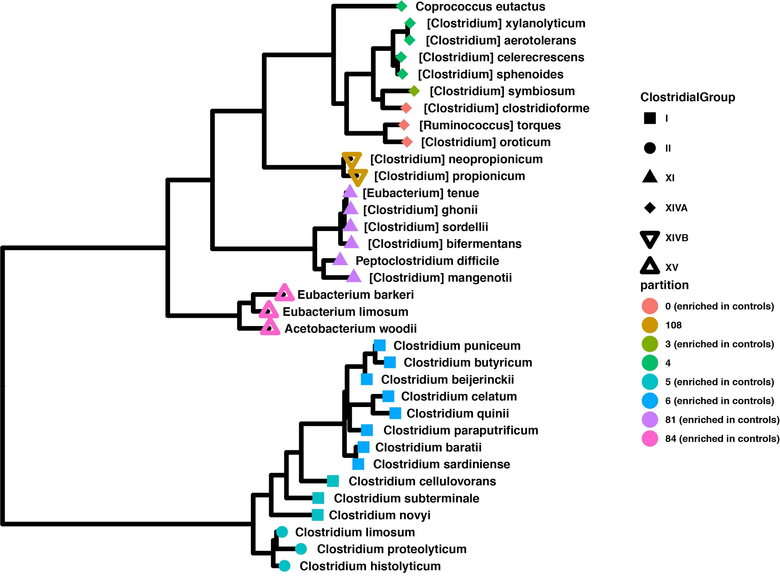
ATLAS captures Clostrial class groups

Slide 26
Conclusion
Taxonomic annotation of microbiome samples is challenging
ATLAS provides a new way to capture ambiguity rather than relying on standard taxonomic levels and latest common ancestor strategy
ATLAS generates similar annotations as phylogenetic placement method with higher computational efficiency
ATLAS can be combined with phylogenetic methods to improve runtime by pruning tree to identified partitions

Slide 27
Thank you!
Contact - nidhi@cs.umd.edu
Software - https://github.com/shahnidhi/outlier_in_BLAST_hits

Slide 28
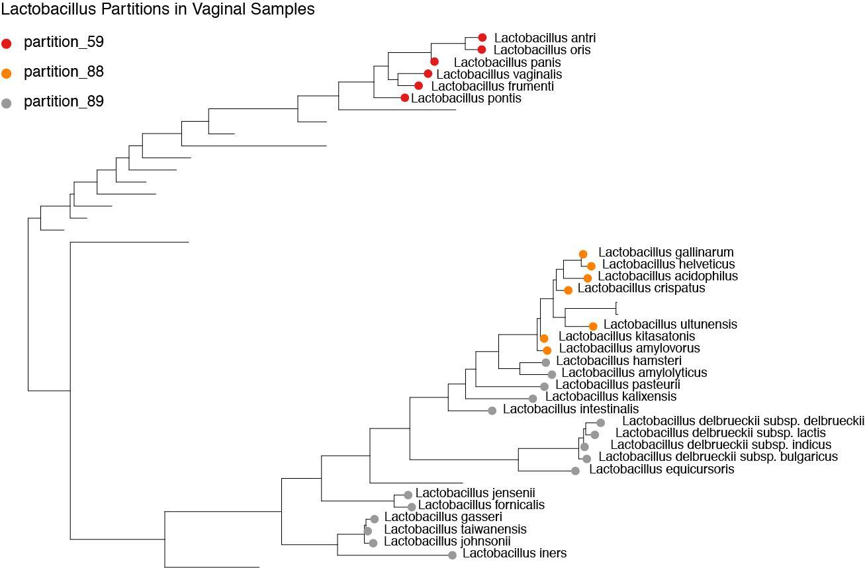
Results
ATLAS partitions capture biologically meaningful groups

