Slide 1
Practical HPC
Introduction to FPGA acceleration
14/04/2021
Marco Barbone
m.barbone19@imperial.ac.uk

Slide 2
About me
M.Sc. in Computer Science and Networking Scuola superiore Sant’Anna & Università di Pisa
CERN OpenLab Summer student
Research Software Engineer, Maxeler Technologies
Software engineer, Intel
Ph.D. Student, Custom Computing research group, Imperial College London, Supervisor Prof. Wayne Luk
Member of Imperial College CMS group
Associate Ph.D. Student, The Institute of Cancer Research, London

Slide 3
Previously

Slide 4
This talk
Practical techniques that can be used to achieve HPC
What the compiler can do for me

Slide 5
Clocks
System clock accuracy ~10ms
Time Stamp Counter – clock frequency influences the results.

Slide 6
Reliable timing
https://stackoverflow.com/questions/49090366/how-to-convert-stdchronohigh-resolution-clocknow-to-milliseconds-micros

Slide 7
CPP clocks and microbenchmarks
high_resolution_clock gives different timing on different platforms/compilers
Unreliable depending on the accuracy required
https://stackoverflow.com/questions/13263277/difference-between-stdsystem-clock-and-stdsteady-clock

Slide 8
Alternatives
Platform specific API
RDTSC counts clock cycles
RDTSC is the most accurate for microbenchmarking but it is not easy to obtain reliable timing
Portability (?)

Slide 9
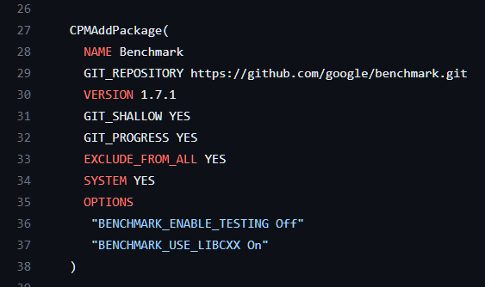
Google Benchmark
Easy to install
Easy to use
Portable
Warns in case of performance scaling

Slide 10
Example

Slide 11
Output

Slide 12
The cost of branching
https://github.com/DiamonDinoia/cpu-performance-tests

Slide 13
The cost of branching (continued)
https://github.com/DiamonDinoia/cpu-performance-tests

Slide 14
The cost of branching (continued)
It can be high: 5x lower performance
Branching is necessary
Can it be avoided?

Slide 15
Branchless programming
Branchless programming is used as an optimization when the cost of branching outweighs alternative approaches.
Always use microbenchmarks to determine the best implementation!
https://www.youtube.com/watch?v=g-WPhYREFjk

Slide 16
Can this branch be removed?
https://github.com/DiamonDinoia/cpu-performance-tests

Slide 17
Banchless approach
We can use a multiplication.
Doing so increases the number of ASM instruction
Is this faster?
https://github.com/DiamonDinoia/cpu-performance-tests

Slide 18
It is faster
https://github.com/DiamonDinoia/cpu-performance-tests

Slide 19
Example #1 branching

Slide 20
Example #1 branchless

Slide 21
Example #2 branching

Slide 22
Example #2 branchless

Slide 23
Example #2 final

Slide 24
Example #3 Branching

Slide 25
Example #3 Branchless

Slide 26
Elementary functions
Functions that compute sin, cos, log …
Used often in scientific computing
They can be quite slow. Optimized to offer high-accuracy & correct rounding
In many use cases, lower accuracy is tolerable
This needs to be thoroughly tested

Slide 27
Example Logarithm
Function | Time (us) | Average Error | Max Error
STD DOUBLE | 65.458 | 0 | 0
STD SINGLE | 50.739 | 1.38617e-08 | 5.86492e-08
FAST LOGF | 47.769 | 1.43832e-08 | 7.55761e-08
APPROXIMATE LOGF | 2.535 | 5.74123e-06 | 1.49805e-05
FASTER LOGF | 1.146 | 0.0125169 | 0.0401875
https://github.com/DiamonDinoia/benchmark-elementary-functions

Slide 28
Performance
Faster logf is 44 times faster than std::log but is also much less accurate.
Is it acceptable?
Depends on the use case
https://github.com/DiamonDinoia/benchmark-elementary-functions

Slide 29
Vectorization

Slide 30
Vectorization
It is a core component of HPC
How to achieve it?
Compiler auto-vectorization
Intrinsics

Slide 31
Vectorization
It is a core component of HPC
How to achieve it?
Compiler auto-vectorization
Intrinsics
Abstraction

Slide 32
Google Highway
Widely utilized (chromium, Firefox and others)
Offers: “Performance-portable, length-agnostic SIMD with runtime dispatch”
Abstractions reduce performance, can we trust highway?

Slide 33
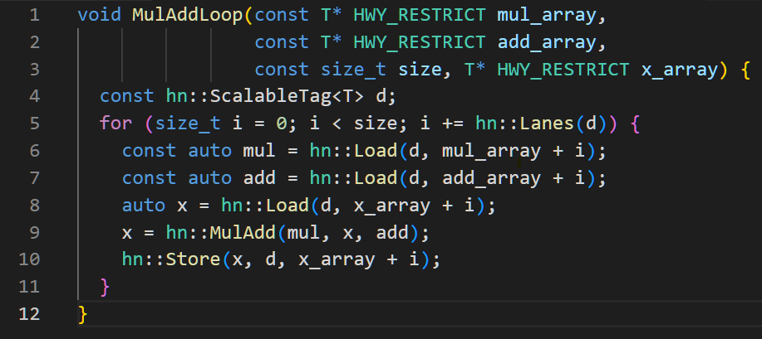
Fused-Multiply-Add

Slide 34
Fused-Multiply-Add

Slide 35
Results
Can be found here: https://gcc.godbolt.org/z/zP7MYe9Yf
It generates vector code using multiple vector instruction set:
project::N_SSE4::
project::N_AVX2::
project::N_AVX3::
Chooses the fastest at runtime
https://gcc.godbolt.org/z/zP7MYe9Yf

Slide 36
Reference code
https://github.com/DiamonDinoia/cpp-learning

Slide 37
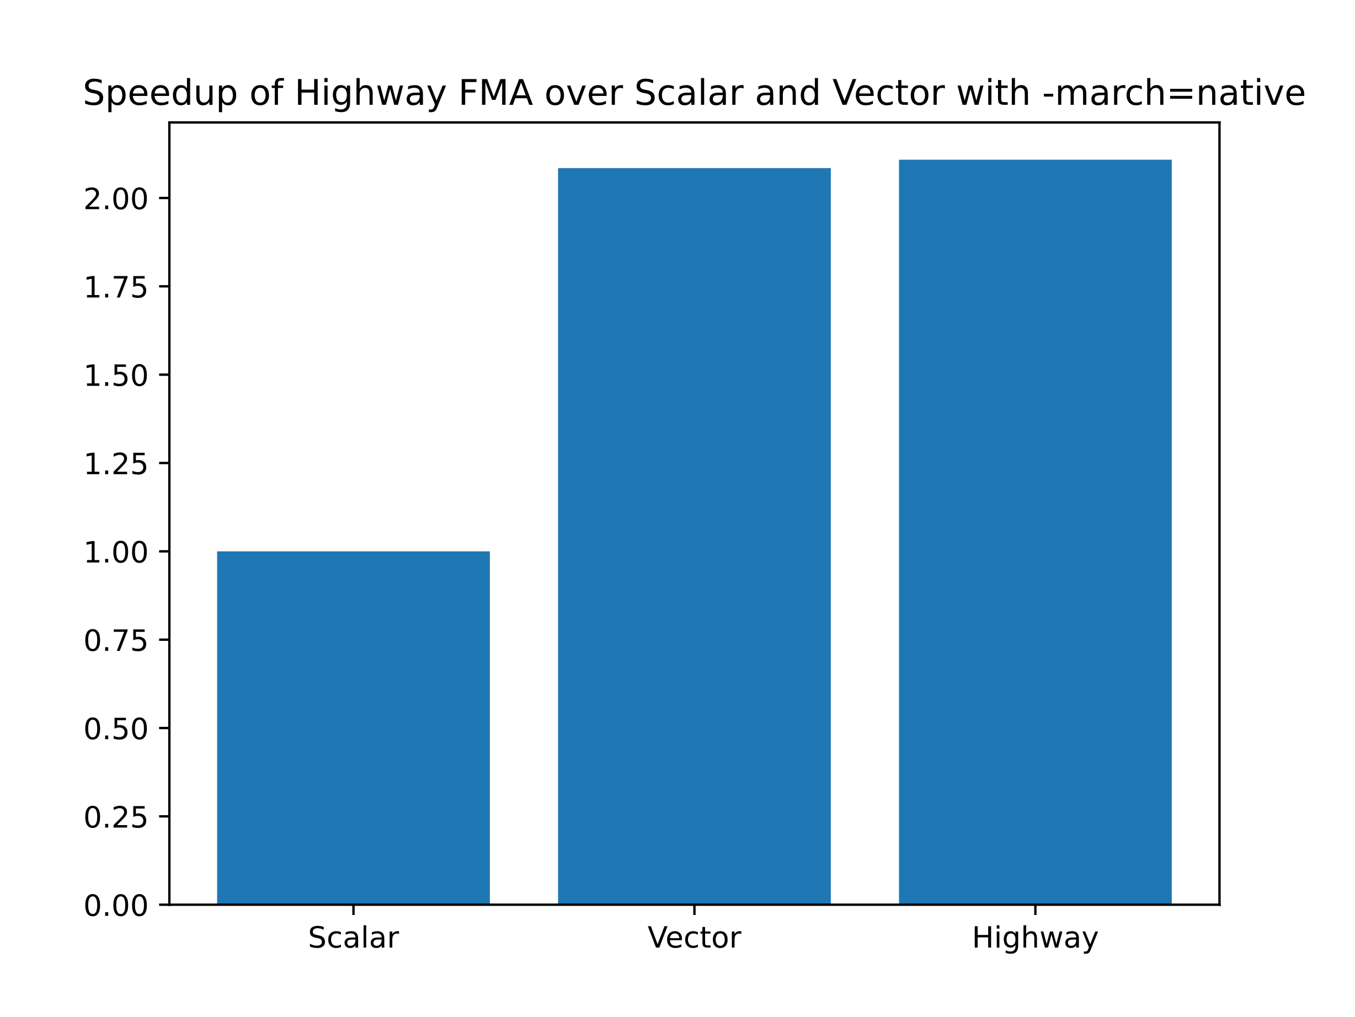
Performance (FMA)
https://github.com/DiamonDinoia/cpp-learning

Slide 38
More complex example Log function

Slide 39
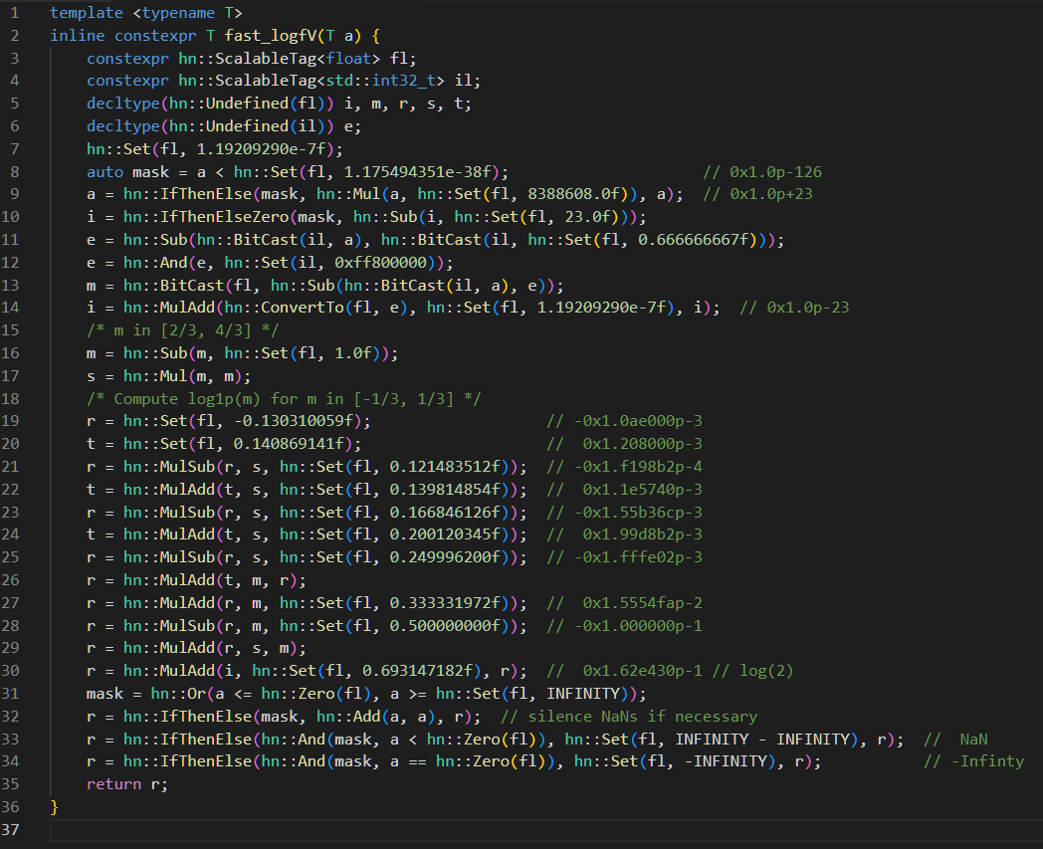
More complex example Log function

Slide 40
More complex example Log function

Slide 41
Beware of memory alignment!
Random segmentation fault otherwise…

Slide 42
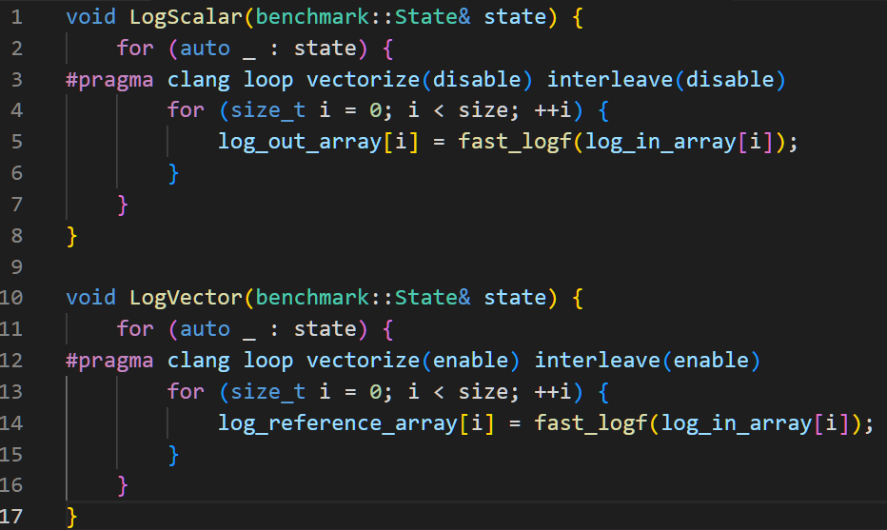
Reference implementations

Slide 43
Reference std::log implementation

Slide 44
Clang-15 vectorization
https://releases.llvm.org/15.0.0/docs/Vectorizers.html?highlight=vectorization

Slide 45
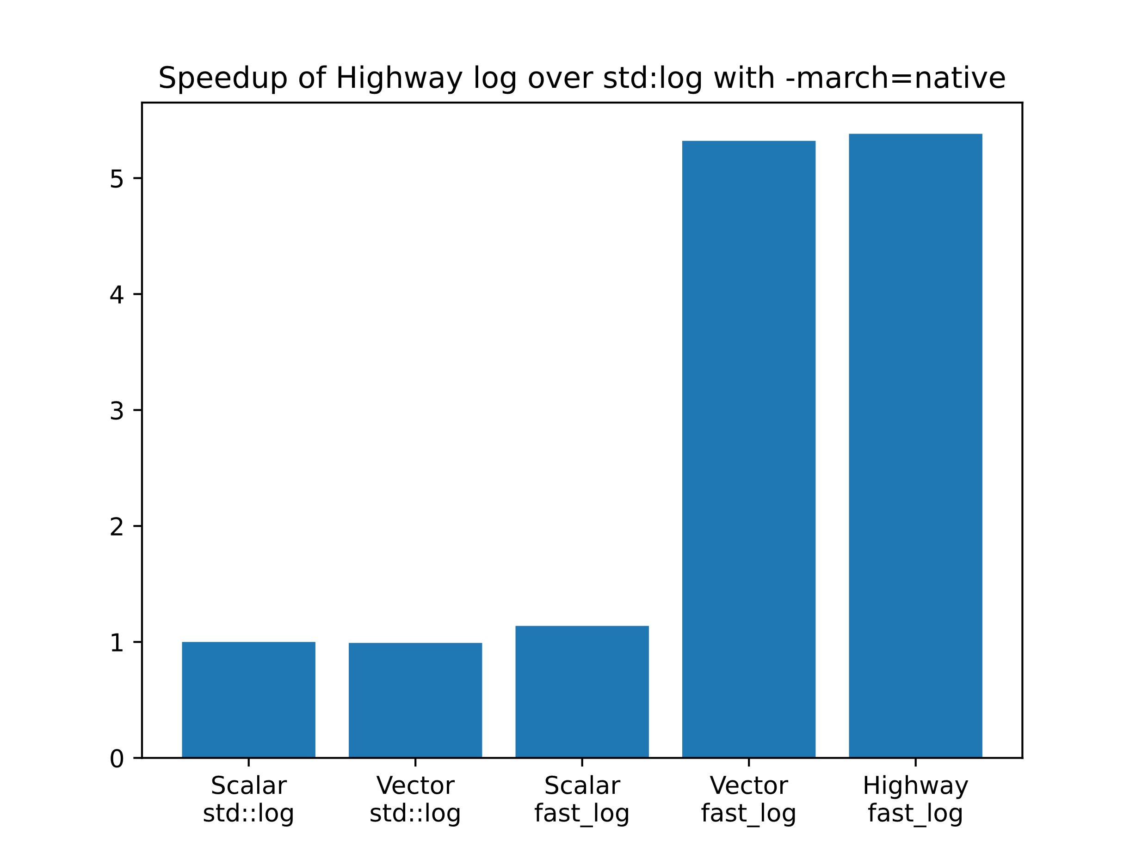
Results

Slide 46
constexpr
The constexpr specifier declares that it is possible to evaluate the value of the function or variable at compile time.
https://en.cppreference.com/w/cpp/language/constexpr

Slide 47
Why it is important
Program
Runtime
constexpr
Program
Runtime
Compile time

Slide 48
Converting a string to different encoding
https://gist.github.com/DiamonDinoia/26e7bed31f384157a7b0159dff45fb48 (credits to Jason Turner)

Slide 49
Converting a string to different encoding
https://gist.github.com/DiamonDinoia/26e7bed31f384157a7b0159dff45fb48 (credits to Jason Turner)

Slide 50
ASM
The string is known at compile time but transformed at runtime!
https://compiler-explorer.com/z/M1n1xjnTz

Slide 51
Adding constexpr

Slide 52
Adding constexpr

Slide 53
ASM
The string is converted at compile time!

Slide 54
constexpr in practice
These executed
at compile time
“zero overhead”

Slide 55
There are limits
3D render of a scene at 60 fps and 1080p resolution
One minute requires ~240MB of storage
Does it make sense to execute the render at compile time entirely?

Slide 56
Summary
Proper timing is difficult. Using library reduces the chance of polluted results
Branches are costly! Branchless programming can give an 8x speedup
Performance portability can be achieved
Execute parts of the program at compile time can greatly reduce the runtime

Slide 57
Extra

Slide 58
Multi dimensional data structures
C/C++ does not support them natively

Slide 59
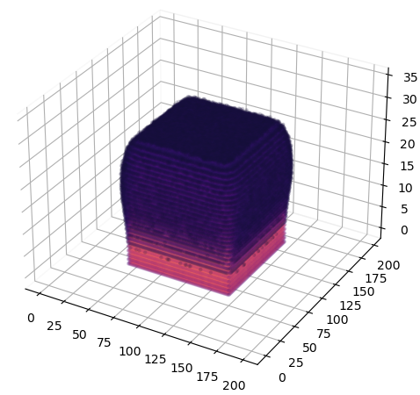
Multi dimensional data structures
6 MeV electron 10x10

Slide 60
Fortran supports it natively

Slide 61
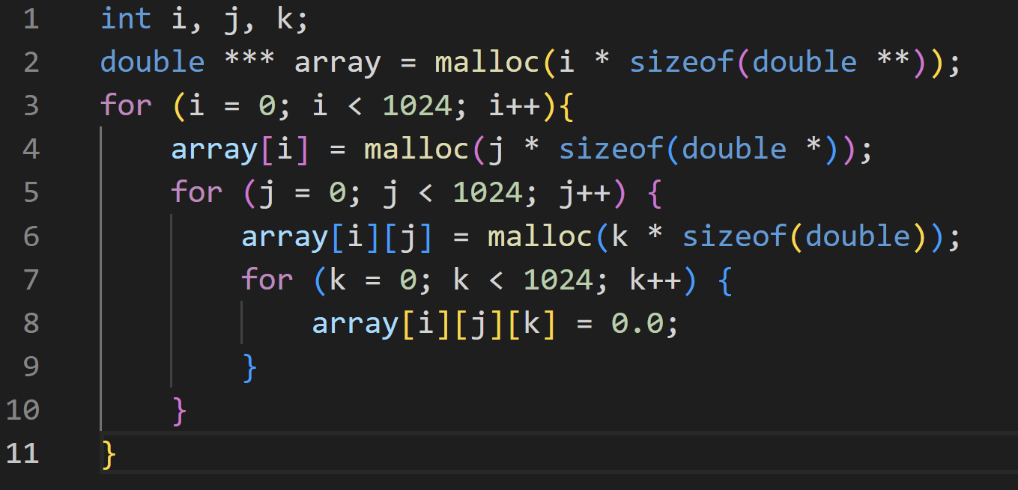
C/C++ does not support them natively
Leads to terrible code

Slide 62
“Proper way”

Slide 63
Multi dimensional data structures
Are commonly used in scientific computing
Are a source of performance degradation
Bug-prone
How many times did you implement such a data structure?

Slide 64
mdspan
Available as a library
C++23 integrated it in the standard
Provides multi-dimensional data structure support
Properly tested and efficient
It easy to implement `restrict` and `aligned` accessor for performance
https://github.com/kokkos/mdspan/wiki/A-Gentle-Introduction-to-mdspan

Slide 65
Example usage
https://github.com/kokkos/mdspan/wiki/A-Gentle-Introduction-to-mdspan

Slide 66
Morton transform
Useful for cache efficient storage in certain simulations

Slide 67
Morton transform & mdspan
https://github.com/DiamonDinoia/morton-span

Slide 68
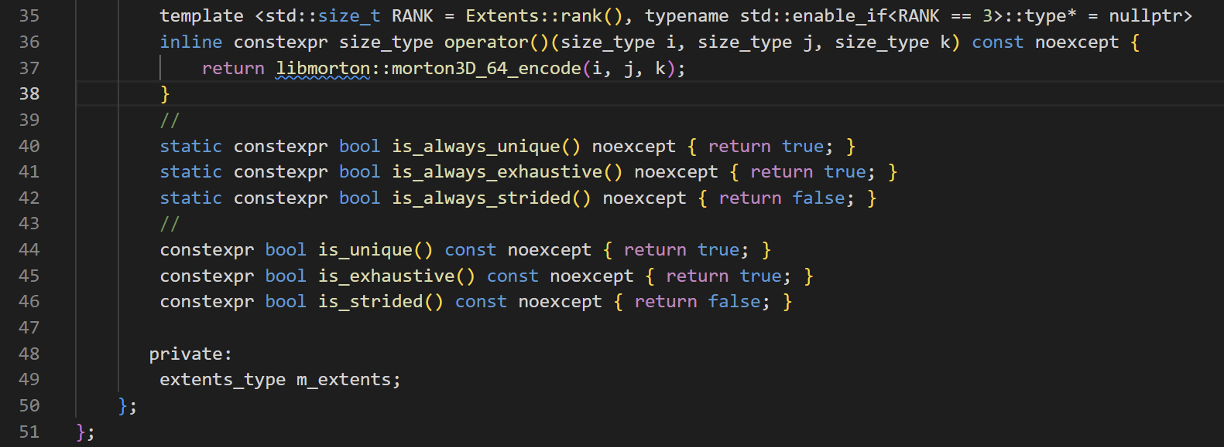
Morton transform & mdspan
https://github.com/DiamonDinoia/morton-span

Slide 69
Conclusion
~50 lines of code (Morton library leveraged)

