Slide 1
Coordinating Panel Software &CPSC)
Ian Fisk
April 22, 2026

Slide 2
Award Committee
Proposed Committee
Internal Members
Peter Boyle
Gavin Davies
Matthew Feickert
External Members
Deborah Bard
Tulika Bose
Ruth Van der Water

Slide 3
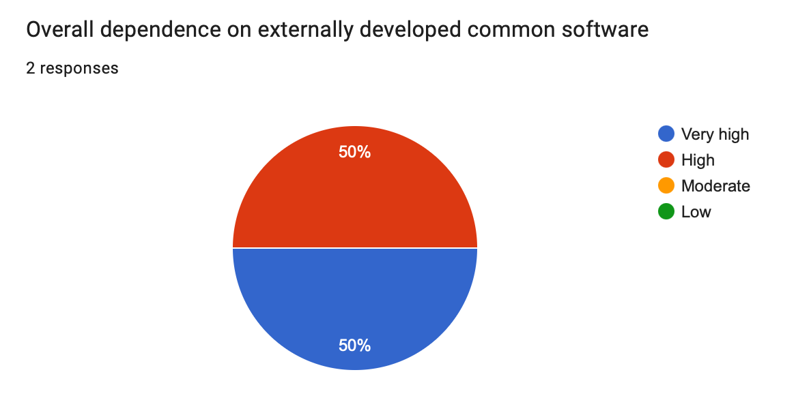
Survey Results
Curiously, ATLAS and CMS said

Slide 4
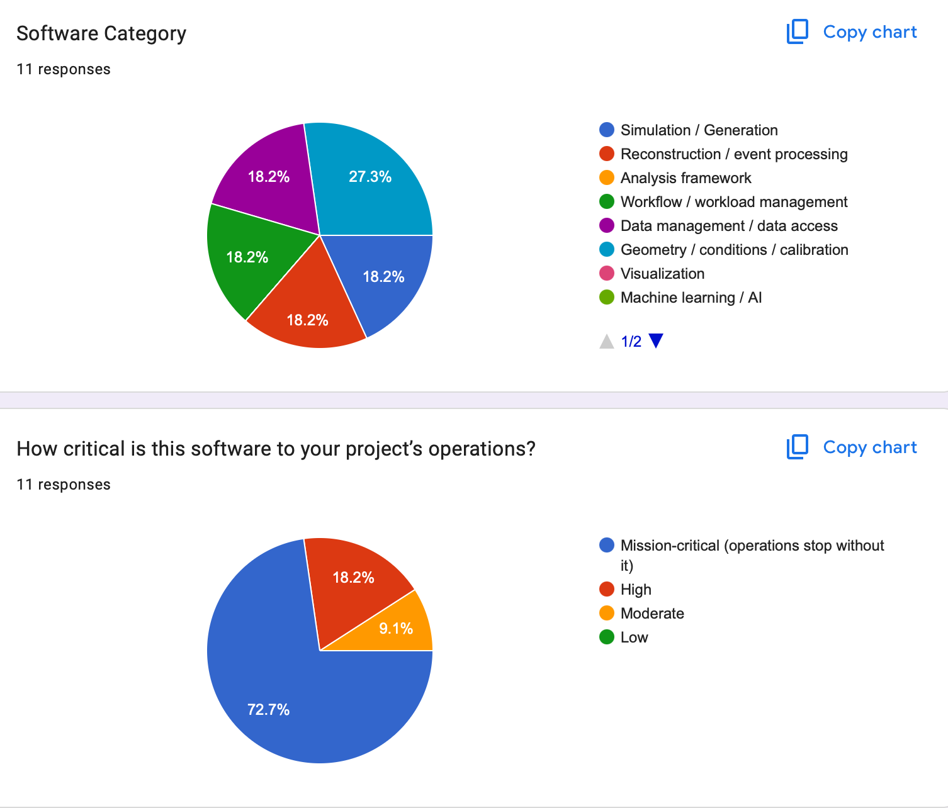
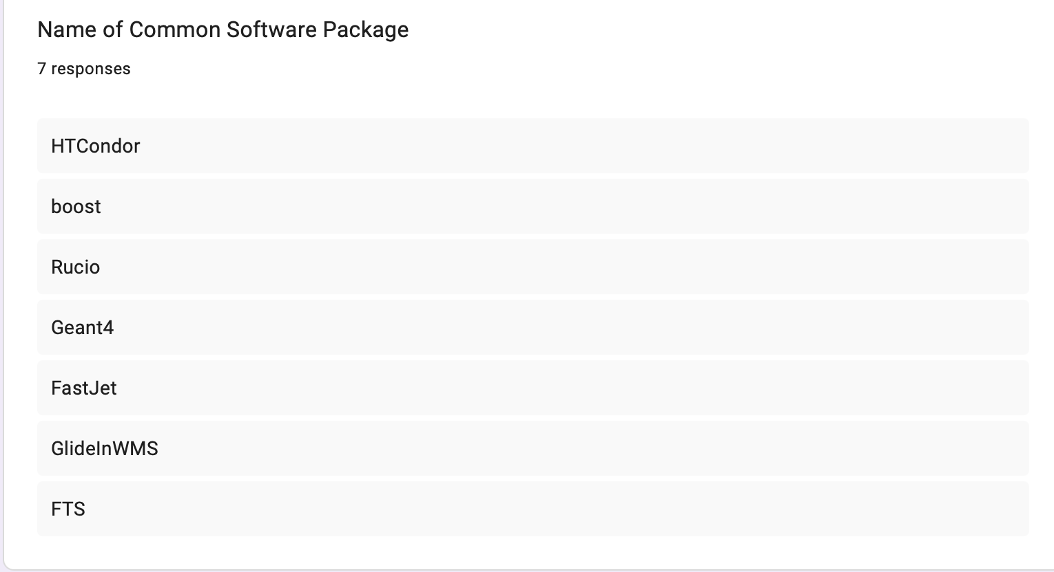
Responses
Most of these came from CMS

Slide 5
