Slide 1
Deep neural networks for spike sorting: exploring options
Jeremy Magland -- with Joakim Anden and Eftychios Pnevmatikakis
29 March 2019
Center for Computational Mathematics
Flatiron Institute, Simons Foundation
Spike sorting collaborators: James Jun, Alex Barnett

Slide 2
Deep neural networks for spike sorting?
Overview of this presentation
Brief overview of the spike sorting problem and its challenges
Describe speech separation problem, clustering via deep embedding, and its relationship to spike sorting
Next steps -- discuss possible ways forward

Slide 3
Spike sorting overview
First I will give a brief overview of the spike sorting problem and a description of our efforts for comparing and validating various spike sorting algorithms using a framework called SpikeForest.

Slide 4
Spike Sorting
Detect neural firing events
Sort into clusters representing individual neurons
Electrophysiology recording (multi-channel timeseries)

Slide 5
Spike sorting as a black box
INPUT
MxN Array
OUTPUT
Collection of spike times and neuron labels
Spike sorting
Which neuron fired when?
Notes:
‹#›

Slide 6
Many spike sorting packages... how to choose?

Slide 7
Evaluation
INPUT
MxN Array
OUTPUT
Collection of spike times and neuron labels
Spike sorting
Ground truth
true spike times and labels
Comparison
Accuracy results
Notes:
‹#›

Slide 8
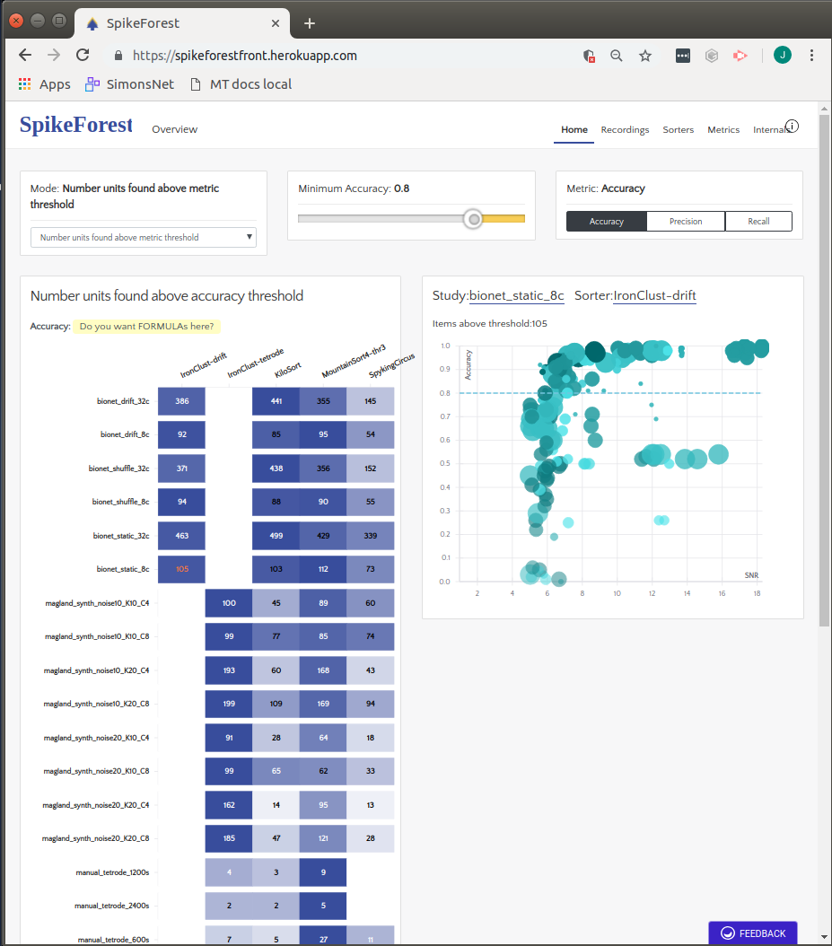
SpikeForest website (in progress)
With: Alex Barnett, James Jun, Liz Lovero
Registered hundreds of ephys recordings (simulation and real) with ground-truth info
Wrapped several algorithms (MountainSort, IronClust, Spyking Circus, Yass, KiloSort, KiloSort2, …)
Framework for running analyses, comparing with ground truth, auto-caching of results
Public website for interactive exploration of results.
Reproducible, transparent, open-source

Slide 9
Spike sorting challenges
Next I will touch upon some of the challenges associated with spike sorting.

Slide 10
Spike sorting challenges
Presence of noise (or background signal)
Unknown event times (detection)
More than one unit (clustering)
Spike waveforms reside in a high-dimensional space
Non-Gaussian clusters (waveform variation)
Drift
Bursting
Overlapping events
Large electrode arrays (many channels)

Slide 11
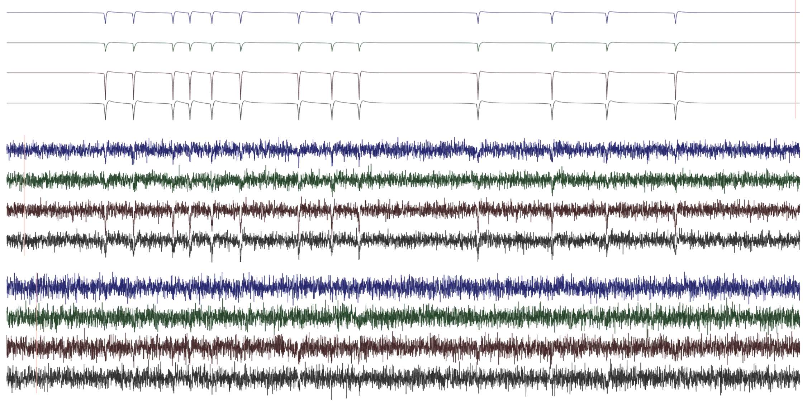
The pure detection problem
(Case of a single unit)
No noise
Somewhat noisy
Very noisy

Slide 12
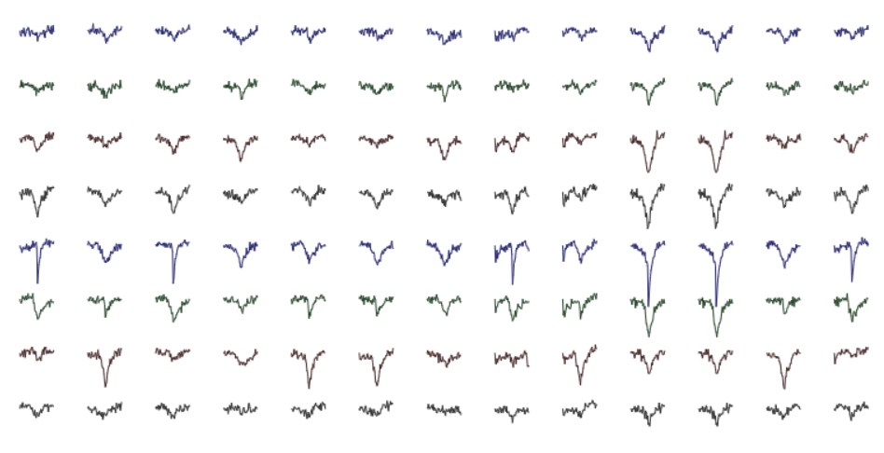
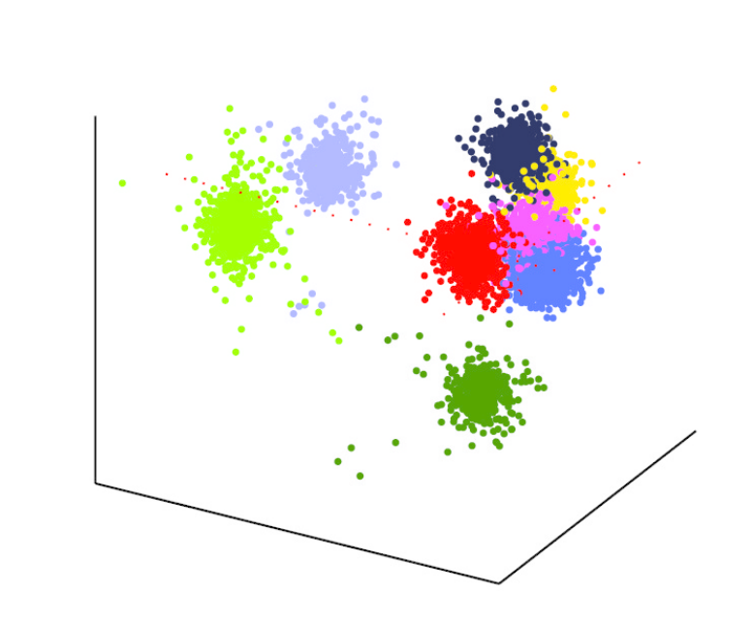
The pure clustering problem
(Case where event times are known)
Feature extraction
Clustering in low-dim feature space

Slide 13
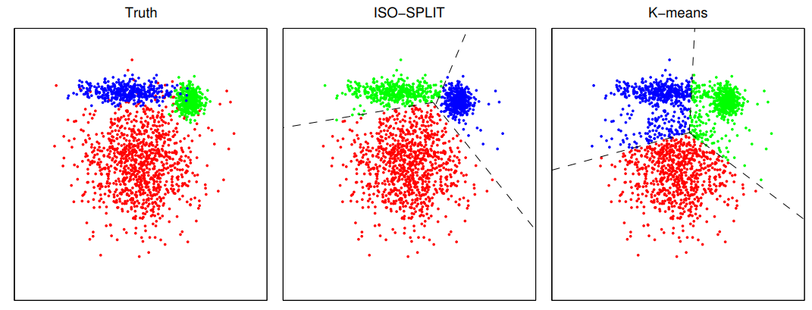
Clustering via ISO-SPLIT
ISO-SPLIT is our density-based method for clustering in low dimensions. Will neural nets be able to handle this aspect of the spike sorting?

Slide 14
High-dimensional space
50 timepoints x 8 electrode channels = 400 dimensions
Or maybe we can bypass the feature extraction step and directly utilize the full spike waveforms in higher dimensions.

Slide 15
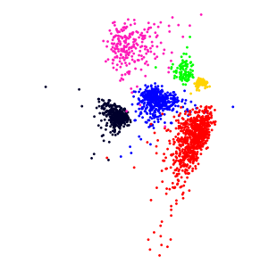
Non-Gaussian cluster distributions
Clusters can have non-Gaussian shapes due to variations in spike waveforms and the complex background signal (noise) distribution.

Slide 16
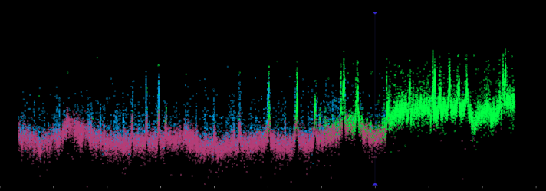
Spike waveform drift and bursting
Spike amplitude
Time (duration ~10 minutes)
Spike amplitude vs. time for a single neuron. Each point is a spike event. Color represents the results of spike sorting. Drift and bursting can cause false splitting of clusters.

Slide 17
Overlapping spikes
When spikes overlap in both time and space, waveform shapes may be distorted.

Slide 18
Large electrode arrays (high channel counts)

Slide 19
Speech blind source separation
Next I will describe the problem of speech separation (audio signals) and the similarities / differences between it and spike sorting.

Slide 20
Speech separation
Speaker 1
Frequency
Speaker 2
Speaker 2
Frequency
Speakers 1&2 mixed
Frequency
Time (duration ~4 seconds)

Slide 21
Speech separation
Speakers 1&2 mixed
Procedure
Classify the time-frequency bins in the spectrogram of the mixture as belonging to one or the other speakers (Clustering)
Apply masks to the spectrogram
Reconstruct the unmixed signals

Slide 22
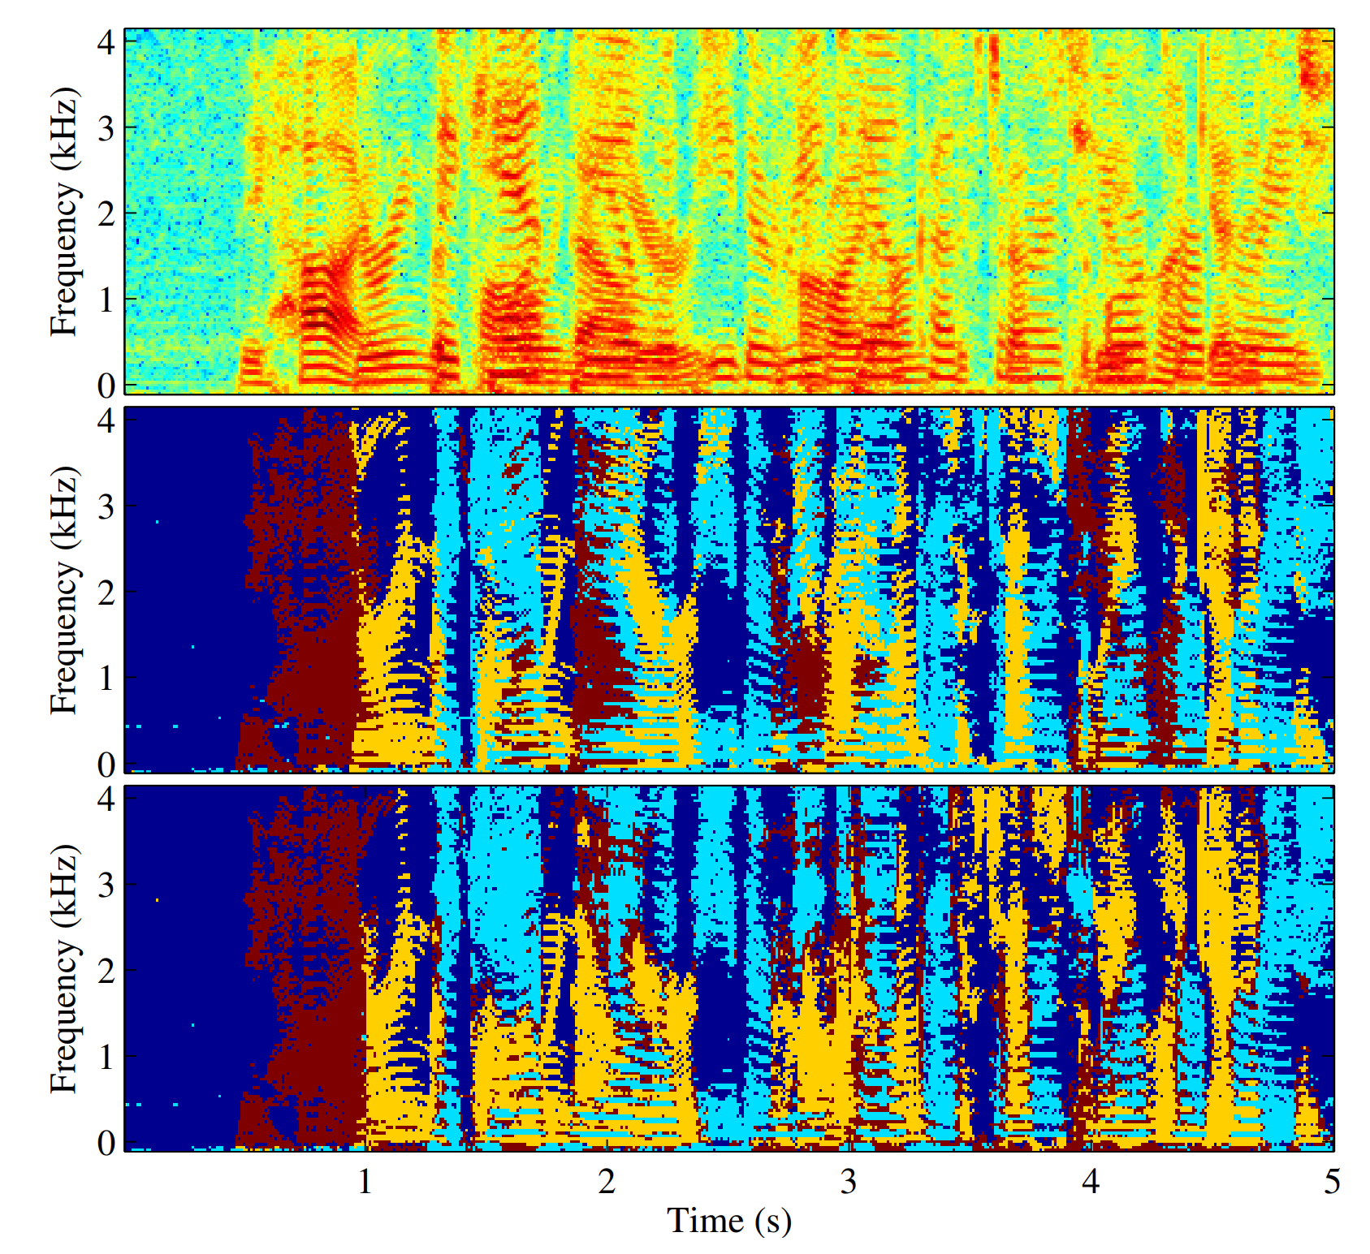
Speech separation via deep clustering
Spectrogram (mixture of three speakers)
Ideal binary masks
Output binary masks
(network trained on 2-speaker mixtures)
Hershey, John R., et al. "Deep clustering: Discriminative embeddings for segmentation and separation." 2016 IEEE International Conference on Acoustics, Speech and Signal Processing (ICASSP).

Slide 23
Speech separation via deep clustering
Training
Obtain audio recordings of mixed speech where ideal spectrogram histogram binning is known (WSJ collection)
Split spectrogram into 100-frame segments (~800 ms, single word)
Neural network: embed each segment in high-dimensional feature space
Optimize separability of the known clusters in the embedding space.
Speech separation
Audio recording of mixed speech with unknown histogram binning
Split spectrogram in 100-frame segments (as above)
Neural network: embed each segment in high-dimensional space
Cluster entire recording (union of all the bins in all the segments) in the embedding space (e.g., k-means) to obtain spectrogram masks.

Slide 24
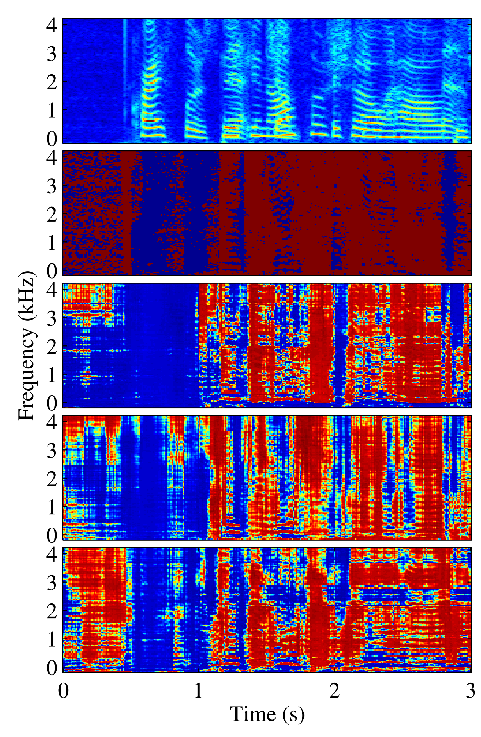
Deep clustering -- training the embedding
Spectrogram segment 100 x M
100 = # time frames per segment
M = # frequences
Spectrogram (mixture of two speakers)
Mask (first speaker)
1st embedding dimension
Embedding via neural net
2nd embedding dimension
Spectrogram segment 100 x M x D
D = dimension of embedding space
3rd embedding dimension
Single segment
Hershey, John R., et al. "Deep clustering: Discriminative embeddings for segmentation and separation." 2016 IEEE International Conference on Acoustics, Speech and Signal Processing (ICASSP).

Slide 25
Deep clustering -- training the embedding
Spectrogram segment 100 x M
100 = # time frames per segment
M = # frequences
Embedding optimizes the separability (or clusterability) of all the bins in the D-dimensional embedding space based on the known speaker assignments.
For example:
Minimize distances between points within the same cluster.
Maximize distances between points in different clusters.
Embedding via neural net
Spectrogram segment 100 x M x D
D = dimension of embedding space

Slide 26
Deep clustering -- applying the network for speech separation
Spectrogram (mixture of two speakers)
Mask (first speaker)
❵
1st embedding dimension
Cluster all the bins in the histogram in the D-dimensional space to obtain the masks for the speakers
2nd embedding dimension
3rd embedding dimension

Slide 27
Back to ephys
Now we’ll go back to electrophysiology and spike sorting and describe the relationship between it and speech separation.

Slide 28
Electrophysiology
Simulated
32 channels
200 milliseconds
30 KHz
40 units
Firing rates: 5-10 Hz

Slide 29
Electrophysiology vs. speech
32 channels
200 milliseconds
30 KHz

Slide 30
Ephys vs speech
The primary difficulty is that in spike sorting the local context around the spike does not help at all in characterizing the spike, aside from the shape of the ~1 millisecond spike itself.
Therefore the technology cannot directly transfer.

Slide 31
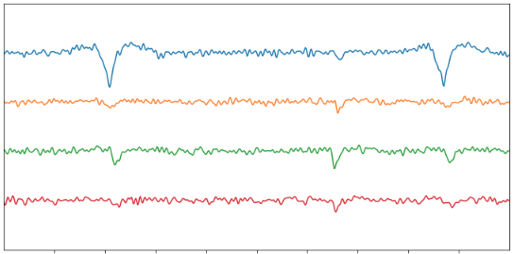
Need to use long time-scale associations in some way
… ...

Slide 32
Possible approach
Timeseries segment M x T
M = # electrode channels
T = # timepoints in segment
Single segment
Incorporate longer time-scale information
Embedding via neural net
Perhaps use nearest neighbor segments within +/- 30 seconds.
Spectrogram segment M x T x D
D = dimension of embedding space

Slide 33
Thank you!
Notes:
‹#›

