Slide 1
SCC Intro

Slide 2
Welcome
All these slides are on indico
  https://indico.flatironinstitute.org/event/2506/
Documentation is here
  https://docs.simonsfoundation.org/index.php/Public:Flatiron_Research_Computing_Table_of_Contents
  When asked to log in, it’s your cluster credentials (LDAP)

Slide 3
Organization
Core IT (ITSupport@simonsfoundation.org)
  Printers
  Office/productivity software license issues
  Email problems
  General IT problems
  Wifi
Scientific Computing (Robert Blackwell, Nick Carriero, Alex Chavkin, Justin Creveling, Ian Fisk, Pat Gunn,Yanbin Liu, Liz Lovero, Andras Pataki, Dylan Simon, Jonathan Tischio, Nikos Trikoupis, Aaron Watters) (scicomp@flatironinstitute.org)
  Questions about any of the central Linux clusters
  Package and configuration management on cluster
  Technical software and performance issues
  IO and data storage
Scientific Computing Documentation is here:
https://docs.simonsfoundation.org/index.php/Category:Flatiron_Institute_RC
Your mentor/sponsor or instructor will be your first point of contact.

Slide 4


General ARCHITECTURE
High performance computing resources tend to be centralized
  Individual machines need to work together, and groups of machines access the same data
  We are optimized for data access
FIREWALL
Fabric
HEADNODES
(rusty1,rusty2)
GATEWAY
PROCESSING
ssh (port 61022) and Google
Authenticator
ssh
ssh/SLURM
scp –P 60122 or
Globus
Google ID
STORAGE
BINDER

Slide 5
Gateways and Interactive nodes
If you are on the internal FI network, you don’t need to connect through the gateway (you are inside the gate)
If you are outside (this includes the guest network), you can connect via ssh to port 61022
  You will authenticate with google authenticator and your cluster password
rusty and the popeye nodes are intended for light interactive work
  We use cgroups and you will find yourself restricted to 1 core and only a limited amount of memory
We have two gateways
Aliased to gateway
On both coasts we have interactive nodes
rusty and popeye

Slide 6
RESOURCE SCHEDULING
We have ~600 computers on each coast
  It would be impossible to manually schedule who gets access and for how long
We use a resource schedule system called SLURM (Simple Linux Utility for Resource Management) often referred to as a “batch scheduler”
  As a user you ask for a certain number of nodes and the system can either start specific jobs or allocate them for interactive access
    When a job or interactive session finishes the nodes are returned to the pool of resources
Organizations choose specific philosophies how they optimize getting processing completed
  For most resources we have chosen to allocate entire nodes
    Users are expected to use the computing efficiently
    There is a gen partition with strict resource limits (200 cores), but lax time limits
    There is a partition per center (cca,ccb, etc) with more generous resources limits (1280 cores) but a week time limit
    There is a preempt partition with not resources limits, but an unpredictable time limit
Nodes have 28 – 128 cores
512GB to 1TB of RAM

Slide 7
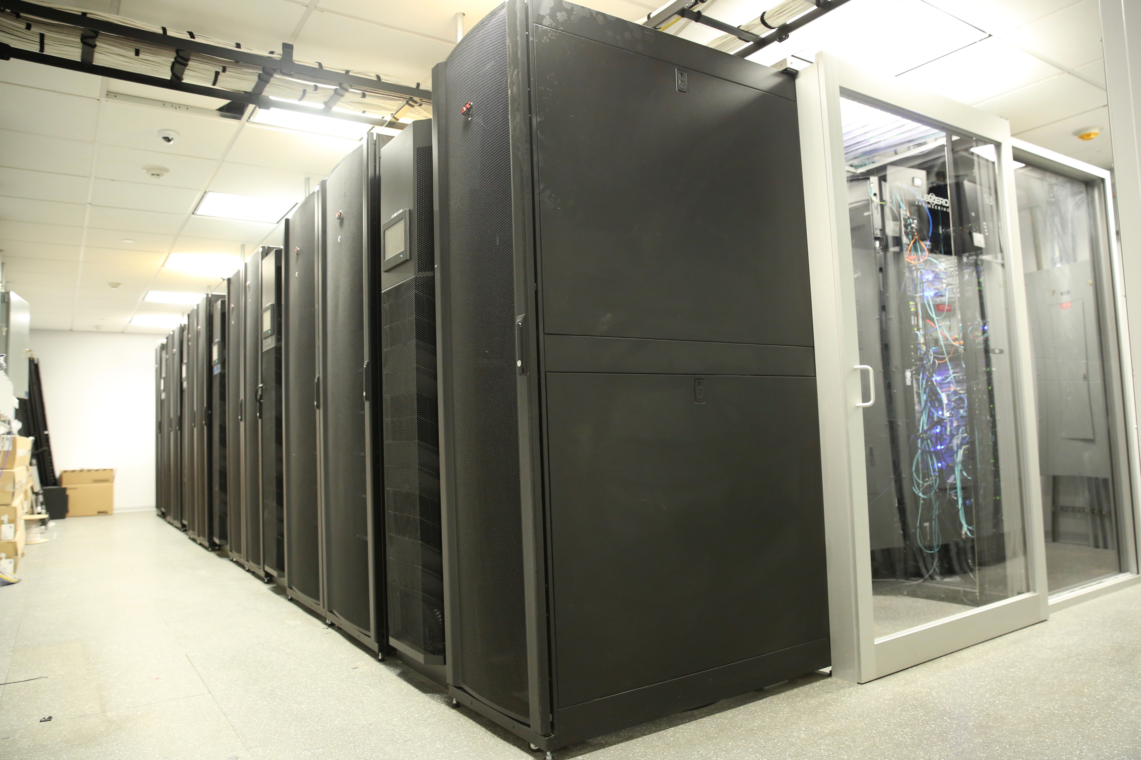
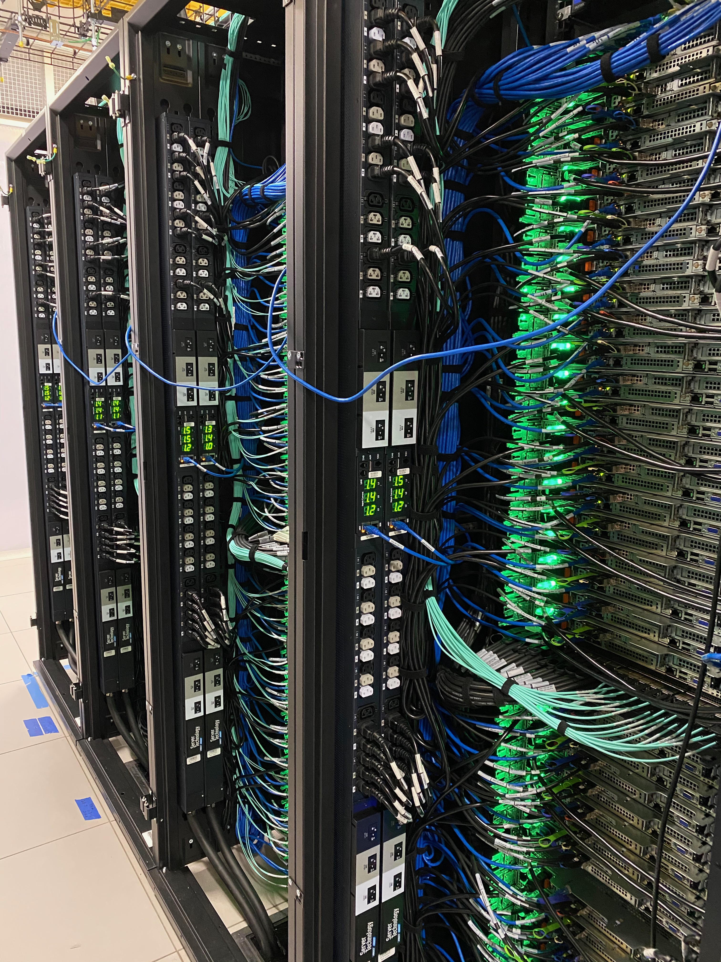
What and where?
We have three computing centers
  At 162
    6.7k cores: 240 2x14 Broadwell nodes, 512GB RAM, 10Gb/s Ethernet and 100Gb/s Omnipath
    7.7k cores: 192 2x20 Skylake nodes 768GB RAM, 10Gb/s Ethernet and 100Gb/s Omnipath
    50 GPU nodes 160 GPUs Mostly v100-32GB, but 12 A100s)
    96 core, 3 TB node and 192 core, 6TB node
  At CoreSite in NJ
    40k cores: 320 2x64 AMD EPYC nodes, 1TB RAM, 25Gb/s Ethernet and 100Gb/s InfiniBand
  Co-location at BNL (~3ms, common software and file systems)
    4800 cores: 120 2x20 core Skylake nodes, 768GB RAM, 2x10Gb/s Ethernet
  At SDSC (~70 ms, independent software and file systems)
    Popeye: 28k cores, 576 2x24 core nodes, 768GB RAM, EDR InfiniBand (144 Intel Xeon Platinum 8168 2.7GHz, 432 8268 2.90GHz) (Added 216 2x32 core Icelake next week)
    32 GPU nodes (128 v100-32GB)
Rusty
Popeye
Notes:
First two are collectively known as “rusty”.

Slide 8
ACCOUNTS
Staff have been given Linux cluster accounts. All user accounts are stored in a central system that enforces a consistent user namespace
All home directories for Linux are stored in a GPFS parallel shared file system
  250TB of RAID6 with a nightly incremental backup.
  This is not intended for intermediate results or large final results (> 1MB)
We have a new system for account management
  https://fido.flatironinstitute.org
  Allows reset of token, check status of accounts, staff can request and management external sponsored users
Notes:
Tmux, screen

Slide 9
Storage Resources
250TB of GPFS space for home directories
  Incremental back-up and RAID6.
  Code, docs, notes should live here. If you use more than ~1 TB, we will urge you to clean up and move data to the volumes intended for it.
~15PB of usable space in cephfs (3 copies or erasure encoded)
  Data and large results files should live here /mnt/ceph/users/
  If there is anything you need to keep, but you don’t expect to access for a while, let us know. We have tape archiving resources offsite.
Keep in mind that all compute nodes have node-local storage too.

Slide 10
FI Configuration
All the Linux systems are configured with via centralized management systems.
  We are nearly entirely CentOS 7.6 for workers and desktops
Expanded and updated software environment mostly deployed through modules
  module avail
    Same environment on desktops and clusters
If you need a package, please ask. Also feel free to install (non-privileged) software in your own directory. Please be careful with conda.
All Linux home directories are centrally served. A user can log into most systems and will see the same files (but make a SLURM allocation if you want a resource for significant work).

Slide 11
SOME NOTES
We use a fifo batch system and we try to keep the wait times short
  Try to be a good citizen
  Submitting with accurate estimates for time and resources may result in quicker allocation
Most of the systems are allocated exclusively by default.
  This means you get all the cores
    There are tools like disBatch that can help you use all the cores
Our systems have a lot of cores and memory
  Understand the parallelism of your code
The GPU nodes are shared because they are quad GPUs systems
  If you can’t use all four, allocate one and a reasonable number of cores and memory so that the others can be used by someone else
GPFS is backed-up nightly. It’s intended for code and important persistent things
  Intermediate files with a lot of churn belong in ceph or on node local storage
cephfs is a great file system, but the cluster is large and you have enough resources to really hammer things
  Always a good idea to check IO behavior as you increase the scale of your runs
  Ask questions

Slide 12
IF YOU REMEMBER NOTHING ELSE
Scientific Computing Documentation is here:
https://docs.simonsfoundation.org/index.php/Category:Flatiron_Institute_RC
scicomp@flatironinstitute.org
Is the mailing list to write with problems
There is also a scicomp slack channel

