Slide 1












The CO Mapping Array Pathfinder
Patrick C. Breysse (CITA), for the COMAP Collaboration
CCA Intensity Mapping Workshop, 21 Feb 2019

Slide 2
Goal: Map distribution of molecular gas across cosmic history

Slide 3
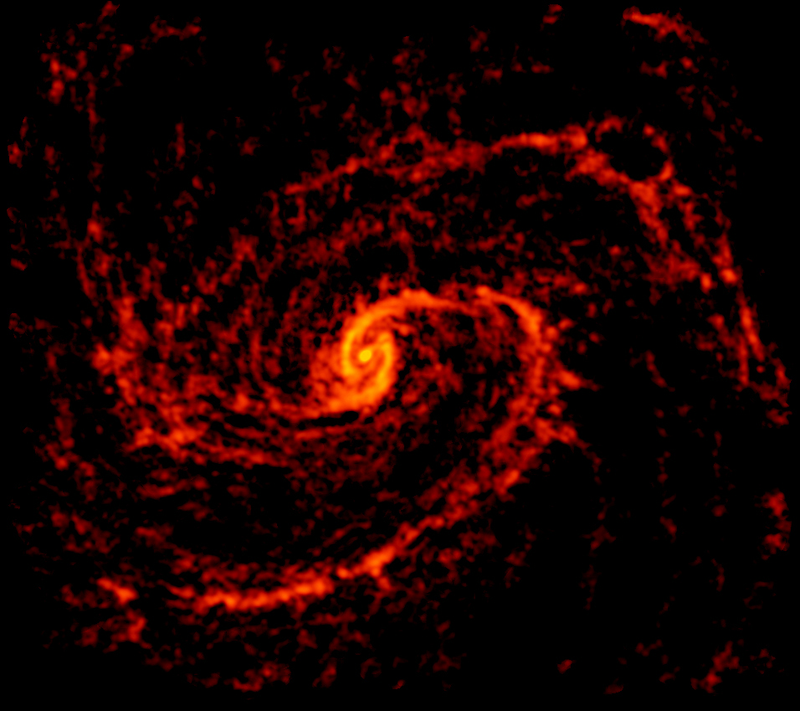
Why CO?
Abundant in molecular clouds, accessible ladder of transitions
Traces fuel for star formation, important for understanding ISM
At high-z, traces formation of ionizing sources during EoR
Credit: ALMA (ESO/NAOJ/NRAO); NRAO/AUI/NSF, B. Saxton

Slide 4
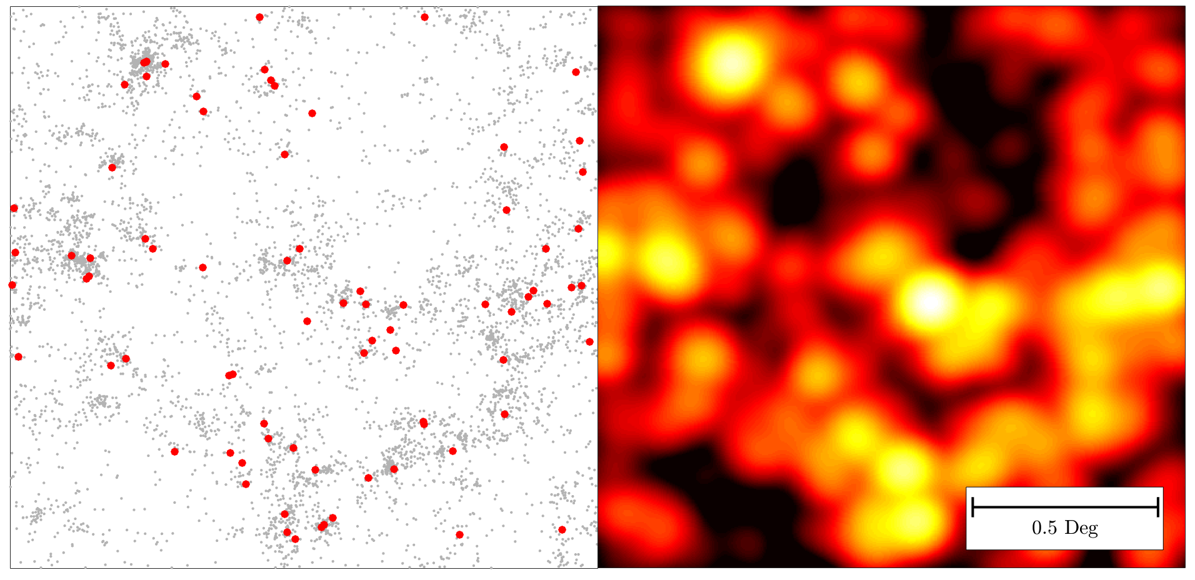
CO Intensity Mapping
Faint Galaxies Bright Galaxies CO Emission

Slide 5
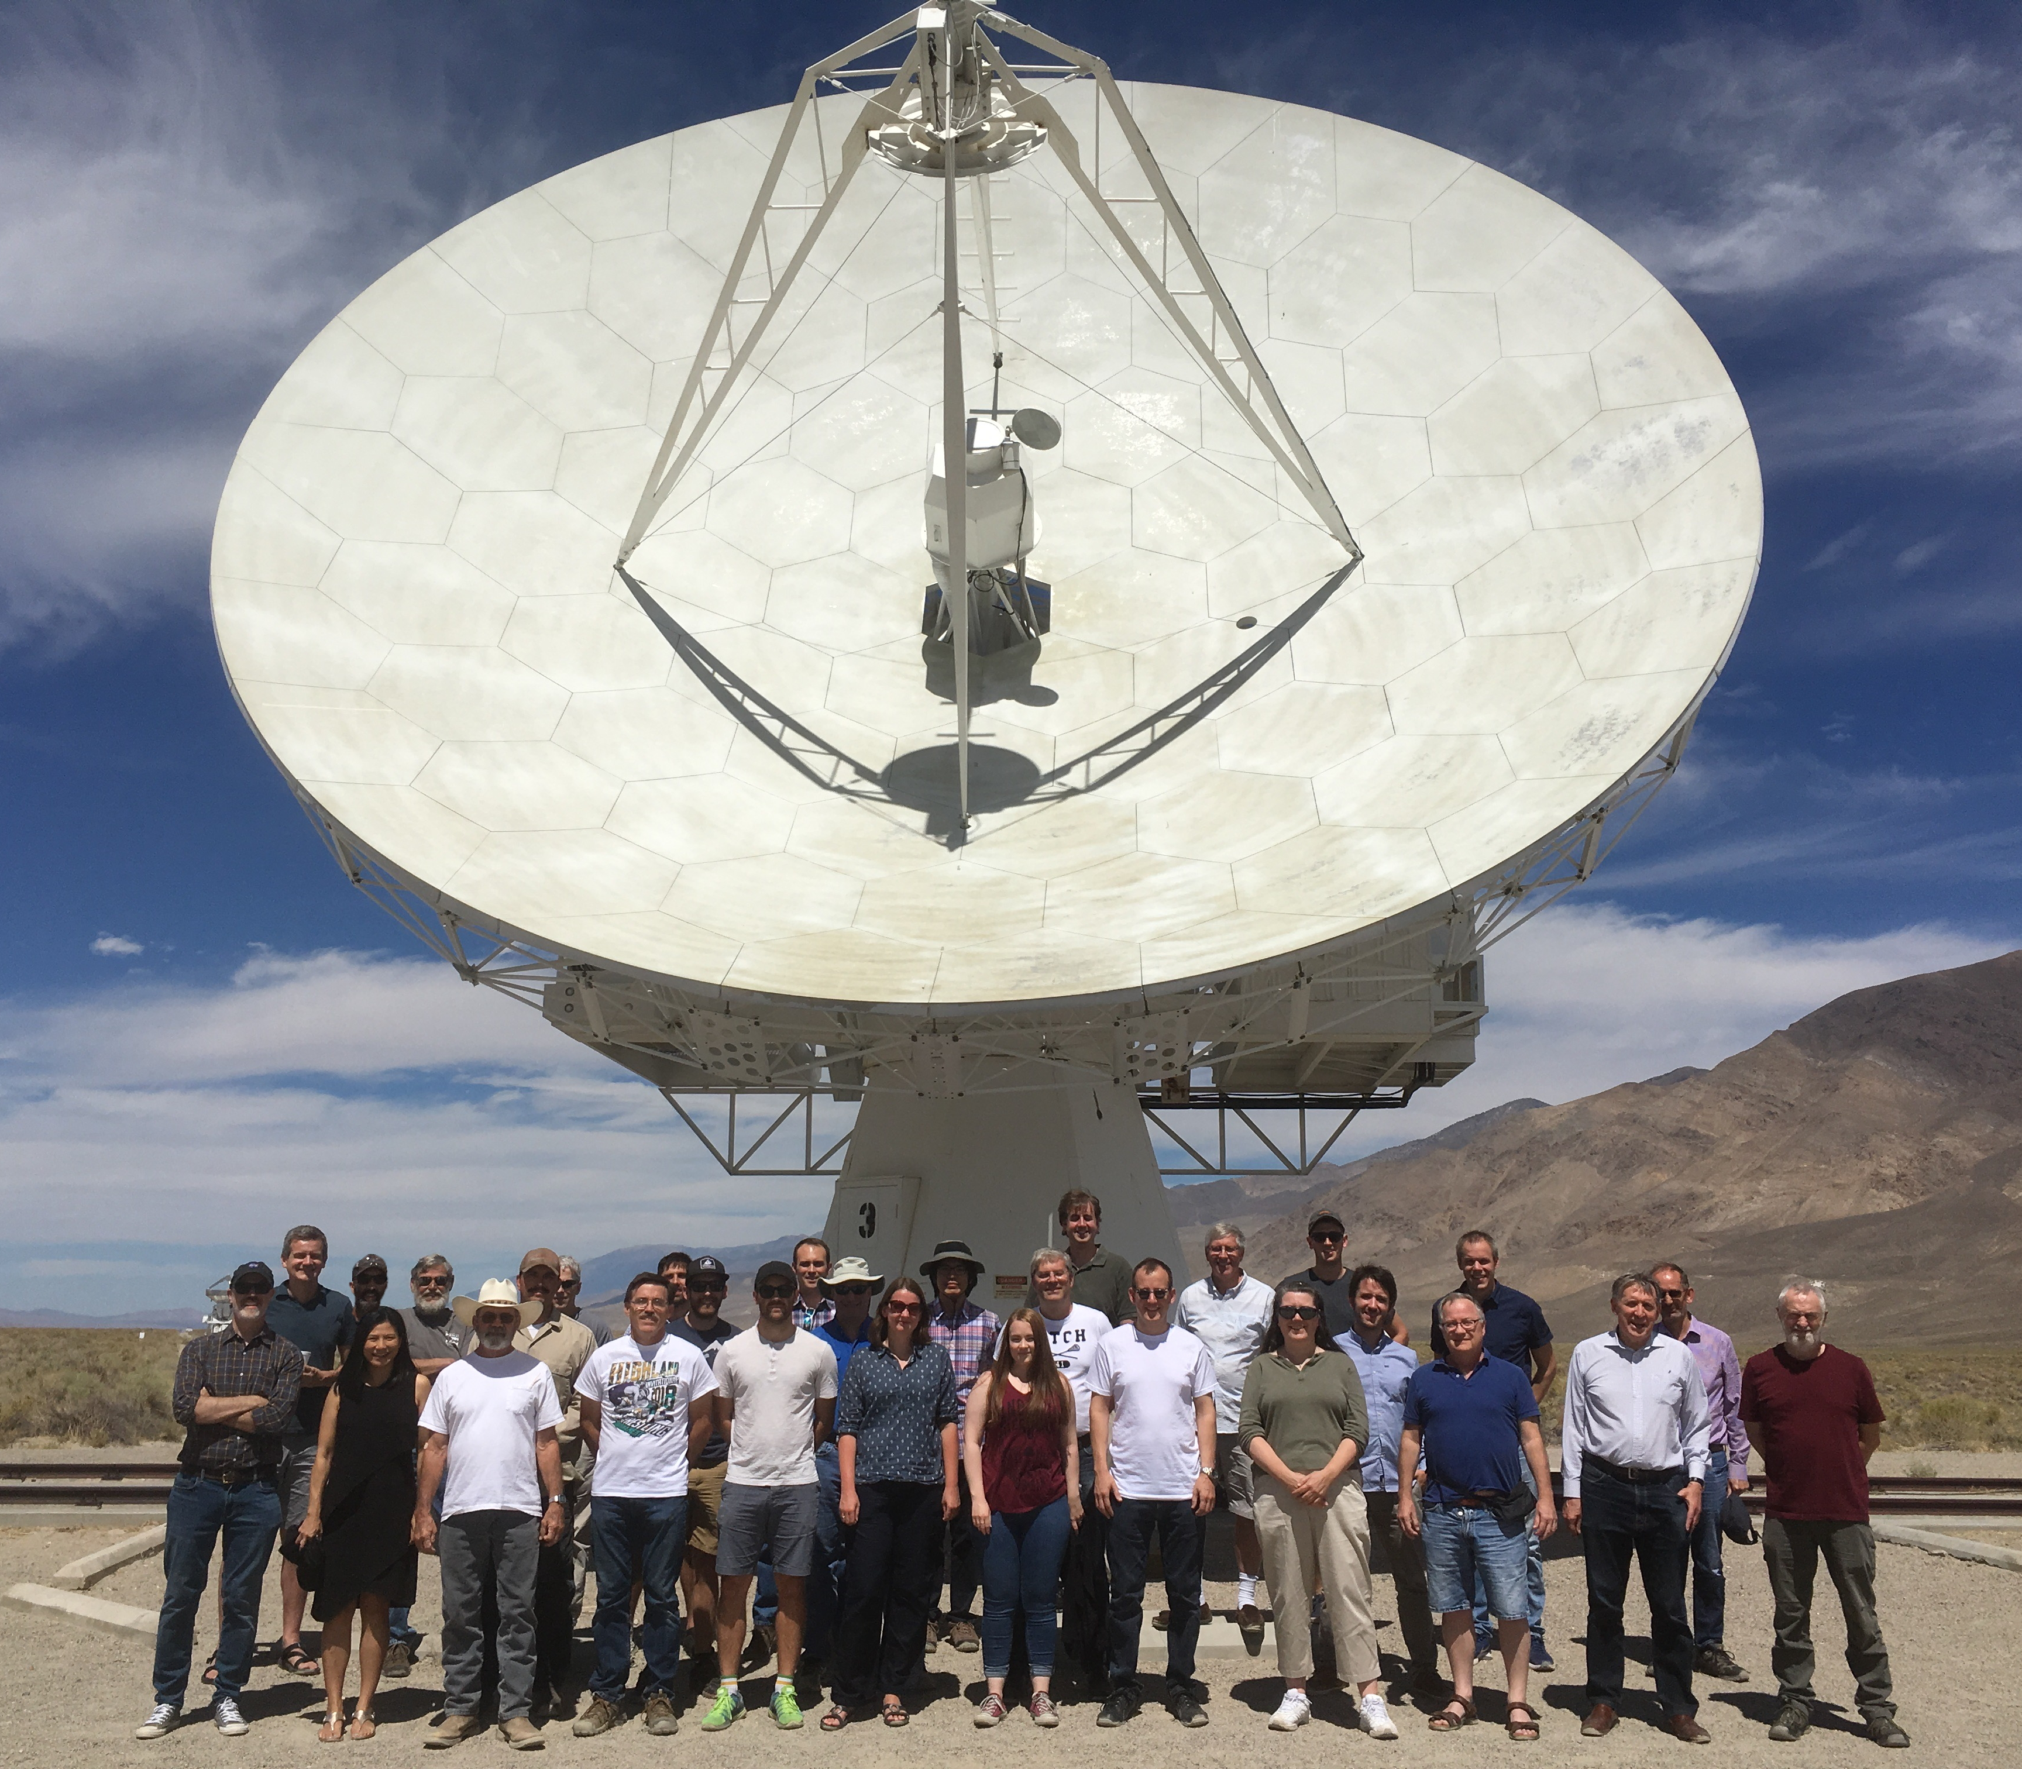
CO Mapping Array Pathfinder
10.4 m telescope at Owens Valley Radio Observatory
19 single-polarization pixels
Ambient temperature feeds, 20K LNA’s
26-34 GHz, z=2.4-3.4 in CO(1-0)
2 years on two 2.5 deg² fields
~2 MHz spectral resolution

Slide 6
CO Mapping Array Pathfinder
10.4 m telescope at Owens Valley Radio Observatory
19 single-polarization pixels
Ambient temperature feeds, 20K LNA’s
26-34 GHz, z=2.4-3.4 in CO(1-0)
2 years on two 2.5 deg² fields
~2 MHz spectral resolution

Slide 7
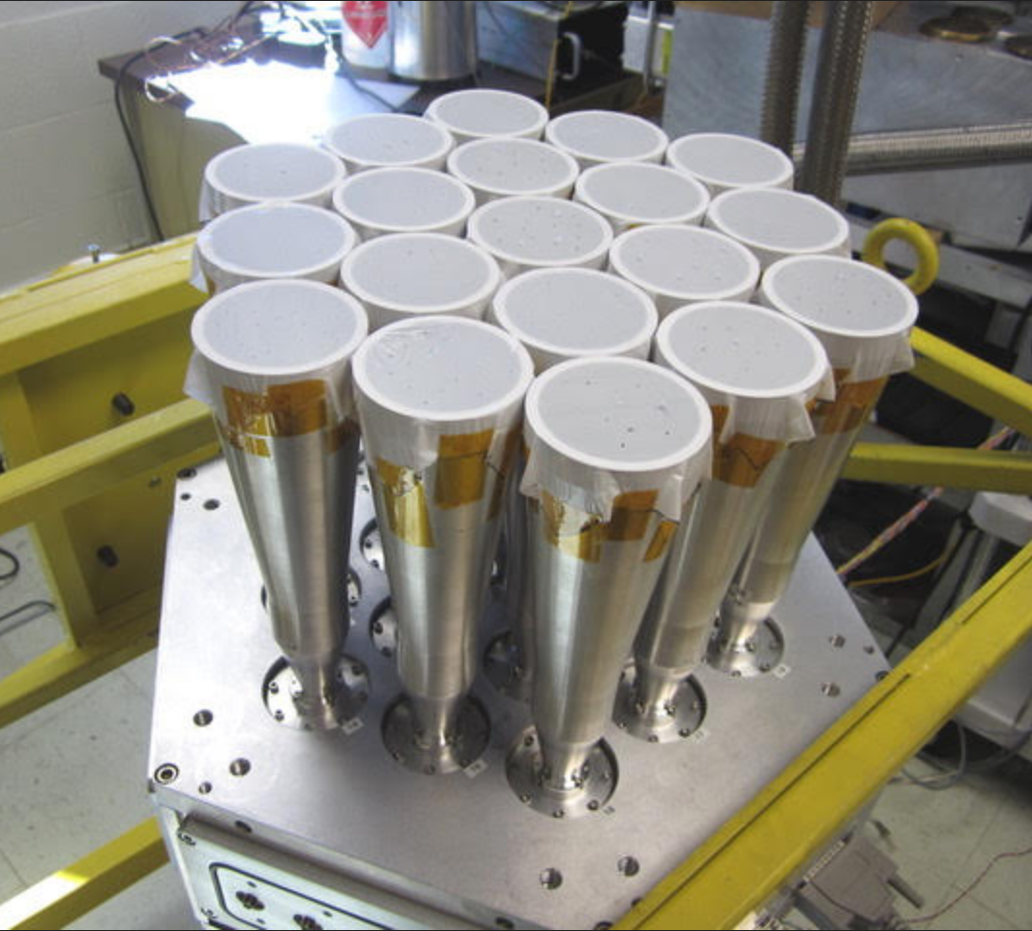
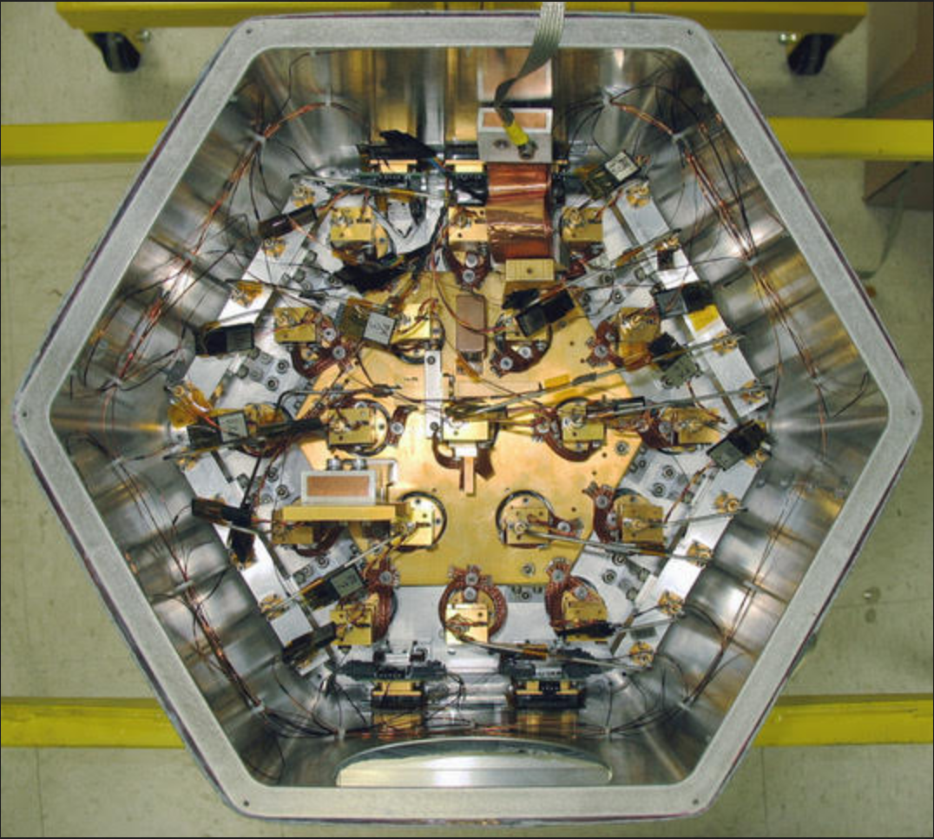
CO Mapping Array Pathfinder
10.4 m telescope at Owens Valley Radio Observatory
19 single-polarization pixels
Ambient temperature feeds, 20K LNA’s
26-34 GHz, z=2.4-3.4 in CO(1-0)
2 years on two 2.5 deg² fields
~2 MHz spectral resolution

Slide 8
Commissioning now, two-year observing campaign starting ~April 2019

Slide 9
COMAP Collaboration
Hans Kristian Eriksen
Marie Foss
Håvard Ihle
Ingunn Wehus
Erik Alexander Levén
Kieran Cleary (PI)
Jonathan Kocz
James Lamb
Timothy Pearson
Tony Readhead
David Woody
J. Richard Bond
Patrick Breysse
Laura Keating
Gunjan Lakhlani
Norm Murray
George Stein
Dongwoo Chung
Sarah Church
Marco Viero
Risa Wechsler
Brandon Hensley
Marcelo Alvarez
Tzu-Ching Chang
Todd Gaier
Charles Lawrence
Joseph Lazio
Andrew Harris
Joshua Gundersen
Clive Dickinson
Stuart Harper
Hamsa Padmanabhan
Rodrigo Reeves

Slide 10

CO Luminosity Function
Empirical SFR densities
$$\frac{L}{L_{⨀}}=A\frac{M}{M_{⨀}}$$
Mergers
2014
Theory,
Breysse+
Predicted Signal to Noise
Empirical scalings
M82 L_{CO}/SFR
A
Breysse, P. C., Kovetz, E. D., & Kamionkowski, M. 2014, MNRAS, 443, 3506

Slide 11
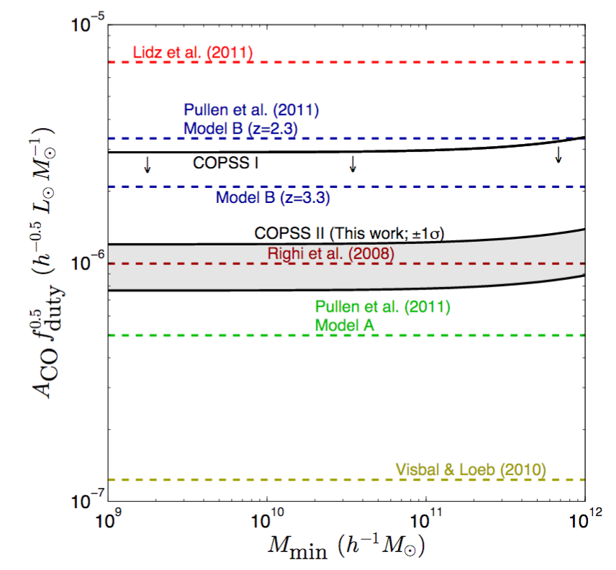
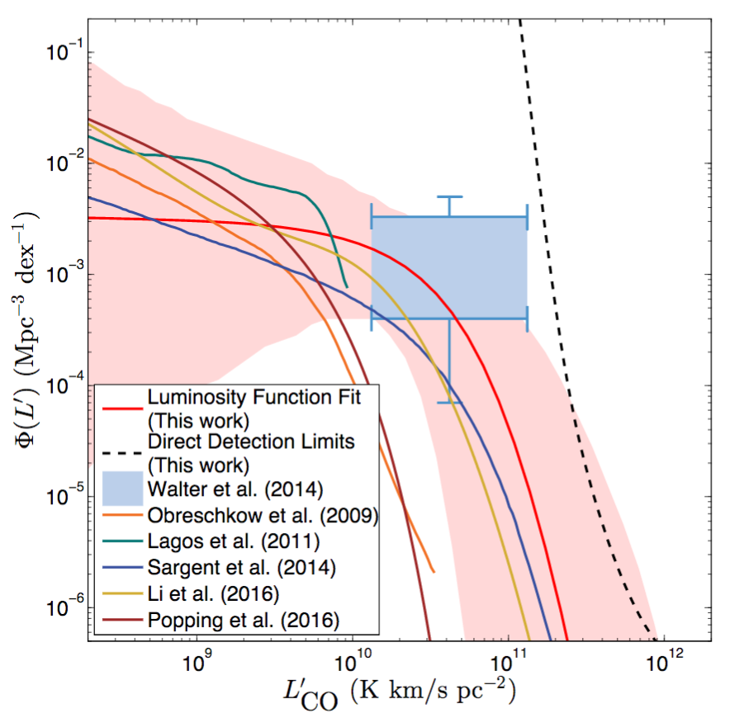
CO Luminosity Function
2016
COPSS,
Keating+
Keating, G. K. et al., 2016, arXiv:1605.03971

Slide 12
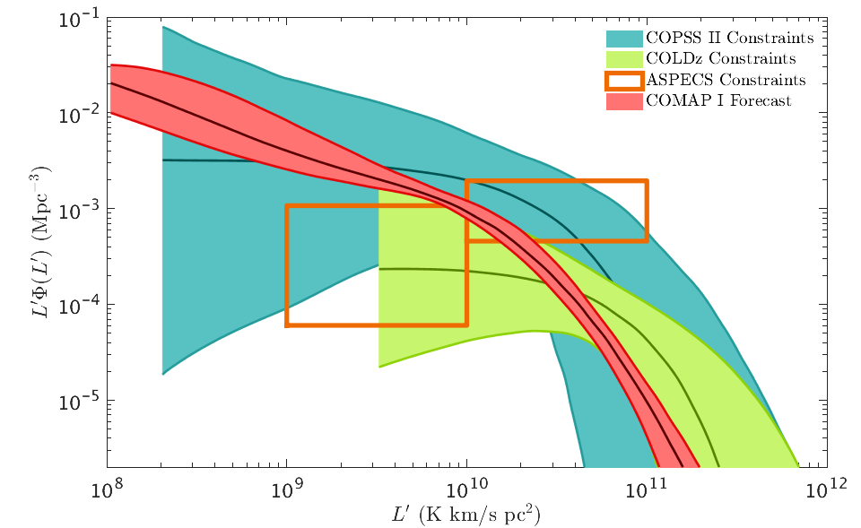
CO Luminosity Function
COPSS (IM)
$$\frac{L}{L_{⨀}}=A\frac{M}{M_{⨀}}$$
ASPECS (Direct)
COMAP
Forecast,
Ihle+ 2018
Luminosity Function
COMAP
COLDz (Direct observation)
CO Luminosity (K km/s pc²)
Ihle+2018 (inc. PCB), Keating+ 2016, Riechers+2018, Decarli+2016

Slide 13
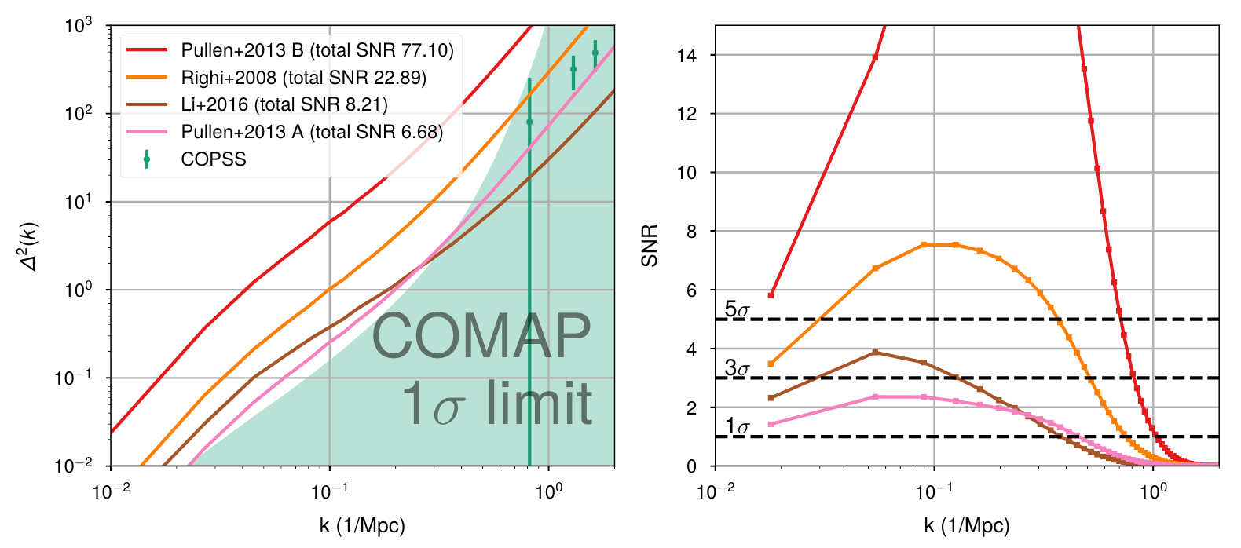
Power Spectrum
COPSS Data
~8σ detection of Li et al. P(k) with Phase I

Slide 14
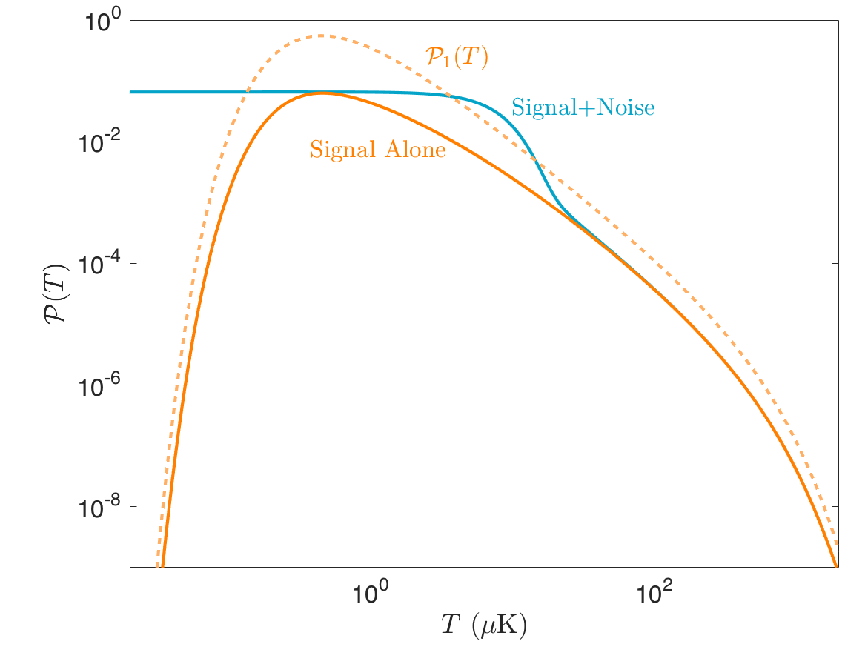
Voxel Intensity Distribution
Power spectrum only gives Gaussian information
Sub-galactic physics highly non-Gaussian
VID- Maps histogram of map intensities onto dn/dL (Breysse+2016)
Mostly independent from power spectrum (Ihle+ 2018)

Slide 15
Voxel Intensity Distribution
Power spectrum only gives Gaussian information
Sub-galactic physics highly non-Gaussian
VID- Maps histogram of map intensities onto dn/dL (Breysse+2016)
Mostly independent from power spectrum (Ihle+ 2018)
Power Spectrum
VID
Combined

Slide 16
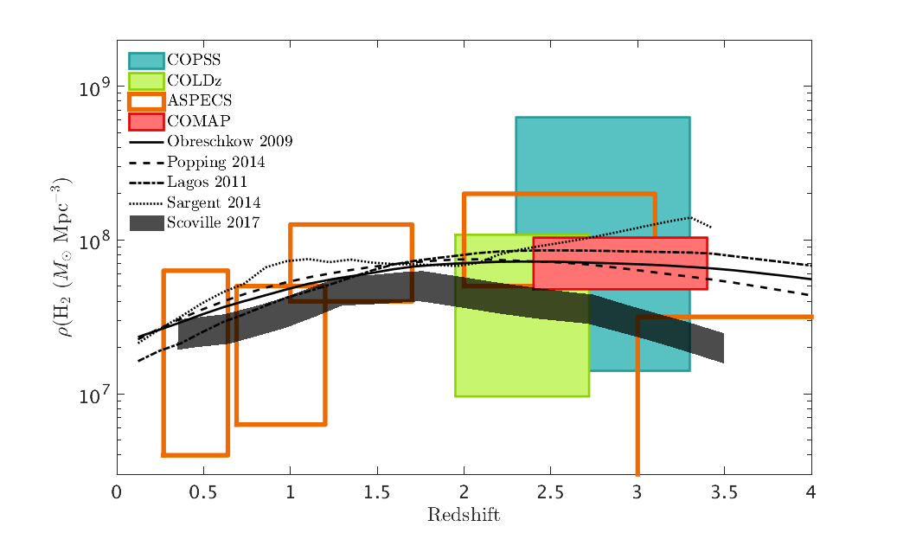
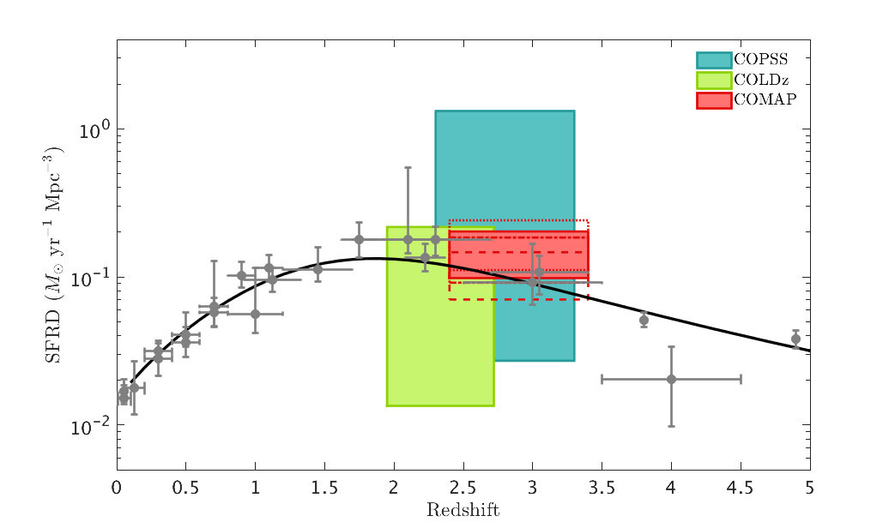
Molecular Gas Physics
Molecular Gas Density
Star Formation Rate Density
Redshift
Redshift
Comparable or better sensitivity to direct measurements, but sensitive to faint population

Slide 17
Cross-Correlations
CO Auto
Galaxies
Spec-z
Chung+ 2018- Cross-correlate with other tracers to improve SNR/reject foregrounds
Best candidates: HETDEX LAE’s or Ly⍺ IM
Improve SNR by factor of ~2
photo-z
Ly⍺ IM
LAE’s

Slide 18
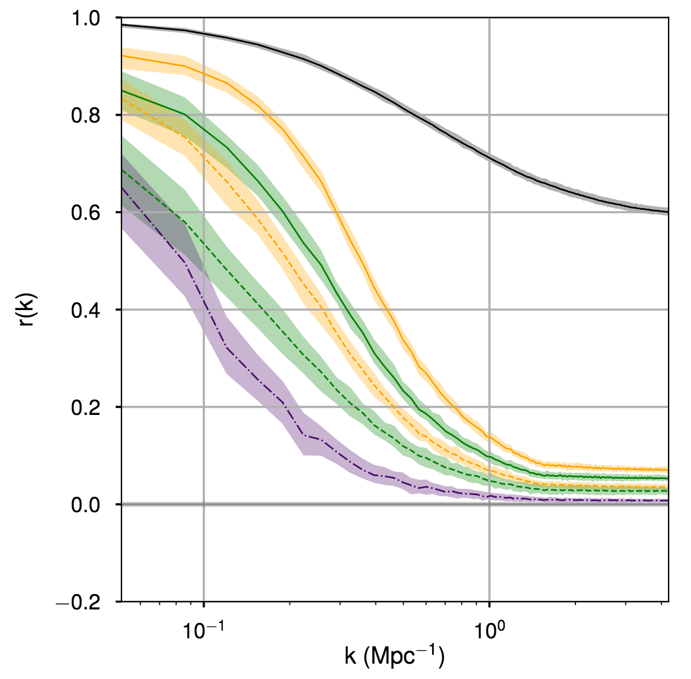
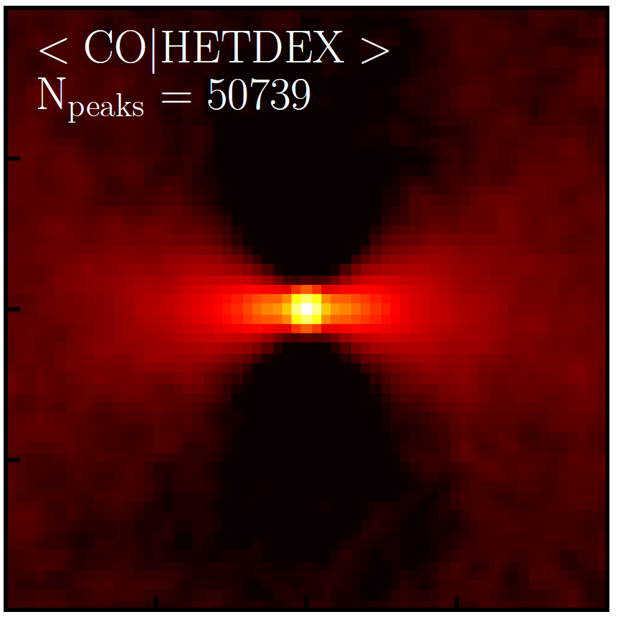
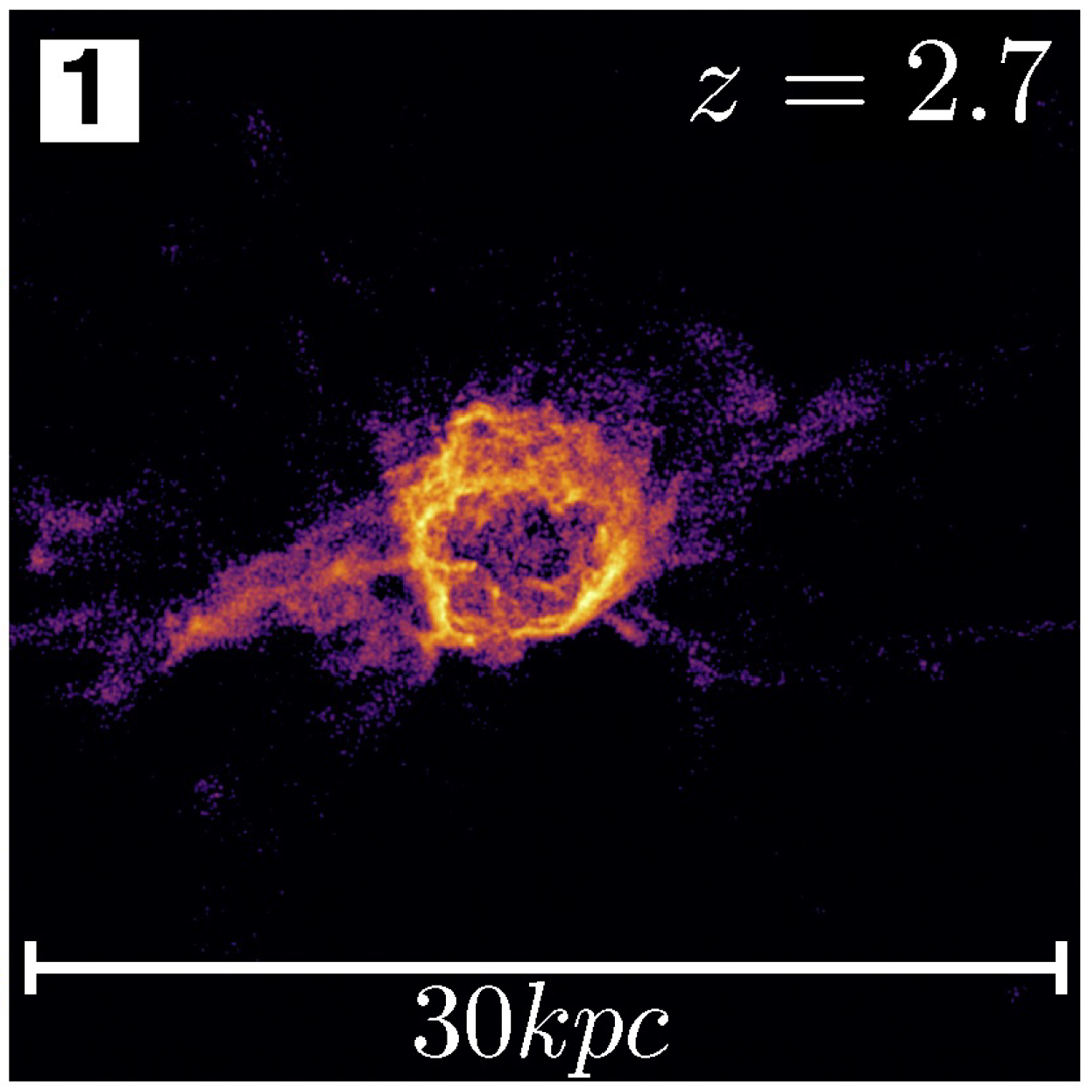
More Science
FIRE Simulations- Connect signals to underlying physics
Evidence of bursty star formation?
Stacking- look for filamentary structure in CO
Other CO lines- CO(2-1) at reionization, ¹³CO?

Slide 19
What’s Next?
Duplicate Pathfinder on multiple 10m OVRO dishes
  More sensitivity to z~3 signal
  Also gets CO(2-1) at reionization
Combine with new 15 GHz detector
  Gets CO(1-0) at reionization
  Cross-correlate to isolate high-z

Slide 20
Conclusion
COMAP is taking data!
  Commissioning now
  Science observing starts in ~April
Expect ~8σ detection of CO(1-0) power at z~3
Lots of exciting science to come!

