Slide 1
Calibration Challenges
Kevin Bandura
West Virginia University

Slide 2
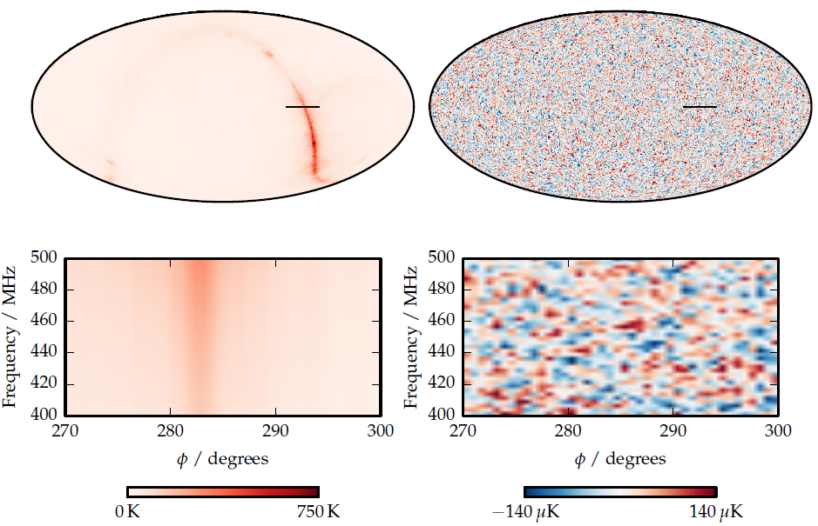
Foregrounds
Foregrounds
21cm signal
Shaw et al. 2015

Slide 3
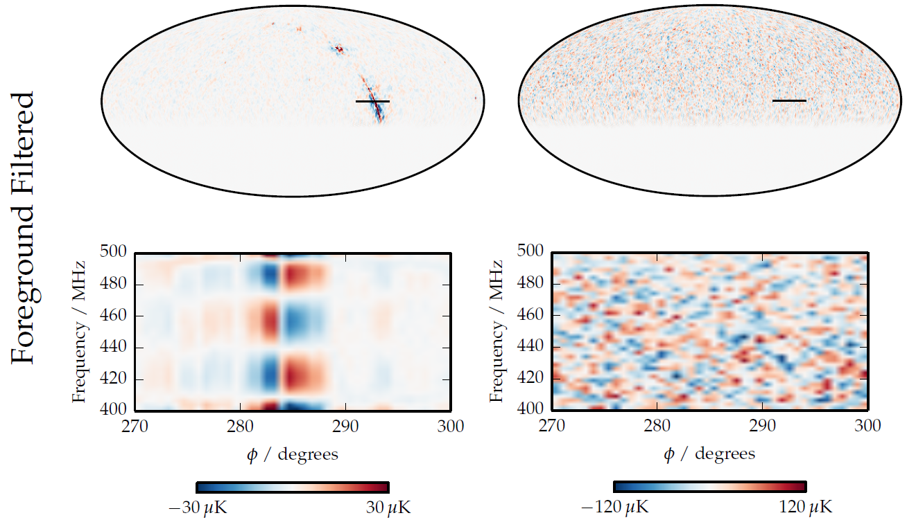
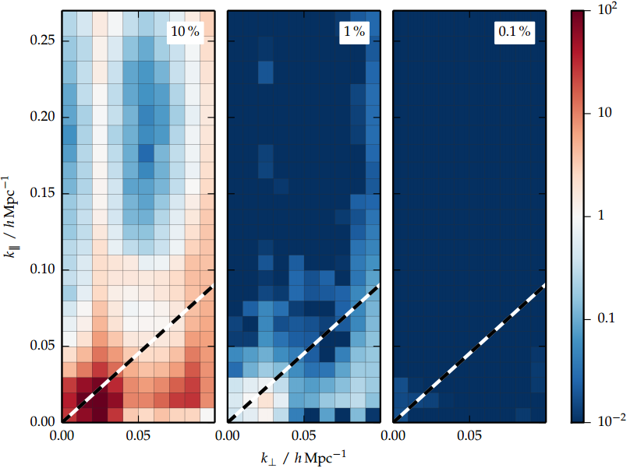
Foregrounds
Error in Power spectrum due to % error in gain
Filtered Foregrounds
Filtered
21cm signal
Shaw et al. 2015

Slide 4
Requirements
Beam Calibration to better than 0.1%
Complex Gain target better than 1% (Shaw et al. 2015)
  ~0.3% amplitude
  ~0.003 Radian phase
Redundant Baseline compression or FFT Beamforming will require Real-time Calibration

Slide 5
Redundant Baseline Calibration
Requires baselines to be actually redundant.
Corr-cal
  Imperfect Sky model + nearly redundant baselines

Slide 6
Analog System
Notes:
The chime analog system is a simple design. There is no mixing, we directly amplify the signal. On the focal-line there is the feed and LNA, the signal is then transmitted over coax, to a Shielded container. There the signal is filtered and further amplified to a level which can be digitized by the adc.

Slide 7
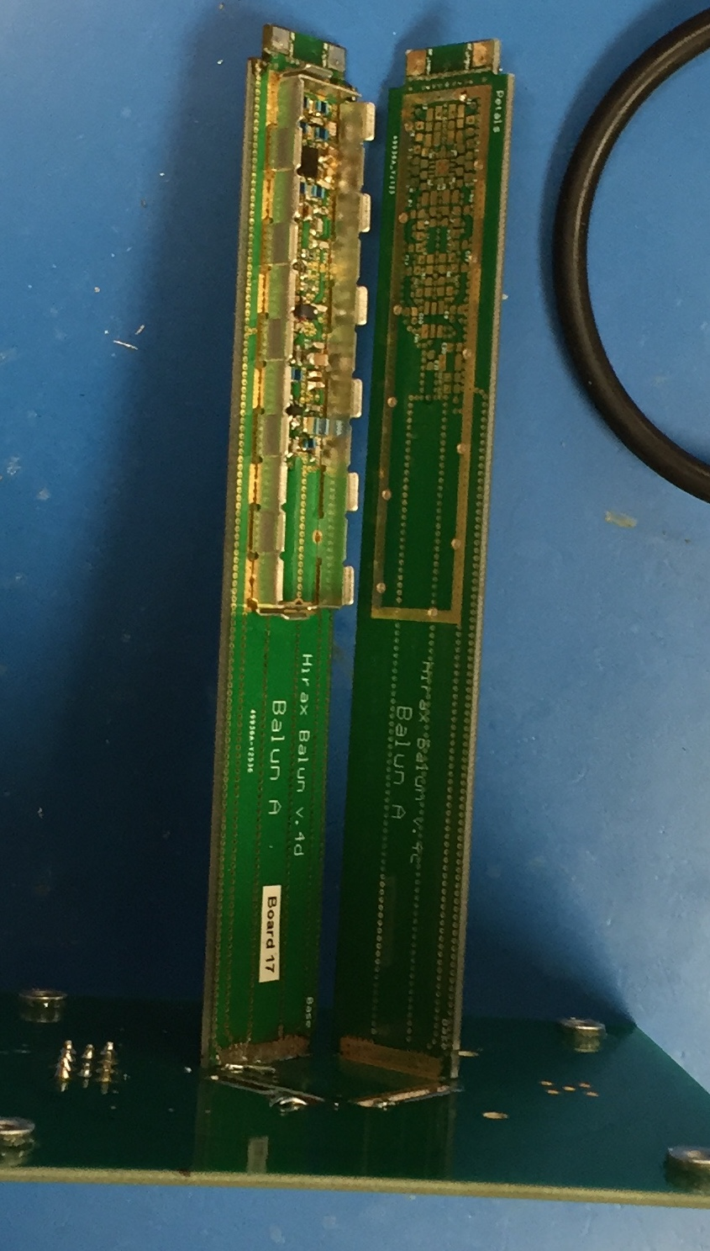
Temperature Stability
Current analog amplifier chains have
~0.2 % / °C amplitude variation
Maintain to 1°C
  Measure and model temperature to remove more variation
Analog chain phase
  Cable lengths change ~10-50ppm/ °C ~20ppm/ °C LMR400
    100m cable -> 1-5mm cable change per °C
    0.002-0.01 radians/ °C per cable.
  Fiber similar, ~10ppm/ °C.
  Steel ~15 ppm / °C
Maintain Entire Analog System to within ~1 °C

Slide 8
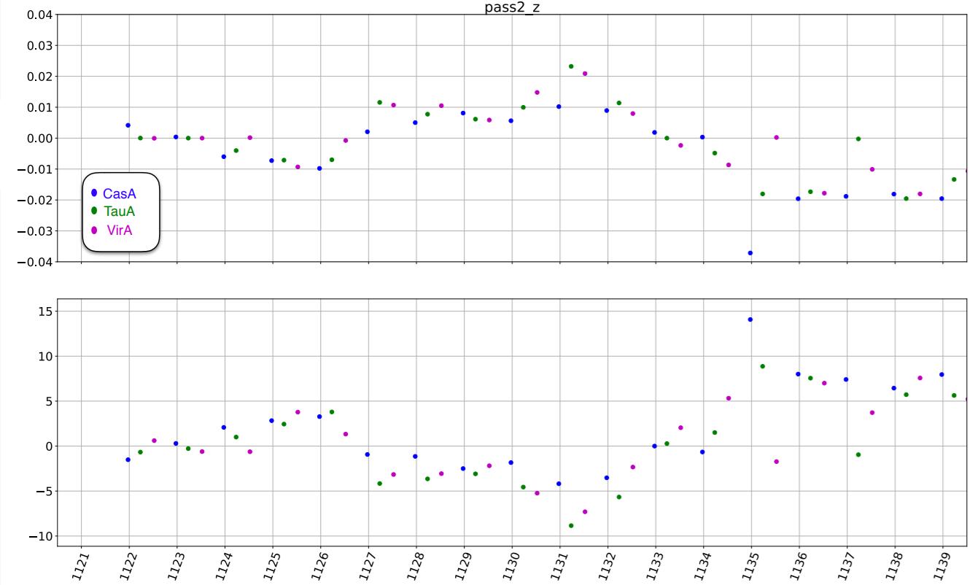
Measure Gain Variations
Amplitude
Ambient
Temperature °C
Credit: Seth Siegel

Slide 9
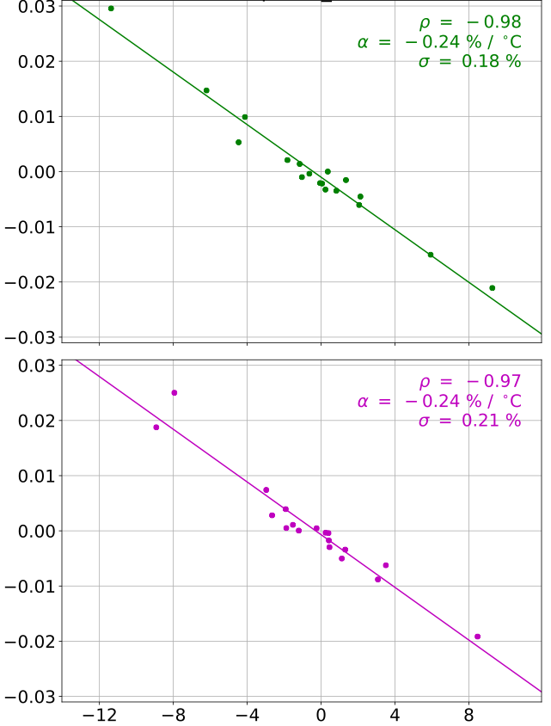
CHIME Pathfinder Temperature Stability
Thermal Model to remove common mode amplitude fluctuations. Approaching the ~0.5% amplitude stability
TauA
17 Transits
Common Mode
Fractional Amplitude Fluctuations
VirA
17 Transits
Credit: Seth Siegel
Tsource - Tcal [°C]

Slide 10
Add Temperature Stabilization
Heater and/or TEC:
  Maintain ~ 20-40°C
Digital electronics at focus
Measure each amplifier and transmission system

Slide 11
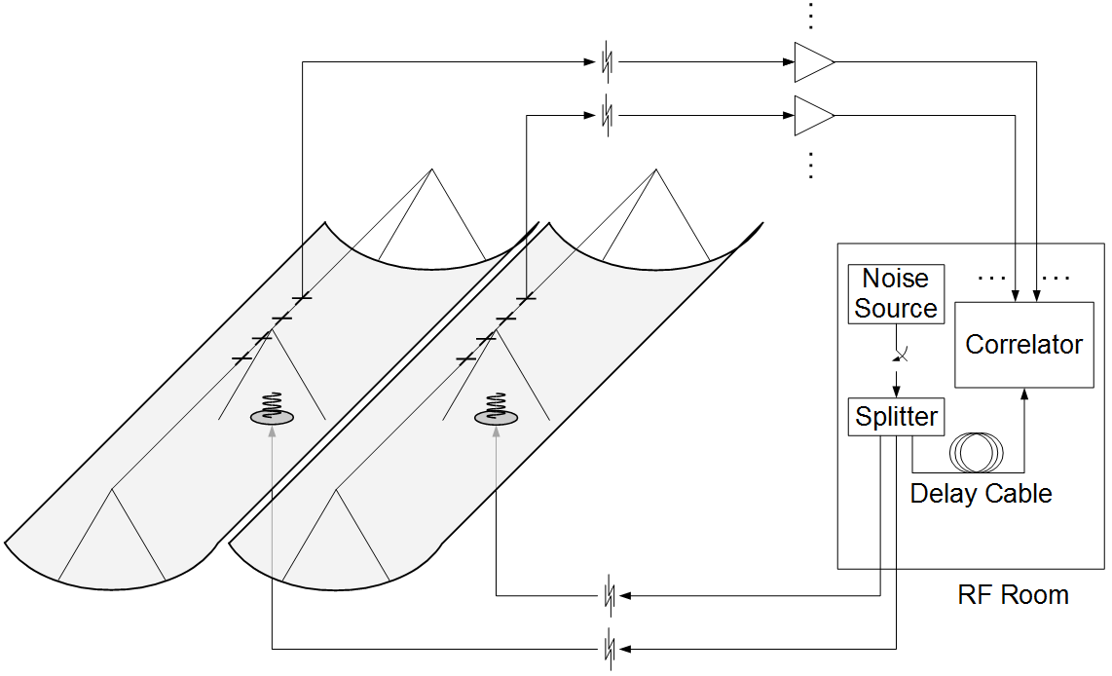
Broadband Signal Injection
Broadband Injected Signal
Measured by Correlator
Notes:
For gain calibration using a broadband injected signal. The signal is injected into the feeds with an antenna, and also measured directly into the correlator. We have tested this system as shown with 8 channels on the pathfinder. We were able to solve for the relative gains to better than 1% on second timescales.

Slide 12
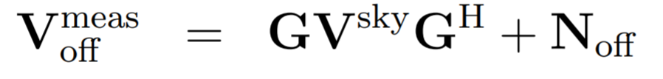
Gain Calibration
Visibilities

Slide 13
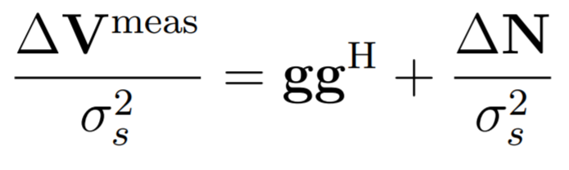
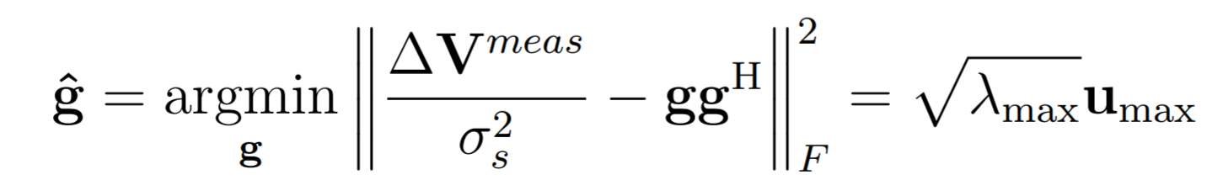
Broadband Signal Injection

Slide 14
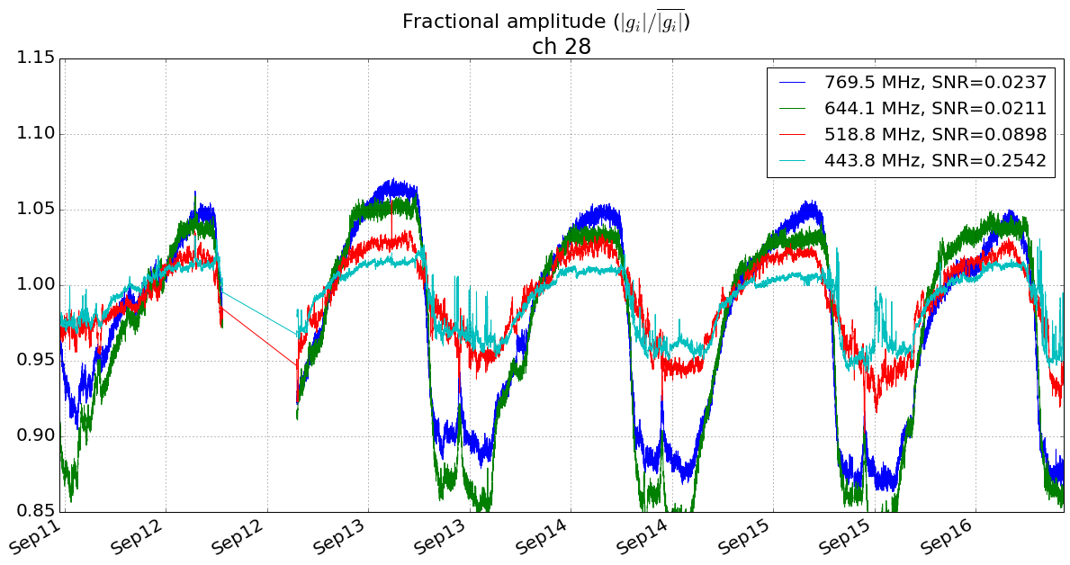
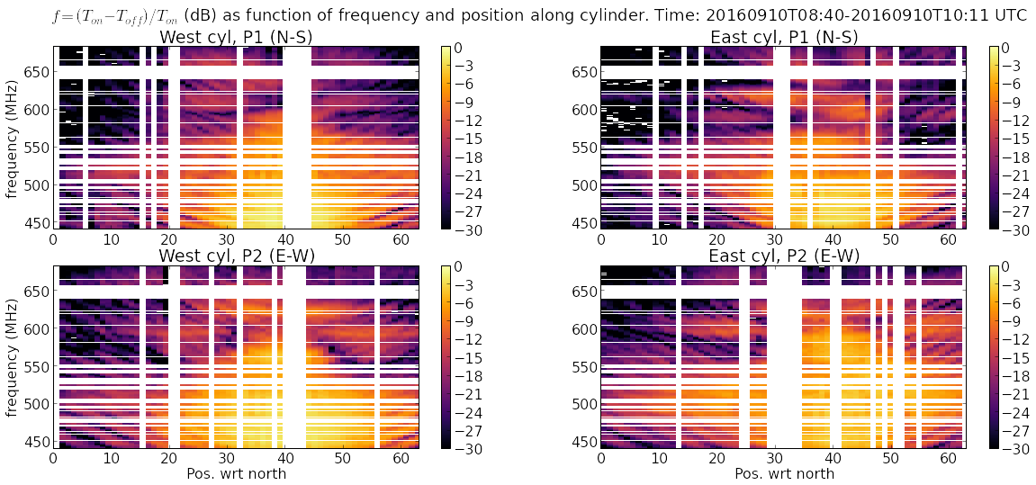
Broadband Signal Injection
Calibration to the 1% level.
Injection system must be stable and uniform
Credit: Juan Mena

Slide 15
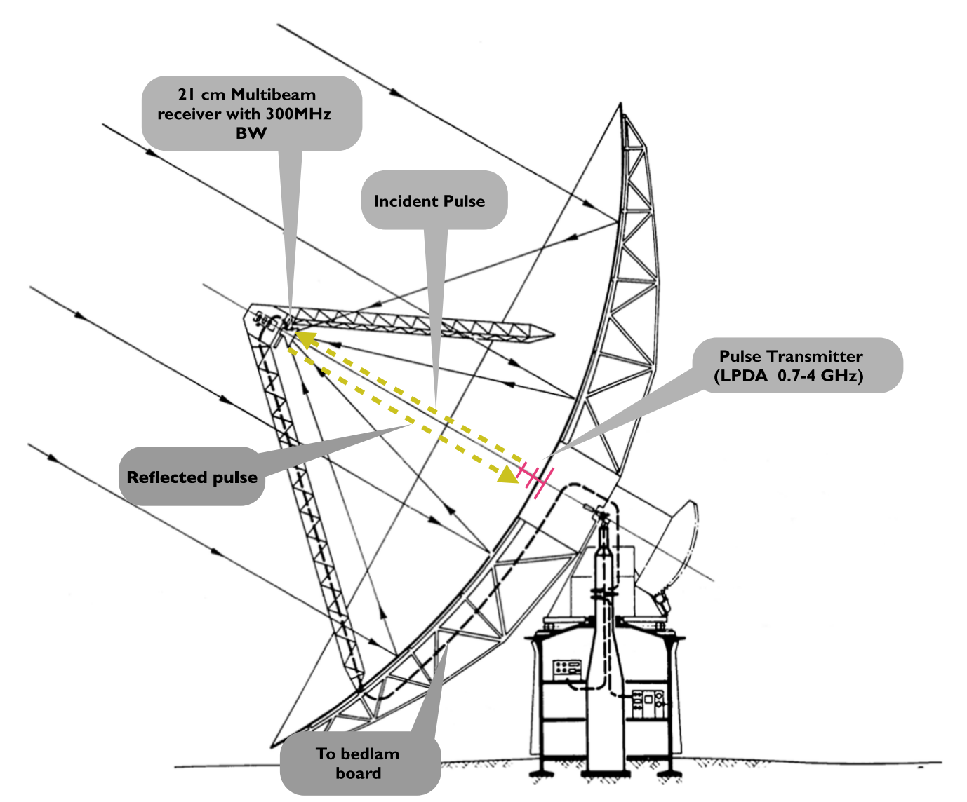
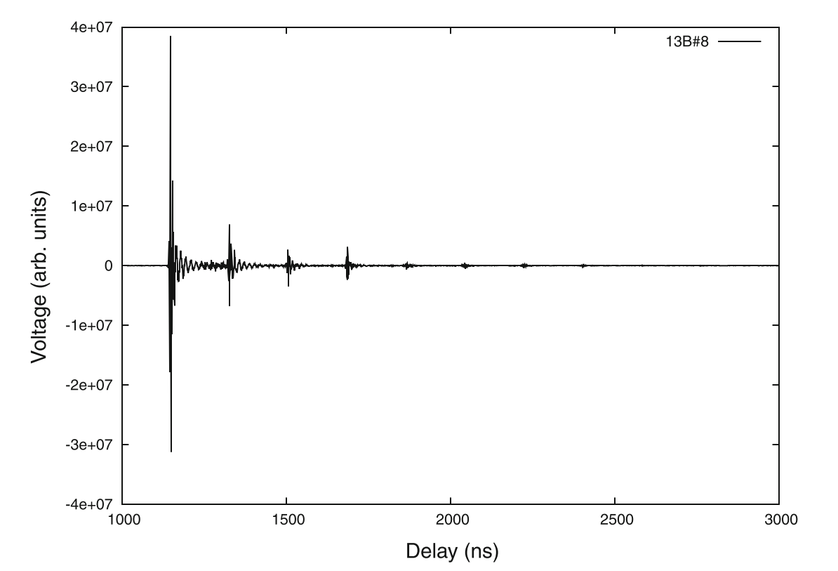
Pulse Injection
Instead of broadband noise, inject < ns pulse
Measure in time domain.
“Strong Signal”, synchronize and blank out
Bandpass Calibration. (Patra et. al. 2017)
Patra et. al. 2017
Patra et. al. 2017

Slide 16
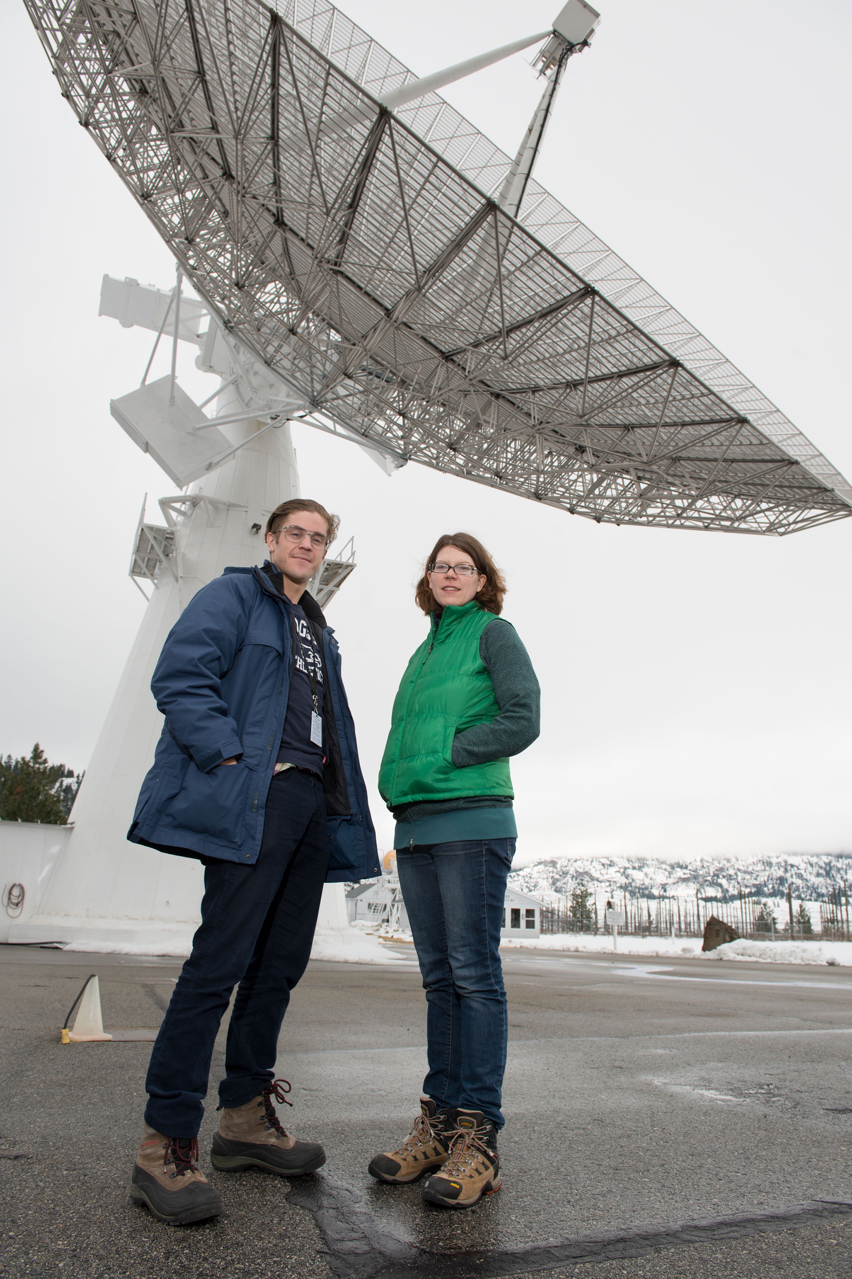
Beam Calibration
Holography
Transiting
source
X

Slide 17
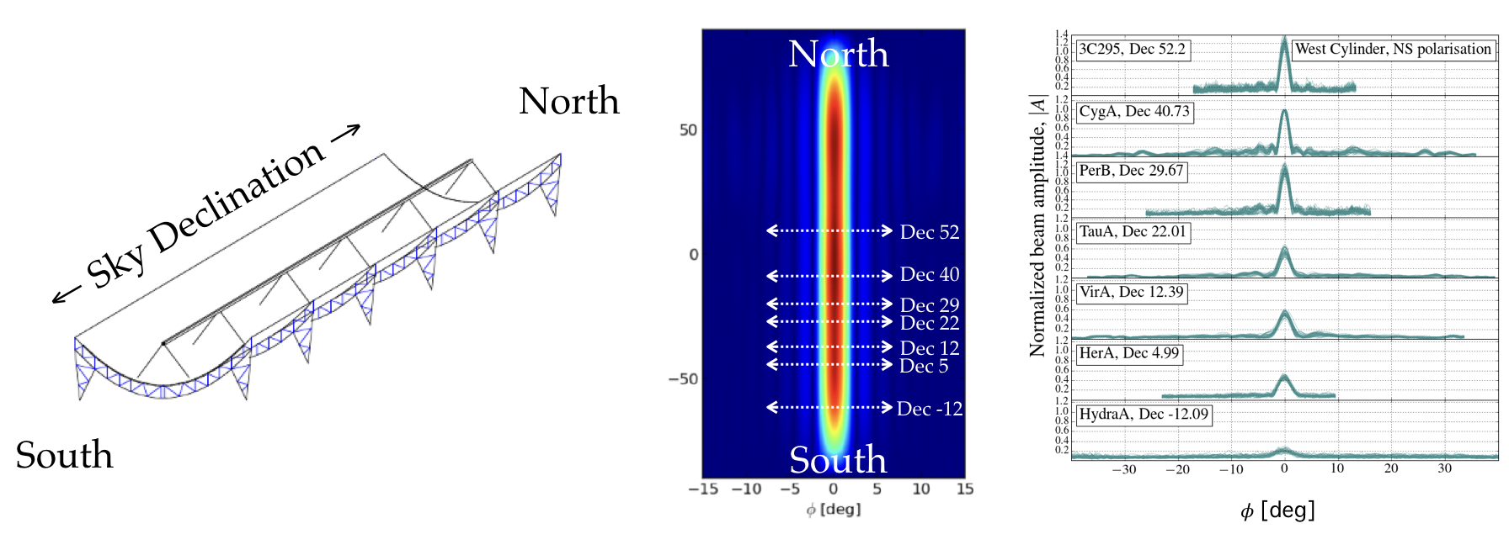
Holography
Berger et al 2016

Slide 18
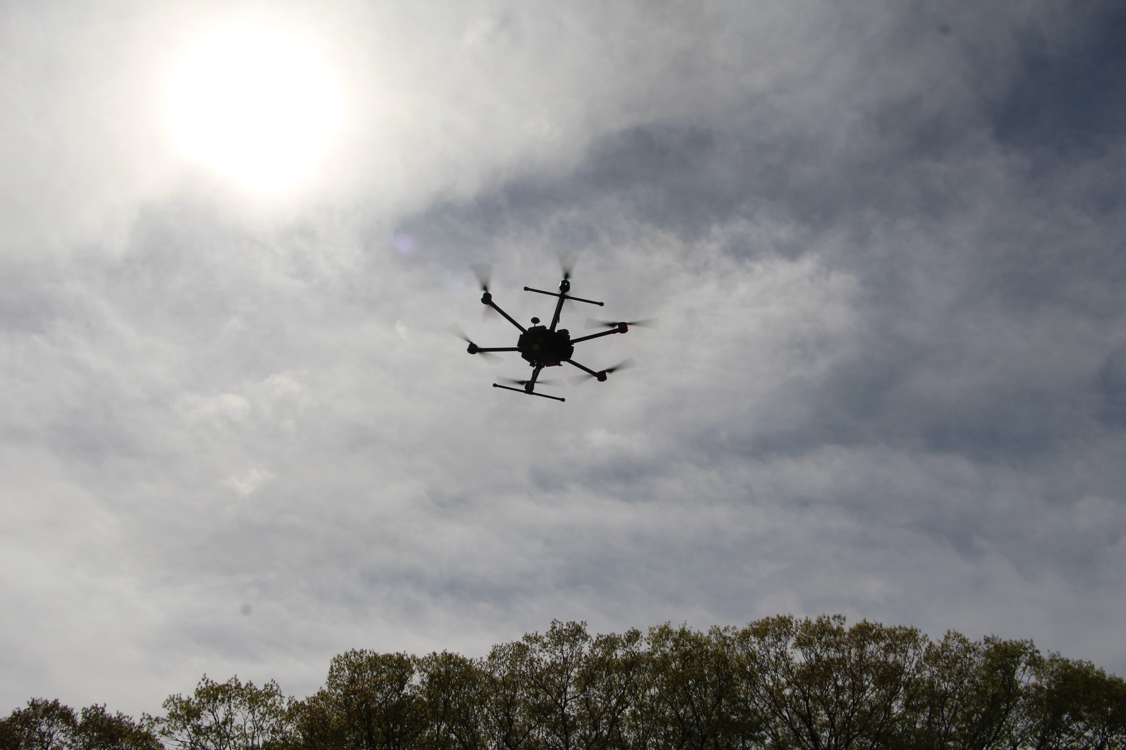
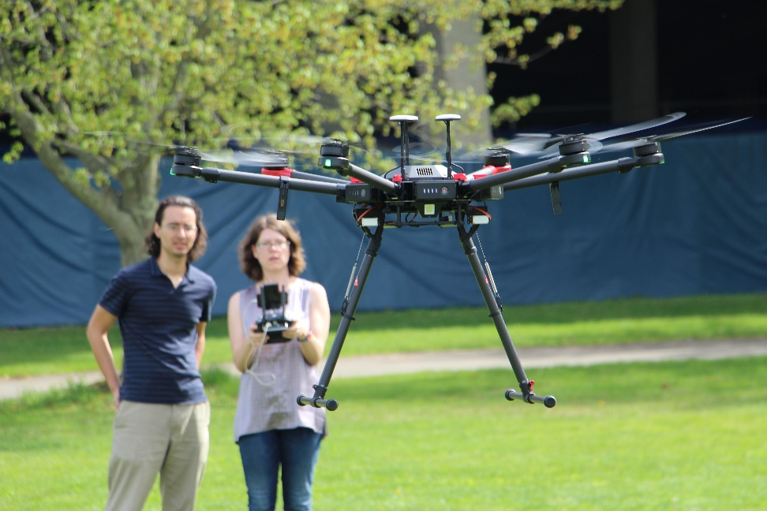
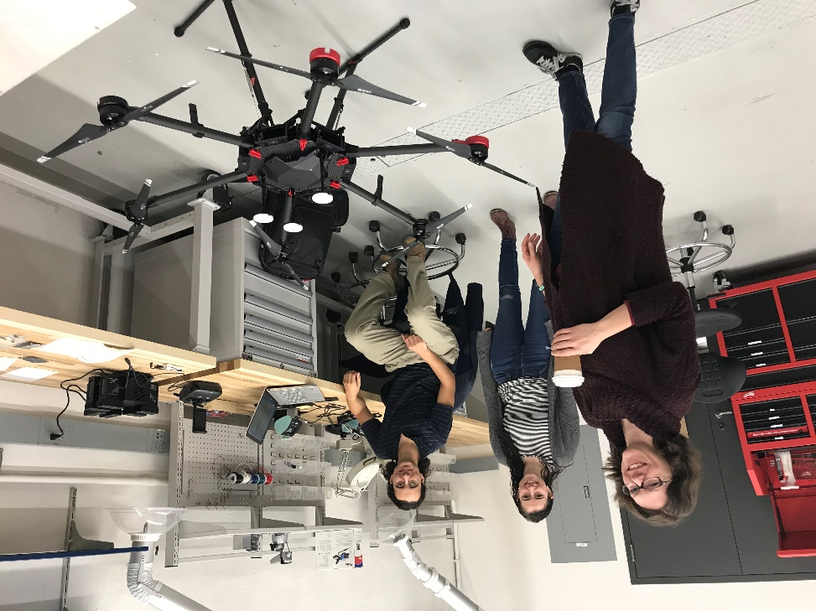
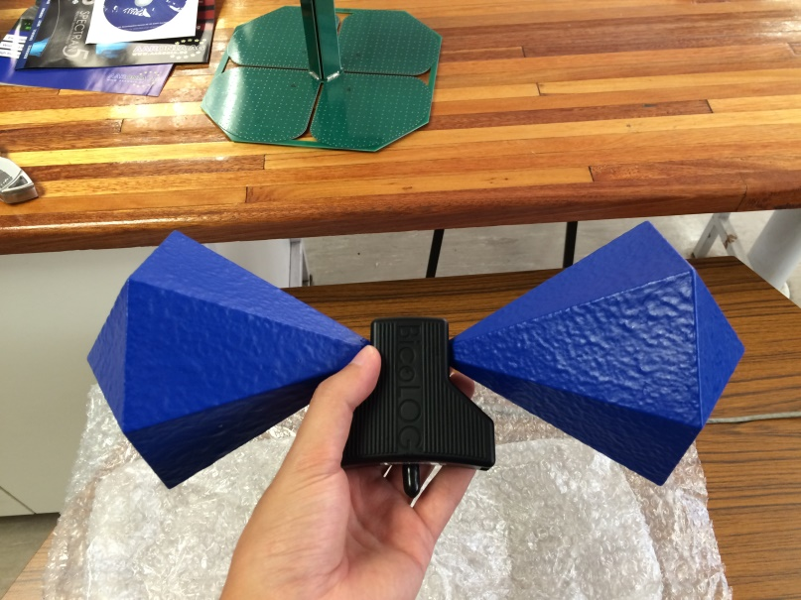
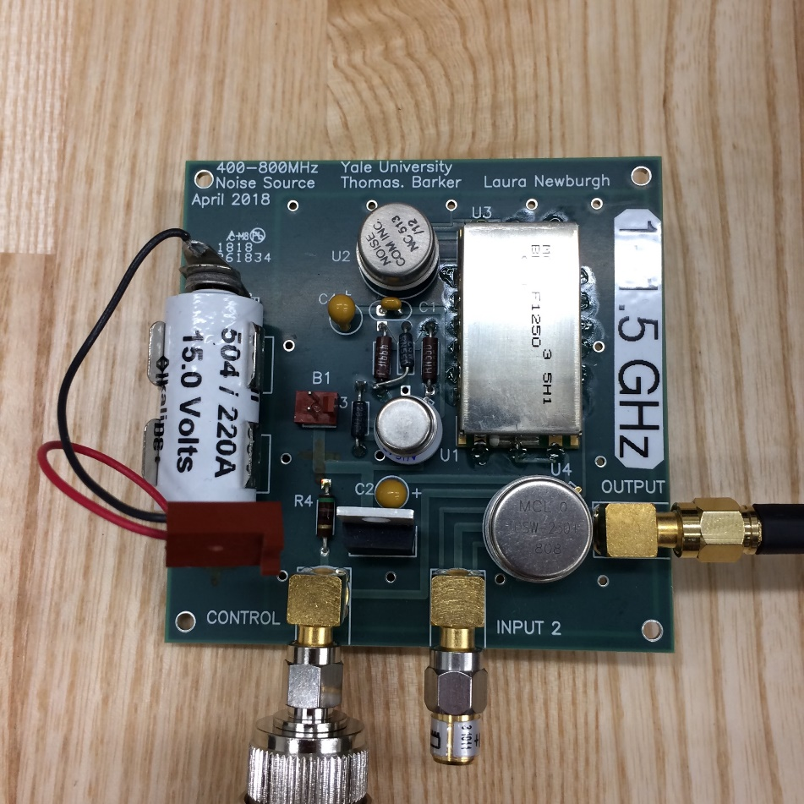
Drone Calibration

Slide 19
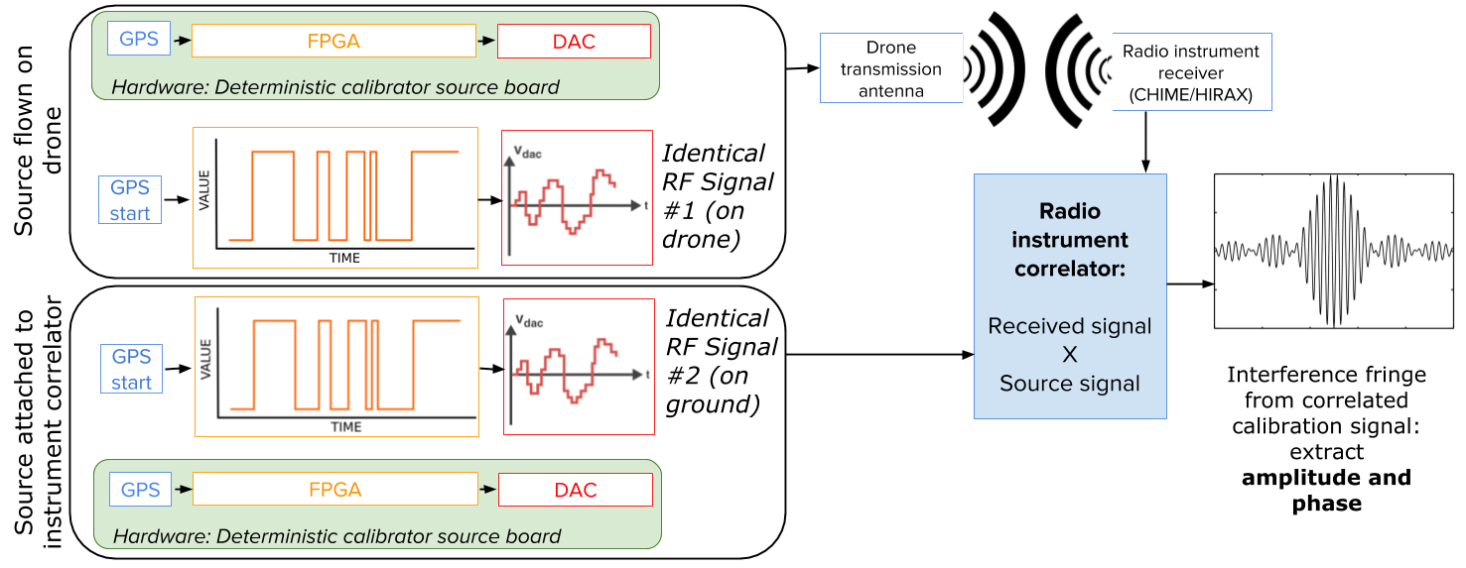
Improved Calibration Source

Slide 20
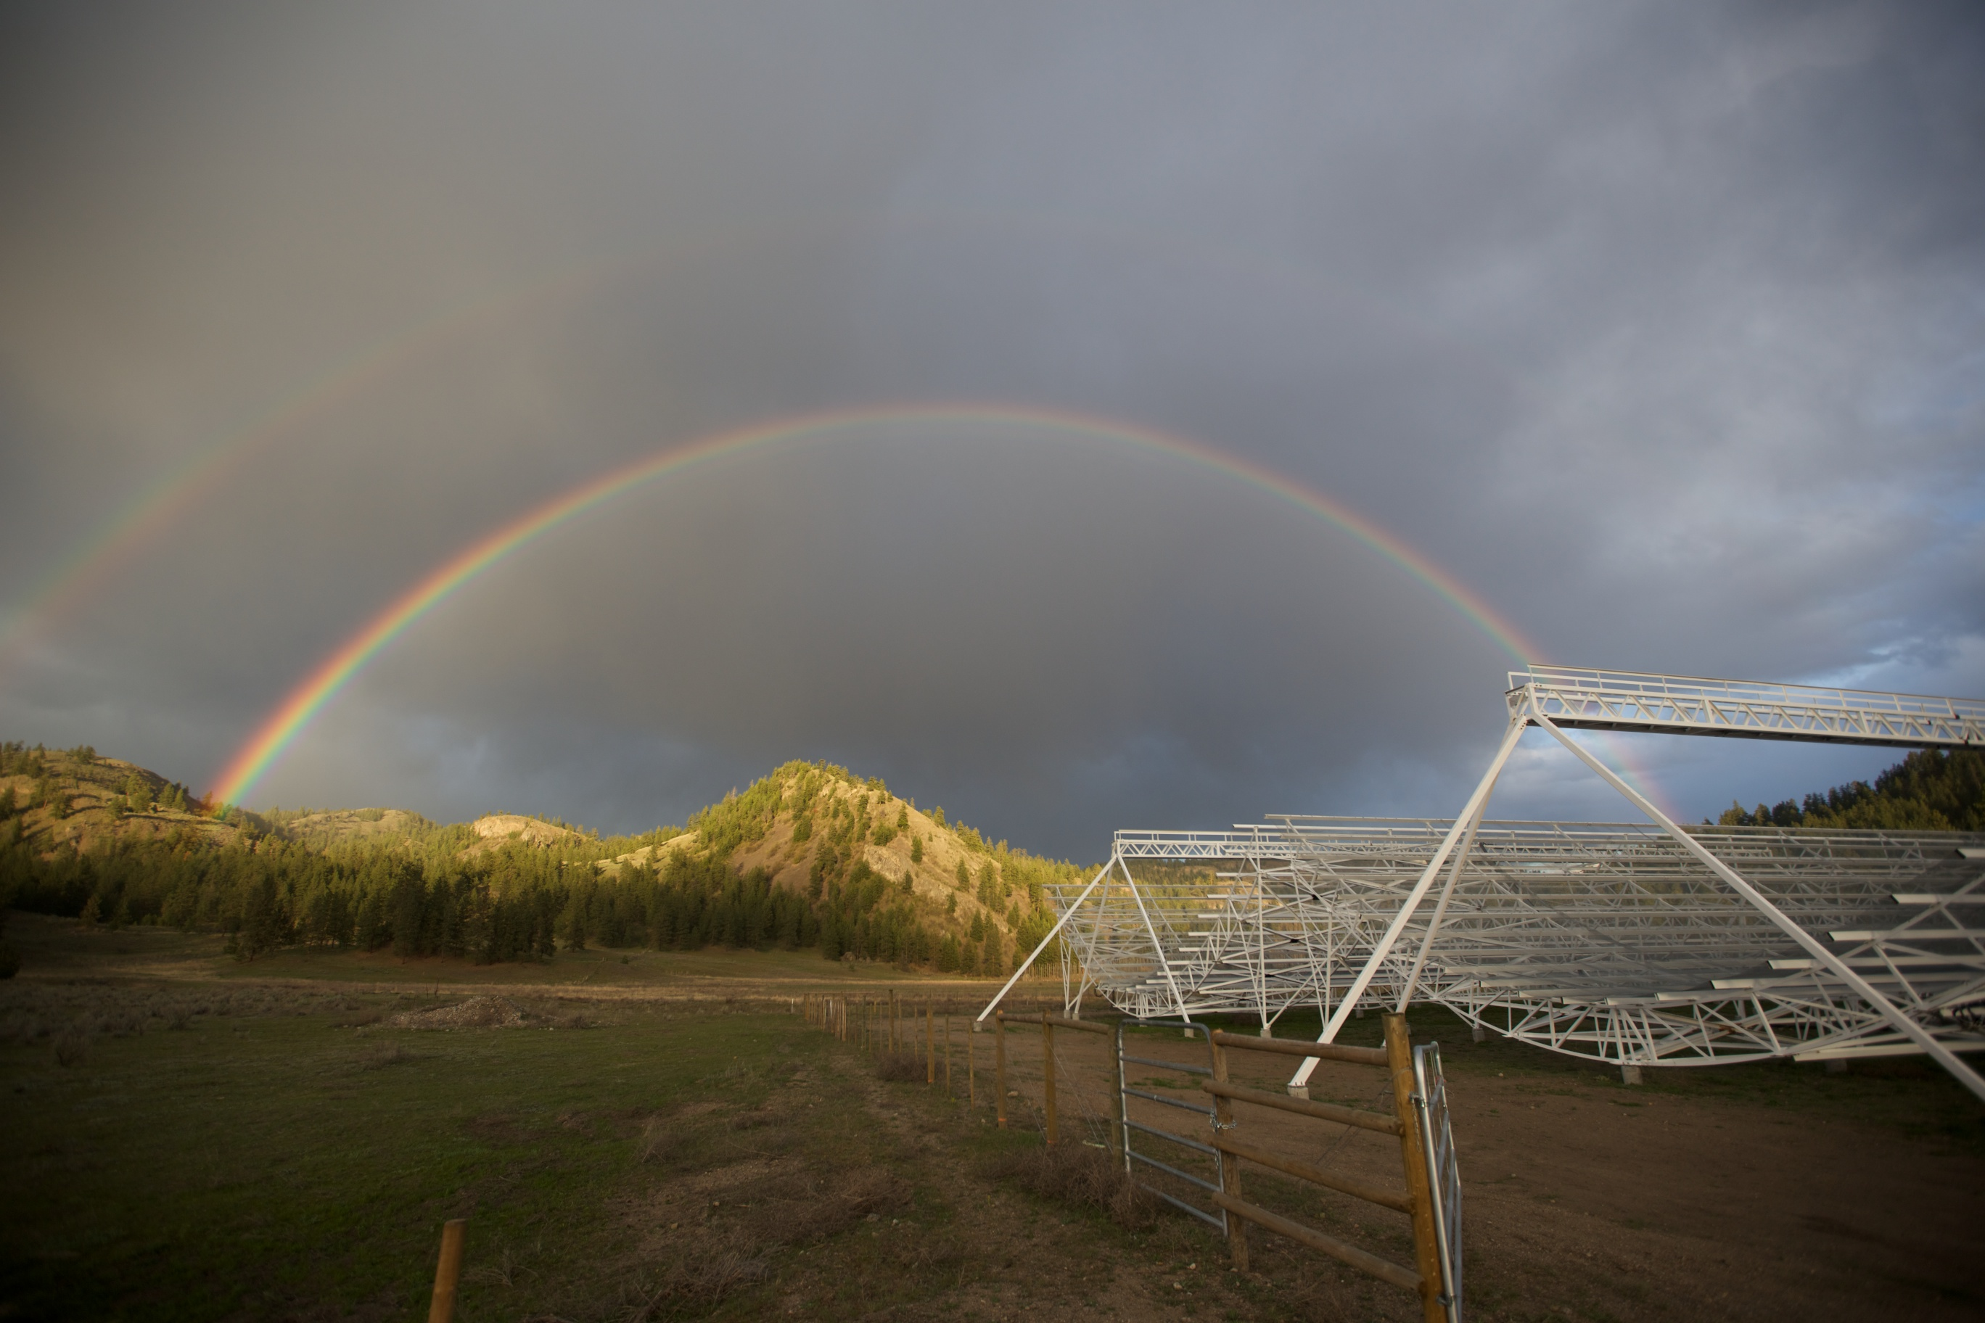
Summary
Need to understand Gain to ~1% and Beams to 0.1%
Measure parameters correlated with Gain variation
Measure gain variation with sky and synthetic sources
Measure Beam with holography
Measure Beam with drones

Slide 21
Correlator F-Engine and Networking

Slide 22
Correlator F-Engine
Two Gbit
Ethernet
Custom Backplane
Power, clock, timestamp
Board inter-connect
Digital signals come in/out the back
ARM processor
DDR RAM
Ethernet
FPGA
9U VME Front-panel
Two FMC Mezzanines

Slide 23
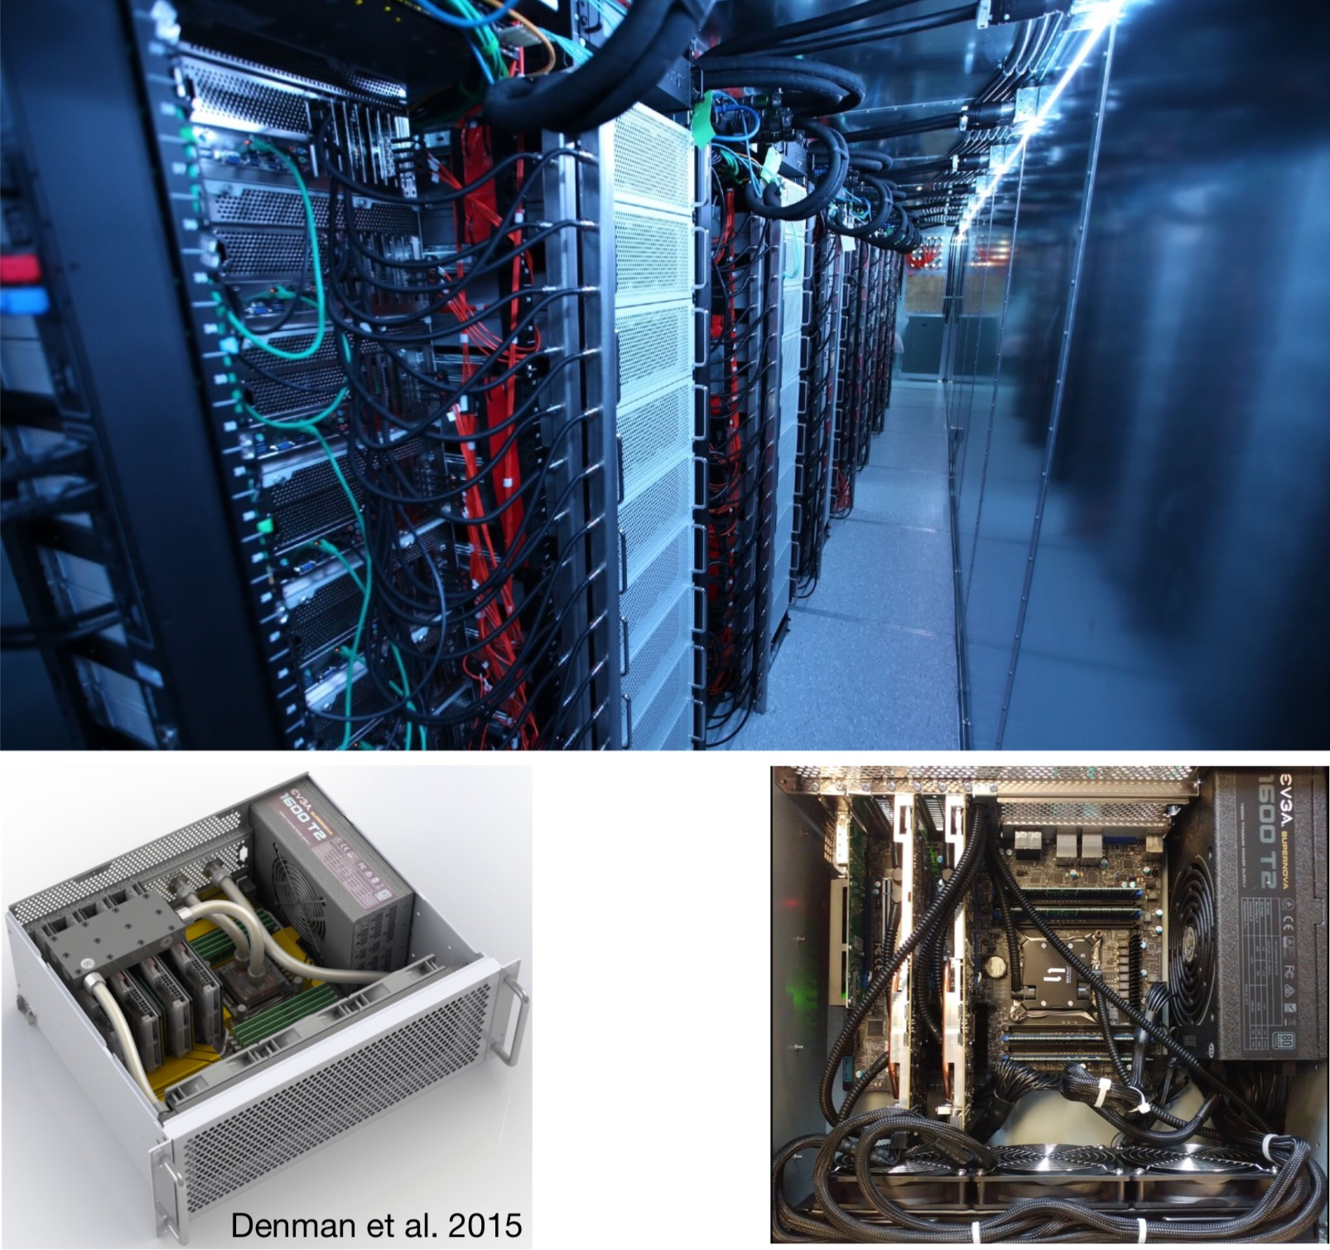
Correlator –X Engine
GPU
Pathfinder: 13T complex MAC/s
CHIME: 840 TcMAC/s
FRB FFT Beamformer
Pulsar Beamformer
AMD s9300x2

Slide 24
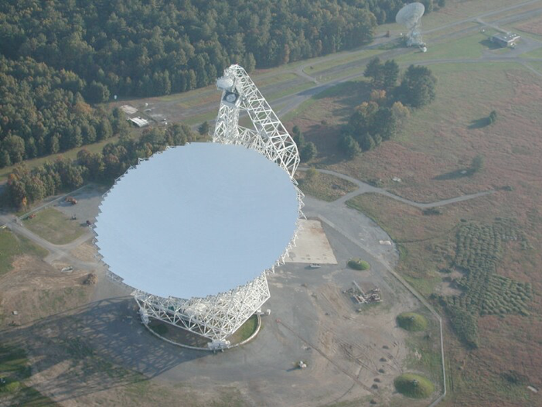
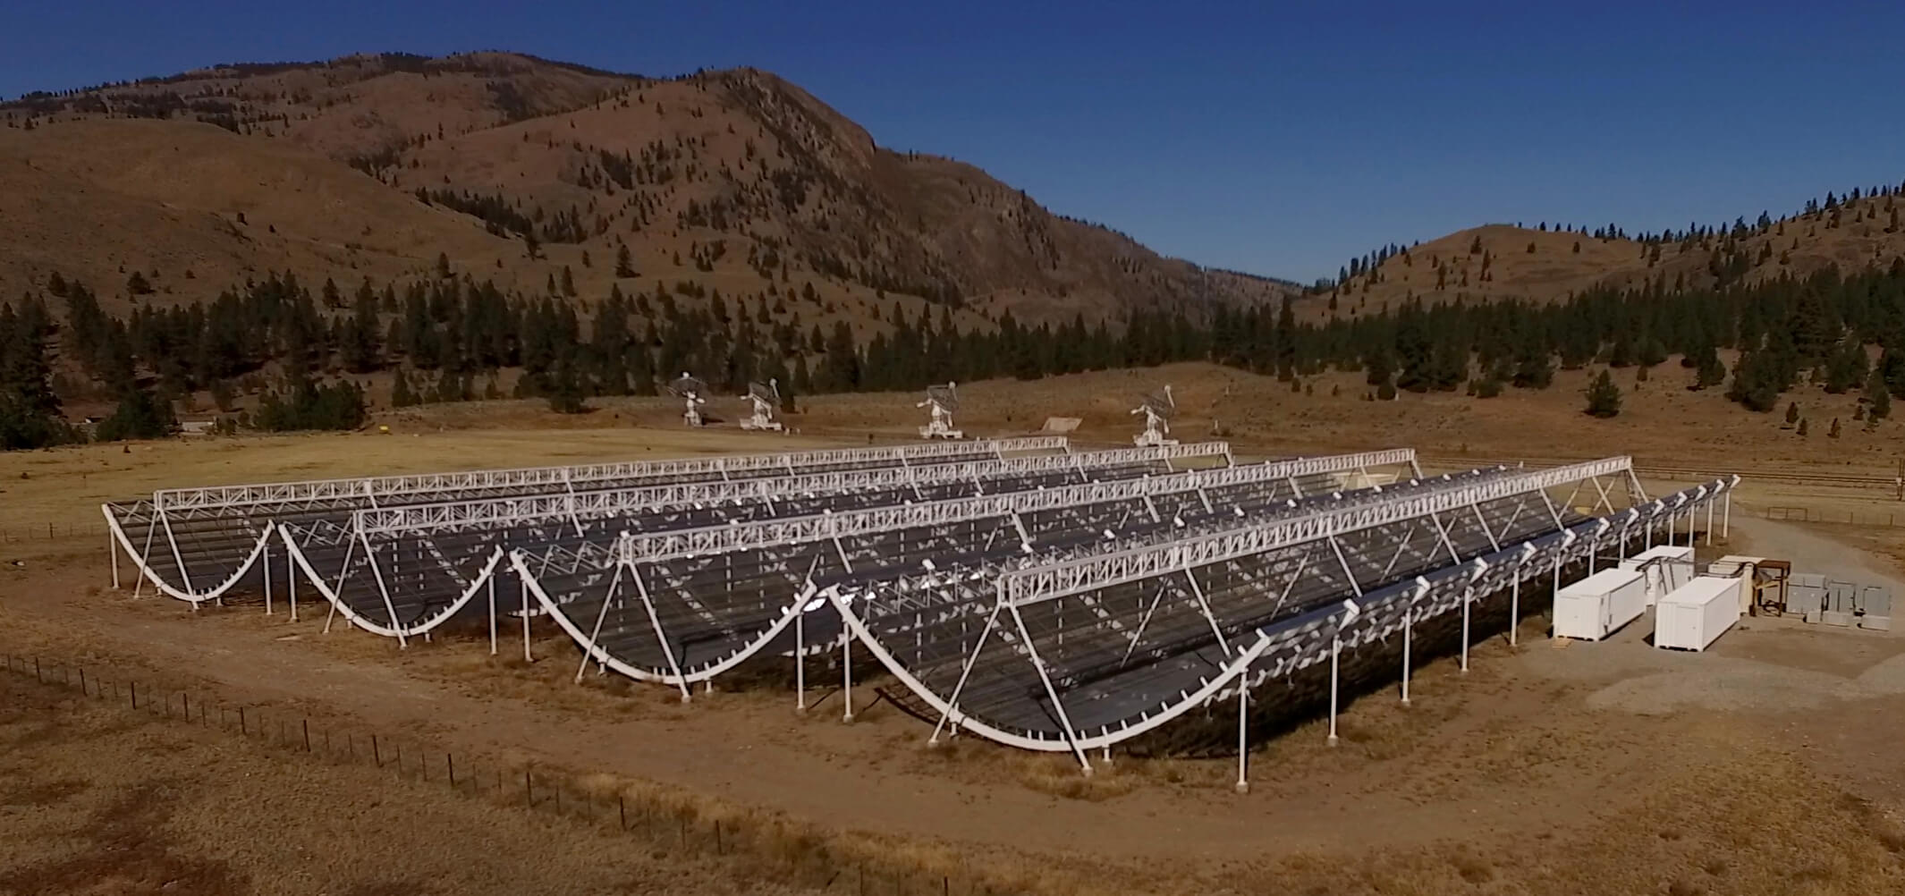
CHIME
The Canadian Hydrogen Intensity Mapping Experiment
Drift scan = 1/2 sky daily
  Due to actual N-S beam
400-800MHz band
  0.8 < z < 2.5 (for 21cm)
390kHz frequency resolution
  24kHz (16x) for FRB
13’-26’ spatial resolution
  (5-10 min observing time)
BAO scale to <10%
  w₀ to ±0.05 (w₀ ~ 1)
  w_{a} to ±0.2 (w_{a} ~ 0)

Slide 25
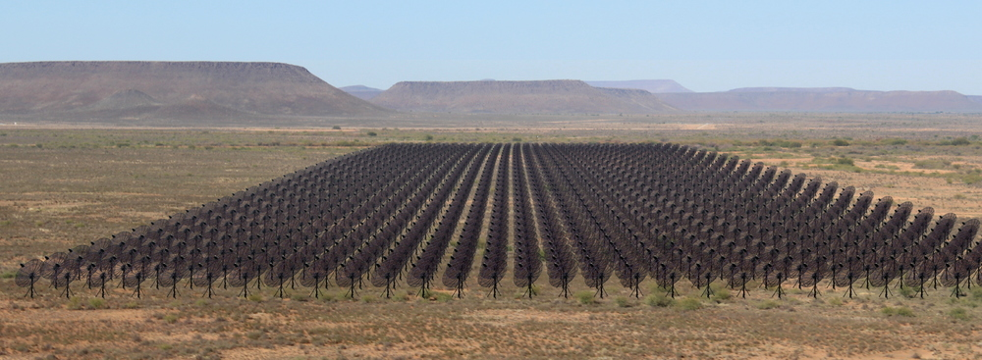
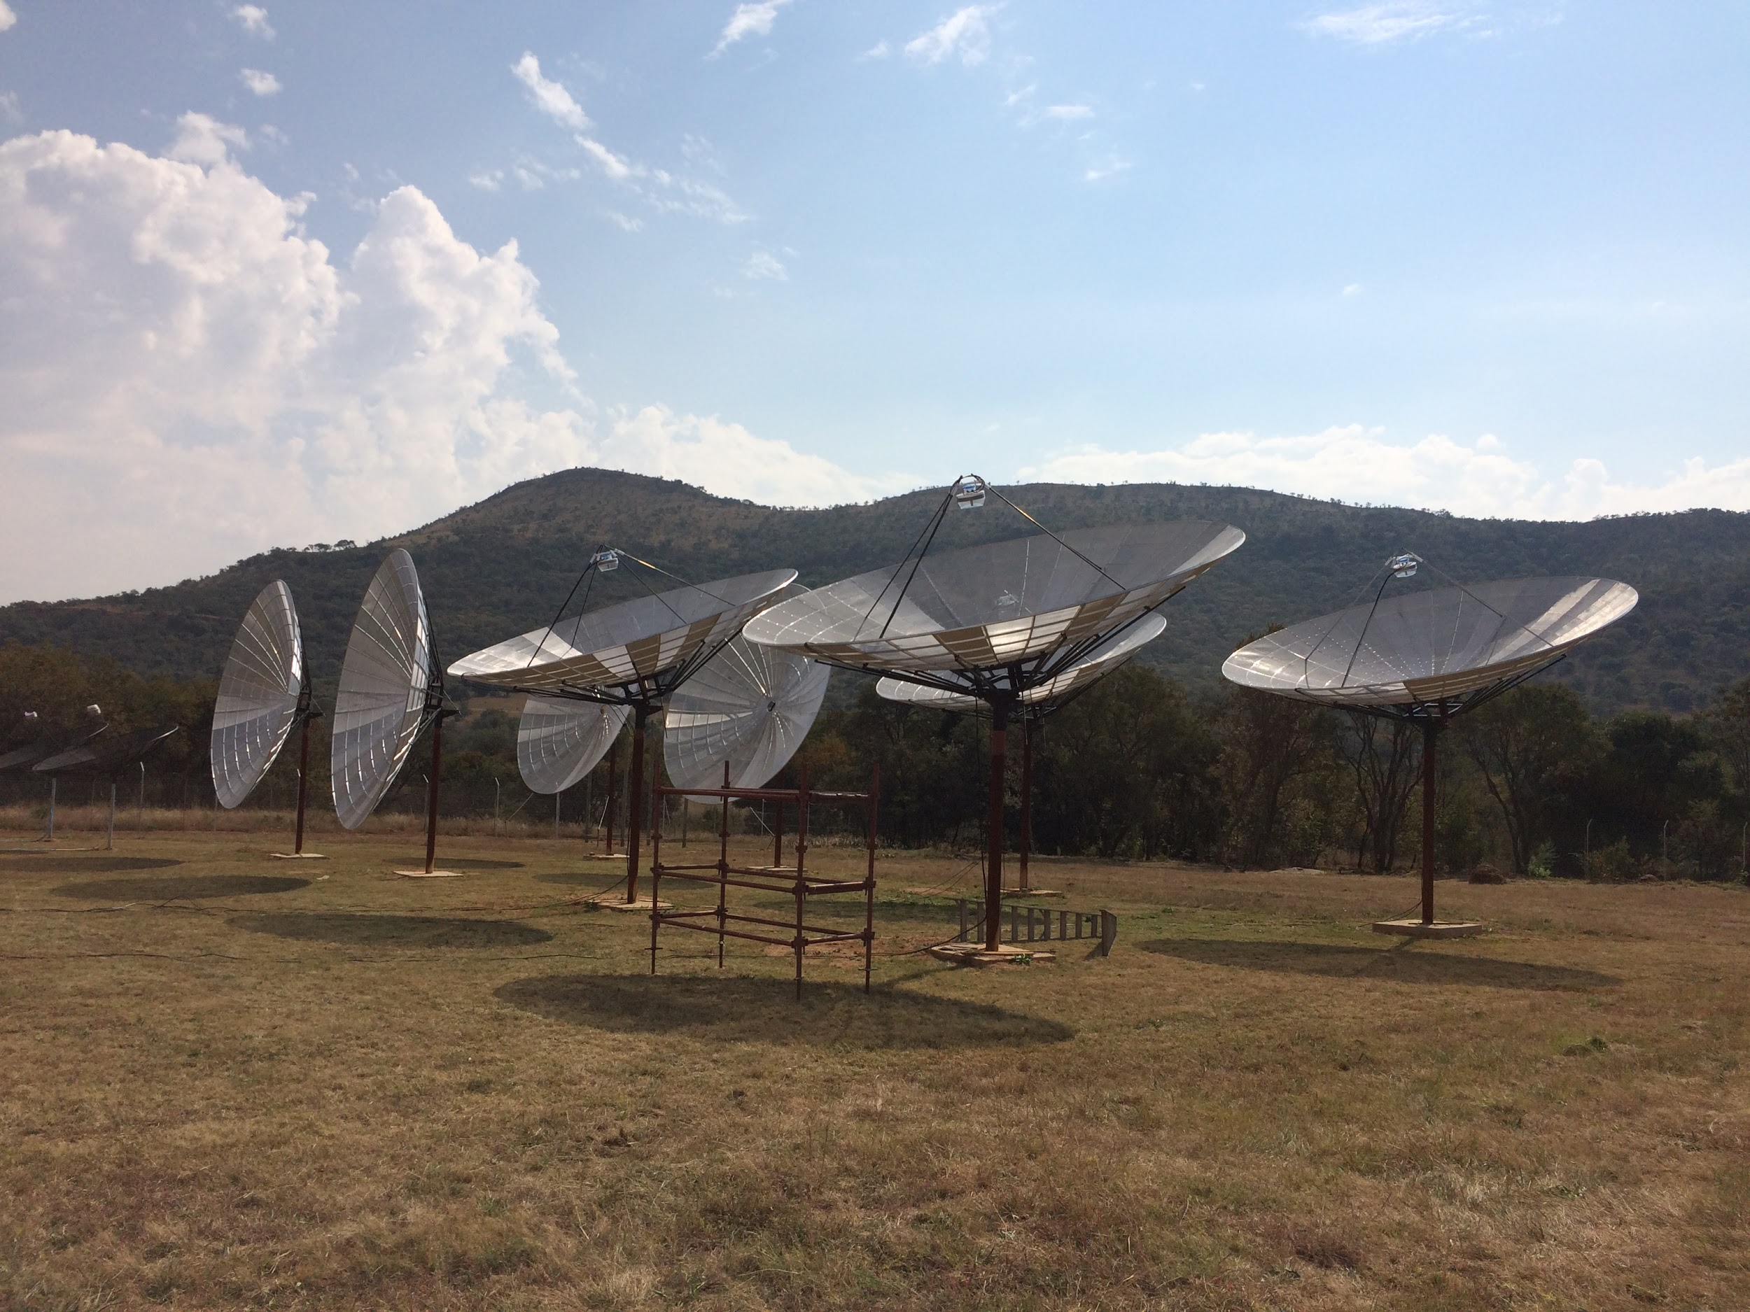
HIRAX
1024 6m Dishes
Karoo Desert
South Africa

Slide 26
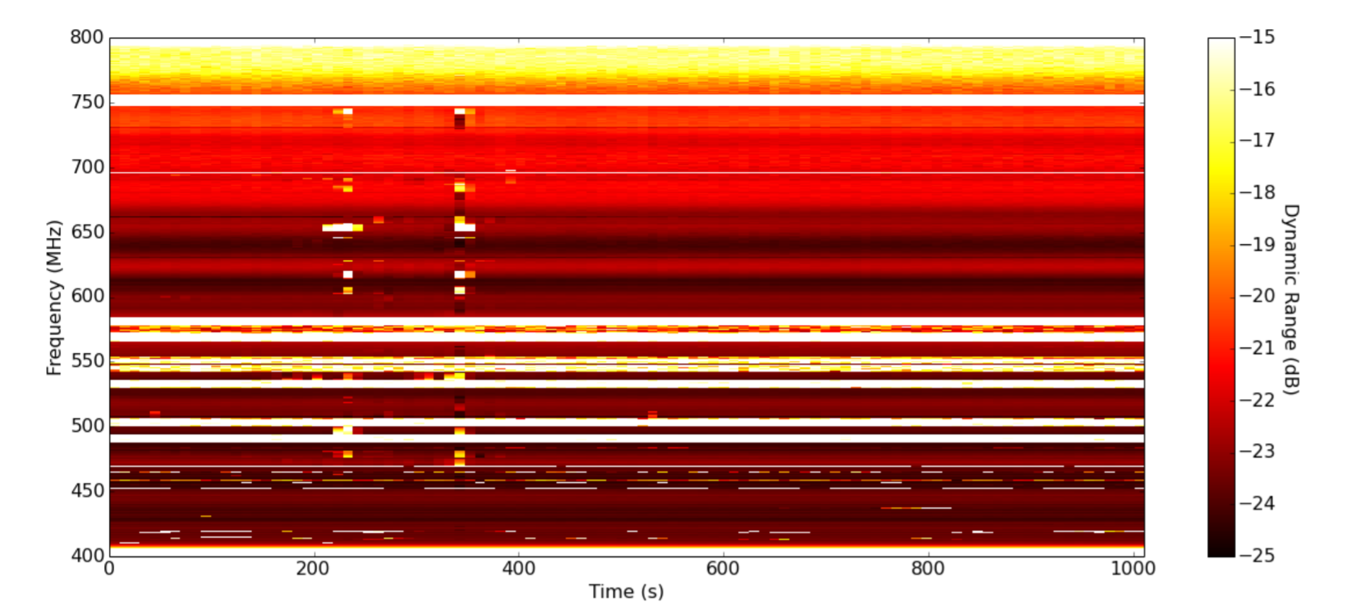
Broadband Signal Injection

