Slide 1
SCC Intro

Slide 2
Welcome
It’s a strange summer
We are all figuring this out as we go
All these slides are on indico
https://indico.flatironinstitute.org/event/625/
You should have at least one personal machine by now
Eventually most of you will have both a desktop and a laptop
Some of you may have data you want to import
We can talk about the most efficient way to do this based on the size and type of the data

Slide 3
Organization
Core IT (ITSupport@simonsfoundation.org)
Printers
Office/productivity software license issues
Email problems
General IT problems
Wifi
Scientific Computing (Robert Blackwell, Nick Carriero, Alex Chavkin, Justin Creveling, Ian Fisk, Pat Gunn,Yanbin Liu, Liz Lovero, Andras Pataki, Dylan Simon, Jonathan Tischio, Nikos Trikoupis, Aaron Watters) (scicomp@flatironinstitute.org)
Questions about any of the central Linux clusters
Package and configuration management on cluster
Technical software and performance issues
IO and data storage
Scientific Computing Documentation is here:
https://docs.simonsfoundation.org/index.php/Category:Flatiron_Institute_RC

Slide 4
General ARCHITECTURE
High performance computing resources tend to be centralized
Individual machines need to work together, and groups of machines access the same data
FIREWALL
Fabric
HEADNODES
(rusty1,rusty2)
GATEWAY
PROCESSING
ssh (port 61022) and Google
Authenticator
ssh
ssh/SLURM
scp –P 60122 or
Globus
Google ID
STORAGE
BINDER

Slide 5
RESOURCE SCHEDULING
We have ~600 computers on each coast
It would be impossible to manually schedule who gets access and for how long
We use a resource schedule system called SLURM (Simple Linux Utility for Resource Management) often referred to as a “batch scheduler”
As a user you ask for a certain number of nodes and the system can either start specific jobs or allocate them for interactive access
When the jobs or interactive session finishes the nodes are returned to the pool of resources
Organizations choose specific philosophies how they optimize getting processing completed
For most resources we have chosen to allocate entire nodes
Users are expected to use the computing efficiently
Nodes have 28 – 48 cores
512GB to 768GB RAM

Slide 6
Computing
4 core
800 core
10HP
1000HP

Slide 7
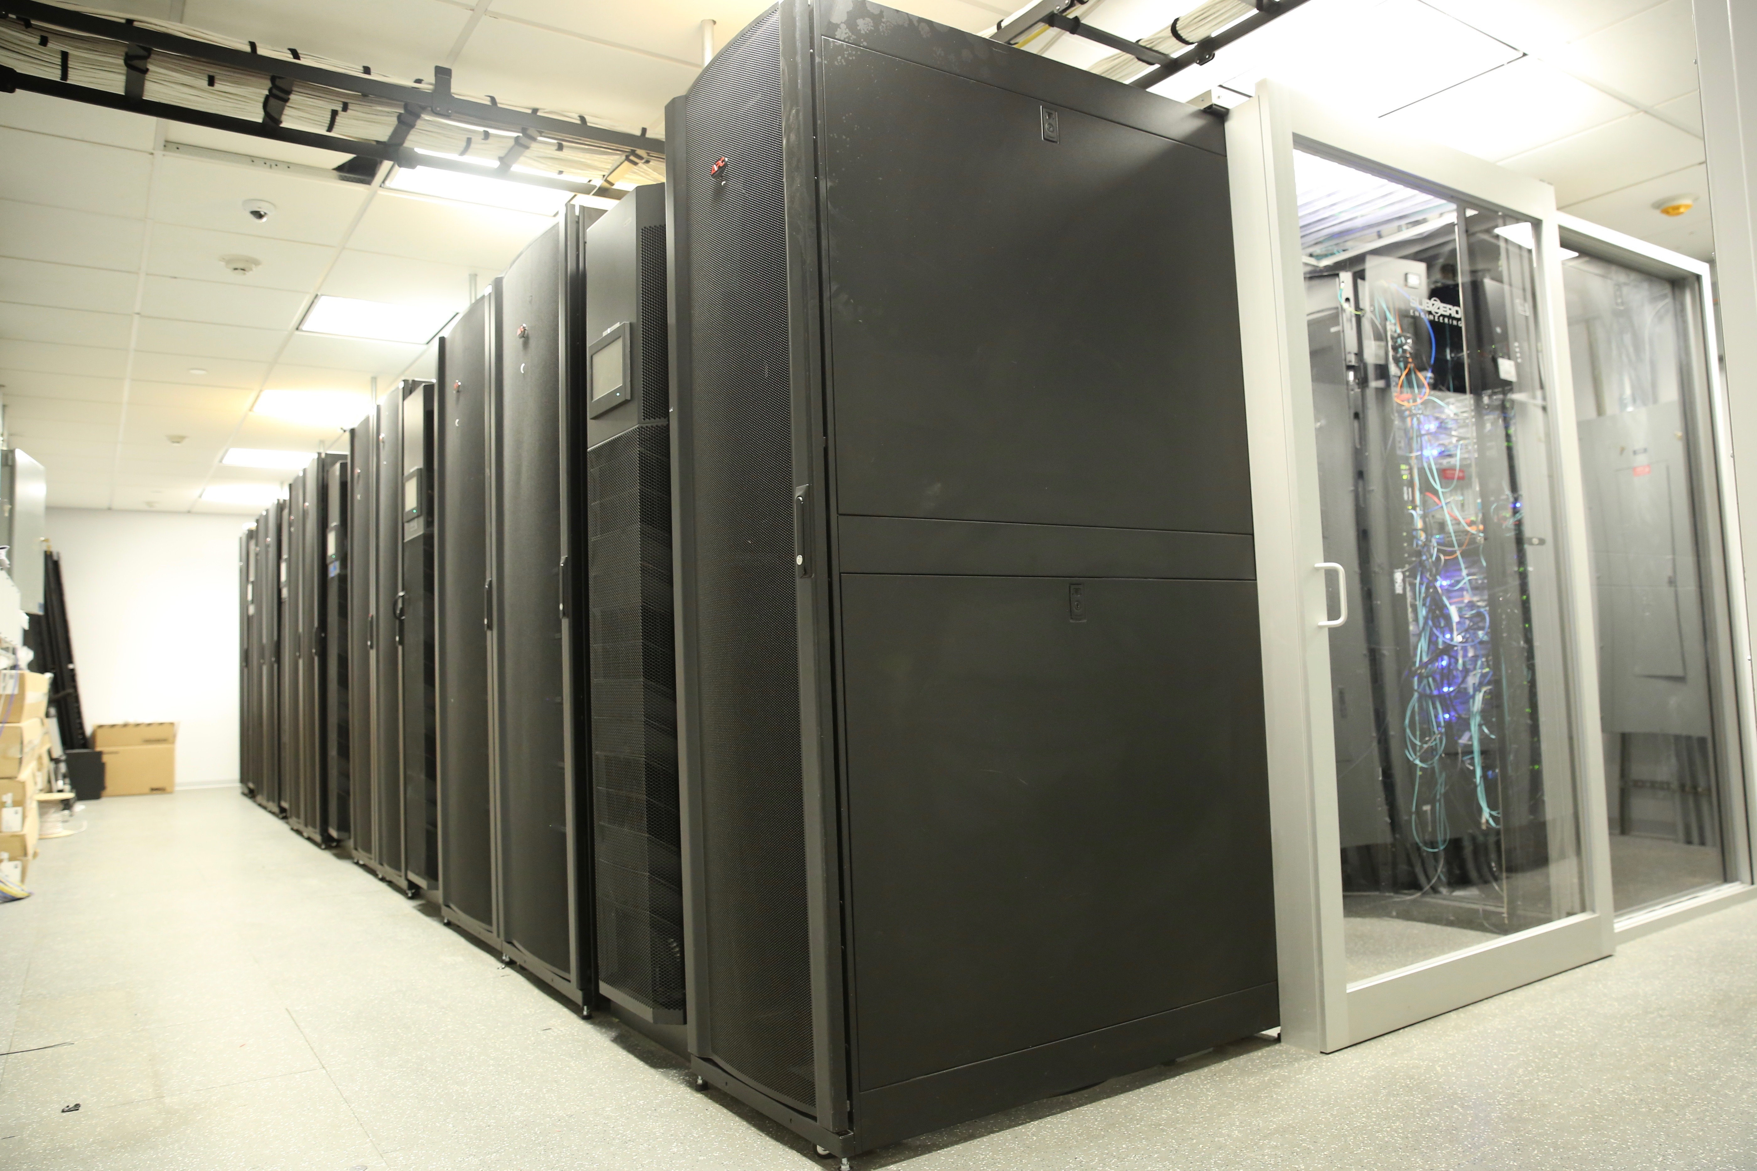
What and where?
We have three computing centers
At the Institute in the basement
6720 cores: 240 2x14 Broadwell nodes, 512GB RAM, 10Gb/s Ethernet and 100Gb/s Omnipath
7680 cores: 192 2x20 Skylake nodes 768GB RAM, 10Gb/s Ethernet and 100Gb/s Omnipath
1096 cores: 14 2x14 core nodes, 256GB and 16 2x22 core nodes, 384GB RAM, 40Gb/s InfiniBand and 10Gb/s Ethernet
50 GPU nodes 160 GPUs Mostly v100-32GB)
96 core, 3 TB node and 192 core, 6TB node
Co-location at BNL (~3ms, common software and file systems)
4800 cores: 120 2x20 core Skylake nodes, 768GB RAM, 2x10Gb/s Ethernet
At SDSC (~70 ms, independent software and file systems)
Popeye: 17k cores, 360 2x24 core nodes, 768GB RAM, EDR InfiniBand
32 GPU nodes (128 v100-32GB)
Rusty
Notes:
First two are collectively known as “rusty”.

Slide 8
ACCOUNTS
Staff have been given Linux cluster accounts. All user accounts are stored in a central system that enforces a consistent user namespace
All home directories for Linux are stored in a GPFS parallel shared file system
250TB of RAID6 with a nightly incremental backup.
If you have a Linux workstation, same credentials and files. That is, your workstation and cluster accounts are indistinguishable.
From the FI network (wired or wireless), access rusty via a round robin balanced login pool (ssh rusty).
Access popeye.sdsc.edu from gateway.flatironinstitute.org (internally, “gateway”).
You can also add an ssh-key and access from anywhere
You need keys to connect to popeye
Note: neither rusty proper nor gateway is intended for compute or memory intensive work.
Notes:
Tmux, screen

Slide 9
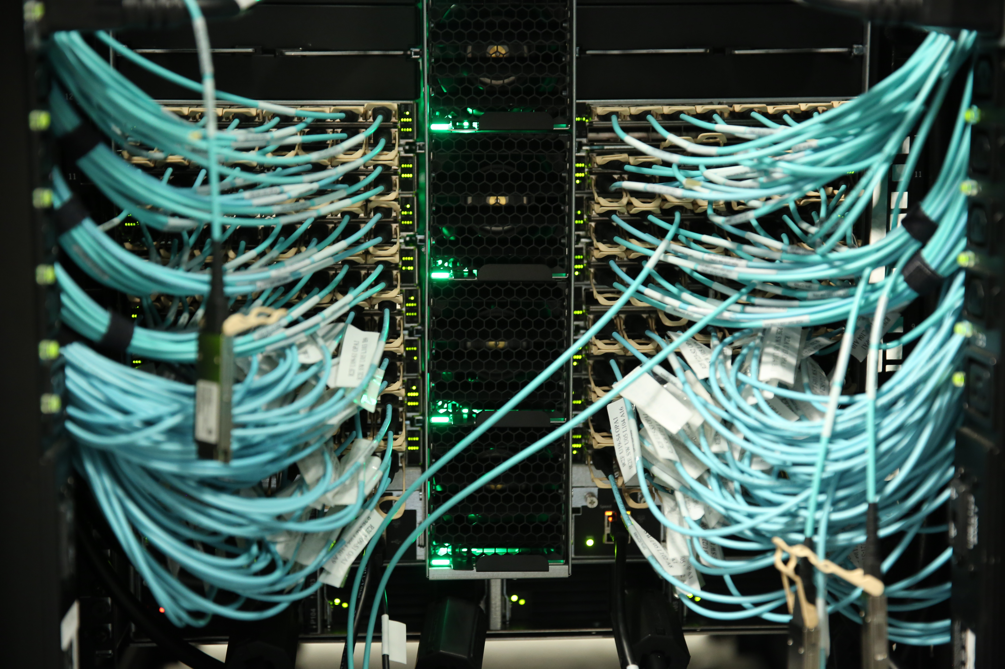
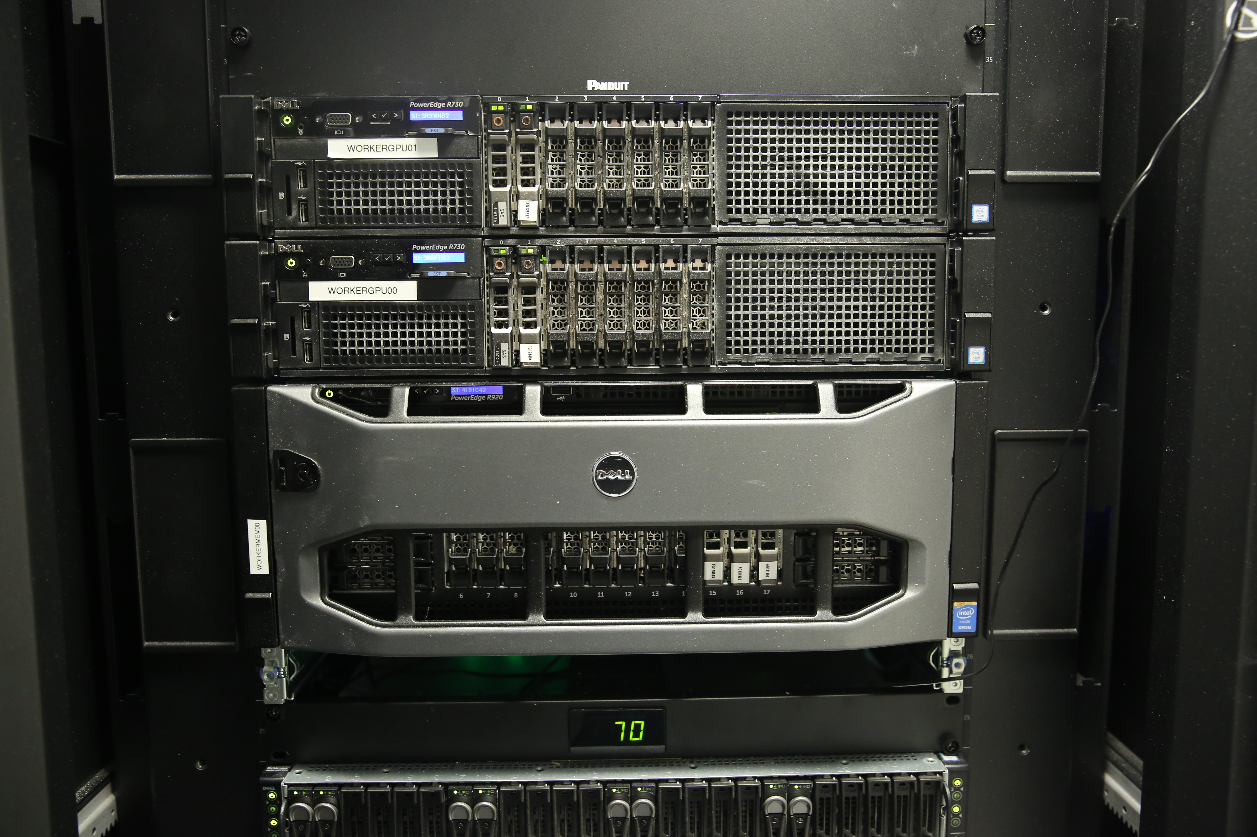
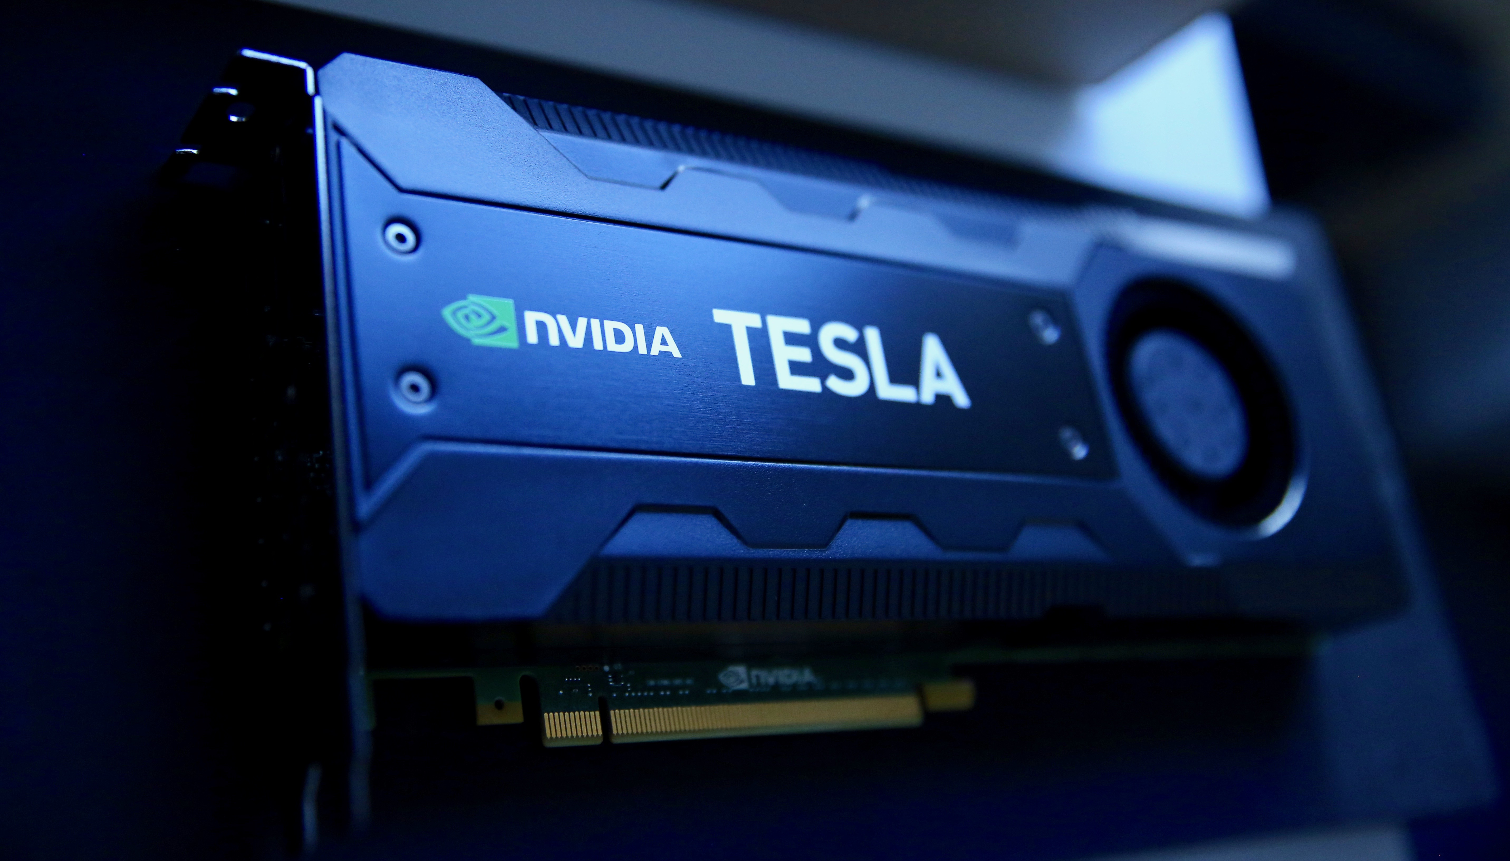
Computing Resources
Computing resources are managed via the SLURM resource control system. Currently users have access to:
A general partition (gen): 4-5 Omnipath connected nodes per user (~160 cores). No time limit.
A genx and a bnlx partition which allow selection of a fraction of a machine for small tasks. DEFAULT IS WHOLE NODE.
A center specific partition (cca, ccb, ccq, ccm): 21-30 Omnipath connected nodes per user/150-200 for the center overall. 7 day limit.
An Infiniband partition (ib): 30 nodes, any user can take all of them. 7 day limit.
A preempt partition for all Omnipath nodes (preempt). Any user can take as much as they want, but a job will be killed if its nodes are needed to fulfill a non-preempt request. Good for work that makes incremental progress and can be restarted. 7 day limit.
A GPU partition (gpu): 2 nodes with two Tesla K40s, five with two Pascals, five with two 16GB Volta. 40 with quad 32GB volta and NVLink, 7 day, 32 GPU limit. (Note: --gres:gpu=2). These are shared
A partition for large memory machines (mem). Currently 96cores, 3TB of RAM and 192cores and 6TB of RAM
A BNL partition (bnl). 10 nodes per user (400 cores, ~7 TB RAM in aggregate), 10 day time limit.
Need something different? Talk to us!
Notes:
Somewhat oversubscribed.

Slide 10
Storage Resources
250TB of GPFS space for home directories
Incremental back-up and RAID6.
Code, docs, notes should live here. If you use more than ~1 TB, we will urge you to clean up and move data to the volumes intended for it.
~15PB of usable space in cephfs (3 copies or erasure encoded)
Data should live here /mnt/ceph/users/
If there is anything you need to keep, but you don’t expect to access for a while, let us know. We have tape archiving resources offsite.
Keep in mind that all compute nodes have node-local storage too.

Slide 11
FI Configuration
All the Linux systems are configured with via centralized management systems.
We are nearly entirely CentOS 7.6 for workers and desktops
Expanded and updated software environment mostly deployed through modules
module avail
Same environment on desktops and clusters
If you need a package, please ask. Also feel free to install (non-privileged) software in your own directory. Please be careful with conda.
All Linux home directories are centrally served. A user can log into most systems and will see the same files (but use your desktop or make a SLURM allocation if you want a resource for significant work).
By keeping the configuration in common management systems and the user info in central file systems we can easy replace hardware when needed.

Slide 12
Connecting
We support ssh for external connections:
There is an ssh port at gateway.simonsfoundation.org that uses two-factor authentication
Instructions at docs.simonsfoundation.org
You’ll need google authenticator or similar software

Slide 13
Moving DATA AROUND
Small quantities of data can be sent with scp and two factor authentication (or sshfs).
Data export can be done with a web interface (we have two mechanisms, please ask if you are interested).
Large quantities of data can be moved around with gridftp and globus. Documentation for how to do this is on the docs.simonsfoundation.org instructions.

Slide 14
SOME NOTES
We use a fifo batch system and we try to keep the wait times short
Try to be a good citizen
Submitting with accurate estimates for time and resources may result in quicker allocation
Most of the systems are allocated exclusively by default.
This means you get all the cores
There are tools like disBatch that can help you use all the cores
Our systems have a lot of cores and memory
Understand the parallelism of your code
The GPU nodes are shared because they are quad GPUs systems
If you can’t use all four, allocate one and a reasonable number of cores and memory so that the others can be used by someone else
GPFS is backed-up nightly. It’s intended for code and important persistent things
Intermediate files with a lot of churn belong in ceph or on node local storage
cephfs is a great file system, but the cluster is large and you have enough resources to really hammer things
Always a good idea to check IO behavior as you increase the scale of your runs
Work with mentors

Slide 15
IF YOU REMEMBER NOTHING ELSE
Scientific Computing Documentation is here: https://docs.simonsfoundation.org/index.php/Category:Flatiron_Institute_RC
scicomp@flatironinstitute.org Is the mailing list to write with problems

