Slide 1
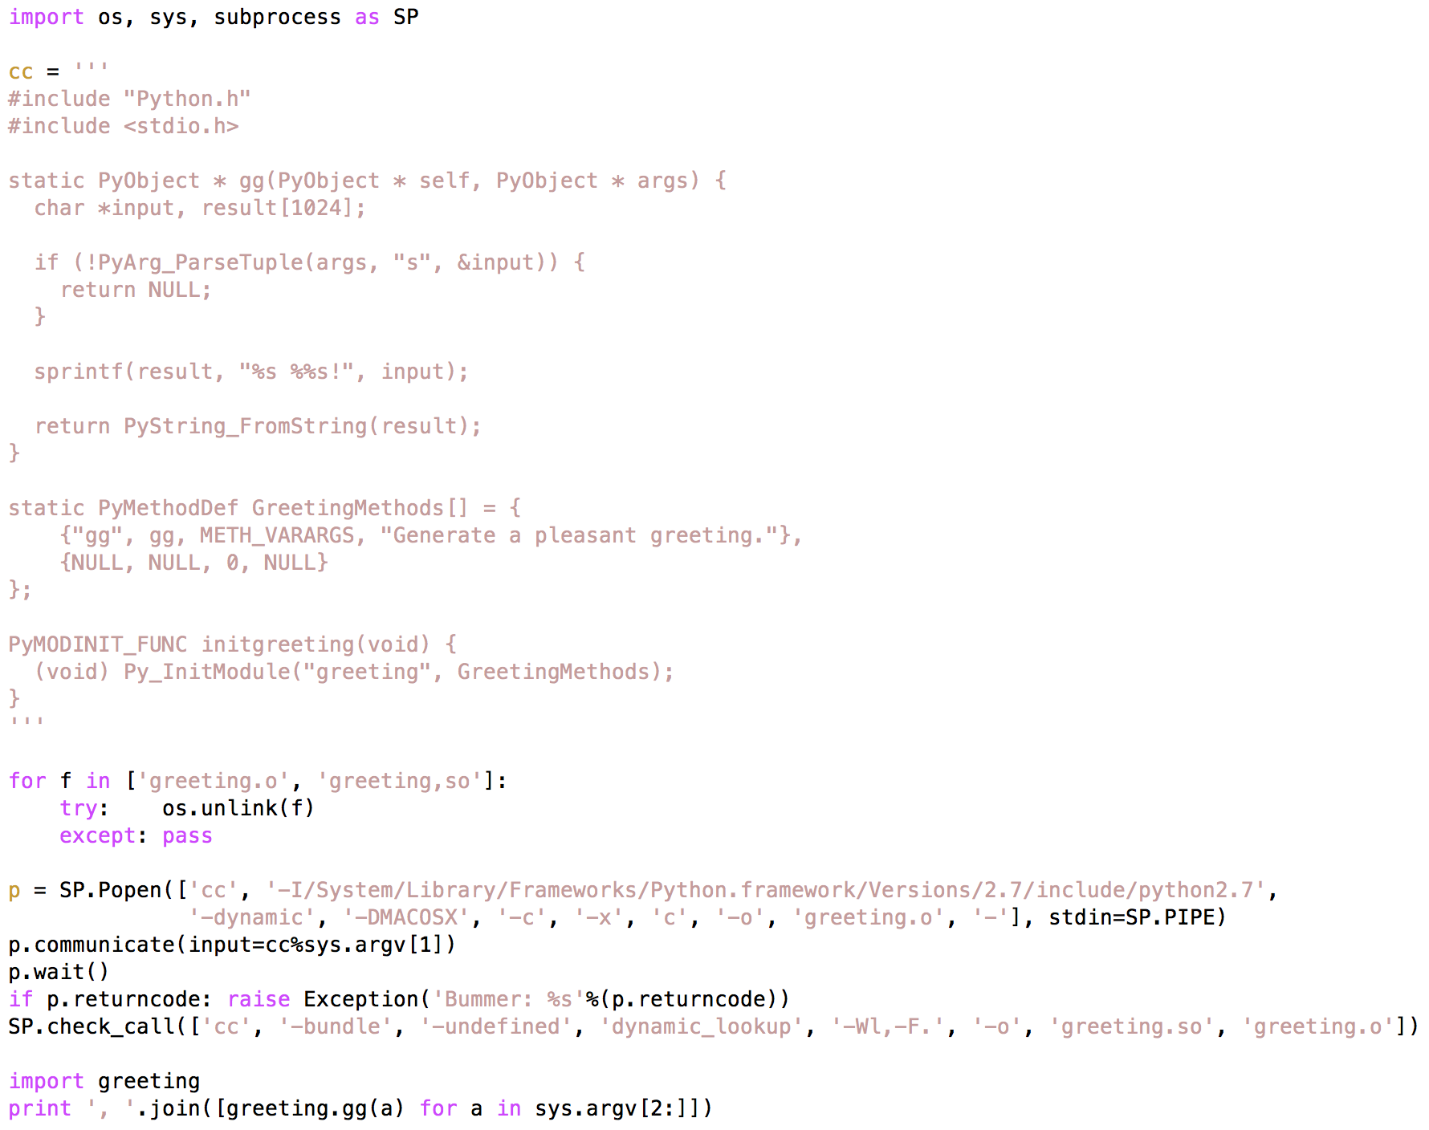

Slide 2
$ python pchw.py Hello Earth Mars "Proxima Centauri b"
Hello Earth!, Hello Mars!, Hello Proxima Centauri b!
$ python pchw.py "Woof woof" Boyd Charley
Woof woof Boyd!, Woof woof Charley!

Slide 3
Organizational Notes
Revue: A series of light entertainments …
Review: Institute-wide code review—Give and take expected, design decisions defended, alternatives discussed, problems disclosed
Ample breaks and afternoon receptions provide opportunities for more in-depth follow up
  Today (24 Oct) the reception will be held at 162. Please leave GDFA no later than 4 PM, so that the events team can prepare for a 5 PM presentation.
Panel discussion tomorrow. Please send suggestions to center representatives: Dan Foreman-Mackey, Doug Renfrew, Jeremy Magland, Miles Stoudenmire, Dylan Simon
Wrap up session on Friday: Comments, suggestions to Ian or me.
Notes:
Wrap up: Things to expand on, topics for next year’s event, next flatware “event” (which needn’t be on the scale of this one, at least not right away).

Slide 4
Flatware Motivations
Experienced developers know they can learn a lot from other developers—foster these exchanges
Broaden the horizons of new developers
  Clarify opportunities and challenges
  “Use the source, Luke!”. Present a variety of FI projects with repos to study
Non-developers
  Not yet …
  If not a developer now, learn how to be a better user of someone else’s code
  Reveal the occult

Slide 5
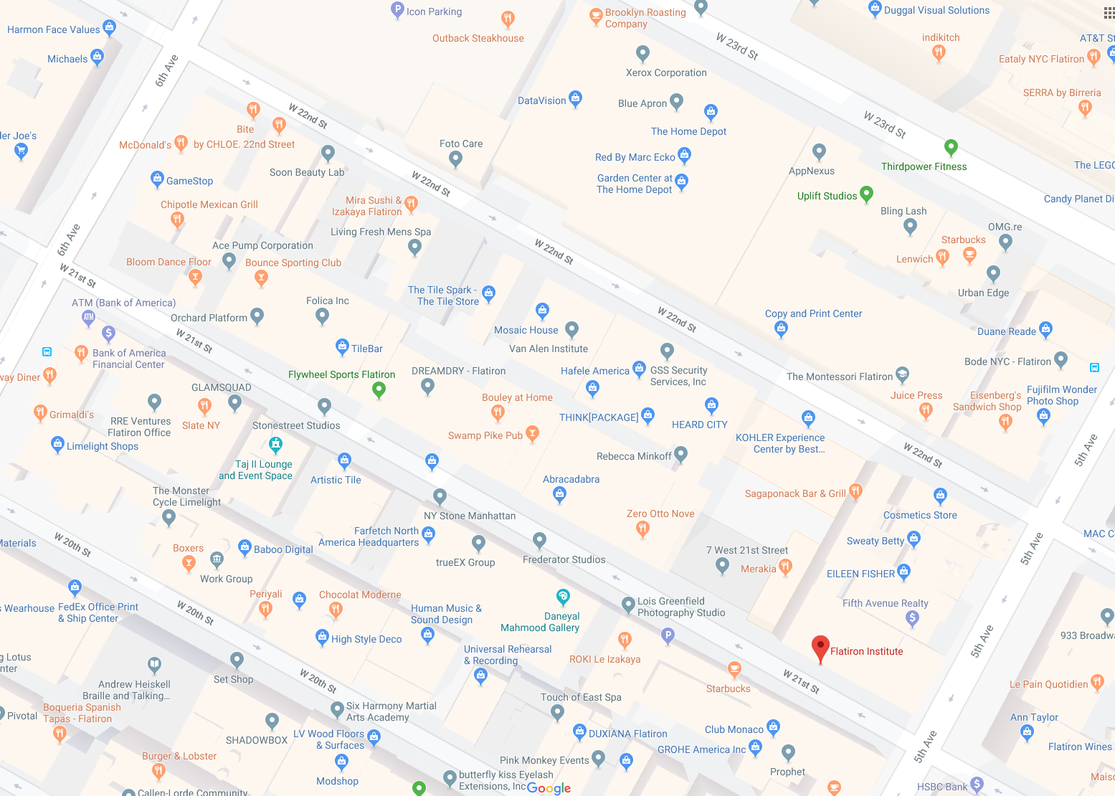
Any sufficiently advanced technology is indistinguishable from magic (A C Clarke)

Slide 6
Want to encourage computational scientists to engage in the science of computation…
Software as an object of experimental study
  Observe
  Hypothesize
  Experiment
  <<Repeat>>
Ultimate result: better software and better computational scientists!

